Slide 1
Solving Mole Ratio problems
Convert any given weight or molecule count to moles (“all roads lead through moles”)
Relate the computed moles above to desired moles (‘body parts’ ratio…)
If necessary, convert desired moles to target grams or molecule count

Slide 2
In-class exercise #5b: chem 1114
Mole Calculations: part 2
2.1)mole to mole:
how many moles of O are present in 0.1666 mole of C₆ H₁₂O₆?
1 mol O
2.2) mole to mole
how many moles of C₆H₁₂O₆ can be made with 12 mole of O ?
2moles C₆H₁₂O₆

Slide 3
In-class exercise #7b: chem 1114 Mole Calculations: part 2
2.3) weight to moles
how many moles of C₆H₁₂O₆ in a sample containing 216 g C ?
3 mol
2.4) moles to weight
how many grams of C₆H₁₂O₆ are formed with 0.2666 mol H?
= 4 g

Slide 4
2.5) moles to molecules
how many molecules of O are present in 0.8333 mol of C₆ H₁₂O₆?
=5*10²³
2.6) molecules to moles
how many moles of C₆ H₁₂O₆ are formed from 5.04*10²⁵ atoms of H ?
7 moles

Slide 5
2.7 mass to molecules:
how many molecules of C₆ H₁₂O₆ form from 96 g of C ?
8 *10²³ molecules of C₆H₁₂O₆
2.8 atoms to mass:
how many grams of H are combined with 2.7*10²⁴ atoms of O in C₆H₁₂O ₆ ?
9 grams H

Slide 6

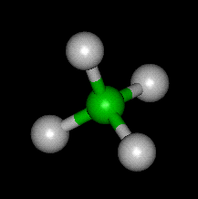

% composition problems: using mole concept to convert weights to formulas
Sample problem #1 (see also pp 93-102)
A compound of N and O contains 63.63 wt % N and 36.36 wt % O. What is the empiric formula of the compound ?
empiric formula= mole ratio of elements in compound expressed in lowest whole numbers
Definition:
Example: CH₂O = empiric formula of glucose
Actual molecular formula (what it really has in atom count)
C₆H₁₂O₆=
(CH₂O)₆
Sugar =Carbo hydrate

Slide 7
Which formulas below are empiric
(= lowest common denominator form) ??
Now EMPIRIC
C₃H₆O₃
÷ 3
NOT EMPIRIC
CH₂O
N₃F₇
EMPIRIC…3 & 7 have no shared factors

Slide 8
Which formulas below are empiric
(= lowest common denominator form) ?? (continued)
H₃P₉O₁₂S₅
Do not write HP₃O₄S_{5/3}
EMPIRIC …5 has no shared factors with 3,9 or 12
÷ ???
Cu₄(PO₄)₈*2H₂O
NOT EMPIRIC
2
ALMOST EMPIRIC
FINALLY EMPIRIC
Cu₂(PO₄)₄*H₂O
H₂ Cu₂P₄ O₁₇

Slide 9
Sample problem #1 continued
A compound of N and O contains 63.63% N and 36.36 %O. What is the empiric formula of the compound ?
=Laughing gas
table approach
=>N₂O
Dinitrogen monoxide
CORRECT NAME…
n
n_{min}
element
N
O
w(g)
AW=Atomic wt (g/mol)
n=w/AW
moles
63.63/14=
4.545
4.545 = 2
2.273
63.63
14
36.36
36.36/16=
2.273
2.273 =1
2.273
16

Slide 10
Problem 2: formula determination with a few more twists
A compound contains: 0.3158 g C, 0.0526 g H and 0.631 g O. It’s molecular weight (MW) is 228 g/mol. What is the molecular formula of the compound ?
element
C
H
O
AW (g/mol)
n=w/AWmoles
n
n _{min}
Whole # equivalent
w(g)
0.3158
0.0526
0.631
12
1
16
0.3158/12=0.0263
0.0263 =1 0.0263
1*2=2
0.0526/1=0.0526
0.0526 = 2 0.0263
2*2=4
0.631/16=0.0394
0.0394 =1.5 0.0263
2*1.5=3

Slide 11
Problem 2: formula determination with a few more twists (continued)
From table: Empirical formula…C₂H₄O₃
Empiric mass = 2*12 + 4*1 + 3*16= 76
Given Molecular mass =228 g/mol
Compute ratio of molecular mass to empiric mass (> 1)
Molecular mass = 228 = 3
Empiric mass 76
Molecular formula= C_{2*3} H_{4*3} O_{3*3}
= C₆ H₁₂ O₉

Slide 12
In-class exercise 6: chem 1114 Chemical Composition
Element | Weight % | Atomic mass | moles | ratio
C | 27.27 | 12 g/mol
O | 72.73 | 16
27.27/12
=2.2725
1
72.73/16
=4.5456
4.5456/2.2725 =2
Empiric formula=:
C₁O₂=CO₂
Element | Weight % | Atomic mass | moles | ratio
C | 33.3 | 12
H | 8.3 | 1
O | 44.4 | 16
33.3/12
=2.775
1
8.3/1=8.3
8.3/2.775
=3
44.4/16
=2.775
1
Empiric formula=:
C₁H₃O₁= CH₃O

Slide 13
Element | Weight % | Atomic mass | moles | ratio | X multiplier
C | 33.64 | 12
H | 1.87 | 1
O | 44.86 | 16
N | 19.63 | 14
33.64/12
=2.803
2.803/1.4=2
3*2
= 6
1.87/1
=1.87
1.87/1.4
=1.333
3*1.333
= 4
44.86/16
=2.803
2.803/1.4=2
3*2
=6
19.63/14
=1.4
1
3*1
= 3
Empiric formula=: ____________________
MW= 856 Molecular formula = _______________
C₆H₄O₆N₃
C_{6*4}H_{4*4}O_{6*4}N_{3*4} =C₂₄H₁₆O₂₄N₁₂
856/214
=4
C₆H₄O₆N₃ weighs 12*6+4*1+6*16+3*14=214

Slide 14
Chemical Compositions from Reaction Data
1) A 0.30 gram sample of carbon black is burned in a covered crucible. The collected gas weighs 0.70 grams. What is the empiric formula of the gas ? (C =12, O =16)
C ---------------------------------------→ CO_{x}
0.3 g 0.7 g
Mass O=0.7-0.3 g=0.4 g
Mol C= 0.3/12
=0.025
Mol O= 0.4/16
=0.025
Mole C/Mol O = 0.025/0.025=1=>CO

Slide 15
Chemical Compositions from Reaction Data (continued)
2) A hydrocarbon sample (C_{x} H_{y}) is burned in oxygen producing 1.0 gram of CO₂ and 0.4086 g H₂O. What is the empiric formula for the hydrocarbon ? (C=12, O=16, H=1)
Blackboard work !

Slide 16
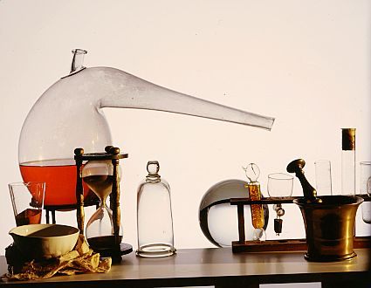
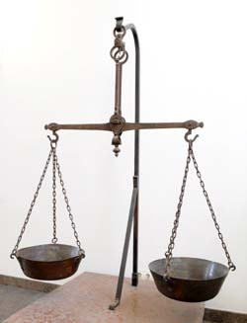
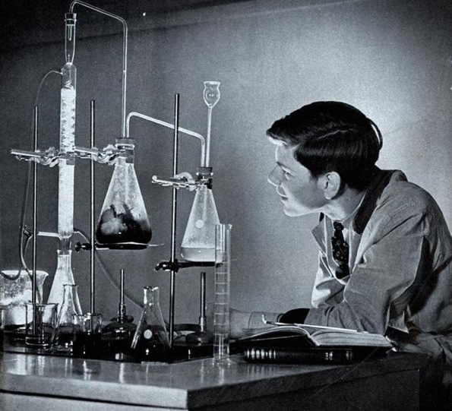
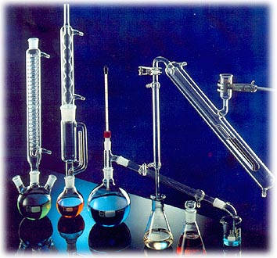
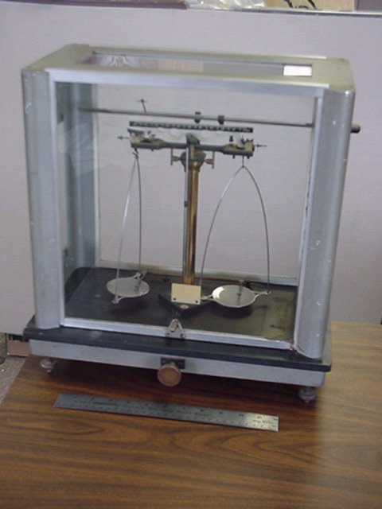

Brief historical aside:
Finding compositions: then and now
Then: ~ 1700-1950 : classical chemical methods decompose and capture elements
Glassware
+ Balance
+ Chemical Finesse
1750
1950

Slide 17
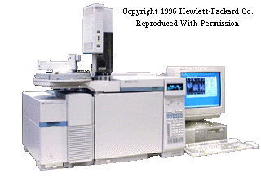
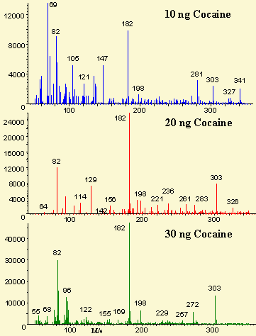
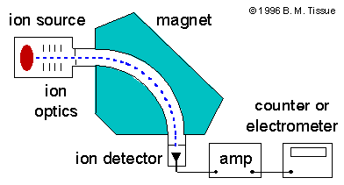
…now 1950-2010
…instrumentation rules
ASC Instrumentation lab has three of these (~80 k$ each)
Mass Spec (CSI !)
Mass spectrum of cocaine

Slide 18

Old-school analysis took 1-3 days…relied on the bench skills and savvy of the chemist
New school GC-MS analysis yields answers in a few minutes…computer matches patterns… any yahoo can feed the instrument and read the computer output
a grumpy old Doc Fong kvetch….
With every advance, we lose something
…many recent Ph.Ds in chemistry know
more about computers than classical analysis, can’t build equipment and are not `sensitive’ in the lab.

Slide 19
Chemical bookkeeping: balancing reactions old school
(on blackboard)
2
2
Cu +O₂ → CuO
Example #1:
Element combustion
Balanced !!!! ☺

Slide 20
Reaction balancing (continued)
Example #2:
Organic combustion
Balanced…at last !!!!
C₃H₈+ O₂ → CO₂+ H₂O
5
3
4
Propane=LNG
Liquid Natural Gas

Slide 21
Slightly trickier balancing…the odd/even oxygen dilemma
Internal combustion reaction
2
16
__C₈H₁₈ + __O₂→ __H₂O + __ CO₂
25
18
Octane = gasoline
balanced

Slide 22
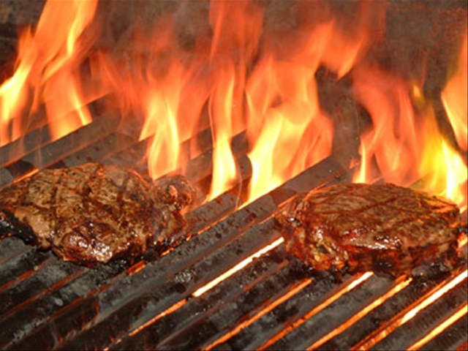
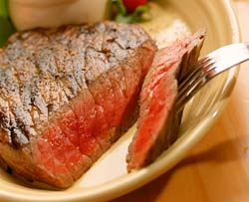
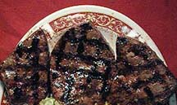
Sometimes several answers possible
Barbecuing steaks…
C₃H₈ + 5O₂ → 4H₂O +3CO₂
Complete combustion
C₃H₈ + 4O₂ → 4H₂O +2CO₂ + C
Incomplete combustion
C₃H₈ + 3O₂ → 4H₂O + CO₂ + 2C
C₃H₈ + 2O₂ → 4H₂O + 3C
Low O₂
→Low CO₂
₋→ High C
(charred)
Hi O₂
→Hi CO₂
→Low C
(no `char’)

