Slide 1
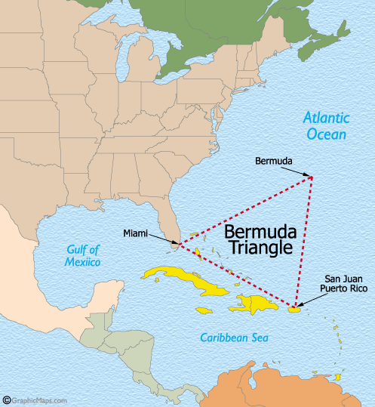
Another way to view mole calculations
(if you are allergic to eggs): the Bermuda triangle method
The Real Bermuda Triangle
The Bermuda Triangle of Chemistry
Moles (n)
Weight (w) molecule count (N)
ALL ROADS LEAD THROUGH MOLES
Where hapless chemistry students go in…
and become hopelessly lost
Where hapless ships and planes go in…
…and become hopelessly lost

Slide 2

mole math the triangle way
You always get MW and/or Avogodro’s # = 6.02*10²³
w= n x MW
Moles (n)
N= n x 6.02*10²³
If you have moles they multiply !!
(because…
moles breed whenever they can)
Molecule count (N)
Weight (w)

Slide 3
reverse mole math the triangle way
n = w
MW
Moles (n)
n= N
6.02*10²³
If you want moles
…don’t let these horny critters multiply…divide them up!!!
Molecule count (N)
Weight (w)

Slide 4
Trips around the triangle: N→w
Given:
100 g/mol =MW
w= n*MW= 20 x 100
6.02*10²³
Moles (n)
n= 20
6.02*10²³
All roads lead through moles
Given molecule count N=20
Weight (w)
?
w~3.3*10⁻²¹ g
Given : chemist’s dozen =1 mol count=6.02*10²³

Slide 5

Trips around the triangle: w→N
Given: 100 g/mol =MW
n= w = 200
MW 100
N=n x 6.02*10²³
⁼200 x 6.02*10²³
100
Moles (n)
All roads lead through moles
Molecule count N
Given weight w=200 g
?
N=1.2*10²⁴
Given : chemist’s dozen =1 mol count=6.02*10²³

Slide 6

AN ANECDOTE
What an `out-of-towner’ in NYC asked Yehudi Menuhin (world’s greatest violinist)
“How do you get to the Lincoln Center for the Performing Arts ?”
Yehudi‘s answer (supposedly):
“Practice, practice, practice, practice….”
EXERCISE 5…
PRACTICE,
PRACTICE, PRACTICE
One cat’s response to this `humorous’ anecdote….

Slide 7
Ways to do mole calculations so far:
Moles and dozens are the same: eggs as molecules
Wandering around the Bermuda triangle
How textbook does it : (pp 115-124)
`factor-label’ analysis
(you can read it there…)

Slide 8
Exercise #5: mole calculations part 1
weight per mole (MW): what does a mole of C₆ H₁₂O₆ weigh ?
(C=12; H=1; O=16) =_______ g/mol
6*12 + 12*1 + 6*16 = 180 g/mol
1.1) mole to mass: how many g C₆ H₁₂O₆ of are present in 0.00555 mole of C₆ H₁₂O₆?
0.00555 mol * 180 g/mol = 1 g
1.2) mass to mole: how many moles of C₆ H₁₂O₆ are in 360 g of C₆H₁₂O₆?
360 g/180 g mol⁻¹ = 2 moles
1.3) mole to # molecule: how many molecules of C₆ H₁₂O₆ are in 0.5 mol of C₆H₁₂O₆ ?
0.5 mol *6*10²³ molecules/mol = 3*10²³ molecules
1.4) mass to # molecules: how many molecules of C₆ H₁₂O₆ are in 120 g of C₆ H₁₂O₆ ?
(120/180) mol * 6*10²³ molecules =4*10²³ molecules mol

Slide 9
Exercise 5 part 1 (continued)
1.5) # molecules to moles: how many moles in 3*10²⁴ molecules of
C₆ H₁₂O₆ ?
3*10²⁴ molecules/ 6*10²³ molecules/mol ⁼ 5 moles
1.6) # molecules to mass How many grams of C₆ H₁₂O₆ are in 2.0 *10²² molecules of C₆ H₁₂O₆ ?
2*10²² molecules * 180 g
6*10²³ molecules/mol mol
0.0333 * 180 = 6 grams

Slide 10

…need more practice…??????
…impromptu blackboard problems
PRACTICE,
PRACTICE, PRACTICE

Slide 11
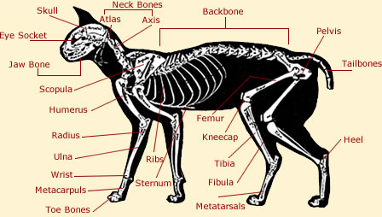

Moles: part 2 body parts (mole ratio) math: the knee bone is connected to the thigh bone….

Slide 12
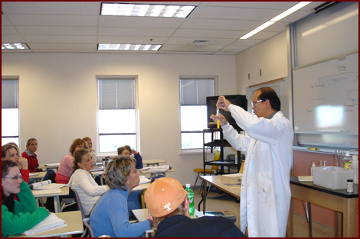
How many hands ???
1
6
5
2
3
4
7
9
8
10
11
2 hands
1 people
= 22 hands
11 people
x

Slide 13

How many toes connected to the hands (assuming no deformities) ?
5
4
3
2
1
5 hands
x
1 person
hand
10 toes
person
x
= 50 toes

Slide 14

Mole parts (ratios) math
given 6 moles C₃H₄O₆
How many moles of C ?
6 mol C₃H₄O₆ x 3 moles C =
1 mol C₃H₄O₆
18 moles C

Slide 15
Mole parts (ratio) math continued
Given 45 grams of C₆H₁₂O₆
…and MW of C₆H₁₂O₆
=180 g/mol
How many grams of C are present ??
First, convert mass to moles (all roads lead through moles)
45 g C₆H₁₂O₆
x 1 mole C₆H₁₂O₆
180 g C₆H₁₂O₆
= 0.25 moles
C₆H₁₂O₆

Slide 16
Mole parts (ratio) math
continued
Next, relate given moles to desired moles via mole ratio (need C moles )
0.25 moles C₆H₁₂O₆
6 mole C
1 mole C₆H₁₂O₆
x
???
=1.5 moles C
Finally, convert moles to grams in usual way:
x
12 g C
1 mole C
1.5 moles C
= 18 g C

Slide 17
Solving Mole parts (ratio) problems
Convert any given weight or molecule count to moles (“all roads lead through moles”)
Relate the computed moles above to desired moles
If necessary, convert desired moles to target grams or molecule count

Slide 18
In-class exercise #5b: chem 1114
Mole Calculations: part 2
2.1)mole to mole:
how many moles of O are present in 0.1666 mole of C₆ H₁₂O₆?
1 mol O
2.2) mole to mole
how many moles of C₆H₁₂O₆ can be made with 12 mole of O ?
2moles C₆H₁₂O₆

Slide 19
In-class exercise #7b: chem 1114 Mole Calculations: part 2
2.3) weight to moles
how many moles of C₆H₁₂O₆ in a sample containing 216 g C ?
3 mol
2.4) moles to weight
how many grams of C₆H₁₂O₆ are formed with 0.2666 mol H?
= 4 g

Slide 20
2.5) moles to molecules
how many molecules of O are present in 0.8333 mol of C₆ H₁₂O₆?
=5*10²³
2.6) molecules to moles
how many moles of C₆ H₁₂O₆ are formed from 5.04*10²⁵ atoms of H ?
7 moles

Slide 21
2.7 mass to molecules:
how many molecules of C₆ H₁₂O₆ form from 96 g of C ?
8 *10²³ molecules of C₆H₁₂O₆
2.8 atoms to mass:
how many grams of H are combined with 2.7*10²⁴ atoms of O in C₆H₁₂O ₆ ?
9 grams H

Slide 22
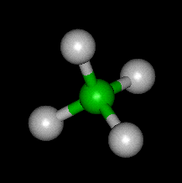
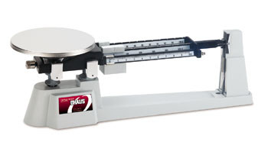
% composition problems: using mole concept to convert weights to formulas
Sample problem #1 (see also pp 93-102)
A compound of N and O contains 63.63 wt % N and 36.36 wt % O. What is the empiric formula of the compound ?
empiric formula= mole ratio of elements in compound expressed in lowest whole numbers
Definition:
Example: CH₂O = empiric formula of glucose
Actual molecular formula (what it really has in atom count)
C₆H₁₂O₆=
(CH₂O)₆
Sugar =Carbo hydrate

Slide 23
Which formulas below are empiric
(= lowest common denominator form) ??
EMPIRIC
C₃H₆O₃
÷ 3
NOT EMPIRIC
CH₂O
N₃F₇
EMPIRIC…3 & 7 have no shared factors
H₃P₉O₁₂S₅
EMPIRIC …5 has no shared factors with 3,9 or 12
Do not write HP₃O₄S_{5/3}
2
÷ ???
Cu₄(PO₄)₈*2H₂O
NOT EMPIRIC
FINALLY EMPIRIC
ALMOST EMPIRIC
H₂ Cu₂P₄ O₁₇
Cu₂(PO₄)₄*H₂O

