Slide 1

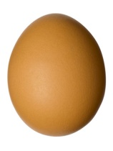
THE ONE PLACE EGG WORLD AND CHEMISTRY WORLD DEVIATE CONCEPTUALLY A TEENY BIT:
Egg world
Chem world
Mass
dozen
Mass = molecular weight
mol (MW)
Must weigh box of eggs
Add up atomic masses using Periodic Table

Slide 2
Mass (grams) = MW
mol
= sum of masses in grams of component elements in a compound
( taken from Periodic Table)
Example: methane (CH₄) MW
~ atomic mass (Table)
# atoms/molecule
product
C
H
12.011~12
1.00794~1
1
4
~12*1=12
~1*4 = 4
Sum = MW = 12+4=16 g/mole

Slide 3
Another MW calculation: glucose (C₆H₁₂O₆)
From molecular formula
Element mass/mol
C 12.011 ~12
H 1.0079 ~ 1
0 15.9994 ~16
# moles
6
12
6
6
C
12.011
From periodic table
Computing the molecular weight, MW
C
6*12
H
12*1
O
6*16
+
+
= 180 g/mol
Molecular weight of a mole of glucose = MW

Slide 4
In – class exercise on Molecular Weight (MW) calculations
Find MW of…
H₂SO₄
CaCl₂
Cu₃(PO₄)₂
2*1 + 1*32 + 4*16 = 98 g/mol
1*40 + 2*35.4 = 110.4 g/mol
3*63.5 + 2*(1*31 +4*16) = 380.5 g/mol
CaCl₂*2H₂O
1*40 + 2*35.4 + 2*(2*1 + 1*16)=146.8 g/mol

Slide 5
EXERCISE 4B: simple mole calculations
…egg math approach

Slide 6
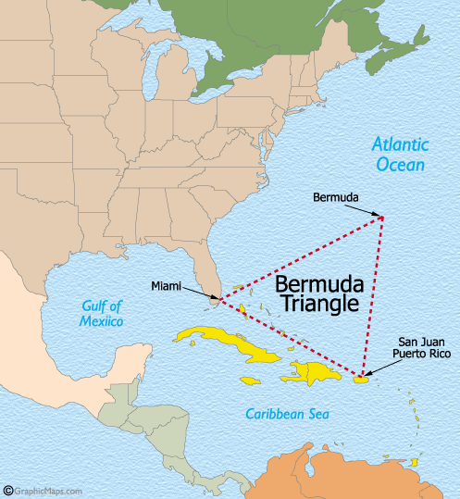
Another way to view mole calculations
(if you are allergic to eggs): the Bermuda triangle method
The Real Bermuda Triangle
The Bermuda Triangle of Chemistry
Moles (n)
Weight (w) molecule count (N)
ALL ROADS LEAD THROUGH MOLES
Where hapless chemistry students go in…
and become hopelessly lost
Where hapless ships and planes go in…
…and become hopelessly lost

Slide 7

mole math the triangle way
You always get MW and/or Avogodro’s # = 6.02*10²³
w= n x MW
Moles (n)
N= n x 6.02*10²³
If you have moles they multiply !!
(because…
moles breed whenever they can)
Molecule count (N)
Weight (w)

Slide 8
reverse mole math the triangle way
n = w
MW
Moles (n)
n= N
6.02*10²³
If you want moles
…don’t let these horny critters multiply…divide them up!!!
Molecule count (N)
Weight (w)

Slide 9
Trips around the triangle: N→w
Given:
100 g/mol =MW
w= n*MW= 20 x 100
6.02*10²³
Moles (n)
n= 20
6.02*10²³
All roads lead through moles
Given molecule count N=20
Weight (w)
?
w~3.3*10⁻²¹ g
Given : chemist’s dozen =1 mol count=6.02*10²³

Slide 10

Trips around the triangle: w→N
Given: 100 g/mol =MW
n= w = 200
MW 100
N=n x 6.02*10²³
⁼200 x 6.02*10²³
100
Moles (n)
All roads lead through moles
Molecule count N
Given weight w=200 g
?
N=1.2*10²⁴
Given : chemist’s dozen =1 mol count=6.02*10²³

Slide 11

AN ANECDOTE
What an `out-of-towner’ in NYC asked Yehudi Menuhin (world’s greatest violinist)
“How do you get to the Lincoln Center for the Performing Arts ?”
Yehudi‘s answer (supposedly):
“Practice, practice, practice, practice….”
EXERCISE 5…
PRACTICE,
PRACTICE, PRACTICE
One cat’s response to this `humorous’ anecdote….

Slide 12
Exercise #5: mole calculations part 1
weight per mole (MW): what does a mole of C₆ H₁₂O₆ weigh ?
(C=12; H=1; O=16) =_______ g/mol
6*12 + 12*1 + 6*16 = 180 g/mol
1.1) mole to mass: how many g C₆ H₁₂O₆ of are present in 0.00555 mole of C₆ H₁₂O₆?
0.00555 mol * 180 g/mol = 1 g
1.2) mass to mole: how many moles of C₆ H₁₂O₆ are in 360 g of C₆H₁₂O₆?
360 g/180 g mol⁻¹ = 2 moles
1.3) mole to # molecule: how many molecules of C₆ H₁₂O₆ are in 0.5 mol of C₆H₁₂O₆ ?
0.5 mol *6*10²³ molecules/mol = 3*10²³ molecules
1.4) mass to # molecules: how many molecules of C₆ H₁₂O₆ are in 120 g of C₆ H₁₂O₆ ?
(120/180) mol * 6*10²³ molecules =4*10²³ molecules mol

Slide 13
Exercise 5 part 1 (continued)
1.5) # molecules to moles: how many moles in 3*10²⁴ molecules of
C₆ H₁₂O₆ ?
3*10²⁴ molecules/ 6*10²³ molecules/mol ⁼ 5 moles
1.6) # molecules to mass How many grams of C₆ H₁₂O₆ are in 2.0 *10²² molecules of C₆ H₁₂O₆ ?
2*10²² molecules * 180 g
6*10²³ molecules/mol mol
0.0333 * 180 = 6 grams

