Slide 1
Adding and subtracting to correct sig fig count
Calculator says
To correct sig fig
2+ 0.02 + 0.100 =
2.120
2
Number with least precision dictates answer’s decimal count
Calculator says
To correct sig fig
512.16- 0.1 + 31.1234 =
543.1834
543.2
100 -1 +0.76 +212.333=
312.093
300

Slide 2
Rounding rules:
0-4 round down
5-9 round up
a) 123.74 →nearest 0.1??
a) 123.7
b) 123.8
b) 123.75 →nearest 0.1??

Slide 3
Multiplying an dividing to correct sig fig count
Calculator says
To correct sig fig
1.001 * 3.11 =
4.0* 0.75000
1.03770333
1.0
2 sig fig
2 sig fig
Number in calculation with minimum sig fig count dictates sig fig count in answer
Calculator says
To correct sig fig
85 * 32.700*0.001=
2.7795
3
2
5
1
1 sig fig
Sig fig count ?

Slide 4
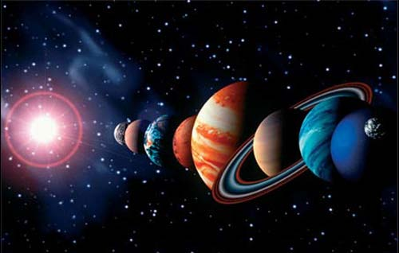
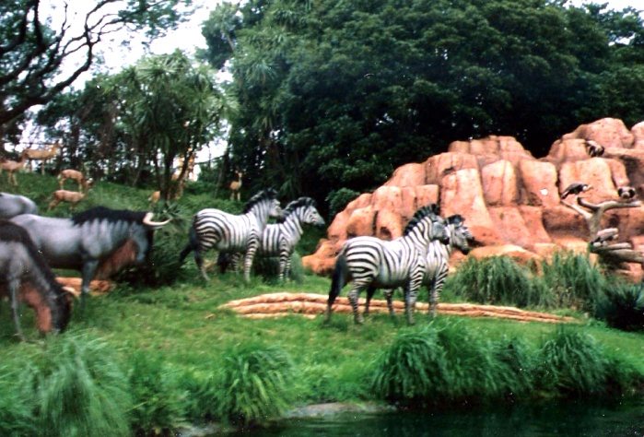
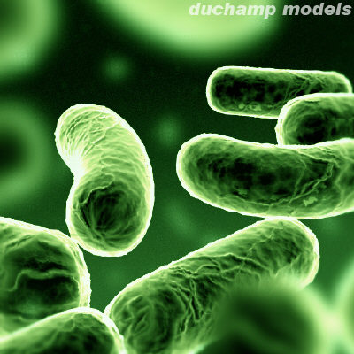
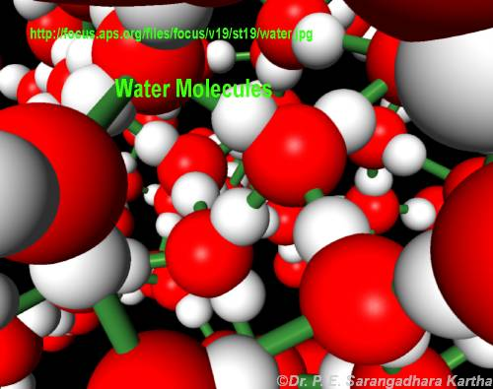
INTRO TO MOLES: Every science involves counting….
Astronomers count ……
Animal biologists count …….
Bacteriologists count …..
Chemists count…….

Slide 5

Doc asks a “dumb” question
How long would it take the fastest computer in the world (The Fujitsu `Venus’) to count all the molecules of water in a teacup assuming it counted at its maximum processor rate = 128,000,000,000 molecules/second (128 GHz) ?
Answer: ~ 2 million years
How do we `count’ atoms and molecules without having to actually count them ???

Slide 6

Chemists conveniently count atoms and molecules using…
Moles

Slide 7
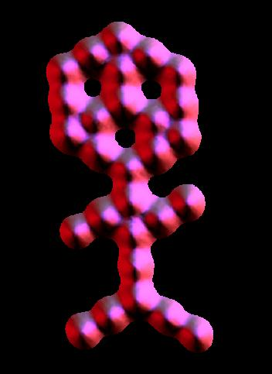

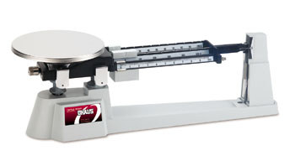
A trip to Mole land
Moles connect the atomic world to human world
~0.00000002 m
~2 m
~ 10²⁷ molecules in the shape of a couch potato
~30 CO₂ molecules arranged in shape of muffin man (IBM)
Moles allows us to conveniently connect between these worlds using a scale

Slide 8
The mole: starting definitions
What is a chemical mole ?
The usual textbook rant…….
∼ # protons in of 1 gram of protons
≡ # atoms in 12.000 g of ¹²C
≅ 6.02217 *10²³ atoms
(Avogodro’s Number)
…Not that helpful when first starting out… ☹

Slide 9
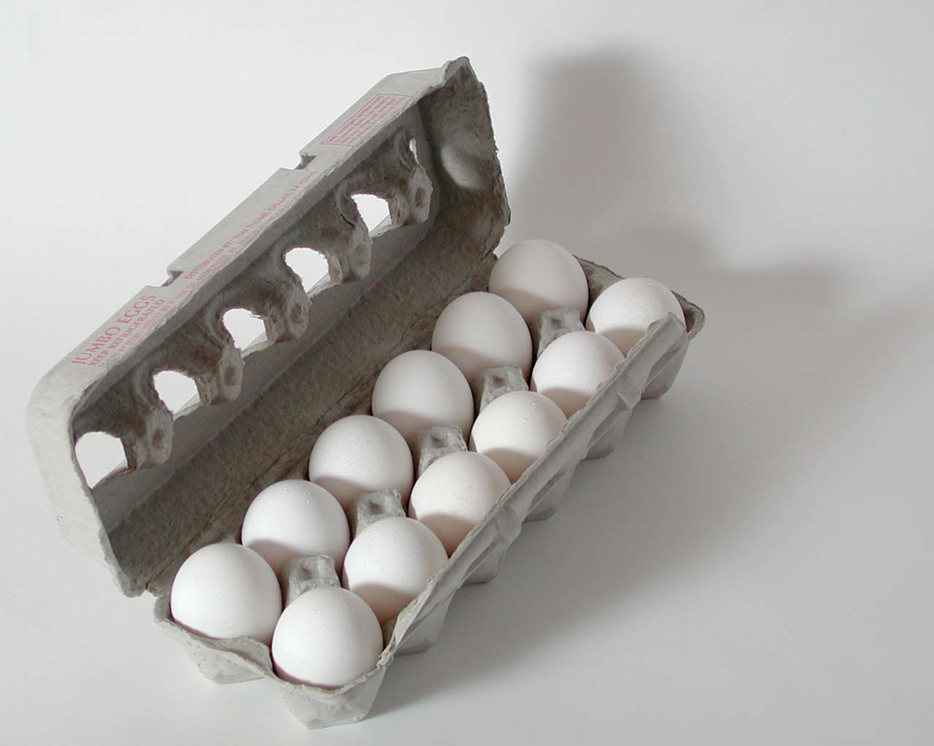

Mole count is really …
same idea as a `dozen’
EXERCISE 4A: EGG CALCULATIONS
Assertion: If you can do ‘egg’ calculations, you can do basic mole calculations

Slide 10

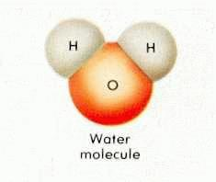
EGG WORLD
CHEMISTRY WORLD
Smallest unit
1 egg
1 molecule
Practical
Counting unit
Dozen
Mole=chemist’s dozen

Slide 11
EGG WORLD
CHEMISTRY WORLD
# of smallest units in practical counting unit
1 dozen=12
1 mole ≈ 6.0221 *10²³
(Avogadro’s #)
Practical mass unit
grams/mole
=gram molecular weight
= molecular weight (MW)
(ADD)
grams/dozen
(WEIGH)

Slide 12
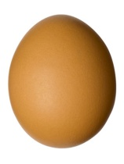
THE ONE PLACE EGG WORLD AND CHEMISTRY WORLD DEVIATE CONCEPTUALLY A TEENY BIT:
Egg world
Chem world
Mass
dozen
Mass = molecular weight
mol (MW)
Must weigh box of eggs
Add up atomic masses using Periodic Table

Slide 13
Mass (grams) = MW
mol
= sum of masses in grams of component elements in a compound
( taken from Periodic Table)
Mass = 1 mol C* mass C+ 4 mol H * mass H
Mole CH₄ mol mol
MW = 1*12 + 4*1 =
From molecular formula
16 g
From Periodic table

Slide 14
Another MW calculation: glucose (C₆H₁₂O₆)
From molecular formula
Element mass/mol
C 12.011 ~12
H 1.0079 ~ 1
0 15.9994 ~16
# moles
6
12
6
6
C
12.011
From periodic table
Computing the molecular weight, MW
C
6*12
H
12*1
O
6*16
+
+
= 180 g/mol
Molecular weight of a mole of glucose = MW

Slide 15
In – class exercise on Molecular Weight (MW) calculations
Find MW of…
H₂SO₄
CaCl₂
Cu₃(PO₄)₂
2*1 + 1*32 + 4*16 = 98 g/mol
1*40 + 2*35.4 = 110.4 g/mol
3*63.5 + 2*(1*31 +4*16) = 380.5 g/mol
CaCl₂*2H₂O
1*40 + 2*35.4 + 2*(2*1 + 1*16)=146.8 g/mol

Slide 16
EXERCISE 4B: simple mole calculations

Slide 17
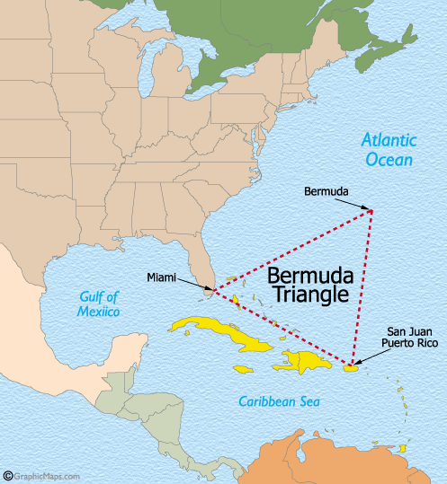
Another way to view mole calculations
(if you are allergic to eggs): the Bermuda triangle method
The Real Bermuda Triangle
The Bermuda Triangle of Chemistry
Moles (n)
Weight (w) molecule count (N)
ALL ROADS LEAD THROUGH MOLES
Where hapless chemistry students go in…
and become hopelessly lost
Where hapless ships and planes go in…
…and become hopelessly lost

Slide 18

mole math the triangle way
You always get MW and/or Avogodro’s # = 6.02*10²³
w= n x MW
Moles (n)
N= n*6.02*10²³
If you have moles they multiply !!
(because…
moles breed whenever they can)
Molecule count (N)
Weight (w)

Slide 19
reverse mole math the triangle way
n = w
MW
Moles (n)
n= N
6.02*10²³
If you want moles
…don’t let these horny critters multiply…divide them up!!!
Weight (w)
Molecule count (N)

Slide 20
Trips around the triangle: N→w
Given:
100 g/mol =MW
w= n*MW= 20 * 100
6.02*10²³
Moles (n)
n= 20
6.02*10²³
All roads lead through moles
Given molecule count
N=20
Weight (w)
?
w~3.3*10⁻²¹ g
Given : chemist’s dozen =1 mol count=6.02*10²³

Slide 21

Trips around the triangle: w→N
Given:
100 g/mol =MW
n= w = 200
MW 100
N=n x 6.02*10²³
⁼200 x 6.02*10²³
100
Moles (n)
All roads lead through moles
Molecule count N
Given weight w=200 g
?
N=1.2*10²⁴
Given : chemist’s dozen =1 mol count=6.02*10²³

Slide 22

AN ANECDOTE
What an `out-of-towner in NYC asked Yehudi Menuhin (world’s greatest violinist)
“How do you get to the Lincoln Center for the Performing Arts ?”
Yehudi‘s answer (supposedly):
“Practice, practice, practice, practice….”
EXERCISE 5…
PRACTICE,
PRACTICE, PRACTICE
One cat’s response to this `humorous’ anecdote….

Slide 23
Exercise #5: mole calculations part 1
weight per mole (MW): what does a mole of C₆ H₁₂O₆ weigh ?
(C=12; H=1; O=16) =_______ g/mol
6*12 + 12*1 + 6*16 = 180 g/mol
1.1) mole to mass: how many g C₆ H₁₂O₆ of are present in 0.00555 mole of C₆ H₁₂O₆?
0.00555 mol * 180 g/mol = 1 g
1.2) mass to mole: how many moles of C₆ H₁₂O₆ are in 360 g of C₆H₁₂O₆?
360 g/180 g mol⁻¹ = 2 moles
1.3) mole to # molecule: how many molecules of C₆ H₁₂O₆ are in 0.5 mol of C₆H₁₂O₆ ?
0.5 mol *6*10²³ molecules/mol = 3*10²³ molecules
1.4) mass to # molecules: how many molecules of C₆ H₁₂O₆ are in 120 g of C₆ H₁₂O₆ ?
(120/180) mol * 6*10²³ molecules =4*10²³ molecules mol

Slide 24
Exercise 5 part 1 (continued)
1.5) # molecules to moles: how many moles in 3*10²⁴ molecules of
C₆ H₁₂O₆ ?
3*10²⁴ molecules/ 6*10²³ molecules/mol ⁼ 5 moles
1.6) # molecules to mass How many grams of C₆ H₁₂O₆ are in 2.0 *10²² molecules of C₆ H₁₂O₆ ?
2*10²² molecules * 180 g
6*10²³ molecules/mol mol
0.0333 * 180 = 6 grams

