Slide 1
Exercise #3: Unit conversions
(via factor-label & Algebraic)
answers
Convert 45.7 kg to g
4.57*10⁴ g
Convert 0.73 mL to μL
730 μL =7.3*10² μL
Convert 3.6 Ms to ns
3.6*10¹⁵ ns

Slide 2
Exercise #3: Unit conversions (continued)
answers
Convert 0.001 mg to pg
10⁺⁶ pg
Convert 7.2 kg/L to mg/ μL
Hint:
convert numerator first,
then convert denominator
and finally divide numerator result by denominator result
7.2 mg/μL

Slide 3

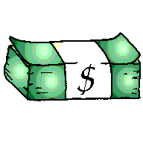
U-DO-IT !!!
How many dg in 2.4 kg ?
2.4*10⁴ dg
23 nm = ? μm
2.3*10⁻² μm
Convert 5.0*10³ ps to ms
5*10⁻⁶ ms
Convert 3.0*10¹⁰ cm/g to km/mg (2 mole $)
3.00*10² km/g

Slide 4
Examples of matter intensity (d) values
d= m(g)
V(mL)
density= d measures the `intensity’ of matter in a defined space
Solar black hole~10,000,000,000,000,000,000,000,000 g/mL
( 4 Earth masses in a teaspoon)
Neutron star 5,000,000,000 g/mL
(~ 1 NJ class Battleship/teaspoon )
Liquid mercury 14 g/mL
Liquid water 1 g/mL
Air 0.001 g/mL
Deep space 0.000000000001 g/mL

Slide 5
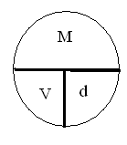
Some standard density problems see also: page 18
Finding d
A flask contains 25.0 ml ether weighing 17.84 g. What is the density in g/mL of ether ?
d= m/V= 17.84 g/25.0 mL= 0.714 g/mL

Slide 6
More standard density problems see also: page 18
Finding M
What is the mass of a 43.8 mL sample of gasoline whose density is 0.70 g/cm³
M = V*d =43.8 cm³ *0.70 g/cm³ = 30.7 g

Slide 7
Yet more standard density problems
Finding V
Bromine liquid has a density of 3.10 g/mL. What is the volume of 88.5 g of bromine.
V= M/d= 88.5 g/ (3.1 g/mL) = 28.5 mL

Slide 8




Why are sig fig important ?
SIGNIFICANT FIGURES (sig figs)
14 marks to right of 1.1
How long ?
4
1.114
0.001 increments
100 marks from 1.1 to 1.2
1.0
1.1
2
1.1
1
~1
MORAL:
# sig figs implied by measurement precision
Sig fig count implies level of precision in measurement

Slide 9
ANOTHER MORAL….
Higher verifiable precision correlates with higher technical development
1492: Columbus is within + 10,000 miles of estimate for Earth’s diameter
2012: we can pin point the position of anyone via GPS to within + 0.00005 miles
( ± 3 inches)
In ~ 500 years human measurement precision has increased by > 10 million

Slide 10
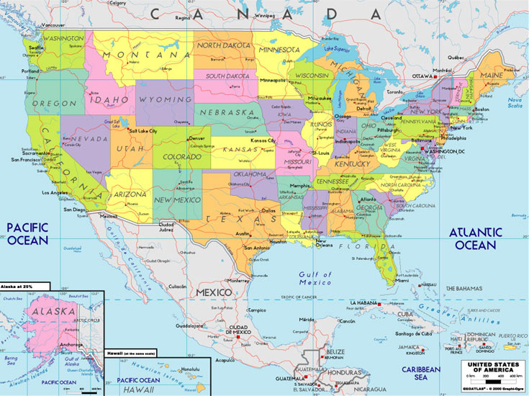
Counting sig figs: Atlantic & Pacific method
Absent (No)
Decimal
Move from right (Atlantic side). Start counting when first non-zero digit encountered
Number=
Sig fig count=
200
5050
120011
10010000
1
3
6
4

Slide 11
sig figs in regular numbers :
Atlantic & Pacific method (continued)
Possesses (has) decimal
Move from left (Pacific side). Start counting when first non-zero digit encountered
Number=
Sig fig count=
1.0010
0.00500
80.0000
0.010013
5
3
6
5

Slide 12
Sig Fig count in scientific notation…
It’s all in the pre-exponent….
Examples:
Scientific notation number
Sig fig count
2
1.0*10³⁰⁰⁰
6*10⁻¹²
1
1.23456*10¹
6
6.0000000*10⁻³²³⁴
8

