Slide 1

Where we’ve been so far
on the chemistry road trip
…so far…its all been about atoms
Basic atomic structure and element language
Light as a probe of atoms
Electronic models of atoms (Bohr and others)
Electronic configurations of atoms
Periodicity of atoms

Slide 2
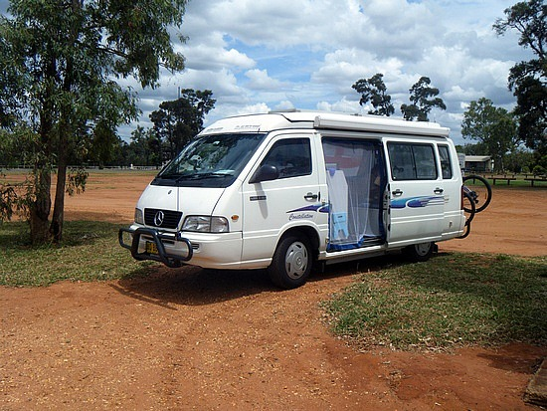
NEXT STOP ON THE CHEMISTRY ROAD TRIP:
MOLECULES AND COMPOUNDS
=>atoms in combination…where the `real’ chemistry starts…done old school way through weights & moles

Slide 3
Fundamental SI (le Systeme International) Units
Basic biggies to know
Length (meters, m)
Mass (kilograms, kg)
time (seconds, s)
Temperature (Kelvin, K)
`mks’
+Chemistry add-on
count of stuff (moles, mol)

Slide 4



Trouble in measurement paradise: hassles over unit choices
English vs Metric
U-DO-IT pp 11-14
metric vs Metric
Not in text (Doc does it)
USA (we are idiots) use English units ☹
feet vs meters
lbs vs kg
gallons vs liters
cm vs m
g vs kg
mL vs dL

Slide 5
derived units = combos of fundamental L,M, t, T...
Physical quantity
Derived unit
Area(A) =
L(m) x L(m)
m²
Volume (V)=
L(m) x L(m) x L(m)
m³
M(kg)
V(m³)
kg
m³
Density(d)=

Slide 6
DERIVED UNITS (continued)
Physical quantity
Derived unit
L(m)
t(s)
m
s
Speed=
M(kg)*L(m) * L(m)
t(s)*t(s)
=F*d(m)
kg m²
s²
Energy=

Slide 7
Why we need unit prefixes
US National Debt
$4,000,000,000,000
Time for one elementary computer operation
0.000000001 seconds (s)

Slide 8
Why we need unit prefixes (continued)
US National Debt in scientific notation
$4,000,000,000,000=
$4*10¹²
$
Time for one elementary computer operation in scientific notation
0.000000001 seconds (s)
1*10⁻⁹ s

Slide 9
Unit prefixes
(see also-table R.2, pg 3 know these)
Prefix symbol | Prefix name | Math equivalent
T | Tera | 10¹²
G | giga | 10⁹
M | mega | 10⁶
k | kilo | 10³
d | deci | 10⁻¹
c | centi | 10⁻²
m | milli | 10⁻³
μ | micro | 10⁻⁶
n | nano | 10⁻⁹
p | pico | 10⁻¹²

Slide 10
A Typical metric-Metric Conversion Problem
100 km = ????? cm
3 ways to do this…..
Factor-label
Algebraic way (Marine way)
Count-the-magnitudes, move decimal
ALL THREE REQUIRE THAT YOU KNOW THE PREFIX MAGNITUDES, NAMES AND SYMBOLS

Slide 11
Exercise #3: Unit conversions
(via factor-label & Algebraic)
answers
Convert 45.7 kg to g
4.57*10⁴ g
Convert 0.73 mL to μL
730 μL =7.3*10² μL
Convert 3.6 Ms to ns
3.6*10¹⁵ ns

