Slide 1
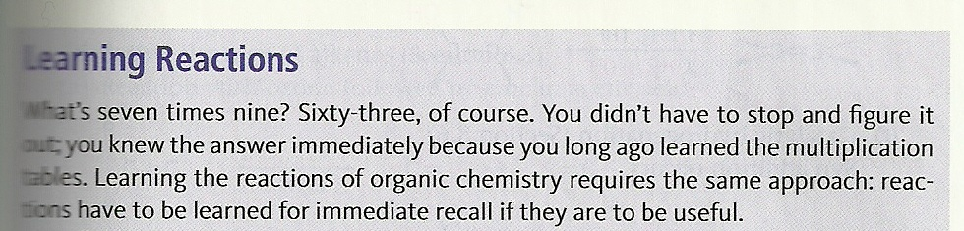
From page 251 of your text: advice and warning

Slide 2
Drill and practice with reactions of alkenes
The 4 main classes of reactions of alkene are: (U-Pick)
elimination, substitution, allylic addition, rearrangement
SN1, SN2, E1 and E2
Carbocation addition, bridgehead addition, free radical addition and organometallic/redox reactions
Radical substitution, SN1, E2 and allylic rearrangement
In a carbocation addition, addition proceeds:
To make rearranged alkene
Anti-Markovnikoff, inverted
Markovnikoff, inverted
Markovnikoff, racemic
Which class of reactions of alkenes always involves Br₂ in CCl₄ or ether ?
Bridgehead (halohydrin) mechanism

Slide 3
Free radical additions are characterized by:
Absence of peroxides and markovnikoff addition
Formation of rings and unsaturated produces
Presence of peroxides and markovnikoff substitution
Presence of peroxides and anti-markovnikoff substitution
Key intermediate state in halohydrin reactions :
Sp² Carbocation
Free radical
3-atom semi-carbocation
5-coordinate complex
Which reaction class(es) can produce larger dimers, trimers…polymers
c) radical
d) carbocation
a) bridgehead
b) Organometallic
/redox
Which reaction class includes reactions that aren’t additions ?
Organometallic (ozonolysis and allylic substitutions)

Slide 4
Term
Anti addition
Reaction class
Bridgehead (halohydrin)
Anti Markovnikoff addition
Radical addition
Syn and anti; H.C. Brown, peroxy acids and NBS
Organometallic/redox
Dimers and trimers; industrial route to ethanol
carbocation
Polymerization; carbene insertion; freon additions
Radical addition
Markovnikoff addition
carbocation

Slide 5
CCl₄ wet
Br₂
H+/reflux
H₂O
Hg(OAc)₂ in THF
NaBH₄ /OH-
>95% yield
100% Mark.

Slide 6
Product name ?
Syn diol
Etc…

Slide 7
ethanol
KOH
+
major
minor
Run an ozonolysis
O₃
Zn/H⁺
Run the anti-Markovnikoff Brown 2 step preparation of alcohols
B₂H₆ neat
H₂O₂ with OH⁻

Slide 8
ether
What’s my common name ?
diazomethane

Slide 9
Anti diol
Final product above is …….
Peroxide/formic acid (makes hydroperoxide)
A different route to anti diol
Starting from any alkene, make 3-bromo-1-butane in one step

Slide 10
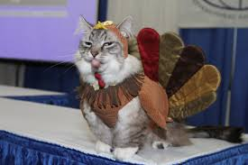
I hates Organic Chemistry and the human that dressed me like this....
but I hoped yo had a Nice Turkey day anyways
FYI…Doc Sux

