Slide 1
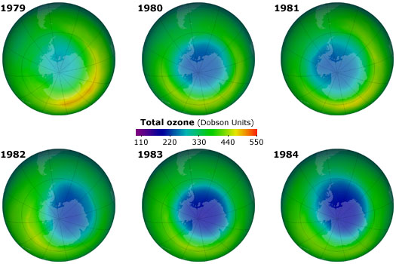
Average Ozone `hole’ over Antarctica a few years after initial CFC Ban

Slide 2
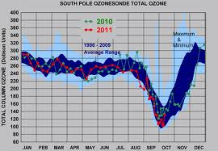
Ozone hole over Antarctica is deepest
in mid-September (NOAA data)

Slide 3
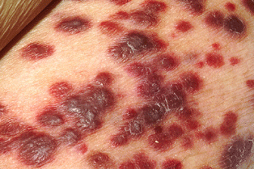
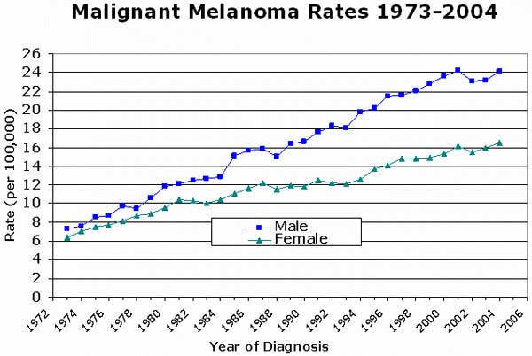
Severe case of skin cancer

Slide 4
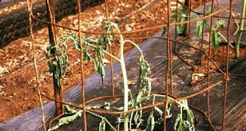
Effect of UV-solarization on plant life

Slide 5
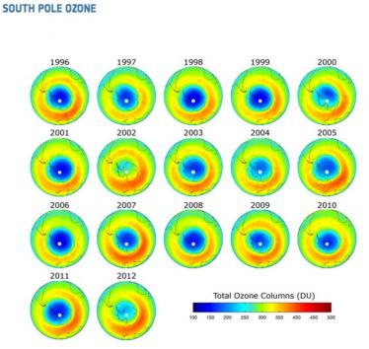
Yearly average from 1996-2012: Things are getting better
http://eijournal.com/industry-insights-trends/is-the-ozone-layer-on-the-road-to-recovery

Slide 6
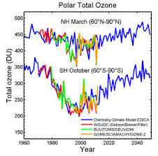
http://www.esa.int/Our_Activities/Observing_the_Earth/Is_the_ozone_layer_on_the_road_to_recovery
2014

Slide 7
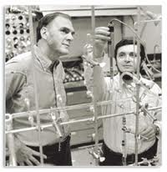
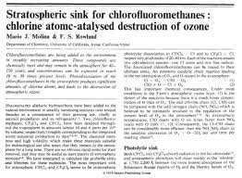
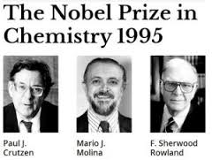
Rowland and Molina- why chemists can be heroes ….

