Slide 1
Problems with Pauling Valence Bond (LCAO) Model: 1955
Fails to provide procedure to determine the numeric details of molecular energy and spectra
translation…can’t compute a stinking thing

Slide 2
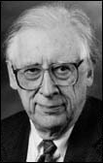
THE `FINAL’ SOLUTION
Solve this for c_{ij}
ψ= Σc_{ij} AO_{ij}
<ψ|H|ψ> = 0 ∀ c_{ij}
∂ c_{ij}
The Big Kahuna of the modern Numerical MO approach
Professor John Pople
Northwestern University:
gets it done….
(tenure: 1965-2005)
Aka: the God of Quantum Computation

Slide 3
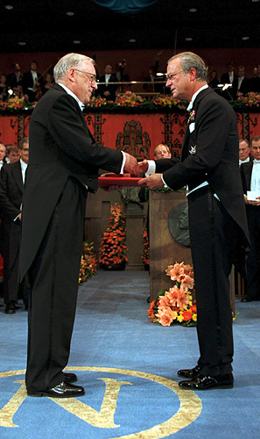

John A. Pople wins the Nobel Prize in Chemistry, 1998 "for his development of computational methods in quantum chemistry".
His un-named, but critical co-conspirator….

Slide 4
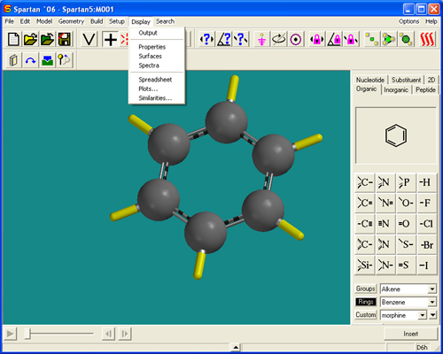
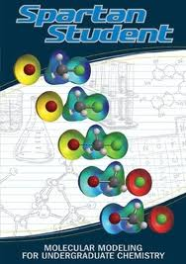
2014:
Molecular Orbital Modeling done via `a black box’ with garden variety laptops
Demo ASC Spartan 8 `professional’ version

Slide 5
Hierarchy of electronic modeling methods
Most rigorous
Computer-based , numerical methods:
Molecular orbital methods (see p.19)
Ab initio methods (no assumptions about `field’ ..mostly for small, reactive molecules)
HF-SCF(Hartree-Fock Self-Consistent field model)*** Moeller-Plesset
Molecular Mechanical models
Extended Huckel (EHMO)*
Simple Huckel (MO)*
***done by Spartan Qchem package in-house..can be a quantum moron and still use to good effect ($700)
*Doc used these in the days of yore as grad student
Pauling LCAO Valence bond method
Lewis Model
HONC
Visual / intuitive methods
least rigorous

