Slide 1


Problems with Pauling Valence Bond (LCAO) Model: 1940
Fails to provide procedure to determine the numeric details of molecular energy and spectra
translation…can’t compute a stinking thing
Doesn’t allow adjustments for changes of atoms bonded to the central atom
Example: can’t distinguish electronic shape or density of CH₄ vs CF₄ except with `electronegativity’ and vague sketches
Linus Pauling
Middle School
Corvallis Ore.

Slide 2
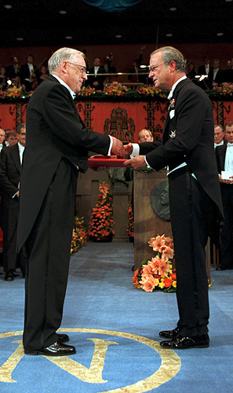
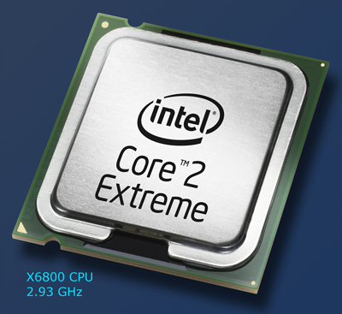
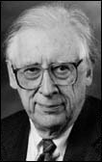
Solve this for c_{ij}
ψ= Σc_{ij} AO_{ij}
<ψ|H|ψ> = 0 ∀ c_{ij}
∂ c_{ij}
The Big Kahuna of the general MO approach
His un-named, but critical co-conspirator….
Professor John Pople
Northwestern University:
(tenure: 1965-2005)
John A. Pople wins the Nobel Prize in Chemistry, 1998 "for his development of computational methods in quantum chemistry".
Aka: the God of Quantum Computation

Slide 3
Generalized Molecular Orbital (MO) Theory:
the `final’ solution
Ex: describing MO for P
Pauling valence bond theory uses just 3s and 3p orbitals
MO theory uses 1s,2s,2p, 3s and 3p orbitals
Key features
Uses both valence and core AO
Uses quantum theory (Schrodinger equation) to approximate the best mix of AO that minimizes the molecule’s total electronic energy
Provides numeric estimates of MO shape and energy levels, structural features (bond length, angle) and electronic charge distribution
Solve this for c_{ij}
ψ= Σc_{ij} AO_{ij}
<ψ|H|ψ> = 0 ∀ c_{ij}
∂ c_{ij}
-23.1 eV
-25.2 eV
-25.6 eV
+0.125
+0.125
-0.25
r(O-H)=0.101 nm
∠(H-O-H)=94º

Slide 4
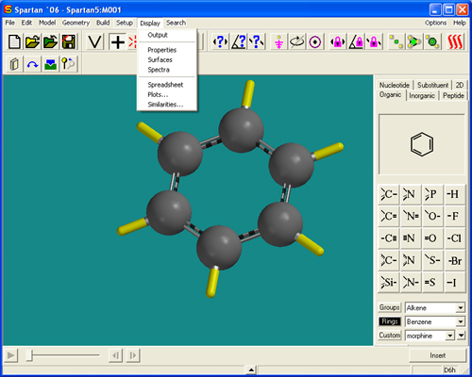

2013:
Molecular Orbital Modeling done via `a black box’ with garden variety laptops
Demo ASC Spartan 8 `professional’ version

Slide 5
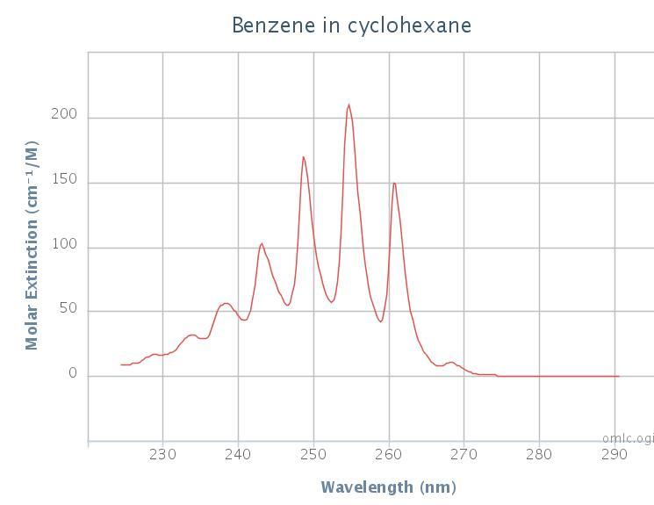
Now in prime time: undergraduate quantum chemistry experiments at ASC
10.9. Guided Practice Session 4: Benzene Using the Spartan 08 Essentials Program
Prelab questions
Compute the total number of valence and core electrons in benzene (C₆H₆). How many filled MO do we expect for benzene?
Go to your Organic Chemistry textbook and look up what it says the `MO’ levels of benzene look like for the 6 delocalized π electrons of the
ring. Sketch the filled and unfilled levels and label them as you find them in your textbook.
Based on the experimental UV-VIS spectrum of benzene (in hexane solvent) below, do the levels proposed by your Organic text book for the π electrons make sense? Why or why not?
Peak λ_{max}(nm)
a 268.5
b 261.0
c 254.8
d 248.8
e 243.0
f 238.3
g 234.0
h 228.8
In- lab Activity
Start a new file and build benzene. Note that in the `Organic’ section of the Model Kit, benzene is listed explicitly under `Rings’ so you won’t even have to build it from scratch, but need only add H atoms to the open bonds. In Set-up, select Equilibrium Geometry, 6-31G* and request computation of IR, orbitals and energies and vibrational modes. Complete the worksheet for session 4.

Slide 6
Non-Mathematical Example of General MO Theory :
Building the O₂ MO diagram
(vaguely described on pp 21-2 of text)
MO features energy levels not drawings
AO (both valence and core) participate
2p_{x} 2p_{y} 2p_{z}
2p_{x} 2p_{y} 2p_{z}
2s
2s
1s
1s
O atom 1s² 2s² 2p⁴
16 e⁻
O atom 1s² 2s² 2p⁴

Slide 7
What General MO teaches about O₂
General MO predicts what Lewis model does (2 bonds for O₂)
Bonds are composed of a sigma and two pi
Two unpaired electrons ! (a new prediction)
1 net anti-bond
3-1 = 2 net bonds
3 bonds
2pπ_{x}
2pπ_{y}
2pσ_{z}
4 Non-bonding pairs
Anti-bond
bond
Bond + anti-bond = non-bond
IN-class: build the N₂ MO with class

Slide 8
Professor Bob Burke’s demo of O₂ paramagnetism (U-Tube)
Carleton University, Ottawa Canada
5 min

Slide 9
Hierarchy of electronic modeling methods
Most rigorous
Ab initio methods (no assumptions about `field’ ..mostly for small, reactive molecules)
HF-SCF(Hartree-Fock Self-Consistent field model)*** Moeller-Plesset
Molecular Mechanical models
Extended Huckel (EHMO)*
Simple Huckel (MO)*
Computer-based , numerical methods:
Molecular orbital methods
***done by Spartan Qchem package in-house..can be a quantum moron and still use to good effect ($700)
*Doc used these in the days of yore as grad student
Pauling LCAO Valence bond method
Lewis Model
HONC
Visual / intuitive methods
least rigorous

