Slide 1
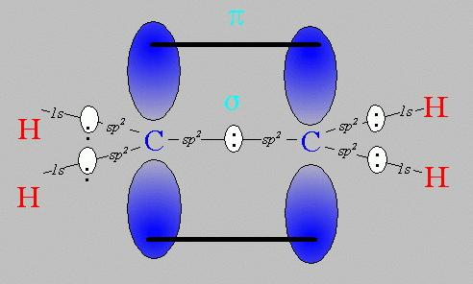
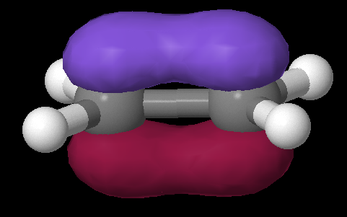
Pi bonds: Pauling’s really great idea to use the `leftovers’
Equivalent Pauling `sigma’ (σ) hybrid structure
Ethene (C₂H₄) Lewis picture
σ
1 leftover p_{z} on each C
sp²
sp²
s+ p_{x} + p_{y}
s+ p_{x} + p_{y}
z
π
x
σ
y

Slide 2
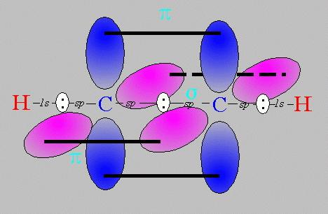
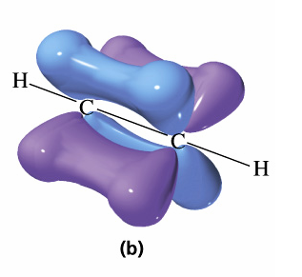
Pi bonds: Pauling’s really great idea to use the `leftovers’ (cont.)
Equivalent Pauling `sigma’ (σ) hybrid structure
Ethyne (C₂H₂) Lewis picture
σ
sp
sp
2 leftover p_{z} on each C
s+ p_{x}
s+ p_{x}
z
π
Z
x
σ
π
x
y
y

Slide 3
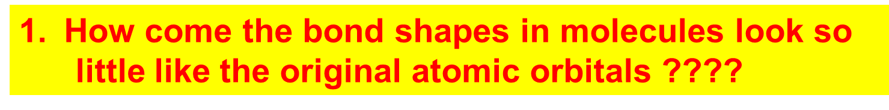
How Pauling’s model `fixes’ the problems with Lewis model
Atomic orbitals (AO) `reorganize’ (hybridize) when individual atoms approach each other such that the number of `links’ predicted by the Lewis model = the number of s, p (and d and f) orbitals combined in the reorganization. The `hybrid’ combinations are called Linear Combinations of Atomic Orbitals (LCAO). The `lobes’ in LCAO on individual atoms overlap and share two electrons between the atoms in a `sigma’ bond (often called a `valence’ or structural linkage bond.)

Slide 4
How Pauling’s model `fixes’ the problems with Lewis model
(continued)
2. How does octet model account for the observed reactivity trend of ethane vs ethene vs ethyne with halogens and ozone ?
`pi’ bonds are far less stable and far more reactive than sigma bonds. (Further out, softer, not between atoms but above and below) Ethane is held together by just `sigma bonds and is thus not very reactive.
Both ethylene and acetylene have pi bonds which are easily reacted. That acetylene is more reactive thane ethylene results because it has two pi bonds while ethylene has only 1 pi bond

Slide 5
How Pauling’s model `fixes’ the problems with Lewis model
(continued)
3. How come ethene sticks to Pt, Rh and Ni in
catalysis, but ethane doesn’t ???
The large and loose electronic clouds above the metals are `soft’ and easily `blended’ (overlapped’ with like electronic distributions (e.g. soft and fluid). Pi bonds are soft and fluid; sigma bonds aren’t. Moreover, the pi bonds are far away from the central core of the molecule, thus reducing nuclear-nuclear repulsions.

Slide 6
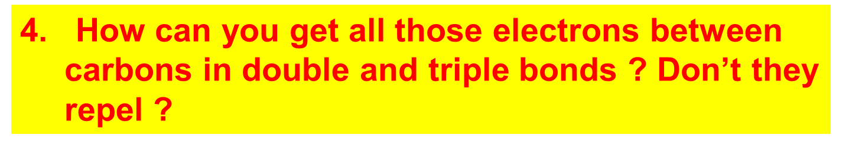
How Pauling’s model `fixes’ the problems with Lewis model
(continued)
The pi bonds occupy space above and below the sigma bond and thus do not crowd them. The two pi bonds are also on different and perpendicularly aligned planes to minimize pi-pi crowding.

Slide 7
USING THE PAULING MODEL:
IN CLASS EXERCISE 3

Slide 8
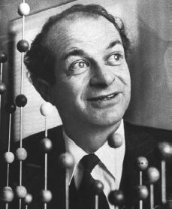
Linus Pauling
An American Chemical Genius
“I am awesome
( and kinda cute in a geeky way…)”
…one of the heroes of my chemical youth…
I
PAULING

Slide 9
Keen intuition + mathematical rigor + outside the box thinking +…he’s was a really nice guy and an inspired teacher !
FYI: You are all the great grandchildren of Linus Pauling !!!

Slide 10
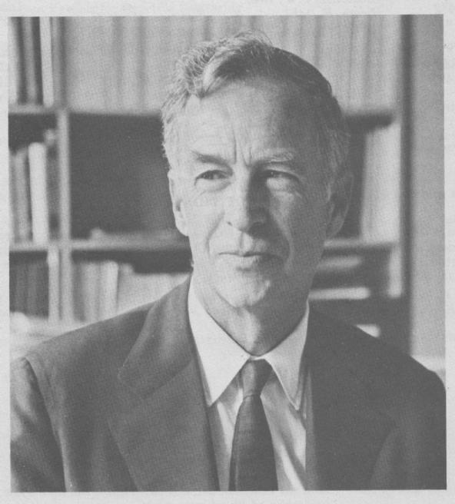
E. Bright Wilson
Harvard University, Chemistry
National Medal of Science 1975
T.W. Richards Endowed Chair
Linus Pauling
Cal Tech, Chemistry
Nobel Prize in Chemistry 1954
Nobel Peace Prize 1962

Slide 11
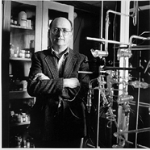

YOU !
‘Doc’ Fong
SUNY Alfred State Chemistry
Coordinator, Forensic Science Technology (and nut case)
R. L. Kuczkowski
University of Michigan, Chemistry
Department Chair

Slide 12
Problems with Pauling Valence Bond (LCAO) Model: 1955
Fails to provide procedure to determine the numeric details of molecular energy and spectra
translation…can’t compute a stinking thing

Slide 13
Problems with Pauling Valence Bond (LCAO) Model: 1955
Doesn’t allow adjustments for changes of atoms bonded to the central atom
Example: can’t distinguish electronic shape or density of CH₄ vs CF₄ except with `electronegativity’ and vague sketches

Slide 14

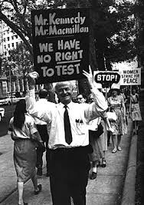
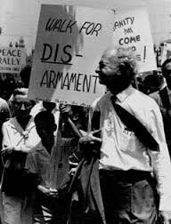
So what ! I’m famous and my theory is still the go-to-theory for number-challenged organic chemists…”

Slide 15
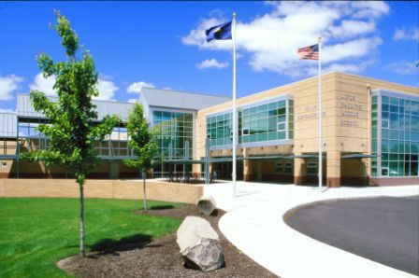
Linus Pauling Middle School
Corvallis Ore.

