Slide 1
Summary of Lewis Model successes
Provides simple process leading to sensible predictions of electronic distributions in most (but not all) compounds in both ground and excited states (Extended Lewis rules)
Lewis structures lead to simple and accurate predictions of molecular shapes (VSEPR)
Lewis predictions of electronic distributions provide simple way to predict chemical interaction and relative stabilities, and provides basis for general acid-base model of reactivity. (Supplement 2)

Slide 2
SOME ISSUES WITH THE LEWIS OCTET MODEL (the nitpicking starts…)
How come the bond shapes in molecules look so
little like the original atomic orbitals ????
2. How does octet model account for the observed reactivity trend of ethane vs. ethene vs ethyne with halogens and ozone ?
3. How come ethene sticks to Pt, Rh and Ni in
catalysis, but ethane doesn’t ???
4. How can you get all those electrons between carbons in double and triple bonds ? Don’t they repel ?

Slide 3
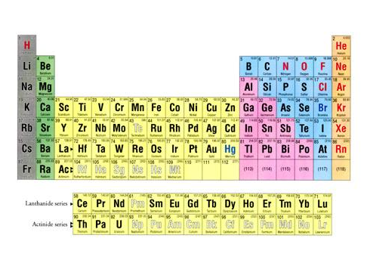
Back to the drawing board….
s
p
1
2
3
4
5
6
7
d
f

Slide 4
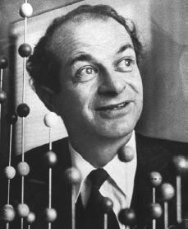
Linus Pauling to the rescue: the Valence Bond or Atomic Orbital Hybridization model
a) Atomic orbitals (AO) `reorganize as they approach each other
s + np = sp^{n} ⇒ n+1 equal hybrid molecular bonding lobes
(# AO combined = # molecular `bonding lobes’
c) Bonding Lobes overlap between atoms to form bonds (2 e⁻ bond)
d) Hybrid bonds more stable than unhybridized alternatives (`variational principle of quantum chemistry…diversity breeds stronger bonds…)

Slide 5
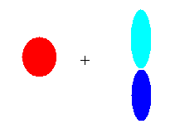

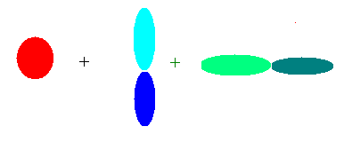
Images of hybrid sigma bond formation
#AO = number of identical lobes in LCAO
Atomic orbitals (AO)
Linearly Combined Atomic Orbitals (LCAO)
linear
sp
2s 2p_{y}
trigonal plane
pyramid
2s 2p_{y} 2p_{x}
sp²
2s 2p_{y} 2p_{x} 2p_{z}
sp³

Slide 6
A note about ` lobes’:
A lobe can contain either a bond or a lone pair
CH₄ = 4 C-H bonds => 4 lobes
=> s+ p_{x} + p_{y} + p_{z} = sp³
NH₃ =
H
|
:N-H
|
H
= 3 bonds + 1 lone pair => 4 lobes
=> s+ p_{x} + p_{y} + p_{z} = sp³

Slide 7


Visualizing Hybridization: AO→ LCAO →bond
s and p AO on isolated C
1) Isolated AO on atoms approach each other from afar….
2) Isolated AO disappear and are re-formed into equal LCAO lobes as each atom `sees’ the other
LCAO re-formed from AO on separate atoms
Sigma bond
Un-overlapped lobe
Un-overlapped lobe
3a) Two atoms get closer
3b) 2 LCAO near each other overlap…reform into a `sigma’ bond.
3c) un-overlapped lobes can bond to something else
s and p AO on isolated C

Slide 8
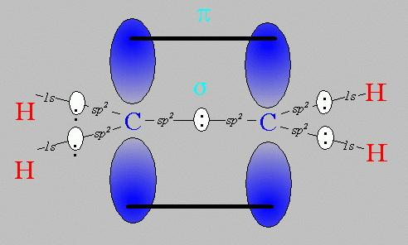
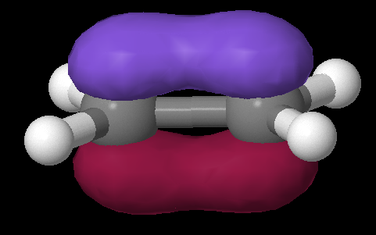
Pi bonds: Pauling’s really great idea to use the `leftovers’
Equivalent Pauling `sigma’ (σ) hybrid structure
Ethene (C₂H₄) Lewis picture
σ
1 leftover p_{z} on each C
sp²
sp²
s+ p_{x} + p_{y}
s+ p_{x} + p_{y}
z
π
x
σ
y

Slide 9
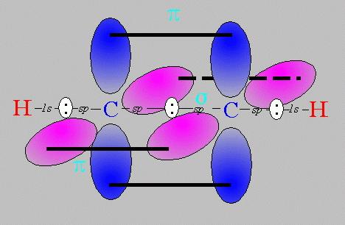
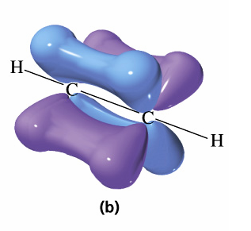
Pi bonds: Pauling’s really great idea to use the `leftovers’ (cont.)
Equivalent Pauling `sigma’ (σ) hybrid structure
Ethyne (C₂H₂) Lewis picture
σ
sp
sp
2 leftover p_{z} on each C
s+ p_{x}
s+ p_{x}
z
π
Z
x
σ
π
x
y
y

Slide 10
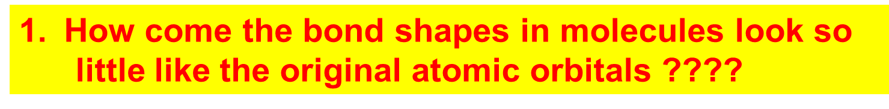
How Pauling’s model `fixes’ the problems with Lewis model
Atomic orbitals (AO) `reorganize’ (hybridize) when individual atoms approach each other such that the number of `links’ predicted by the Lewis model = the number of s, p (and d and f) orbitals combined in the reorganization. The `hybrid’ combinations are called Linear Combinations of Atomic Orbitals (LCAO). The `lobes’ in LCAO on individual atoms overlap and share two electrons between the atoms in a `sigma’ bond (often called a `valence’ or structural linkage bond.)

Slide 11
How Pauling’s model `fixes’ the problems with Lewis model
(continued)
2. How does octet model account for the observed reactivity trend of ethane vs ethene vs ethyne with halogens and ozone ?
`pi’ bonds are far less stable and far more reactive than sigma bonds. (Further out, softer, not between atoms but above and below) Ethane is held together by just `sigma bonds and is thus not very reactive.
Both ethylene and acetylene have pi bonds which are easily reacted. That acetylene is more reactive thane ethylene results because it has two pi bonds while ethylene has only 1 pi bond

Slide 12
How Pauling’s model `fixes’ the problems with Lewis model
(continued)
3. How come ethene sticks to Pt, Rh and Ni in
catalysis, but ethane doesn’t ???
The large and loose electronic clouds above the metals are `soft’ and easily `blended’ (overlapped’ with like electronic distributions (e.g. soft and fluid). Pi bonds are soft and fluid; sigma bonds aren’t. Moreover, the pi bonds are far away from the central core of the molecule, thus reducing nuclear-nuclear repulsions.

Slide 13
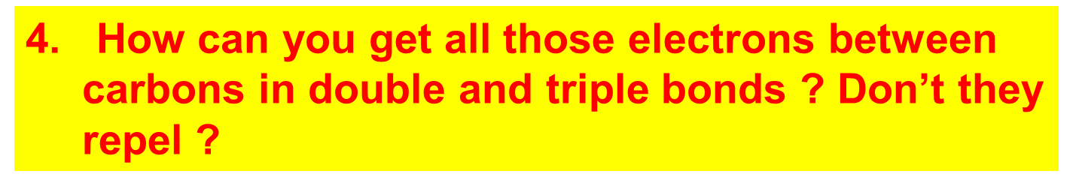
How Pauling’s model `fixes’ the problems with Lewis model
(continued)
The pi bonds occupy space above and below the sigma bond and thus do not crowd them. The two pi bonds are also on different and perpendicularly aligned planes to minimize pi-pi crowding.

Slide 14
USING THE PAULING MODEL:
IN CLASS EXERCISE 3

Slide 15
Linus Pauling
An American Chemical Genius
“I am awesome
( and kinda cute in a geeky way…)”
…one of the heroes of my chemical youth…
I
PAULING

Slide 16
Keen intuition + mathematical rigor + outside the box thinking +…he’s was a really nice guy and an inspired teacher !
FYI: You are all the great grandchildren of Linus Pauling !!!

Slide 17
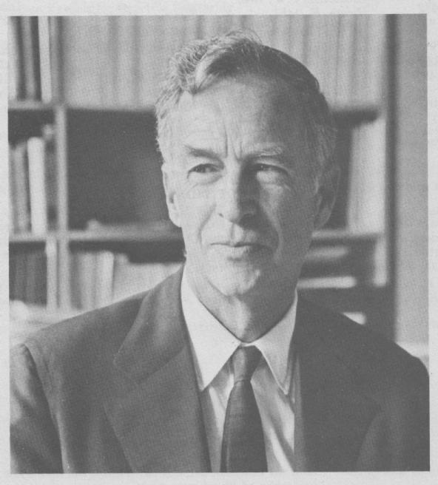
E. Bright Wilson
Harvard University, Chemistry
National Medal of Science 1975
T.W. Richards Endowed Chair
Linus Pauling
Cal Tech, Chemistry
Nobel Prize in Chemistry 1954
Nobel Peace Prize 1962

Slide 18
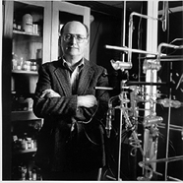

YOU !
‘Doc’ Fong
SUNY Alfred Stat,e Chemistry
Coordinator, Forensic Science Technology (and nut case)
R. L. Kuczkowski
University of Michigan, Chemistry
Department Chair

Slide 19

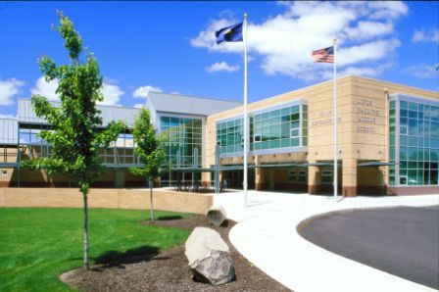
Problems with Pauling Valence Bond (LCAO) Model: 1955
Fails to provide procedure to determine the numeric details of molecular energy and spectra
translation…can’t compute a stinking thing
Doesn’t allow adjustments for changes of atoms bonded to the central atom
Example: can’t distinguish electronic shape or density of CH₄ vs CF₄ except with `electronegativity’ and vague sketches
Linus Pauling
Middle School
Corvallis Ore.

