Slide 1
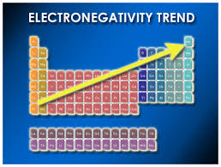
Electronegativity is a measure of how badly a given element wants to steal electrons from its neighbors. (pp 28-30). It guides predictions for dipole directions
(CH₃OH example)

Slide 2
Rough Lewis predictions for reactivity trends (Supplement 2)
octet octet octet octet no octet
no lone pairs no lone pairs lone pairs lone pairs
no charge no charge no charge charge
no dipole dipole dipole dipole
EXAMPLES
  CH₄ CH₃-CH-CH₃ :NH₃ HC≡C: ⁻ HOO* Br*
CH₃*
Reactivity increases to right

Slide 3
Rough Lewis predictions for reactivity trends (Supplement 2)
octet octet octet octet no octet
no lone pairs no lone pairs lone pairs lone pairs
no charge no charge no charge charge
no dipole dipole dipole
EXAMPLES
  CH₄ CH₃-CH-CH₃ :NH₃ HC≡C: ⁻ HOO* Br*
CH₃*
Reactivity increases to right

