Slide 1
Elements closer to the center of the Periodic Table tend to be at the center of molecules
examples
O-C-O not O-O-C for CO₂
O-S-O not O-O-S for SO₂
Cl
Cl
P not Cl-Cl-P-Cl for PCl₃
Cl

Slide 2
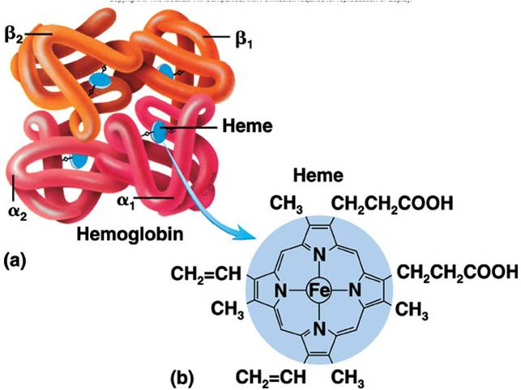
Extreme example of Periodic centrality rule: Hemoglobin
Iron (III) porphyrin complex

Slide 3
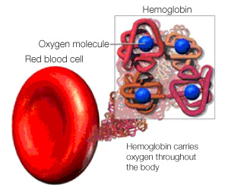
O₂ attaches to Fe(III) porphyrin sites so we can breathe

