Slide 1
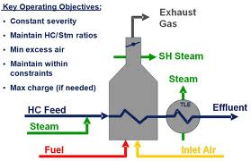
Flow diagram for an ethylene cracking plant
steam
C2-C8 alkanes CH₂=CH₂
850-950 C

Slide 2
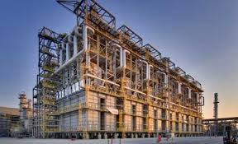
What a typical cracking plant really looks like

Slide 3
There are two main laboratory routes to alkenes
Dehydrohalogenation of R-X (E2 mechanism)
major
minor
2)Dehydration of R-OH (E1 mechanism)
major
minor

