Slide 1
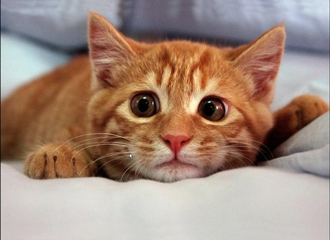
S_{N}1 and S_{N}2 drill and practice
Pleez don’t picks meh

Slide 2
Name of intermediate species formed in S_{N}1 when X⁻ `leaves’ RX:
R⁺, carbocation
Hybridization of carbocation is:
sp²
S_{N}2
Mechanism features aprotic, modestly polar solvents
Racemization happens with this mechanism
S_{N}2
Mechanism for halogenation of 1º alcohols
S_{N}2
Which mechanism features rearrangement ?
S_{N}1
Order of halogen reactivity in S_{N}2 substitution in ROH solvent:
I > Br> Cl > F
2 in S_{N}2 stands for…
Bimolecular rate determining step

Slide 3
1º
Inversion occurs for ________________ RX during substitution with HS⁻
Order α carbon reactivity to S_{N}2
3º << 2º < 1º < 0º
S_{N}1 prefers what kind of solvent ?
Polar, protic solvents
Name of key transition state formed in S_{N}2 ?
5-coordinated, activated complex
Mechanism associated with solvolysis
S_{N}1
In polar, aprotic solvents the order of reactivity for the halogens I-, Br-,Cl- and F- are (from strongest→ weakest):
F⁻ > Cl⁻ > Br⁻ > I⁻

Slide 4
What two experimental conditions forces protonated alcohol concentrations higher during halide substitution on ROH ?
Excess H₂SO₄ and reflux
Mechanism governing the reaction below ?
S_{N}2
To make an an ether from CH₃Br what generic nucleophile would you use ?
RO⁻
Which substrate will react fastest to form a thiol with HS⁻ ?

Slide 5
Rearrangement ??
No. 1º RX runs S_{N}2
Rearrangement ??
No. No higher degree carbocation possible, even though 2º runs S_{N}1
Rearrangement ??
Yes. Can run S_{N}1 and higher carbocation site possible

Slide 6
ID the Reaction associated with each of these potential vs. time curves
S_{N}2
S_{N}1 solvolysis
S_{N}1 Nuc⁻ substitution

Slide 7


