Slide 1
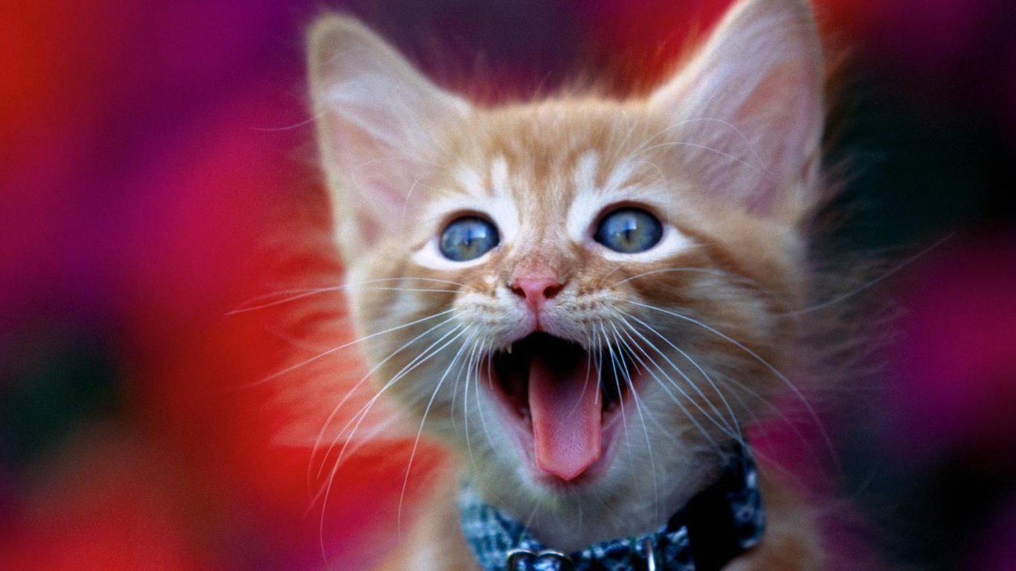
Congratulations ! You’ve survived your first week in Organic Chemistry !!

Slide 2
ISSUES WITH THE LEWIS OCTET MODEL
(the nitpicking starts…)
How come the bond shapes in molecules look so
little like the original atomic orbitals ????
2. How does octet model account for the observed reactivity trend of ethane vs. ethene vs ethyne with halogens and ozone ?
How can you get all those electrons between carbons
in double and triple bonds ? Don’t they repel ?

Slide 3
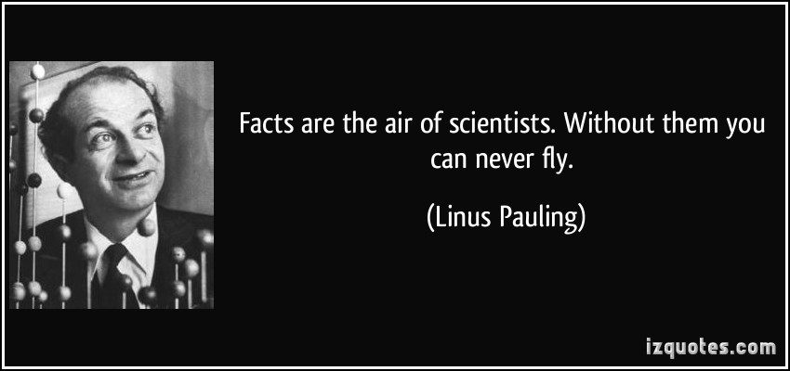
Eventually, another All- American “Superer Duperer” Chemistry Star swoops in and fixes everything (for a while)

Slide 4
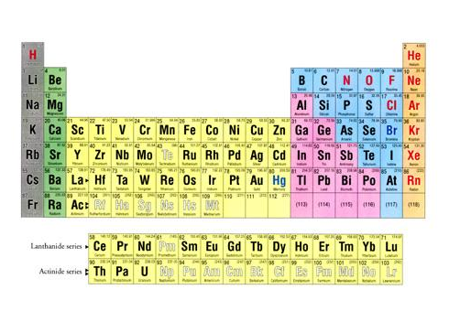
Pauling goes back to the Chemist’s drawing board….
s
p
1
2
3
4
5
6
7
d
f

Slide 5
Pauling’s `Localized’ Valence Bond Hybridization Model
PAULING’S INSIGHTS
Lewis isn’t `wrong’….he just hasn’t :
considered the role the valence s, p, d… orbitals play
realized that all bonds are not the same.

Slide 6
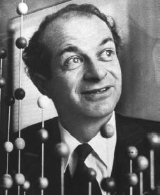
Linus Pauling fixes every criticism with Valence Bond or Atomic Orbital Hybridization model
a) Atomic orbitals (AO) `reorganize as they approach each other
“Sweet !!”
s + np = sp^{n} ⇒ n+1 equal hybrid molecular bonding lobes (# AO combined = # molecular `bonding lobes’ )
c) Bonding Lobes overlap between atoms to form bonds (2 e⁻ /bond)
d) Hybrid bonds more stable than unhybridized alternatives (`variational principle of quantum chemistry…diversity breeds stronger bonds…)

Slide 7
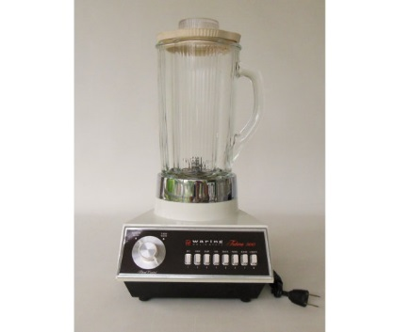
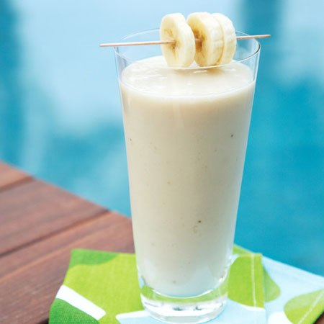
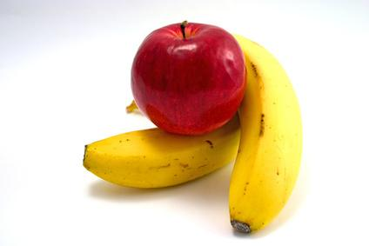
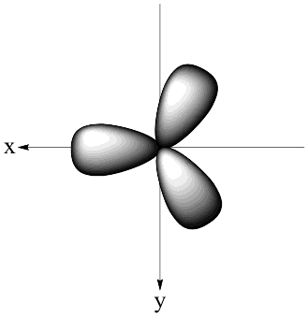
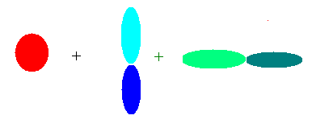
Hybridization is like using a blender……
s+ p_{x} +p_{y}
AO in
sp² smoothy out
Quantum Math Blender

Slide 8
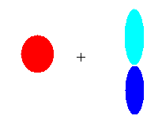

Images of hybrid sigma bond formation
#AO = number of identical lobes in LCAO
Atomic orbitals (AO)
Linearly Combined Atomic Orbitals (LCAO)
linear
sp
2s 2p_{y}
trigonal plane
pyramid
2s 2p_{y} 2p_{x}
sp²
2s 2p_{y} 2p_{x} 2p_{z}
sp³

Slide 9
A note about ` lobes’:
A lobe can contain either a bond or a lone pair
CH₄ = 4 C-H bonds => 4 lobes
=> s+ p_{x} + p_{y} + p_{z} = sp³
NH₃ =
H
|
:N-H
|
H
= 3 bonds + 1 lone pair => 4 lobes
=> s+ p_{x} + p_{y} + p_{z} = sp³

Slide 10


Visualizing Hybridization: AO→ LCAO →bond
s and p AO on isolated C
1) Isolated AO on atoms approach each other from afar….
2) Isolated AO disappear and are re-formed into equal LCAO lobes as each atom `sees’ the other
3c) un-overlapped lobes can bond to something else
LCAO re-formed from AO on separate atoms
Sigma bond
Un-overlapped lobe
Un-overlapped lobe
3a) Two atoms get closer
3b) 2 LCAO near each other overlap…reform into a `sigma’ bond.
s and p AO on isolated C

Slide 11
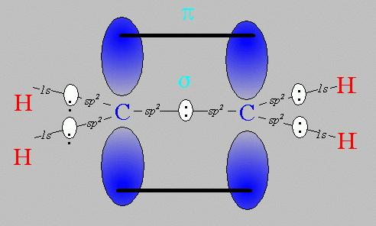
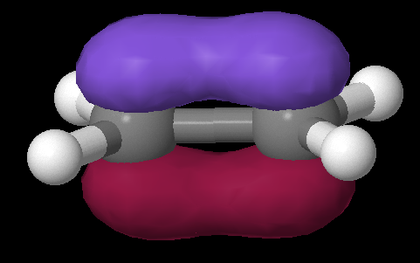
Pi bonds: Pauling’s really great idea to use the `leftovers’ (extra bananas)
Equivalent Pauling `sigma’ (σ) hybrid structure
Ethene (C₂H₄) Lewis picture
σ
1 leftover p_{z} on each C
sp²
sp²
s+ p_{x} + p_{y}
s+ p_{x} + p_{y}
z
π
x
σ
y

Slide 12
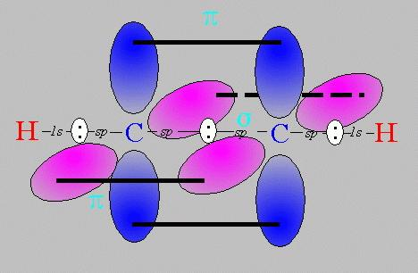
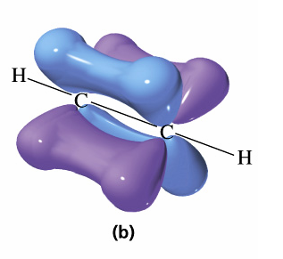
Pi bonds: Pauling’s really great idea to use the `leftovers’ (cont.)
Equivalent Pauling `sigma’ (σ) hybrid structure
Ethyne (C₂H₂) Lewis picture
σ
sp
sp
2 leftover p_{z} on each C
s+ p_{x}
s+ p_{x}
z
π
Z
x
σ
π
x
y
y

Slide 13
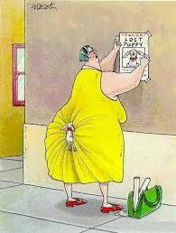
Cartoon rendition of σ and π
π
σ

Slide 14
USING THE PAULING MODEL:
IN CLASS EXERCISE 2

Slide 15
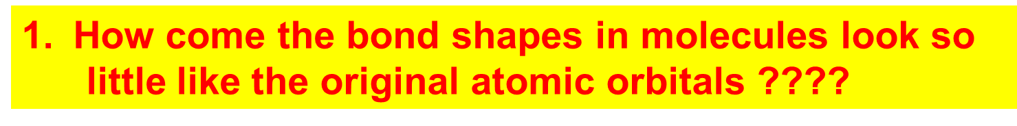
How Pauling’s model `fixes’ the problems with Lewis model
Atomic orbitals (AO) `reorganize’ (hybridize) when individual atoms approach each other such that the number of `links’ predicted by the Lewis model = the number of s, p (and d and f) orbitals combined in the reorganization. The `hybrid’ combinations are called Linear Combinations of Atomic Orbitals (LCAO). The `lobes’ in LCAO on individual atoms overlap and share two electrons between the atoms in a `sigma’ bond (often called a `valence’ or structural linkage bond.)

Slide 16
How Pauling’s model `fixes’ the problems with Lewis model
(continued)
2. How does octet model account for the observed reactivity trend of ethane vs ethene vs ethyne with halogens and ozone ?
`pi’ bonds are far less stable and far more reactive than sigma bonds. (Further out, softer, not between atoms but above and below) Ethane is held together by just `sigma bonds and is thus not very reactive.
Both ethylene and acetylene have pi bonds which are easily reacted. That acetylene is more reactive than ethylene results because it has two pi bonds while ethylene has only 1 pi bond

Slide 17
How Pauling’s model `fixes’ the problems with Lewis model
(continued)
3. How come ethene sticks to Pt, Rh and Ni in
catalysis, but ethane doesn’t ???
The large and loose electronic clouds above the metals are `soft’ and easily `blended’ (overlapped’ with like electronic distributions (e.g. soft and fluid). Pi bonds are soft and fluid; sigma bonds aren’t. Moreover, the pi bonds are far away from the central core of the molecule, thus reducing nuclear-nuclear repulsions.

Slide 18
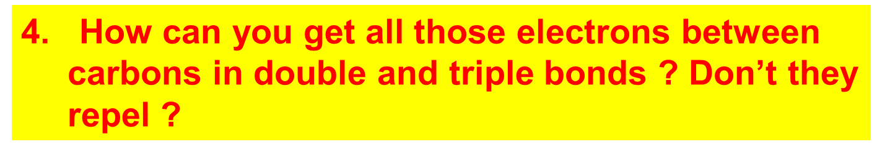
How Pauling’s model `fixes’ the problems with Lewis model
(continued)
The pi bonds occupy space above and below the sigma bond and thus do not crowd them. The two pi bonds are also on different and perpendicularly aligned planes to minimize pi-pi crowding.

Slide 19
Linus Pauling
An American Chemical Genius
“I am awesome
( and kinda cute in a geeky way…)”
…one of the heroes of my chemical youth…
I
PAULING

Slide 20
Keen intuition + mathematical rigor + outside the box thinking +…he’s was a really nice guy and an inspired teacher !
FYI: You are all the great grandchildren of Linus Pauling !!!

Slide 21
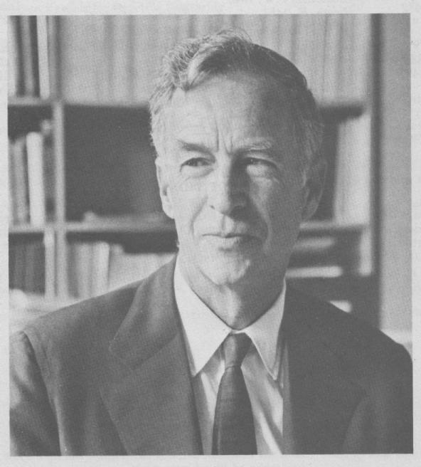
E. Bright Wilson
Harvard University, Chemistry
National Medal of Science 1975
T.W. Richards Endowed Chair
Linus Pauling
Cal Tech, Chemistry
Nobel Prize in Chemistry 1954
Nobel Peace Prize 1962

Slide 22
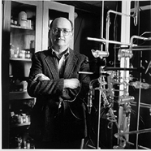

YOU !
‘Doc’ Fong
Senior Chemist
SUNY Alfred State Chemistry
(and nut case)
R. L. Kuczkowski
University of Michigan, Chemistry
Department Chair

