Slide 1

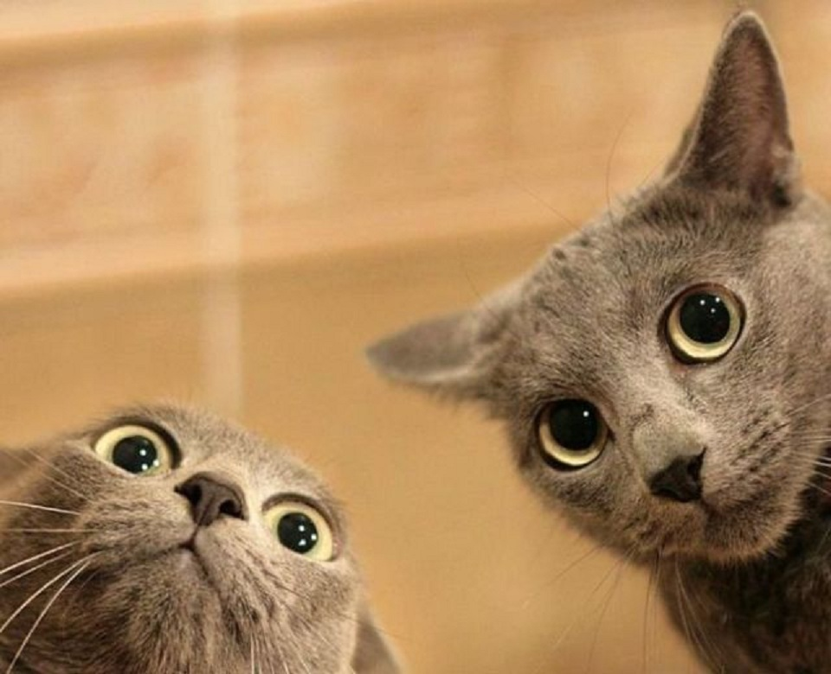
Hand in Letters
Any Questions ?

Slide 2
ISSUES WITH THE LEWIS OCTET MODEL
(the nitpicking starts…)
How come the bond shapes in molecules look so
little like the original atomic orbitals ????
2. How does octet model account for the observed reactivity trend of ethane vs. ethene vs ethyne with halogens and ozone ?
How can you get all those electrons between carbons
in double and triple bonds ? Don’t they repel ?

Slide 3
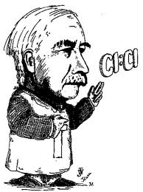
LEWIS MODEL HAS INCONSISTENCIES
WHICH HE DOESN’T BOTHER TO ADDRESS
Oh fudge off…

Slide 4
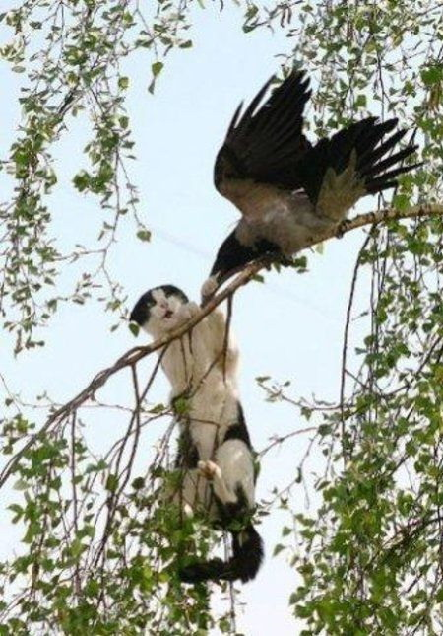
SO NOW
WHAT ?

Slide 5
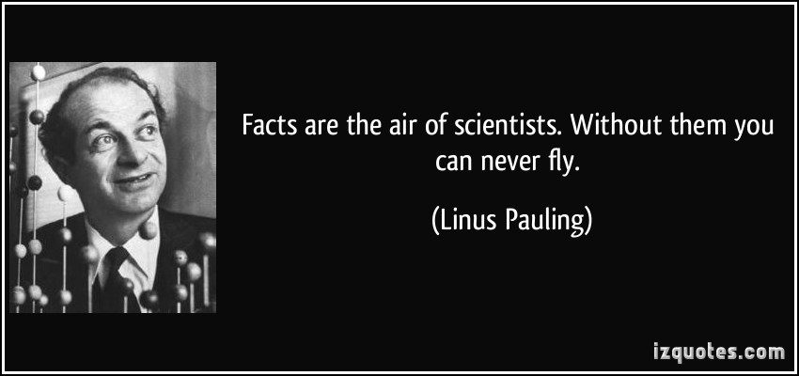
Eventually, another All- American “Superer Duperer” Chemistry Star swoops in and fixes everything (for a while)

Slide 6
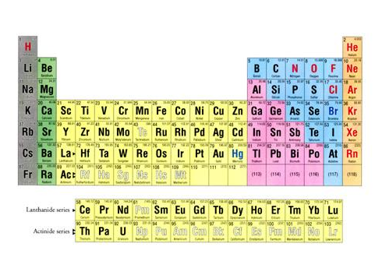
Pauling goes back to the Chemist’s drawing board….
s
p
1
2
3
4
5
6
7
d
f

Slide 7
Pauling’s `Localized’ Valence Bond Hybridization Model
PAULING’S INSIGHTS
Lewis isn’t `wrong’….he just hasn’t :
considered the role the valence s, p, d… orbitals play
realized that all bonds are not the same.

Slide 8
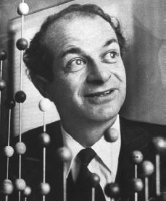
Linus Pauling fixes every criticism with Valence Bond or Atomic Orbital Hybridization model
a) Atomic orbitals (AO) `reorganize as they approach each other
“Sweet !!”
s + np = sp^{n} ⇒ n+1 equal hybrid molecular bonding lobes
(# AO combined = # molecular `bonding lobes’ )
c) Bonding Lobes overlap between atoms to form bonds (2 e⁻ bond)
d) Hybrid bonds more stable than unhybridized alternatives (`variational principle of quantum chemistry…diversity breeds stronger bonds…)

Slide 9
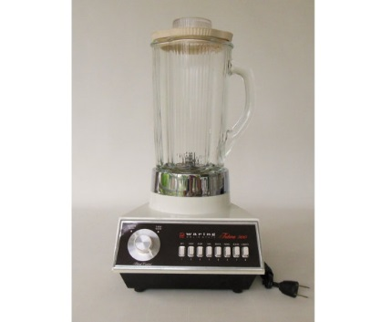
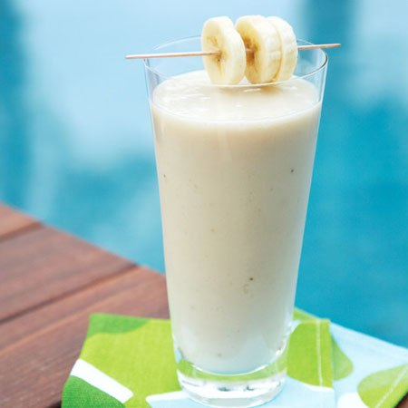
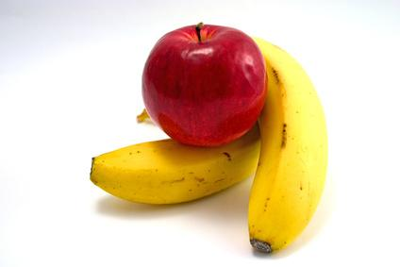
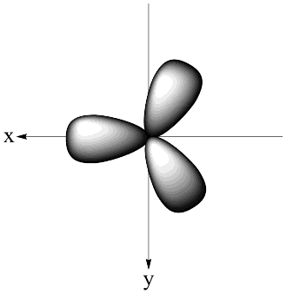
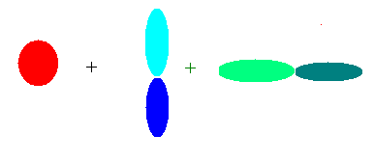
Hybridization is like using a blender……
s+ p_{x} +p_{y}
AO in
sp² smoothy out
Quantum Math Blender

Slide 10
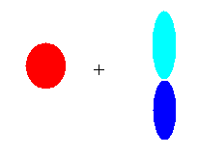

Images of hybrid sigma bond formation
#AO = number of identical lobes in LCAO
Atomic orbitals (AO)
Linearly Combined Atomic Orbitals (LCAO)
linear
sp
2s 2p_{y}
trigonal plane
pyramid
2s 2p_{y} 2p_{x}
sp²
2s 2p_{y} 2p_{x} 2p_{z}
sp³

Slide 11
A note about ` lobes’:
A lobe can contain either a bond or a lone pair
CH₄ = 4 C-H bonds => 4 lobes
=> s+ p_{x} + p_{y} + p_{z} = sp³
NH₃ =
H
|
:N-H
|
H
= 3 bonds + 1 lone pair => 4 lobes
=> s+ p_{x} + p_{y} + p_{z} = sp³

Slide 12


Visualizing Hybridization: AO→ LCAO →bond
s and p AO on isolated C
1) Isolated AO on atoms approach each other from afar….
2) Isolated AO disappear and are re-formed into equal LCAO lobes as each atom `sees’ the other
LCAO re-formed from AO on separate atoms
Sigma bond
Un-overlapped lobe
Un-overlapped lobe
3a) Two atoms get closer
3b) 2 LCAO near each other overlap…reform into a `sigma’ bond.
3c) un-overlapped lobes can bond to something else
s and p AO on isolated C

Slide 13
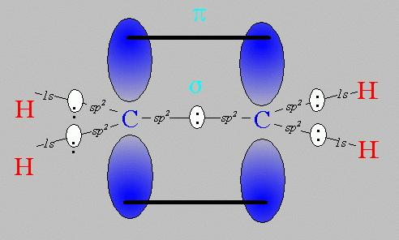
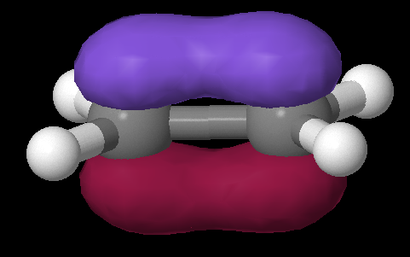
Pi bonds: Pauling’s really great idea to use the `leftovers’ (extra bananas)
Equivalent Pauling `sigma’ (σ) hybrid structure
Ethene (C₂H₄) Lewis picture
σ
1 leftover p_{z} on each C
sp²
sp²
s+ p_{x} + p_{y}
s+ p_{x} + p_{y}
z
π
x
σ
y

Slide 14
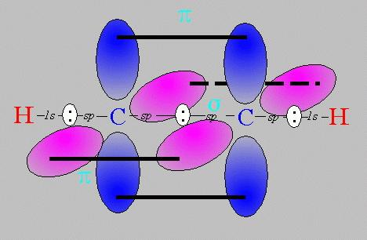
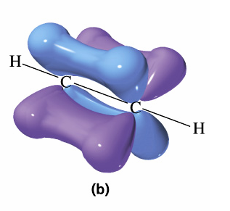
Pi bonds: Pauling’s really great idea to use the `leftovers’ (cont.)
Equivalent Pauling `sigma’ (σ) hybrid structure
Ethyne (C₂H₂) Lewis picture
σ
sp
sp
2 leftover p_{z} on each C
s+ p_{x}
s+ p_{x}
z
π
Z
x
σ
π
x
y
y

Slide 15
USING THE PAULING MODEL:
IN CLASS EXERCISE 2

Slide 16
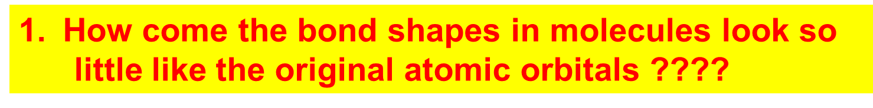
How Pauling’s model `fixes’ the problems with Lewis model
Atomic orbitals (AO) `reorganize’ (hybridize) when individual atoms approach each other such that the number of `links’ predicted by the Lewis model = the number of s, p (and d and f) orbitals combined in the reorganization. The `hybrid’ combinations are called Linear Combinations of Atomic Orbitals (LCAO). The `lobes’ in LCAO on individual atoms overlap and share two electrons between the atoms in a `sigma’ bond (often called a `valence’ or structural linkage bond.)

Slide 17
How Pauling’s model `fixes’ the problems with Lewis model
(continued)
2. How does octet model account for the observed reactivity trend of ethane vs ethene vs ethyne with halogens and ozone ?
`pi’ bonds are far less stable and far more reactive than sigma bonds. (Further out, softer, not between atoms but above and below) Ethane is held together by just `sigma bonds and is thus not very reactive.
Both ethylene and acetylene have pi bonds which are easily reacted. That acetylene is more reactive than ethylene results because it has two pi bonds while ethylene has only 1 pi bond

Slide 18
How Pauling’s model `fixes’ the problems with Lewis model
(continued)
3. How come ethene sticks to Pt, Rh and Ni in
catalysis, but ethane doesn’t ???
The large and loose electronic clouds above the metals are `soft’ and easily `blended’ (overlapped’ with like electronic distributions (e.g. soft and fluid). Pi bonds are soft and fluid; sigma bonds aren’t. Moreover, the pi bonds are far away from the central core of the molecule, thus reducing nuclear-nuclear repulsions.

Slide 19
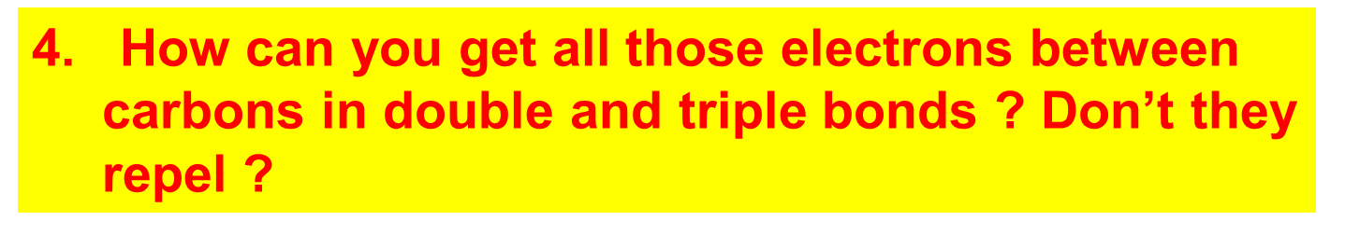
How Pauling’s model `fixes’ the problems with Lewis model
(continued)
The pi bonds occupy space above and below the sigma bond and thus do not crowd them. The two pi bonds are also on different and perpendicularly aligned planes to minimize pi-pi crowding.

Slide 20
Linus Pauling
An American Chemical Genius
“I am awesome
( and kinda cute in a geeky way…)”
…one of the heroes of my chemical youth…
I
PAULING

Slide 21
Keen intuition + mathematical rigor + outside the box thinking +…he’s was a really nice guy and an inspired teacher !
FYI: You are all the great grandchildren of Linus Pauling !!!

Slide 22
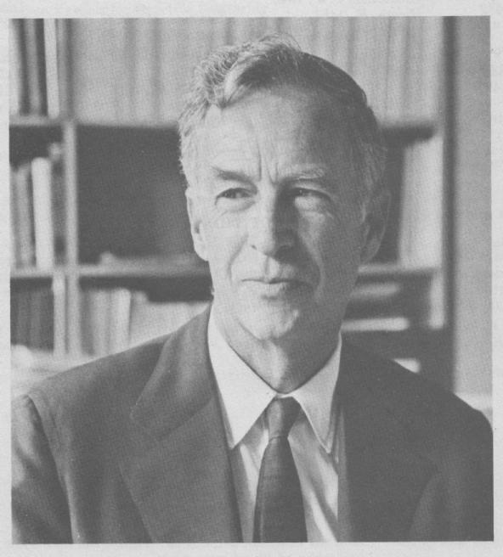
E. Bright Wilson
Harvard University, Chemistry
National Medal of Science 1975
T.W. Richards Endowed Chair
Linus Pauling
Cal Tech, Chemistry
Nobel Prize in Chemistry 1954
Nobel Peace Prize 1962

Slide 23
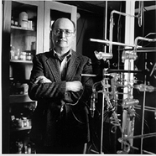

YOU !
‘Doc’ Fong
Senior Chemist
SUNY Alfred State Chemistry
(and nut case)
R. L. Kuczkowski
University of Michigan, Chemistry
Department Chair

Slide 24
Problems with Pauling Valence Bond (LCAO) Model: 1955
Fails to provide procedure to determine the numeric details of molecular energy and spectra
translation…can’t compute a stinking thing

Slide 25
Problems with Pauling Valence Bond (LCAO) Model: 1955
Doesn’t allow adjustments for changes of atoms bonded to the central atom
Example: can’t distinguish electronic shape or density of CH₄ vs CF₄ except with `electronegativity’ and vague sketches

Slide 26

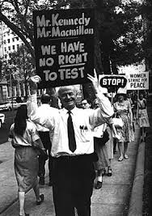
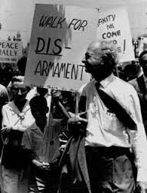
So what ! I’m famous and my theory is still the go-to-theory for number-challenged organic chemists…”

Slide 27
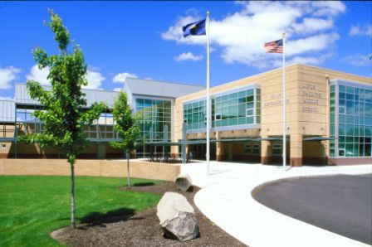
Linus Pauling Middle School
Corvallis Ore.

Slide 28
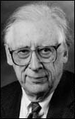
THE `FINAL’ SOLUTION
Solve this for c_{ij}
ψ= Σc_{ij} AO_{ij}
<ψ|H|ψ> = 0 ∀ c_{ij}
∂ c_{ij}
The Big Kahuna of the modern Numerical MO approach
Professor John Pople
Northwestern University:
gets it done….
(tenure: 1965-2005)
Aka: the God of Quantum Computation

Slide 29
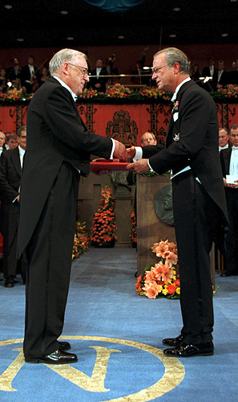
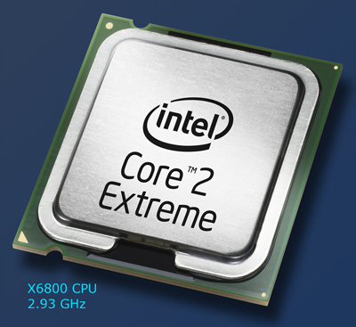
John A. Pople wins the Nobel Prize in Chemistry, 1998 "for his development of computational methods in quantum chemistry".
His un-named, but critical co-conspirator….

Slide 30
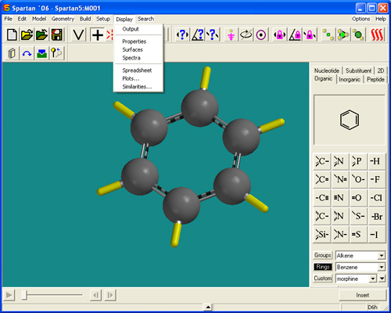
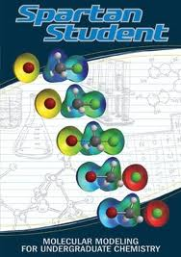
2016: Molecular Orbital Modeling done via `a black box’ with garden variety laptops
Demo ASC Spartan 8 `professional’ version

Slide 31
Hierarchy of electronic modeling methods
Most rigorous
Computer-based , numerical methods:
Molecular orbital methods (see p.19)
Ab initio methods (no assumptions about `field’ ..mostly for small, reactive molecules)
HF-SCF(Hartree-Fock Self-Consistent field model)*** Moeller-Plesset
Molecular Mechanical models
Extended Huckel (EHMO)*
Simple Huckel (MO)*
***done by Spartan Qchem package in-house..can be a quantum moron and still use to good effect ($700)
*Doc used these in the days of yore as grad student
Pauling LCAO Valence bond method
Lewis Model
HONC
Visual / intuitive methods
least rigorous

Slide 32

“Real” Organic Chem Begins Monday 12 Sept!!!!:
Start Reading Chapter 3-
Organic Compounds: Alkanes and Their Stereo Chemistry

