Slide 1
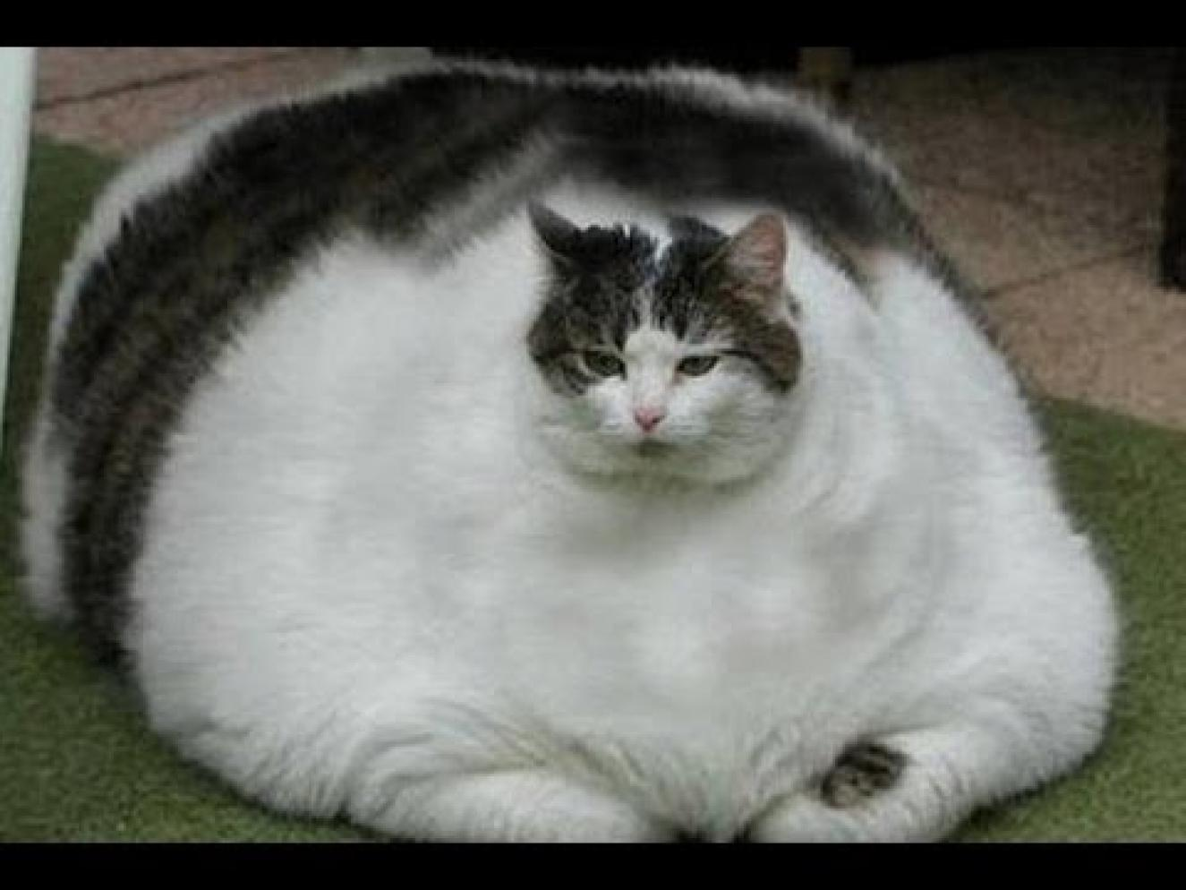
Chapter 6
Reactivity and Mechanism:
THE BIG PICTURE

Slide 2
The Big Picture…
The two `biggies’ that determine whether chemical reaction happens or not:
Thermodynamics
Kinetics

Slide 3
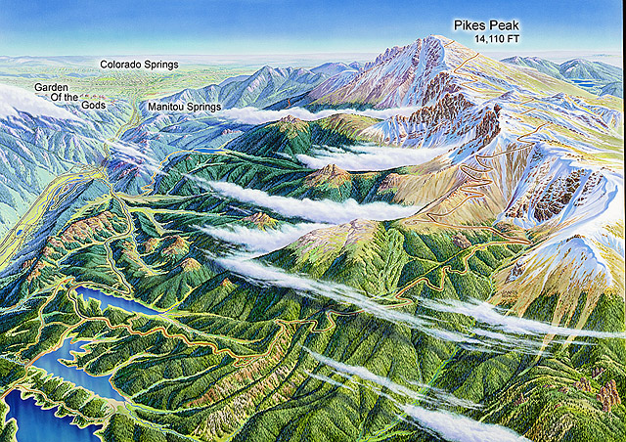
Thermodynamics vs. Kinetics:
A non-chemical analogy
Start trip here
14,110 ft
Go here
Δy
6035 ft
What’s the one constant for all three trips ?

Slide 4
The Big Picture…
Thermodynamic change is `path independent’.
Kinetic change is all about the path…
It’s how you get from here to there.

Slide 5
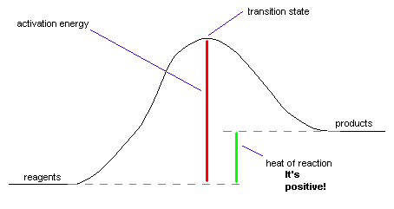
The Big Picture in Pictures:
Reaction Coordinate Energy Diagram
Transition state *
Activation energy, E_{act}
(depends on path)
The kinetic piece
The thermo. piece
Free energy, ΔG
a `state’ function
path independent

Slide 6
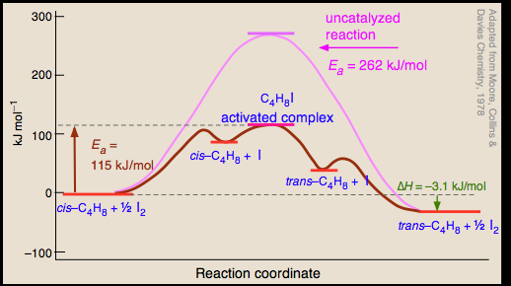
Different paths for same net reaction
Same net ΔG

Slide 7
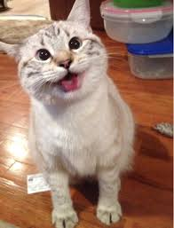

ΔHº > 0
products
reactants
ΔHº < 0
products
reactants
Exothermic: Heat comes out of system
=> wants to do this
Endothermic: Heat must be put into system
=> doesn’t want to do this

Slide 8
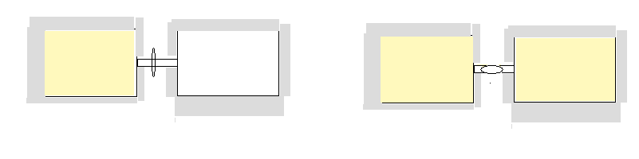
Evidence of something besides energy that drives processes:
Assume two boxes are connected by a stop cock and heavily insulated so that no energy goes in or out in either work or heat forms. Initially, one box is evacuated while the other has gas, with the stopcock closed.
What happens when the stopcock is turned to connect the two boxes ?
Both boxes fill and end up with equal concentrations of gas

Slide 9
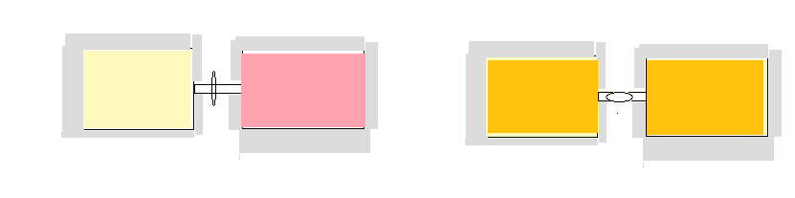
Similarly, if two different gases with equal energy are in two separate boxes , with stopcock closed, what happens when the stop cock opens ???
They mix until evenly distributed on both sides
WHY ???
WHAT `FORCE’ DRIVES THESE EFFECTS ?

Slide 10
The short answer: entropy = S
S is loosely a measure of `system’ chaos
S is more precisely a measure of the degrees of freedom of a system=#`microstates’
(see text Fig 6.5- penny example)

Slide 11

The tendency of S is reflected in the 2nd Law of Thermodynamics and Boltzmann’s equation
dS > δQ/T
S=k ln W
2nd Law in a nutshell
Boltzmann’s eq.
In English…entropy always tends to a maximum:
ΔS _{system} +ΔS_{surroundings} > 0

Slide 12
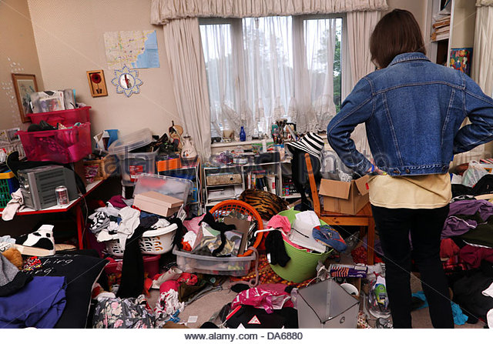
Homespun non-chemical analogies
#1) My teenage daughter’s bedroom 1 day after her Mom cleaned it up

Slide 13
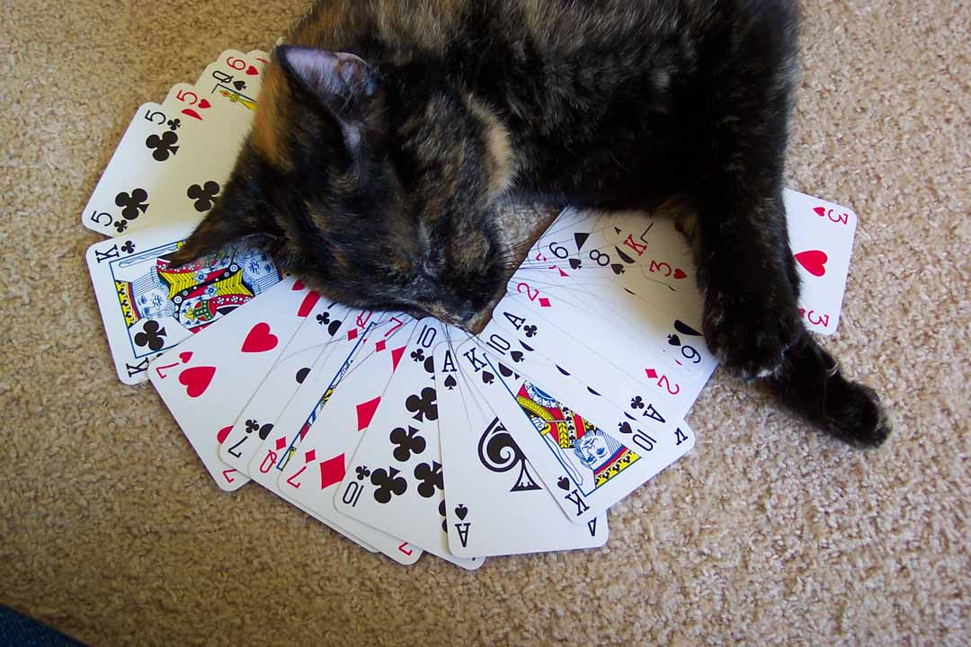
Homespun non-chemical analogies (continued)
2) 52- pick-up

Slide 14
Two more verbally down-to-earth versions of 2nd Law
1) Everything eventually goes to shit.
2) From my Dad (among others…)
“Life’s a bitch,
then you marry her,
then you die….”

Slide 15
In-class exercises deciding if entropy increasing or decreasing
Glass of water freezing
Heating a pot of coffee
Recrystallization of solid
Spilling a glass of water
Salt dissolving into a glass of water

Slide 16
A conundrum:
when a system loses heat, it becomes more ordered….
A chemical system’s `desire’ to become more chaotic is thus counterbalanced by the desire to lose energy …

Slide 17
These two opposing forces are expressed as Gibbs Free energy (at constant P), ΔG
ΔG = ΔH - TΔS
A reaction is predicted to be spontaneous if ΔG < 0
(exergonic)
A reaction is predicted to be non-spontaneous if ΔG > 0
(endergonic)

Slide 18
Guess the sign of ΔH and ΔS for the reactions below
2C₇H₅N₃O₈ → 3N₂ +5H₂O + 7CO₂ + 7C + 1084 kJ/mol
TNT
4C₃H₅N₃O₉ → 6N₂ +10H₂O + 12CO + 7O₂ + 1414 kJ/mol
Nitroglycerin

Slide 19
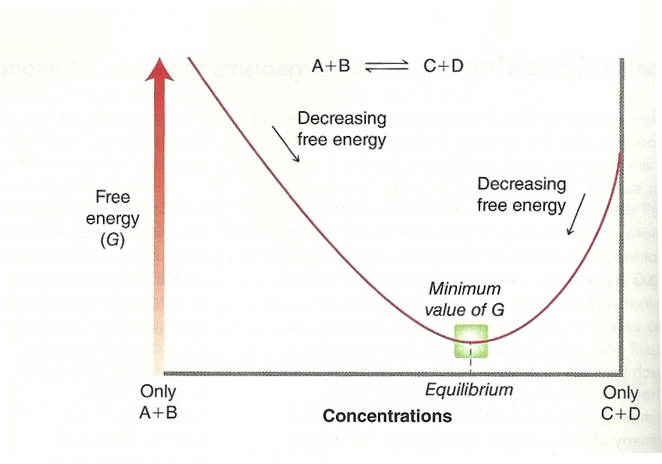
Equilibrium and ΔG: why you always have both reactant and products in the mix: I pusha you, you pusha me back
Chatelier’s Principle

Slide 20
Equilibrium and ΔG: Why you always have both reactant and products in the mix: math insights
dG_{eq} =0 = dH -TdS
dH=TdS
=>K_{eq}= [C]_{eq}[D]_{eq}
[A]_{eq}[B]_{eq}
K_{eq} = 10 ^{-ΔG/RT}

Slide 21
numeric insights on ΔG , K and product formation
R→ P
K_{eq} = 10 ^{-ΔG/RT}
ΔGº (kJ/mol)
K_{eq}=[P]_{eq} / [R]_{eq}
%P
-17
1000
99
-6
10
90
0
1
50
+17
0.001
0.1

Slide 22
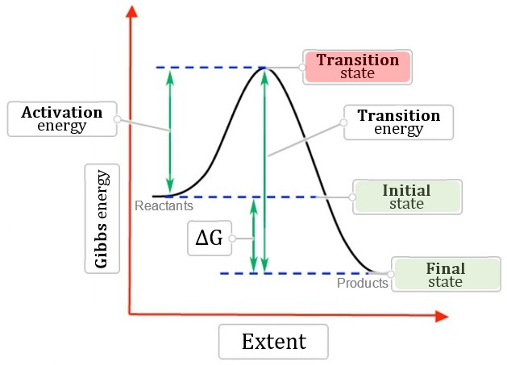
Kinetic Piece
Thermo. piece

Slide 23
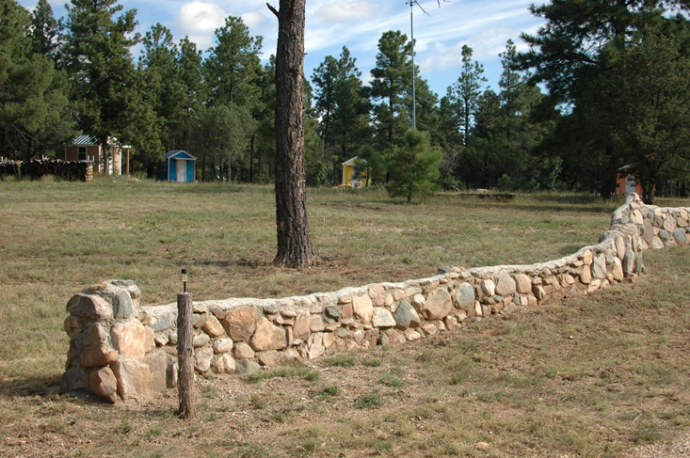
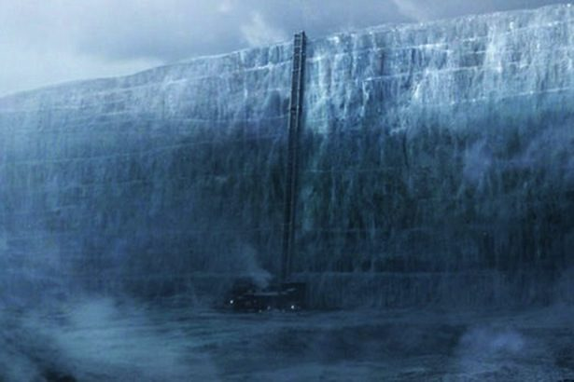
Think of activation energy, E_{act} ,as a `barrier’ preventing spontaneous reaction
Low activation barrier energy
High activation barrier energy

Slide 24


