Slide 1
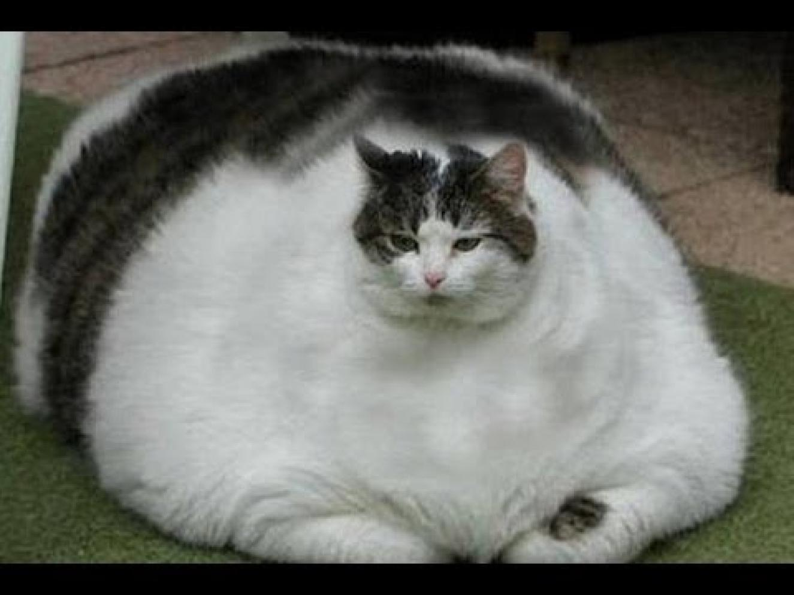
Chapter 6
Reactivity and Mechanism:
THE BIG PICTURE

Slide 2
The Big Picture…
The two `biggies’ that determine whether chemical reaction happens or not:
Thermodynamics
Kinetics

Slide 3
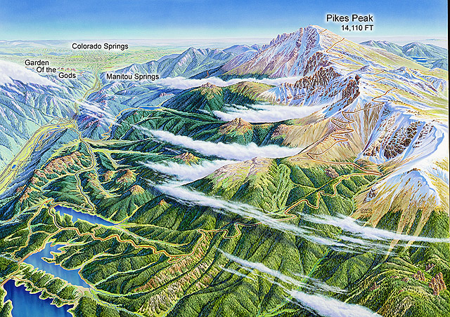
Thermodynamics vs. Kinetics:
A non-chemical analogy
Start trip here
14,110 ft
Go here
Δy
6035 ft
What’s the one constant for all three trips ?

Slide 4
The Big Picture…
Thermodynamic change is `path independent’.
Kinetic change is all about the path…
It’s how you get from here to there.

Slide 5
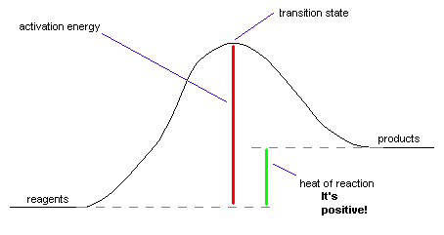
The Big Picture in Pictures:
Reaction Coordinate Energy Diagram
Transition state *
Activation energy, E_{act}
(depends on path)
The kinetic piece
The thermo. piece
Free energy, ΔG
a `state’ function
path independent

Slide 6
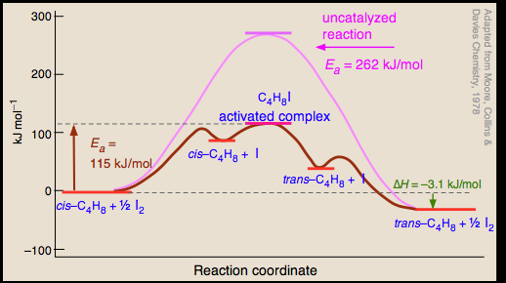
Different paths for same net reaction
Same net ΔG

Slide 7
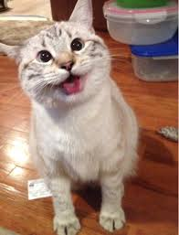
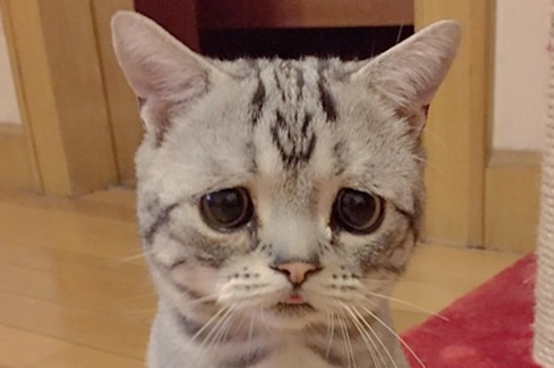
ΔHº > 0
products
reactants
ΔHº < 0
products
reactants
Exothermic: Heat comes out of system
=> wants to do this
Endothermic: Heat must be put into system
=> doesn’t want to do this

Slide 8
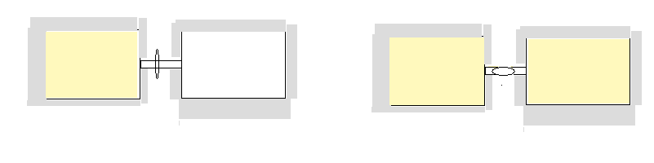
Evidence of something besides energy that drives processes:
Assume two boxes are connected by a stop cock and heavily insulated so that no energy goes in or out in either work or heat forms. Initially, one box is evacuated while the other has gas, with the stopcock closed.
What happens when the stopcock is turned to connect the two boxes ?
Both boxes fill and end up with equal concentrations of gas

Slide 9
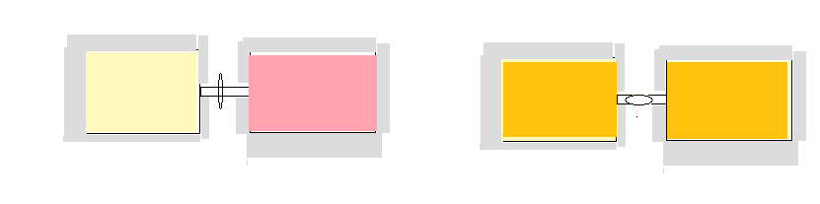
Similarly, if two different gases with equal energy are in two separate boxes , with stopcock closed, what happens when the stop cock opens ???
They mix until evenly distributed on both sides
WHY ???
WHAT `FORCE’ DRIVES THESE EFFECTS ?

Slide 10
The short answer: entropy = S
S is loosely a measure of `system’ chaos
S is more precisely a measure of the degrees of freedom of a system=#`microstates’
(see text Fig 6.5- penny example)

Slide 11
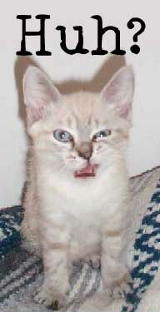
The tendency of S is reflected in the 2nd Law of Thermodynamics and Boltzmann’s equation
dS > δQ/T
S=k ln W
2nd Law in a nutshell
Boltzmann’s eq.
In English…entropy always tends to a maximum:
ΔS _{system} +ΔS_{surroundings} > 0

Slide 12
