Slide 1
The short answer: entropy = S
S is loosely a measure of `system’ chaos
S is more precisely a measure of the degrees of freedom of a system=#`microstates’
(see text Fig 6.5- penny example)

Slide 2

The tendency of S is reflected in the 2nd Law of Thermodynamics and Boltzmann’s equation
dS > δQ/T
S=k ln W
2nd Law in a nutshell
Boltzmann’s eq.
In English…entropy always tends to a maximum:
ΔS _{system} +ΔS_{surroundings} > 0

Slide 3
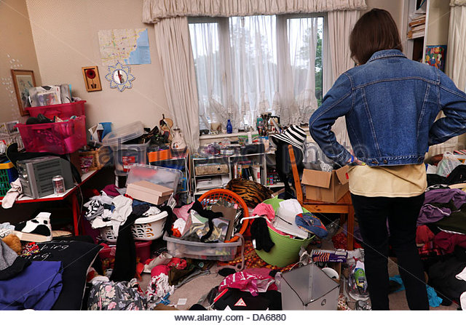
Homespun non-chemical analogies
#1) My teenage daughter’s bedroom 1 day after her Mom cleaned it up

Slide 4
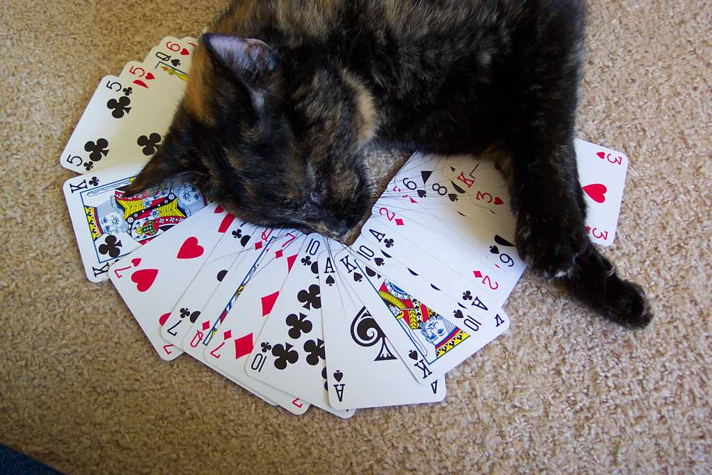
Homespun non-chemical analogies (continued)
2) 52- pick-up

Slide 5
Two verbally down-to-earth versions of 2nd Law
1) Everything eventually goes to shit.
2) From my Dad (among others…)
“Life’s a bitch,
then you marry her,
then you die….”

Slide 6
ΔS _{system} +ΔS_{surroundings} = 0
The only time
…is when heat and work are exchange infinitely slowly between them….a condition referred to as a reversible change

Slide 7
In-class exercises deciding if entropy increasing or decreasing
Glass of water freezing
Heating a pot of coffee
Recrystallization of solid
Spilling a glass of water
Salt dissolving into a glass of water

Slide 8
A conundrum:
when a system loses heat, it becomes more ordered….
A chemical system’s `desire’ to become more chaotic is thus counterbalanced by the desire to lose energy …

Slide 9
These two opposing forces are expressed as Gibbs Free energy (at constant P), ΔG
ΔG = ΔH - TΔS
A reaction is predicted to be spontaneous if ΔG < 0
(exergonic)
A reaction is predicted to be non-spontaneous if ΔG > 0
(endergonic)

Slide 10
Guess the sign of ΔH and ΔS for the reactions below
2C₇H₅N₃O₈ → 3N₂ +5H₂O + 7CO₂ + 7C + 1084 kJ/mol
TNT
4C₃H₅N₃O₉ → 6N₂ +10H₂O + 12CO + 7O₂ + 1414 kJ/mol
Nitroglycerin

Slide 11
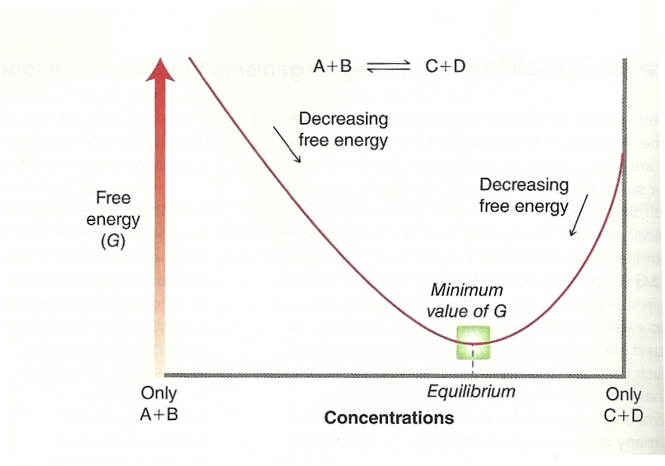
Equilibrium and ΔG: why you always have both reactant and products in the mix: I pusha you, you pusha me back
Chatelier’s Principle

Slide 12
Equilibrium and ΔG: Why you always have both reactant and products in the mix: math insights
dG_{eq} =0 = dH -TdS
dH=TdS
=>K_{eq}= [C]_{eq}[D]_{eq}
[A]_{eq}[B]_{eq}
K_{eq} = 10 ^{-ΔG/RT}

Slide 13
numeric insights on ΔG , K and product formation
R→ P
K_{eq} = 10 ^{-ΔG/RT}
ΔGº (kJ/mol)
K_{eq}=[P]_{eq} / [R]_{eq}
%P
-17
1000
99
-6
10
90
0
1
50
+17
0.001
0.1

Slide 14
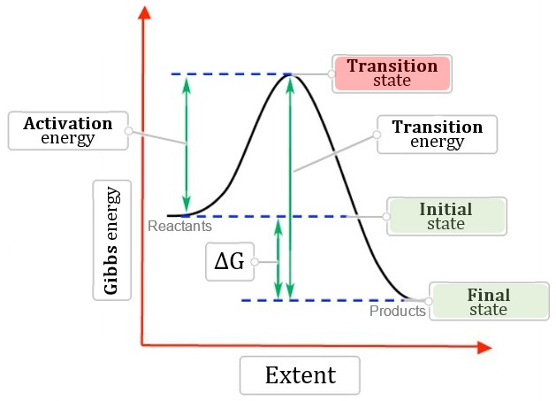
Kinetic Piece
E_{act}
Thermo. piece

Slide 15
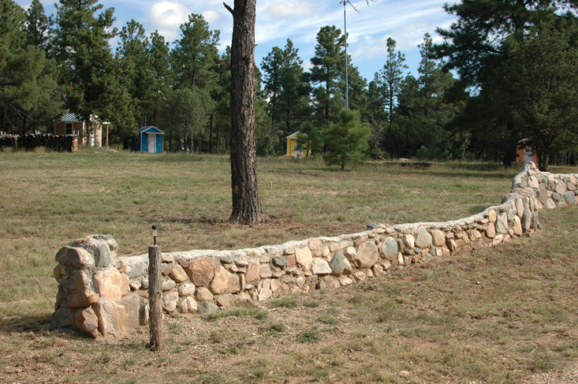
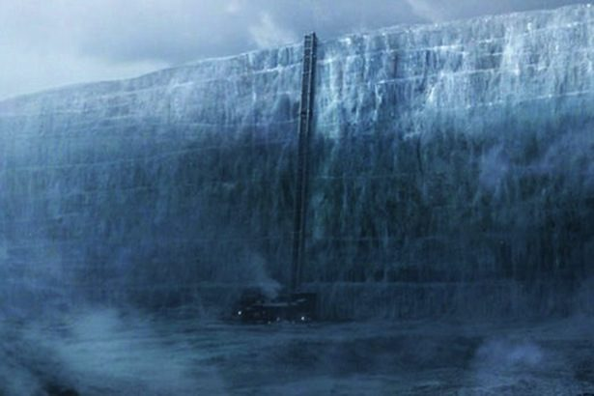
Think of activation energy, E_{act} ,as a `barrier’ preventing spontaneous reaction
Low activation barrier energy
High activation barrier energy

Slide 16

The E_{act} represents the minimum energy that must be available to a molecule during a collision (or internally if self-destructing).
Reaction rate, R , measured as the change in concentration of a product or reactant in time:
R~ Δ[ X ]/Δt
R reflects E_{act}, temperature, concentration & molecular geometry

Slide 17
How Eact, T and concentration are connected to reaction rate: `first order’ (uni-molecular rate) example
Bob
Babs
R= rate of Babs appearance
= k*[Bob]
k=rate constant
=A*exp (-E_{act}/kT)
The pre-exponent, A contains `collisional’ frequencies and cross sections as well as geometry/steric effects`

Slide 18
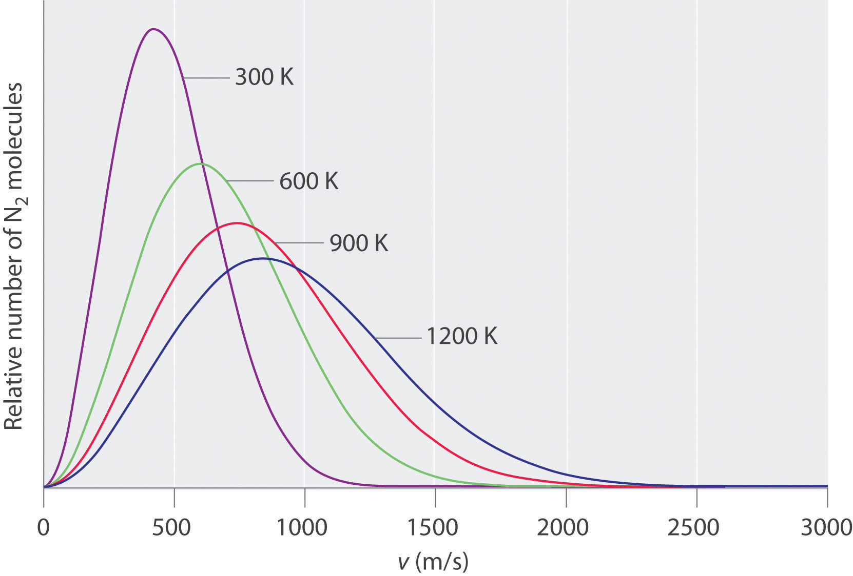
Part of what’s contained in pre-exponent A’
Hypothetical threshold molecular speed to get molecules to start to interact (see also fig. 6.16 of text)

Slide 19

Example of a second order (bimolecular) reaction
+
Bob
Biff
R= rate of Cat appearance
= k*[Bob][Biff]
k=rate constant
Still =A*exp (-E_{act}/kT)

