Slide 1
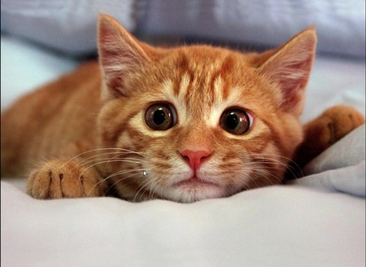
S_{N}1 and S_{N}2 drill and practice
Pleez don’t picks meh

Slide 2
Name of positive species the nucleophile attacks in either S_{N}1 or S_{N}2 halogenation of ROH
ROH₂⁺ protonated alcohol
Mechanism features aprotic, modestly polar solvents
S_{N}2
Racemization happens with this mechanism
S_{N}2
Mechanism for halogenation of 1º alcohols
S_{N}2
Which mechanism features rearrangement ?
S_{N}1
Order of halogen reactivity in S_{N}2 substitution on ROH
I > Br> Cl > F
2 in S_{N}2 stands for…
Bimolecular rate determining step

Slide 3
1º
Inversion occurs for ________________ alcohols during halogenation
Order of ROH reactivity during halogenation
3º > 2º > 1º < 0º
S_{N}1 prefers what kind of solvent ?
Polar, protic solvents
Name of key intermediate formed in S_{N}1
carbocation
Name of key transition state formed in S_{N}2 ?
5-coordinated, activated complex

Slide 4
What two experimental conditions forces protonated alcohol concentrations higher during halide substitution on ROH ?
Excess H₂SO₄ and reflux
Mechanism governing the reaction below ?
S_{N}2
In bromination of ROH what is the nucleophile?
Br⁻
In bromination of ROH, what is the substrate the nucleophile seeks ?
ROH₂⁺

Slide 5
Rearrangement ??
No. 1º ROH runs S_{N}2
Rearrangement ??
No. No higher degree carbocation possible, even though 2º runs S_{N}1
Rearrangement ??
Yes. Runs S_{N}1 and higher carbocation site possible

Slide 6
Draw all likely products of reaction below:
Which product is more likely in the above reaction ?
????
Which is the rearrangement product in above?
Which is the major product in the above reaction?

Slide 7


