Slide 1
Functional Group Identification Practice
I am a:
aldehyde
Carboxylic acid

Slide 2
I am a…
Alcohol
alkane
ketone

Slide 3
Multiple guess
Which is the acid chloride ?
Which is the ester ?
RCOR’
RCOOH
RCHO
RCOOR’
Which is the amine ?

Slide 4
Multiple multiple guess
Several of us are amides. Who are we ?
Several of us are ethers. Who are we ?

Slide 5

Not it…
Some of us are not alcohols ? Who are we ?
Organic peroxide (boom !)
ester
Carboxylic acid
What am I , really ?
What am I , really ?
What about me ???

Slide 6
Speed dating
R-Y abbreviation full name of compound type
R-Cl
RCOCl
R-H
ROR’
RCOOR’
RCONH₂
Alkyl halide
Acid chloride
Alkane
Ether
Ether
amide

Slide 7
Backwards Speed dating R…???
R-Y abbreviation full name of compound type
R-OH
RCOOH
RNH₂
RCOR’
RCHO
Alcohol
Carboxylic acid
Amine
Ketone
Aldehyde

Slide 8
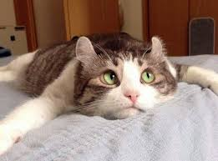
Is it too late to quit this class and take a nice nap ?

