Slide 1
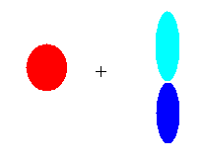



Visualizing Hybridization: AO→ LCAO →bond
s and p AO on isolated C
1) Isolated AO on atoms approach each other from afar….
2) Isolated AO disappear and are re-formed into equal LCAO lobes as each atom `sees’ the other
LCAO re-formed from AO on separate atoms
Sigma bond
Un-overlapped lobe
Un-overlapped lobe
3a) Two atoms get closer
3b) 2 LCAO near each other overlap…reform into a `sigma’ bond.
3c) un-overlapped lobes can bond to something else
s and p AO on isolated C

Slide 2
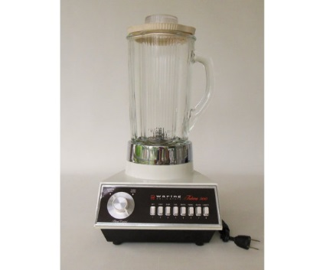
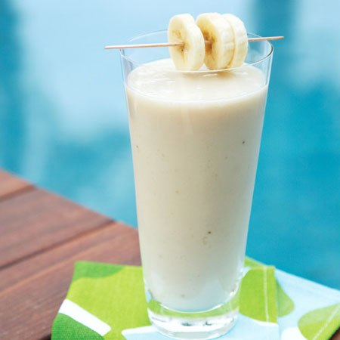
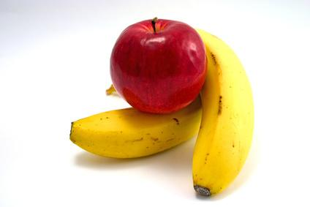
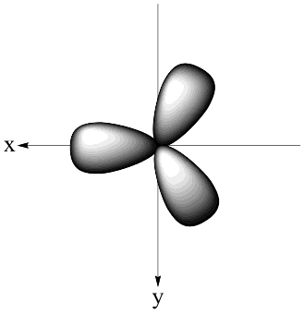
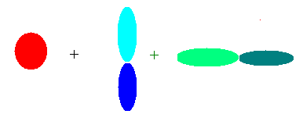
Hybridization is like using a blender……
s+ p_{x} +p_{y}
AO in
sp² smoothy out
Quantum Math Blender

Slide 3
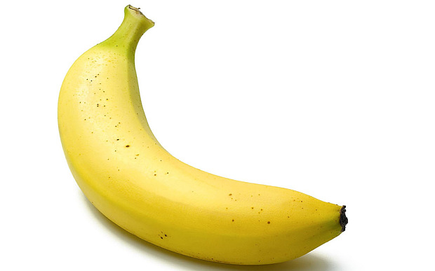
s + p_{x} + p_{y}
sp²
Sometimes there’s an extra banana (or two)…what to do ?

Slide 4
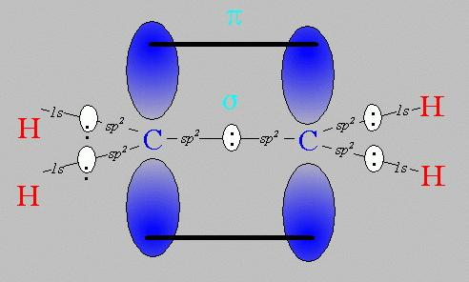
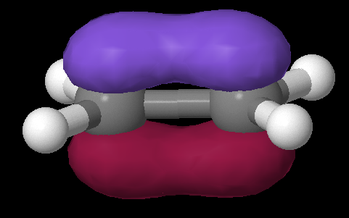
Pi bonds: Pauling’s really great idea to use the `leftovers’
Equivalent Pauling `sigma’ (σ) hybrid structure
Ethene (C₂H₄) Lewis picture
σ
1 leftover p_{z} on each C
sp²
sp²
s+ p_{x} + p_{y}
s+ p_{x} + p_{y}
z
π
x
σ
y

Slide 5
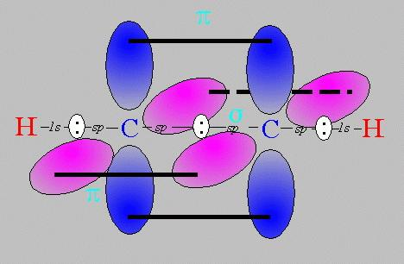
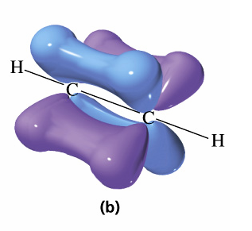
Pi bonds: Pauling’s really great idea to use the `leftovers’ (cont.)
Equivalent Pauling `sigma’ (σ) hybrid structure
Ethyne (C₂H₂) Lewis picture
σ
sp
sp
2 leftover p_{z} on each C
s+ p_{x}
s+ p_{x}
z
π
Z
x
σ
π
x
y
y

Slide 6
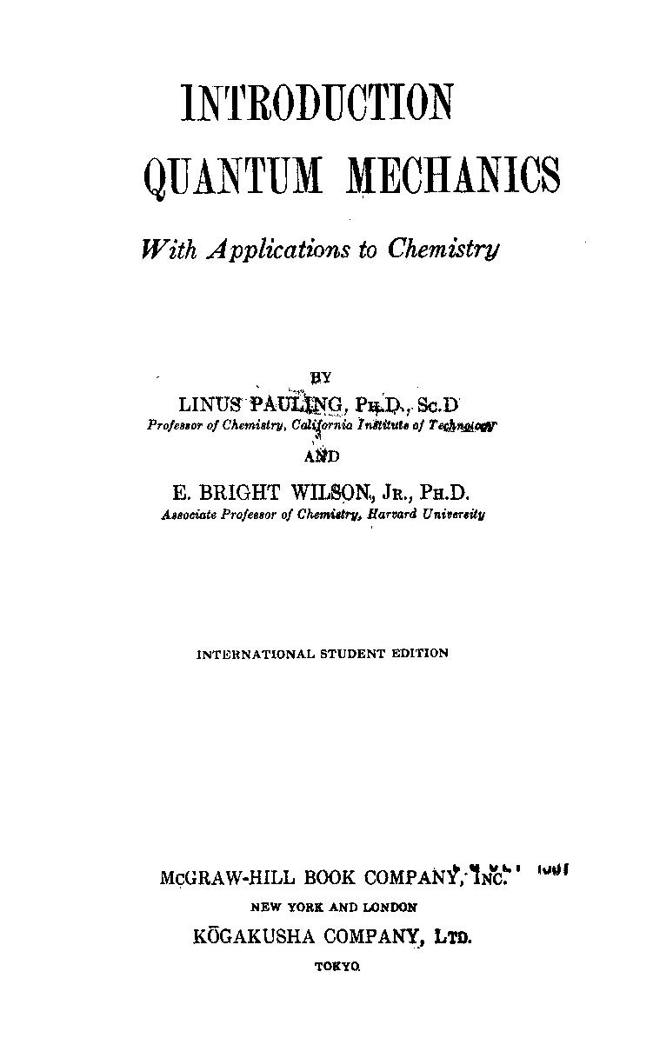

Slide 7
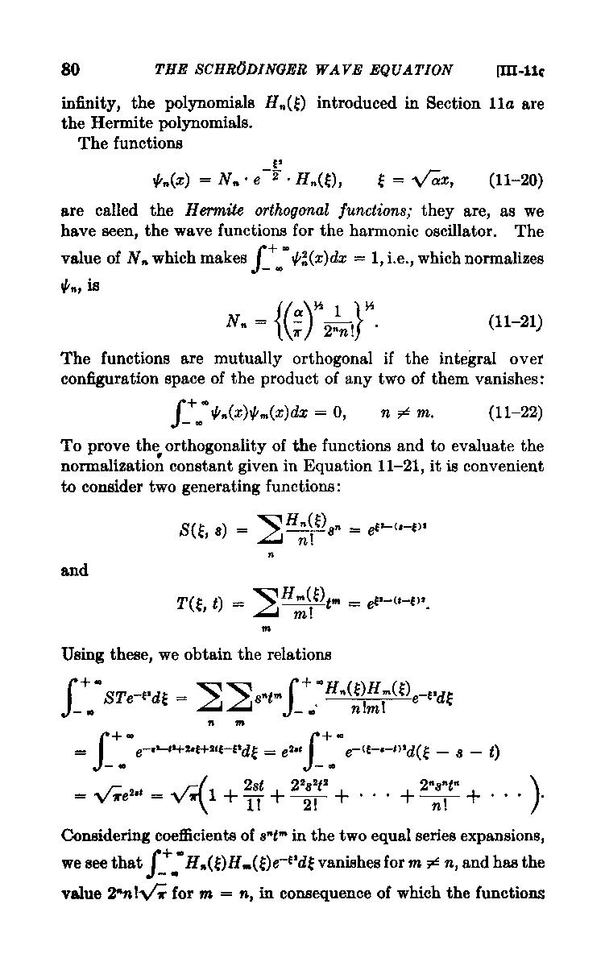

Slide 8
USING THE PAULING MODEL:
IN CLASS EXERCISE 3

Slide 9
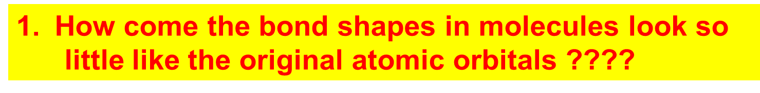
How Pauling’s model `fixes’ the problems with Lewis model
Atomic orbitals (AO) `reorganize’ (hybridize) when individual atoms approach each other such that the number of `links’ predicted by the Lewis model = the number of s, p (and d and f) orbitals combined in the reorganization. The `hybrid’ combinations are called Linear Combinations of Atomic Orbitals (LCAO). The `lobes’ in LCAO on individual atoms overlap and share two electrons between the atoms in a `sigma’ bond (often called a `valence’ or structural linkage bond.)

Slide 10
How Pauling’s model `fixes’ the problems with Lewis model
(continued)
2. How does octet model account for the observed reactivity trend of ethane vs ethene vs ethyne with halogens and ozone ?
`pi’ bonds are far less stable and far more reactive than sigma bonds. (Further out, softer, not between atoms but above and below) Ethane is held together by just `sigma bonds and is thus not very reactive.
Both ethylene and acetylene have pi bonds which are easily reacted. That acetylene is more reactive thane ethylene results because it has 2 pi bonds while ethylene has only 1 pi bond

Slide 11
How Pauling’s model `fixes’ the problems with Lewis model
(continued)
3. How can you get all those electrons between
carbons in double and triple bonds ? Don’t they repel ?
The pi bonds occupy space above and below the sigma bond and thus do not crowd them. The two pi bonds are also on different and perpendicularly aligned planes to minimize pi-pi crowding.

Slide 12
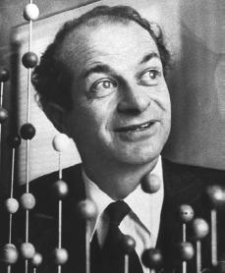
Linus Pauling
An American Chemical Genius
“I am awesome
( and kinda cute in a geeky way…)”
…one of the heroes of my chemical youth…
I
PAULING

Slide 13
Keen intuition + mathematical rigor + outside the box thinking + he’s was a really nice guy and an inspired teacher!
FYI: You are all the great grandchildren of Linus Pauling !!!

Slide 14
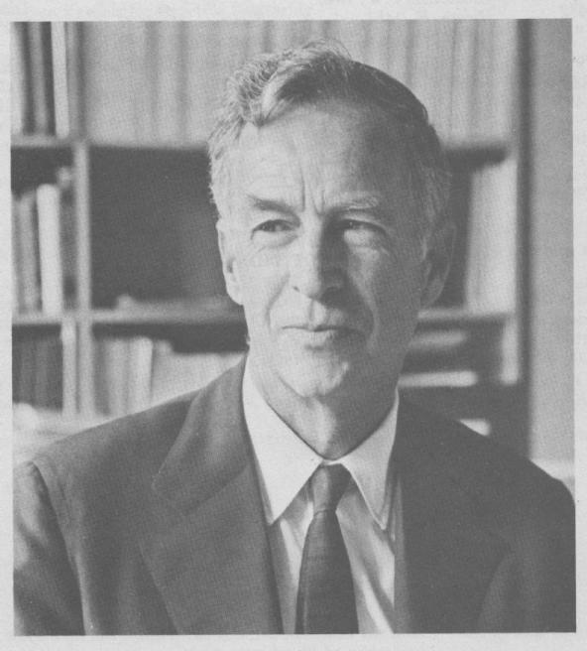
E. Bright Wilson
Harvard University, Chemistry
National Medal of Science 1975
T.W. Richards Endowed Chair
Linus Pauling
Cal Tech, Chemistry
Nobel Prize in Chemistry 1954
Nobel Peace Prize 1962

Slide 15
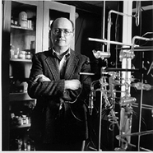

YOU !
‘Doc’ Fong
Senior Chemist
SUNY Alfred State Chemistry
(and nut case)
R. L. Kuczkowski
University of Michigan, Chemistry
Department Chair

Slide 16
Problems with Pauling Valence Bond (LCAO) Model: 1955
Fails to provide procedure to determine the numeric details of molecular energy and spectra
translation…can’t compute a stinking thing

Slide 17
Problems with Pauling Valence Bond (LCAO) Model: 1955
Doesn’t allow adjustments for changes of atoms bonded to the central atom
Example: can’t distinguish electronic shape or density of CH₄ vs CF₄ except with `electronegativity’ and vague sketches

Slide 18

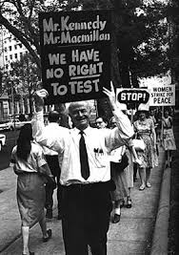
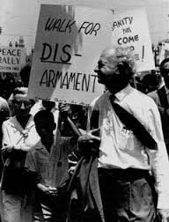
So what ! I’m famous and my theory is still the go-to-theory for number-challenged organic chemists…”

Slide 19
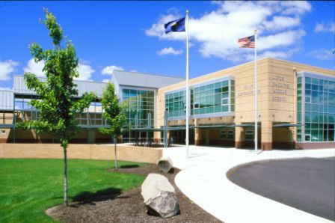
Linus Pauling Middle School
Corvallis Ore.

Slide 20
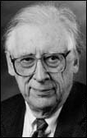
THE `FINAL’ SOLUTION
Solve this for c_{ij}
ψ= Σc_{ij} AO_{ij}
<ψ|H|ψ> = 0 ∀ c_{ij}
∂ c_{ij}
The Big Kahuna of the modern Numerical MO approach
Professor John Pople
Northwestern University:
gets it done….
(tenure: 1965-2005)
Aka: the God of Quantum Computation

Slide 21
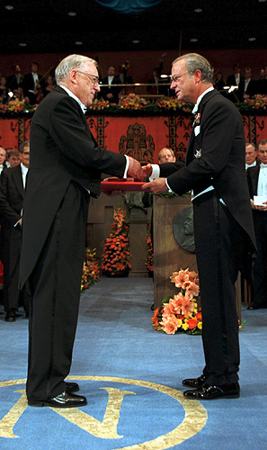
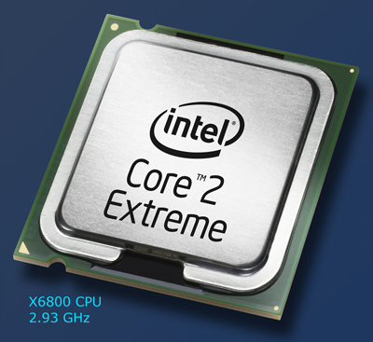
John A. Pople wins the Nobel Prize in Chemistry, 1998 "for his development of computational methods in quantum chemistry".
His un-named, but critical co-conspirator….

Slide 22
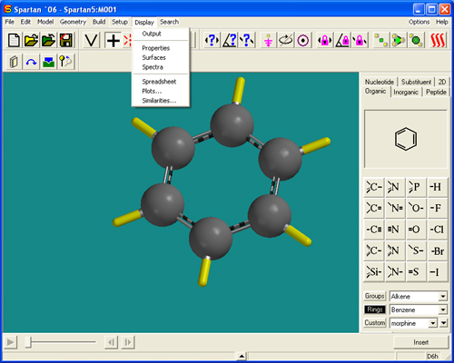
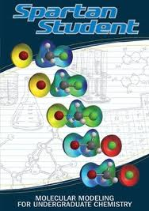
2015: Molecular Orbital Modeling done via `a black box’ with garden variety laptops
Demo ASC Spartan 8 `professional’ version

Slide 23
Hierarchy of electronic modeling methods
Most rigorous
Computer-based , numerical methods:
Molecular orbital methods (see p.19)
Ab initio methods (no assumptions about `field’ ..mostly for small, reactive molecules)
HF-SCF(Hartree-Fock Self-Consistent field model)*** Moeller-Plesset
Molecular Mechanical models
Extended Huckel (EHMO)*
Simple Huckel (MO)*
***done by Spartan Qchem package in-house..can be a quantum moron and still use to good effect ($700)
*Doc used these in the days of yore as grad student
Pauling LCAO Valence bond method
Lewis Model
HONC
Visual / intuitive methods
least rigorous

Slide 24

“Real” Organic Chem Begins Monday 9/14 !!!!:
Start Reading Chapter 3-
Organic Compounds: Alkanes and Their Stereo Chemistry

