Slide 1
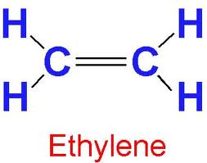
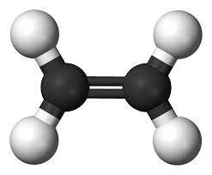
The usual 2D picture
Introduction to alkenes
(one of Doc’s thesis areas)
Ball and stick model

Slide 2
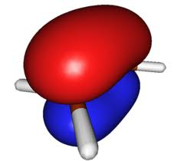
A better way to think of ethylene:
The big, fat π system is the main thing…
π bond
σ system (help me! help me !)
Flat sp² sigma (σ) structure bonds squished inside by π and rendered chemically irrelevant

Slide 3
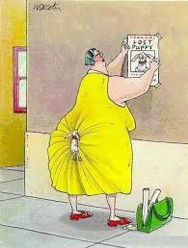
Cartoon rendition of σ and π
π
σ

Slide 4
Rough Reactivity order in most cases
π >>>>> lone pairs > 3>2>1>0

Slide 5
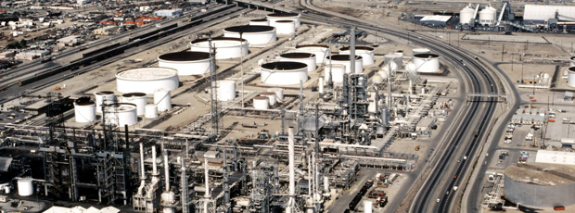
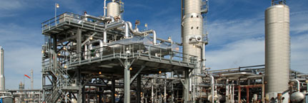
STEAM-CRACKING TO ALKENES: INTRODUCTION TO INDUSTRIAL SYNTHESIS
C2-C8 alkanes
-253 -104 -47 -6º C bp
Fluor Corporation Cracking and
Fractionating facility St. Romuald,
Quebec, Canada
ONEOK Hydrocarbon fractionator facility
Bushton, Kansas, USA

Slide 6
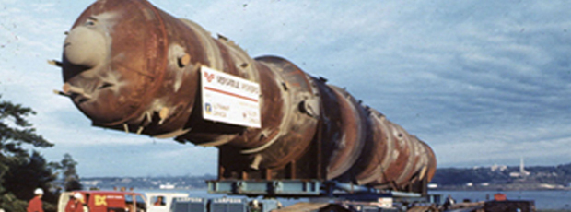
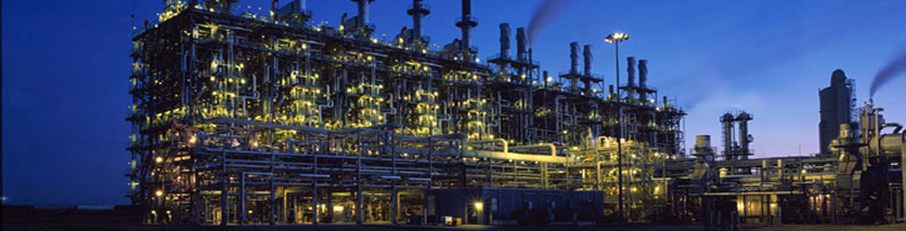
Synthetic and refined chemical sales account for a large fraction of the USA’s exports
INDUSTRIAL CHEMISTRY IS AN ENORMOUS, BIG PROFITABLE BUSINESS….
A single fractionating column for hydrocarbon cracking
Example of Industrial Scale Chemistry
Just ethylene sales: ~ 200 billion $/year
Production ~ 200 million tons/year
(FYI ~800 billion tons of gasoline were used in the US in 2010)
A Steam cracking facility somewhere in Texas

