Slide 1
Rough Lewis predictions for reactivity trends (Supplement 2)
octet octet octet octet no octet
no lone pairs no lone pairs lone pairs lone pairs
no charge no charge no charge charge
no dipole dipole dipole
EXAMPLES
  CH₄ CH₃-CH-CH₃ :NH₃ HC≡C: ⁻ HOO* Br*
CH₃*
Reactivity increases to right

Slide 2
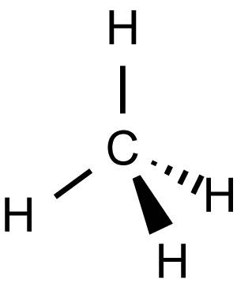
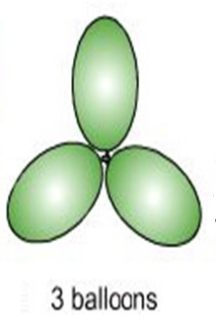
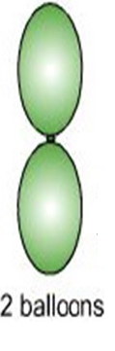
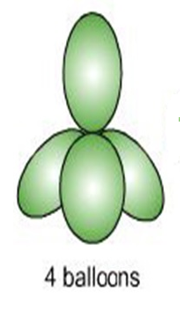
Lewis Model Correctly Predicts Molecular Shape
(VSEPR theory : electron clouds are balloons)
:N≡N:
TRIGONAL PLANAR
LINEAR
TETRAHEDRON

Slide 3
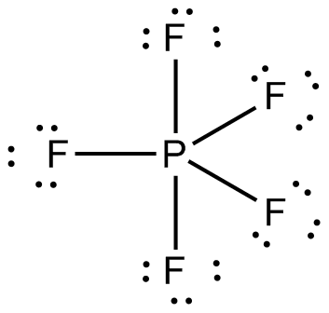
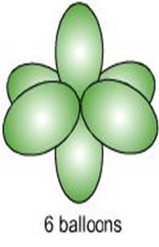
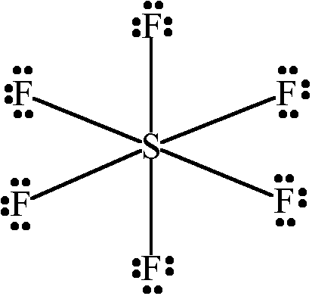
TRIGONAL BIPYRAMID
OCTAHEDRON

Slide 4
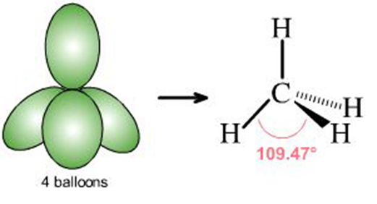
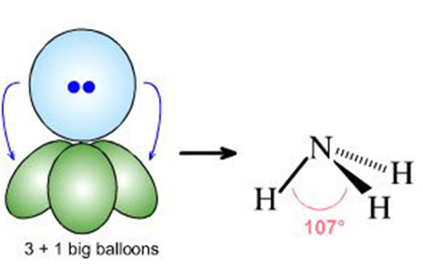
What if lone pairs take up some of the balloon space ?
No lone pairs: 4 bonds to atoms
Pyramid or tetrahedron
1 lone pair + 3 bonds to atoms
Trigonal pyramid

Slide 5
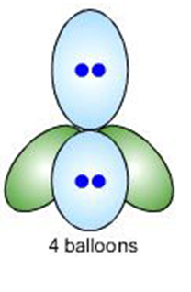
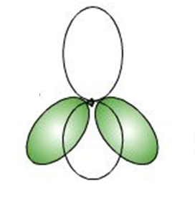
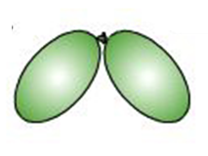
2 lone pairs + 2 bonds to atoms
Chemical example
Bent structure

Slide 6
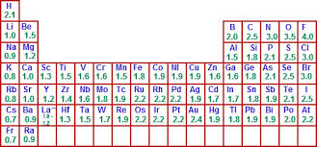
Electronegativity is a measure of how badly a given element wants to steal electrons from its neighbors. It guides predictions for dipole directions
(CH₃OH example)

Slide 7
EXERCISE 2.1 : Dipoles ??? YES OR NO ?
CF₄ F₂C=CH₂ CO₂ CBr₂H₂ CH₂=CH₂
YES
NO
YES
NO
NO

Slide 8
From exercise 2.2: Which end of these molecules is the `attacking’ end ?

Slide 9
2.3. Order the compounds below from least to most reactive
based simply on charge separation trends
CH₄ CH₃ Cl CH₂Cl₂ CCl₄
reactivity= | LEAST | MODEST | HIGH | MOST
MOLECULE
COMMENT | home use | cleaning solvent | EPA hit list | Ozone killer
CH₄
CCl₄
CH₃Cl
CH₂Cl₂
Octet ?
Dipole?
Charge ?
Lone pairs?
Yes
No
No
No
Yes
No
No
Yes
Yes
Yes (1.8)
No
Yes (3 pairs)
Yes
Yes (1.6)
No
Yes (6 pairs)

Slide 10
Summary of Lewis Model successes
Provides simple process leading to sensible predictions of electronic distributions in most (but not all) compounds in both ground and excited states (Lewis rules)

Slide 11
Summary of Lewis Model successes
2) Lewis structures lead to simple and accurate predictions of molecular shapes (VSEPR)

Slide 12
Summary of Lewis Model successes
3) Lewis predictions of electronic distributions provide simple way to predict chemical interaction and relative stabilities, and provides basis for general acid-base model of reactivity. (Supplement 2)

Slide 13
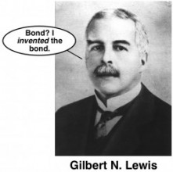
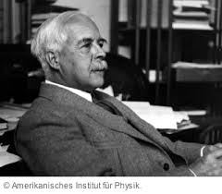

“I rock.”
Gilbert Newton Lewis
America is now land of chemistry’s mega super star

Slide 14
ISSUES WITH THE LEWIS OCTET MODEL
(the nitpicking starts…)
How come the bond shapes in molecules look so
little like the original atomic orbitals ????
2. How does octet model account for the observed reactivity trend of ethane vs. ethene vs ethyne with halogens and ozone ?
3. How can you get all those electrons between carbons in double and triple bonds ? Don’t they repel ?

Slide 15
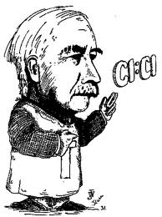
LEWIS MODEL HAS INCONSISTENCIES
WHICH HE DOESN’T BOTHER TO ADDRESS
Oh fudge off…

Slide 16
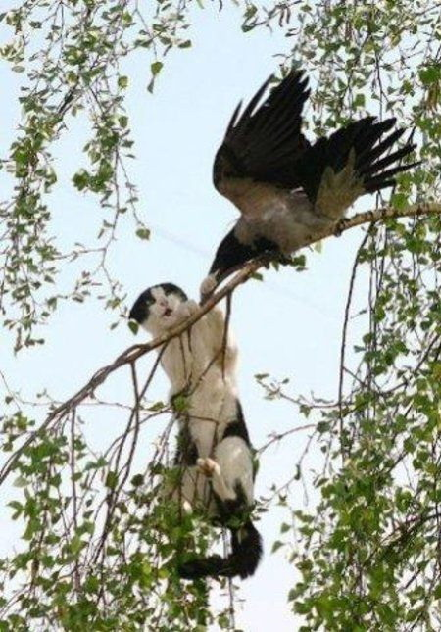
SO NOW
WHAT ?

Slide 17
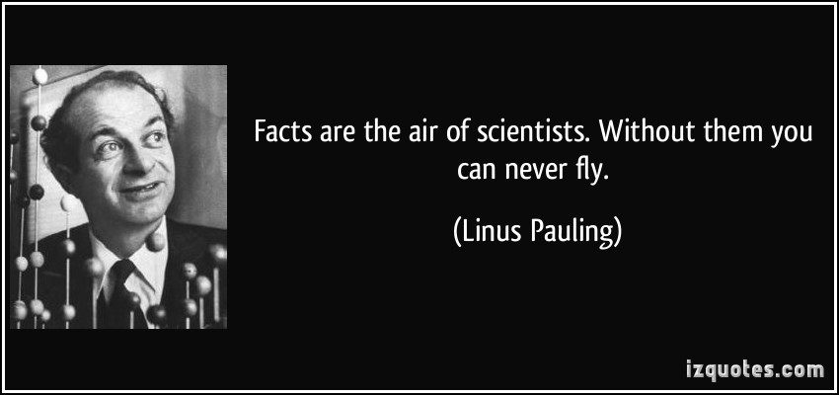
Eventually, another All- American “Superer Duperer” Chemistry Star swoops in and fixes everything (for a while)

Slide 18
Pauling goes back to the Chemist’s drawing board….
s
p
1
2
3
4
5
6
7
d
f

Slide 19
Pauling’s `Localized’ Valence Bond Hybridization Model
PAULING’S INSIGHTS
Lewis isn’t `wrong’….he just hasn’t :
considered the role of the valence s, p, d… orbitals play
realized that all bonds are not the same.

Slide 20
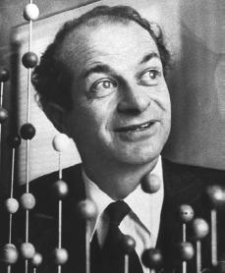
Linus Pauling fixes every criticism with Valence Bond or Atomic Orbital Hybridization model
a) Atomic orbitals (AO) `reorganize as they approach each other
s + np = sp^{n} ⇒ n+1 equal hybrid molecular bonding lobes
(# AO combined = # molecular `bonding lobes’ )
c) Bonding Lobes overlap between atoms to form bonds (2 e⁻ bond)
d) Hybrid bonds more stable than unhybridized alternatives (`variational principle of quantum chemistry…diversity breeds stronger bonds…)

Slide 21
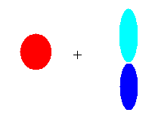

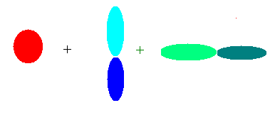
Images of hybrid sigma bond formation
#AO = number of identical lobes in LCAO
Atomic orbitals (AO)
Linearly Combined Atomic Orbitals (LCAO)
linear
sp
2s 2p_{y}
trigonal plane
pyramid
2s 2p_{y} 2p_{x}
sp²
2s 2p_{y} 2p_{x} 2p_{z}
sp³

Slide 22
A note about ` lobes’:
A lobe can contain either a bond or a lone pair
CH₄ = 4 C-H bonds => 4 lobes
=> s+ p_{x} + p_{y} + p_{z} = sp³
NH₃ =
H
|
:N-H
|
H
= 3 bonds + 1 lone pair => 4 lobes
=> s+ p_{x} + p_{y} + p_{z} = sp³

Slide 23


Visualizing Hybridization: AO→ LCAO →bond
s and p AO on isolated C
1) Isolated AO on atoms approach each other from afar….
2) Isolated AO disappear and are re-formed into equal LCAO lobes as each atom `sees’ the other
LCAO re-formed from AO on separate atoms
Sigma bond
Un-overlapped lobe
Un-overlapped lobe
3a) Two atoms get closer
3b) 2 LCAO near each other overlap…reform into a `sigma’ bond.
3c) un-overlapped lobes can bond to something else
s and p AO on isolated C

Slide 24
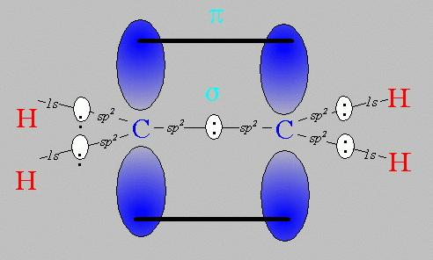
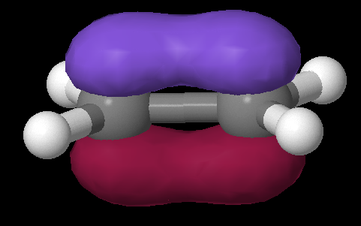
Pi bonds: Pauling’s really great idea to use the `leftovers’
Equivalent Pauling `sigma’ (σ) hybrid structure
Ethene (C₂H₄) Lewis picture
σ
1 leftover p_{z} on each C
sp²
sp²
s+ p_{x} + p_{y}
s+ p_{x} + p_{y}
z
π
x
σ
y

Slide 25
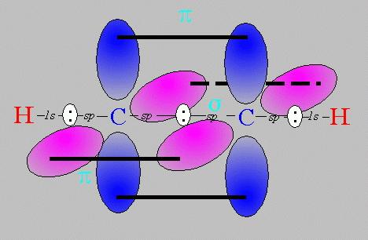
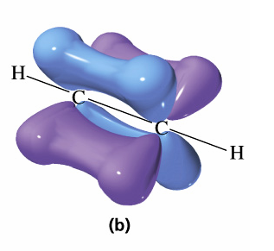
Pi bonds: Pauling’s really great idea to use the `leftovers’ (cont.)
Equivalent Pauling `sigma’ (σ) hybrid structure
Ethyne (C₂H₂) Lewis picture
σ
sp
sp
2 leftover p_{z} on each C
s+ p_{x}
s+ p_{x}
z
π
Z
x
σ
π
x
y
y

Slide 26
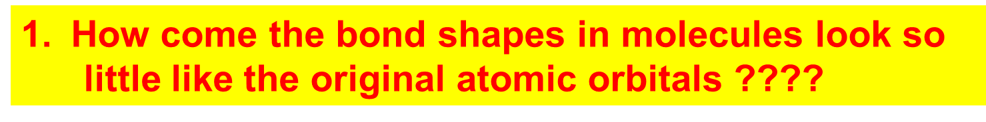
How Pauling’s model `fixes’ the problems with Lewis model
Atomic orbitals (AO) `reorganize’ (hybridize) when individual atoms approach each other such that the number of `links’ predicted by the Lewis model = the number of s, p (and d and f) orbitals combined in the reorganization. The `hybrid’ combinations are called Linear Combinations of Atomic Orbitals (LCAO). The `lobes’ in LCAO on individual atoms overlap and share two electrons between the atoms in a `sigma’ bond (often called a `valence’ or structural linkage bond.)

Slide 27
How Pauling’s model `fixes’ the problems with Lewis model
(continued)
2. How does octet model account for the observed reactivity trend of ethane vs ethene vs ethyne with halogens and ozone ?
`pi’ bonds are far less stable and far more reactive than sigma bonds. (Further out, softer, not between atoms but above and below) Ethane is held together by just `sigma bonds and is thus not very reactive.
Both ethylene and acetylene have pi bonds which are easily reacted. That acetylene is more reactive thane ethylene results because it has two pi bonds while ethylene has only 1 pi bond

Slide 28
How Pauling’s model `fixes’ the problems with Lewis model
(continued)
3. How come ethene sticks to Pt, Rh and Ni in
catalysis, but ethane doesn’t ???
The large and loose electronic clouds above the metals are `soft’ and easily `blended’ (overlapped’ with like electronic distributions (e.g. soft and fluid). Pi bonds are soft and fluid; sigma bonds aren’t. Moreover, the pi bonds are far away from the central core of the molecule, thus reducing nuclear-nuclear repulsions.

Slide 29
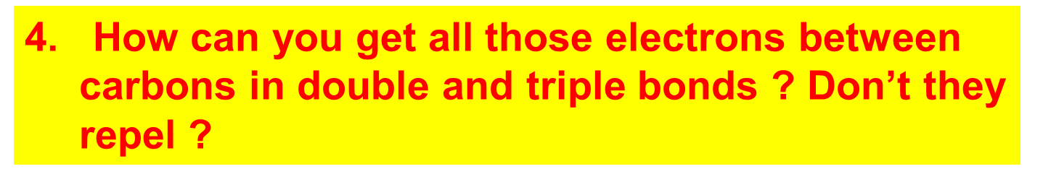
How Pauling’s model `fixes’ the problems with Lewis model
(continued)
The pi bonds occupy space above and below the sigma bond and thus do not crowd them. The two pi bonds are also on different and perpendicularly aligned planes to minimize pi-pi crowding.

