Slide 1
RX – as synthetic gateway
RX
Via Elimination reaction
Alkenes
(ex. CH₃CH₂Cl→ CH₂=CH₂
All via Nucleophilic Substitution Reactions
RCN
ROH
RSH
RCOOR’
nitriles
alcohols
ROR’
ethers
thiols
esters

Slide 2
Two kinds of nucleophilic substitution
S_{N}2
S_{N}1

Slide 3
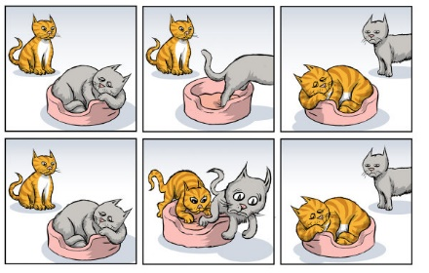
Cat analogy for S_{N}1 vs S_{N}2
S_{N}1
S_{N}2

Slide 4
Factors influencing the rate of an S_{N}2 reaction of RX
1) What’s on the α site along with X- an example: RBr→RI
∴S_{N}2 Reaction rate favors lower degree α: a `steric’ effect
α site degree
0º
1º
2º
3º
Relative
Rate
145
1
0.008
0.0000

Slide 5
Factors influencing the rate of an S_{N}2 reaction of RX (cont.)
2) What’s on the β site along with an example: 1º RBr→RI
∴S_{N}2 Reaction rate favors lower degree β: a `steric’ effect (again)
Site
degree
1º
2º
3º
4º
Relative rate
1
0.8
0.04
0.00001

Slide 6
Take-home message so far:
S_{N}2 is favored mostly by 0º and 1º α sites and 1º and 2 β sites.
Higher degree α,β won’t run S_{N}2

Slide 7
Factors influencing the rate of an S_{N}2 reaction of RX (cont.)
3) What’s the effect of solvent on S_{N}2 rates ?
SOLVENT ?
N₃⁻
Solvent | Dipole moment, μ | Dielectric constant, ε | Relative Rate | Type
CH₃OH | 2.87 | 33 | 1 | protic
H₂O | 1.84 | 78 | 7 | protic
DMSO | 3.96 | 49 | 1,300 | aprotic
DMF | 3.82 | 37 | 2,800 | aprotic
CH₃CN | 3.92 | 38 | 5,000 | aprotic
∴S_{N}2 prefers `softer’, polar aprotic solvents

Slide 8
POLAR PROTIC SOLVENTS (polar and with ability to be H-bond donor)
have dipoles due to polar bonds
have O and H atoms that can be donated into a H-bond
examples are the more common solvents like H₂O and ROH
Anions (Nu⁻) will be solvated due to H-bonding, inhibiting their ability to function as Nu

Slide 9
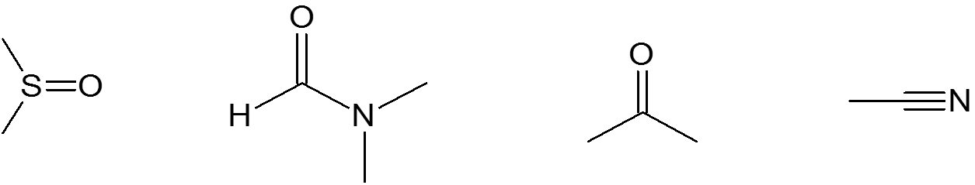
POLAR APROTIC SOLVENTS (polar but no ability to be H-bond donor)
have dipoles due to polar bonds
don't have O or H atoms that can be donated into a H-bond
examples are acetone, acetonitrile, DMSO, DMF (structures below)
anions (Nu⁻) are not solvated and are "naked" and reaction is not inhibited by solvation of Nu⁻
DMSO DMF Acetone Acetonitrile

Slide 10
Factors influencing the rate of an S_{N}2 reaction of RX (cont.)
3) What’s the effect of solvent on S_{N}2 rates (cont.)
CH₃-I + Nuc⁻
CH₃-Nuc +I⁻
Nuc⁻ rate in CH₃OH rate in DMF relative increase
I 43 6,500 x 150
Br 1 21,000 x 21,000
Cl 0.04 41,000 x 1,030,000
F 0.0006 49,000 x 82,000,000

Slide 11
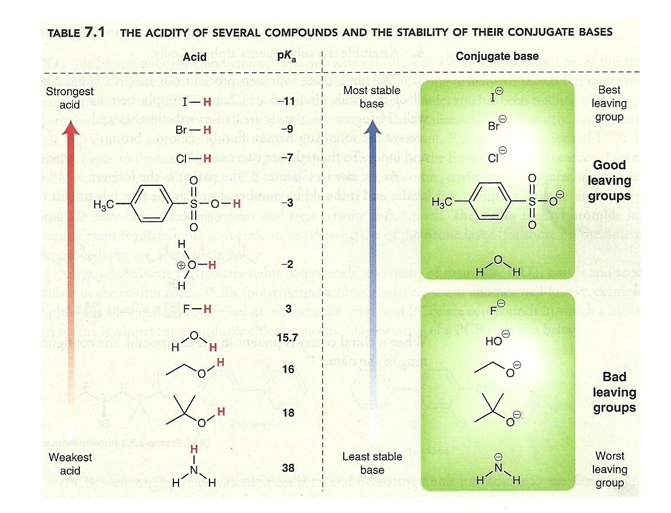
Factors influencing the rate of an S_{N}2 reaction of RX (cont.)
4) What’s the effect of leaving group on S_{N}2 rates ?
The best leaving groups form the most stable
Conjugate bases and come from the strongest
Acids (pK_{a} < 0 )

Slide 12
Factors influencing the rate of an S_{N}2 reaction of RX (cont.)
4) What’s the best Nuc⁻ for increasing S_{N}2 rates ( strength of Nucleophilicity)?
Nuc⁻ Factors favoring faster S_{N}2
a) Stronger bases (with negative charges) are often stronger nucleophiles (but not always):
CH₃CH₂O⁻ is way stronger than CH₃CH₂OH
b) Nuc⁻ strength is lowered by electron-withdrawing groups:
CCl₃⁻ is weaker than CH₃⁻

Slide 13
Factors influencing the rate of an S_{N}2 reaction of RX (cont.)
4) What’s the best Nuc⁻ for increasing S_{N}2 rates (cont.) ?
Nuc⁻ Factors favoring faster S_{N}2 (cont.)
c) Higher polarizability yields higher Nuc⁻ strength in polar protic solvents. Going down the Periodic Table means increasing Nuc⁻ strength.
In polar protic solvents SH⁻ is stronger than OH⁻
In polar protic solvents I⁻ > Br⁻ > Cl⁻ >F⁻ (see table 7.3 of text)

Slide 14
Factors influencing the rate of an S_{N}2 reaction of RX (cont.)
4) What’s the best Nuc⁻ for increasing S_{N}2 rates (cont.) ?
Nuc⁻ Factors favoring faster S_{N}2 (cont.)
d) Higher polarizability yields lower Nuc⁻ strength in polar aprotic solvents. That is, changing the solvent from polar protic to polar aprotic switches the order
In polar aprotic solvents OH⁻ is stronger than SH⁻
In polar aprotic solvents F⁻ > Cl⁻ > Br⁻ >I⁻ (see table 7.3 of text)

Slide 15
Factors influencing the rate of an S_{N}2 reaction of RX (cont.)
4) What’s the best Nuc⁻ for increasing S_{N}2 rates (cont.) ?
Nuc⁻ Factors favoring faster S_{N}2 (cont.)
e) Nuc⁻ strength is lowered by spreading the negative charge around
via resonance.
Is stronger than

Slide 16

Factors influencing the rate of an S_{N}2 reaction of RX (cont.)
4) What’s the best Nuc⁻ for increasing S_{N}2 rates (cont.) ?
f) Smaller is better for Nuc⁻ . Steric hindrance always slows down S_{N}2
>
>

Slide 17
Nucleophilicity and Basicity are not the same…but intertwined
strong nucleophile weak nucleophile
Strong base
weak base
OH⁻ CH₃O⁻ C₂H₅O⁻
NaH
I⁻ Br⁻ Cl⁻
HS- RSH H₂S
H₂O CH₃OH C₂H₅OH

Slide 18
Examples of Nucleophile strength order: tell me why
Why
Must be in polar protic -polarizability increases down column
I⁻ > Br⁻ > Cl⁻ >>F⁻
CH₃CH₂⁻ > CH₂Cl-CH₂⁻
Neighboring electronegative group reduces basicity
CH₃S- < CH₃O-
Must be in polar aprotic where strength decreases down column
NH₂⁻ > NH₃
Negative charge beats no charge
>
No resonance beats resonance (don’t spread out charge)

Slide 19
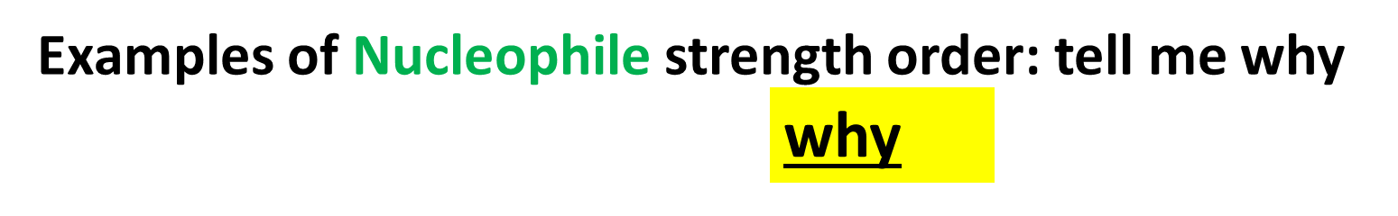
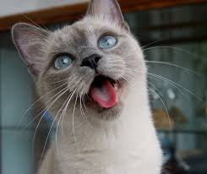
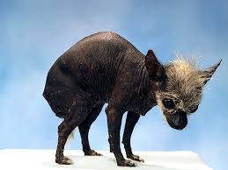
<
Steric effect…smaller is always better for nucleophiles
Cat rule, dogs drool (and poop on the carpet)
>

