Slide 1

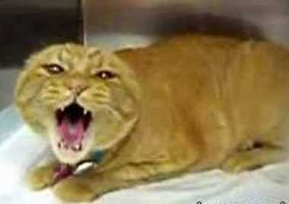
Alkyl Halides (RX): Destination and Gateway
Good RX Kitties
Bad RX Kitties
Freon-11
(refrigerator coolant)
Lindane
(head lice treatment)
CFCs
Freon-12
(Spray can propellant)
Prozac (antidepressant)
PCB
(Transformer insulator, coolant, flame retardant)
Sucralose
(active ingredient in Splenda artificial sweetner)
Dichlorodiphenyltrichlorethane
=DDT
(insecticide)

Slide 2
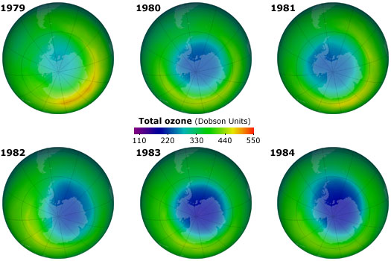
Average Ozone `hole’ over Antarctica created by CFC reactions

Slide 3
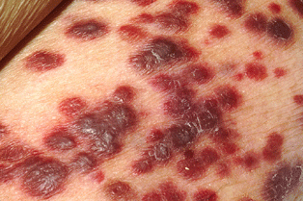
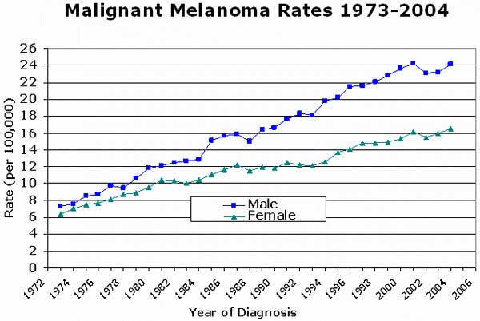
Severe case of skin cancer

Slide 4
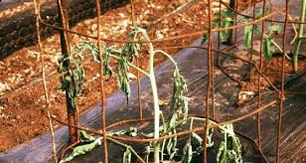
Effect of UV-solarization on plant life

Slide 5
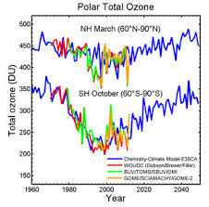
http://www.esa.int/Our_Activities/Observing_the_Earth/Is_the_ozone_layer_on_the_road_to_recovery
Fortunately…
things are getting better for the ozone layer
2014

Slide 6
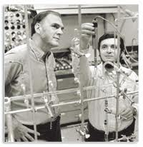
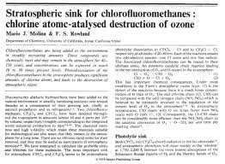
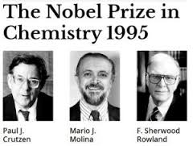
Rowland and Molina- why chemists can be heroes ….

Slide 7
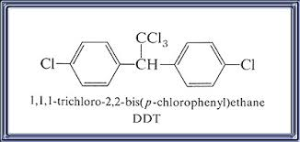
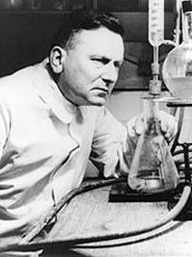
Paul Hermann Mueller wins 1948 Nobel Prize in Medicine and Physiology for synthesizing DDT..,
another hero chemist ?

Slide 8
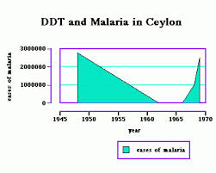
DDT discontinued

Slide 9

Magazine promo from 1952

Slide 10
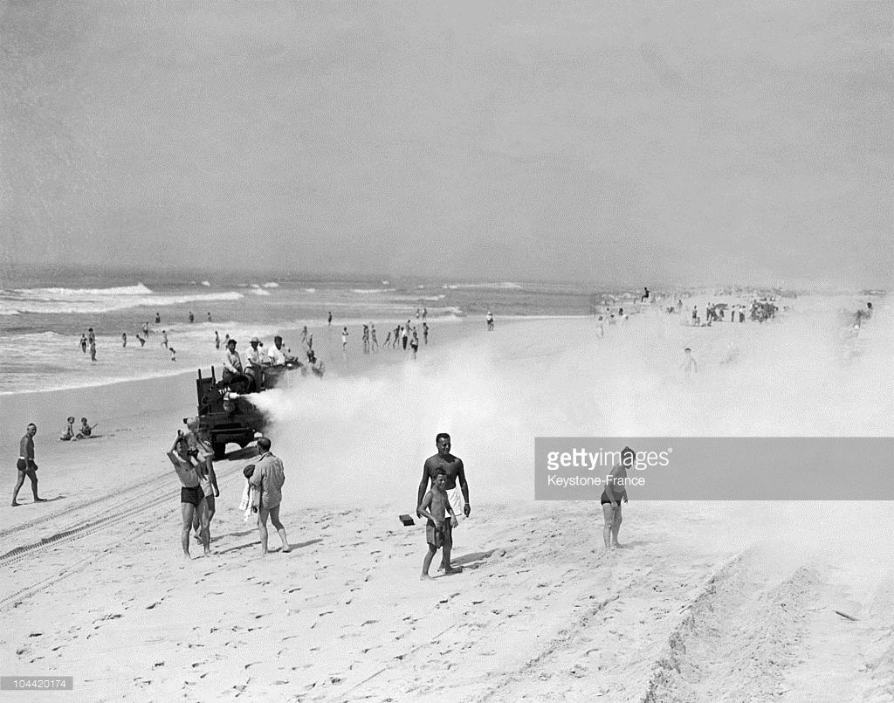
Large scale spraying of DDT at a Long Island Beach in 1948

Slide 11
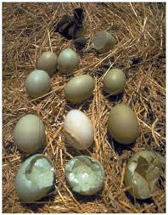
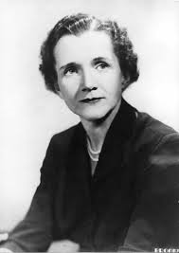
Rachel Carson: Field Biologist

Slide 12
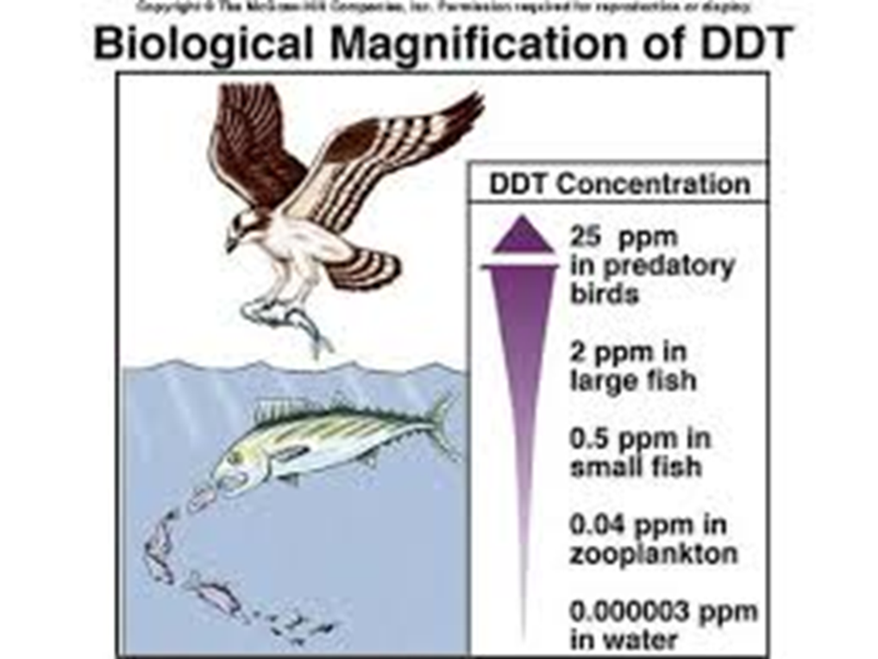


Slide 13
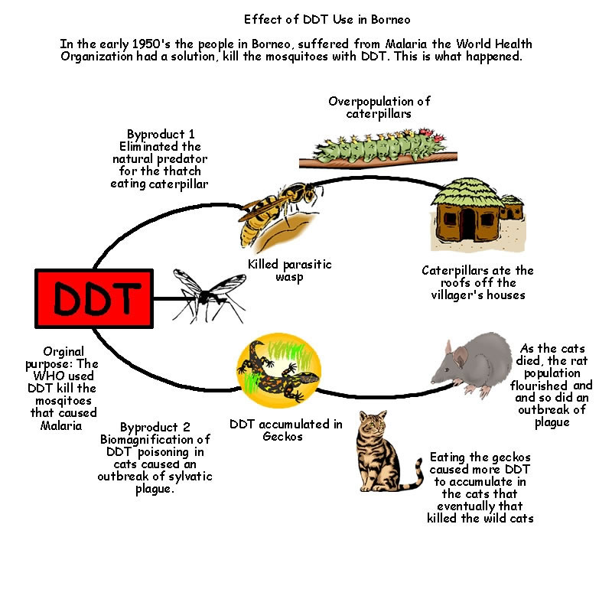
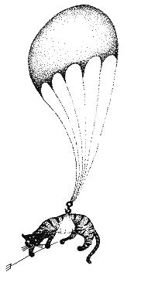
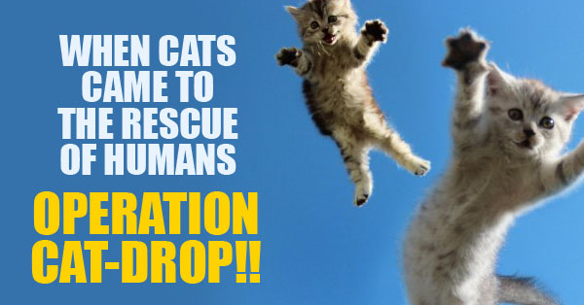
THE FLYING CAT STORY
or
“OPERATION CAT DROP”

Slide 14
DDT discontinued

Slide 15

Sometimes, chemistry works but is bad…..

Slide 16
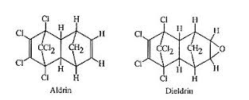
These good kittie RX replacements eventually get to market
Biodegrades in a few weeks
Lives forever…

Slide 17
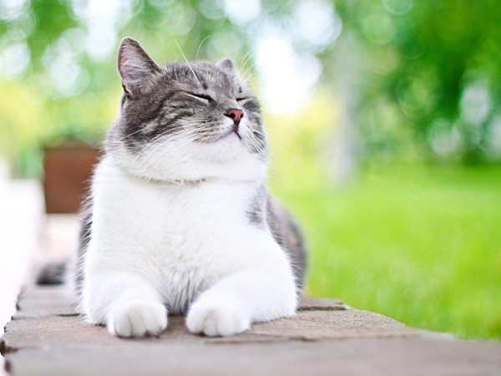
Happily, sometimes Chemists also get things right….

Slide 18
RX – as synthetic gateway
RX
Via Elimination reaction
Alkenes
(ex. CH₃CH₂Cl→ CH₂=CH₂
All via Nucleophilic Substitution Reactions
RCN
ROH
RSH
RCOOR’
nitriles
alcohols
ROR’
ethers
thiols
esters

Slide 19
Two kinds of nucleophilic substitution
S_{N}2
S_{N}1

Slide 20
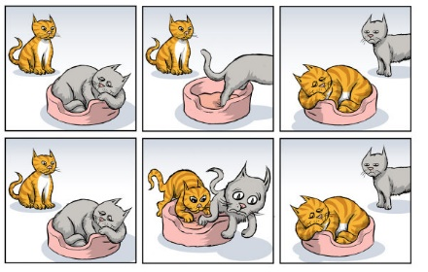
Cat analogy for S_{N}1 vs S_{N}2
S_{N}1
S_{N}2

Slide 21
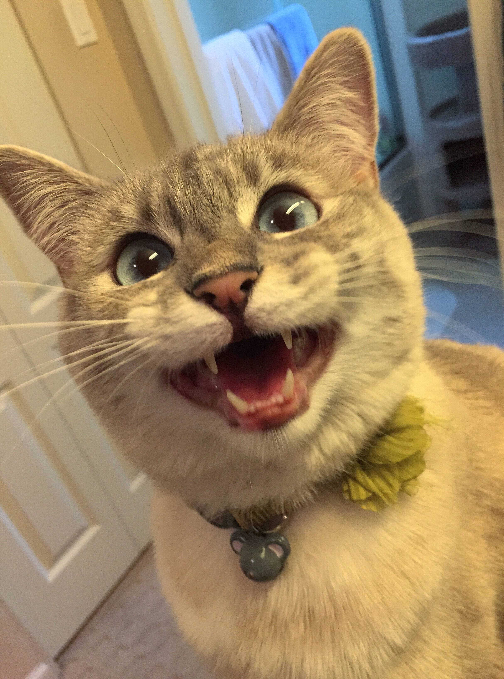
An example of a substitution reaction in the flesh
http://www.youtube.com/watch?v=sjzibxdFfn4
I’m so excited I can hardly breath!
Kitty loves U-tube!!

