Slide 1

Oh boy, I’m so happy !!!!
I’m back for more chemistry !!!!

Slide 2
U-Do-it Examples where we minimize formal charge & break octet rule-
a) SO₂ SO₃ SO₄²⁻
What is the octet rule prediction for SO₂ ?
What will be the S-O bond order in SO₄²⁻ ?
(2+2+1+1)/4= 1.5

Slide 3
Which is the best structure for PO₄²⁻ that satisfies the minimize formal charge rule ?

Slide 4
U-Do-it Examples where we minimize formal charge or simply break octet rule (continued)
c) HClO₄ ClO₄¹⁻
What will be the Cl-O bond order in ClO₄⁻?
(2+2+2+1)/4 =7/4= 1.75

Slide 5
Excited states and formal charges
The COCl₂ example
Can you think of another way we can satisfy octet rule for COCl₂ ??
No formal charges
‘excited state’ of COCl₂

Slide 6
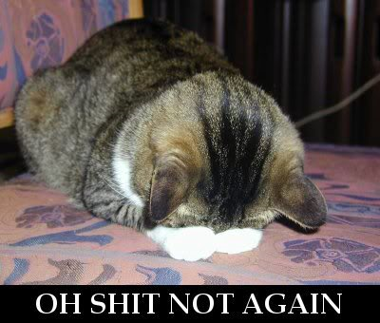
IN-CLASS BOARD OCTET RULE PRACTICE WITH::
Diatomics O₂ √ N₂ √ CO √
tri,tetra-atomics CO₂ √ H₂O √ OF₂√ COCl₂ √
oxyanions NO₃⁻ √ CO₃²⁻ √ SO₄²⁻
Non-Lewis formal charge rule
H₂SO₄ √ SO₂ √ SO₃ √SO₄²⁻
Excited states are predicted ! (a bonus )
√
Any other problems/issues ?
Yes !
Non-Lewis ”got no choice”
and radicals
PF₅ SF₆ NO NO₂

Slide 7
Examples where we minimize formal charge or simply break octet rule because of the atom count on central atom.
PF₅ SF₆

Slide 8
Odd electron count compounds are radical compounds
(=> they have an unpaired electron)
Example 1) NO
N has 5 valence e⁻
O has 6 valence e-
. ..
:N=O:
NO has 11 valence e
Best we can do is minimize formal charge on N: U-Do-it
Example 2) NO₂
N has 5 valence e⁻
2O has 12 valence e-
.. . ..
:O=N=O:
NO₂ has 17 valence e
Best we can do is minimize formal charge on N: U-Do-it

Slide 9
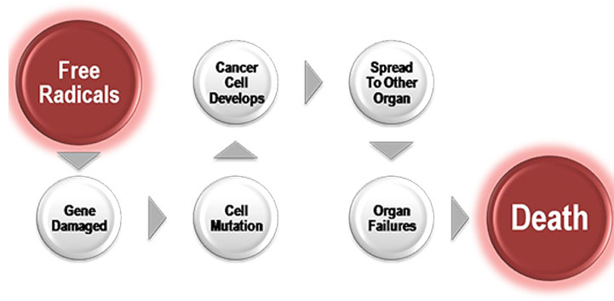
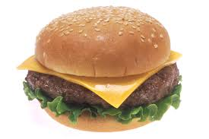
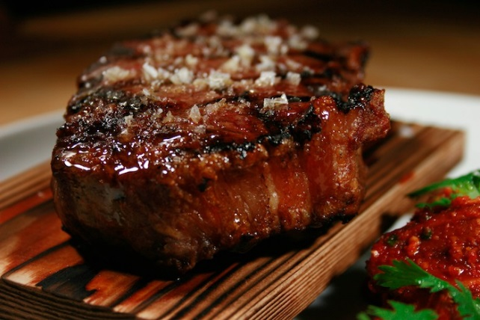
Free radicals are very, very bad for you
Prime sources of free radicals in our food??

Slide 10
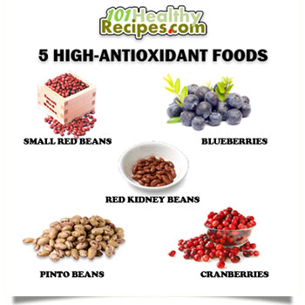
`antioxidant’ is code word for free radical killer

Slide 11
IN-CLASS BOARD OCTET RULE PRACTICE WITH::
Diatomics O₂ √ N₂ √ CO √
tri,tetra-atomics CO₂ √ H₂O √ OF₂√ COCl₂ √
oxyanions NO₃⁻ √ CO₃²⁻ √ SO₄²⁻
Non-Lewis formal charge rule
H₂SO₄ √ SO₂ √ SO₃ √SO₄²⁻
√
Non-Lewis ”got no choice” and radicals
PF₅ √ SF₆ √ NO √ NO₂ √
Fer criss sakes, now are we okay ???

Slide 12
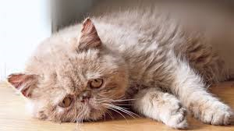
UGLY CHEMICAL FACT OF LIFE #2
For many compounds the Lewis octet prediction of bond lengths don’t match experiment even for elements < Si
Example 1: Ozone O₃
This sucks
Lewis model prediction
Expect O-O length = 15 pm
Expect O=O length = 12 pm
Observe : Both bond lengths
are identical=13.5 pm

Slide 13
Example 2: Benzene C₆H₆
Lewis Model prediction
Expect C-C lengths= 16 pm
Expect C=C lengths = 13 pm
Observe: all C-C lengths are identical = 14.5 pm

Slide 14
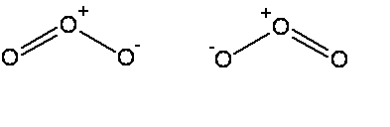


The common thread: if electrons can be moved to make the same molecule => `resonance’
Resonance structure
All bonds are equivalent
in resonance
structures
Resonance structure

Slide 15
`RESONANCE’ circulates the electrons evenly between participating atoms so that the bond lengths between those atoms are identical and an average of the possible single/ double bond distributions.
O-O length = 15 pm
O=O length = 12 pm
Observed O-O bonds all = 13.5 pm
Average = 13.5 pm
C-C lengths= 16 pm
C=C lengths = 13 pm
Average = 14.5 pm
Observed C-C bonds all= 14.5 pm

Slide 16
U-Do-it: Oxyanion examples of resonance
NO₃⁻ NO₂⁻ CO₃⁻²
What is the static octet prediction for each ?
b) What is the actual, expected bond order to O for each example ?
4/3=1.333
3/2=1.5
4/3= 1.333

Slide 17
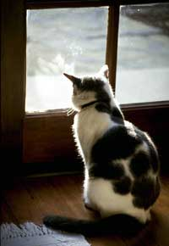
The `big picture’ for the Lewis model, so far:
The Lewis Model of Bonding Tells Chemists:
Bond order and electron ownership
Formal charge distributions
Excited state configurations (COCl₂ example)
Whether resonance exists (or not)

Slide 18

The Lewis model also provides:
Insight into chemical reactivity.
Predictions of Molecular structure (VSEPR theory pp. 193-217)

Slide 19
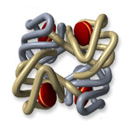
Lewis and chemical reactivity: some simple examples
1) CO and blood
Fe³⁺
vs.
-
CO has 200-400X stronger electrostatic attraction to Fe³⁺ from formal charge vs. O₂. Explains why CO so easily asphyxiates humans even at `low’ concentrations (400 ppm)…it never lets go of the Fe³⁺

Slide 20
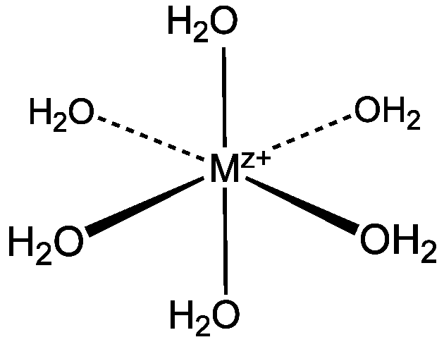
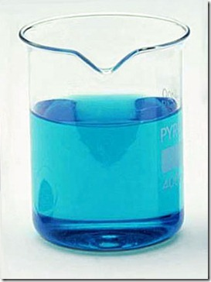
Lewis and chemical reactivity: some simple examples (cont.)
2) complexation of metals
Aquo complexes of metals’
color related to lone pair bonding to M^{z+}
Cu(OH₂)₆²⁺

Slide 21
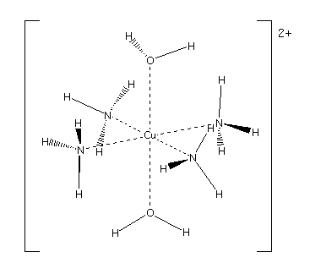

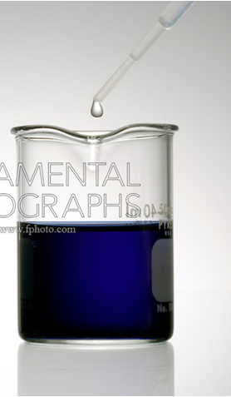
Change the source of the lone pair….. changes the color

Slide 22
Lewis and chemical reactivity: some simple examples (cont.)
In biology we need bacteria and light to fix N₂ (convert to C-N single bonds). Chemically it is very hard to `fix’ N₂ .Why ??
3 bonds are tough to rupture
When H₂O and CO₂ mix to make carbonic acid (essence of Sprite), what goes where to make the acid ??
+2δ
- 2δ
- δ
+ δ

Slide 23
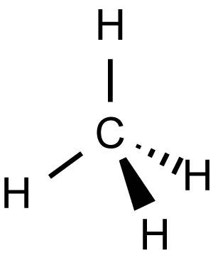
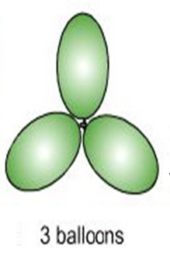
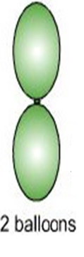
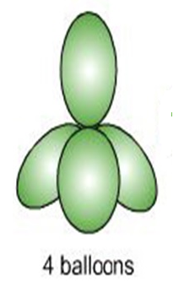
Lewis Model and Molecular Structure predictions
(VSEPR theory : electron clouds are balloons)
:N≡N:
TRIGONAL PLANAR
LINEAR
TETRAHEDRON

Slide 24
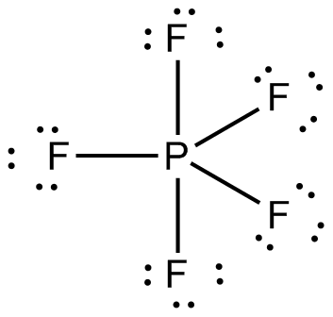
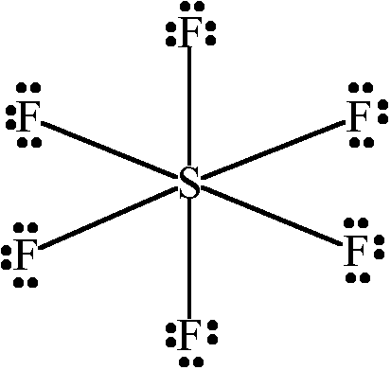
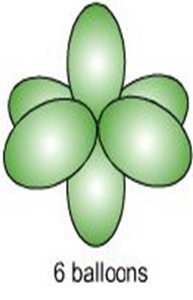
TRIGONAL BIPYRAMID
OCTAHEDRON

Slide 25
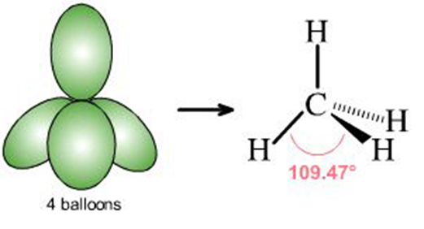
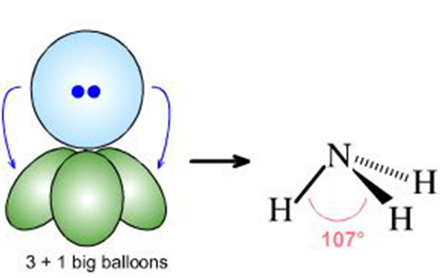
What if lone pairs take up some of the balloon space ?
No lone pairs: 4 bonds to atoms
Pyramid or tetrahedron
1 lone pair + 3 bonds to atoms
Trigonal pyramid

Slide 26
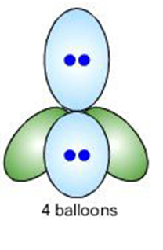
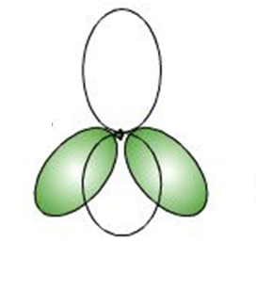
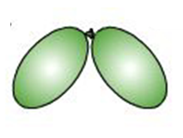
2 lone pairs + 2 bonds to atoms
Chemical example
Bent structure

Slide 27
Lewis structure
Relevant shape?
shape name?
Trigonal plane
formaldehyde
LINEAR
carbon dioxide

Slide 28
Lewis structure
Relevant shape?
shape name?
Bent structure
Nitrite anion
TETRAHEDRON
Sulfuric acid

Slide 29
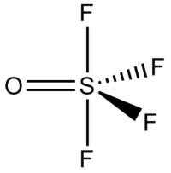
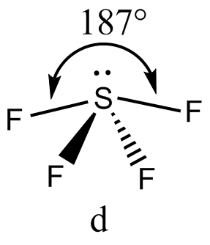
Lewis structure
Relevant shape?
shape name?
Trigonal
bipyramid
Sulfur tetrafluoride
Square pyramid
1 lone pair + 4 bonds

