Slide 1


Slide 2
Lewis `octet’ model (see also pp. 378)
The Entire Lewis model In a nutshell:
All bonds contain two electrons.
All elements except H and He¹ seek an outer (valence) shell of 8 electrons.
If you can –minimize formal charge.
For elements from P onwards, you can break the octet rule and use rule 3.
¹H and He are satisfied with 2 electrons= `duet’ rule

Slide 3
IN-CLASS BOARD OCTET RULE PRACTICE WITH::
Diatomics O₂ √ N₂ √ CO √
Next up….
tri,tetra-atomics CO₂ H₂O OF₂ COCl₂

Slide 4
IN-CLASS BOARD OCTET RULE PRACTICE (continued)::
A new problem with tri,tetra…atomics
Tri, tetratomics CO₂ H₂O OF₂ COCl₂
How do we know what bonds to what ?
Some rules of thumb:
Atoms closer to center of Periodic Table are in center of molecule
Molecules tend to be symmetric.

Slide 5
IN-CLASS BOARD OCTET RULE PRACTICE WITH::
Diatomics O₂ √ N₂ √ CO √
tri,tetra-atomics CO₂ √ H₂O √ OF₂√ COCl₂ √
Now what ???
oxyanions NO₃⁻ CO₃⁻² SO₄²⁻

Slide 6
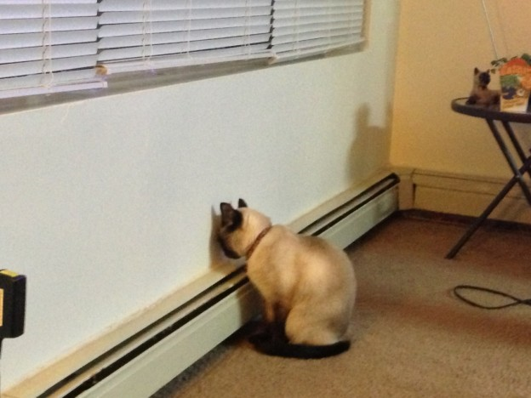
IN-CLASS BOARD OCTET RULE PRACTICE WITH::
Diatomics O₂ √ N₂ √ CO √
tri,tetra-atomics CO₂ √ H₂O √ OF₂√ COCl₂ √
oxyanions NO₃⁻ √ CO₃²⁻ √ SO₄²⁻ √
Are we safe with the octet rule ???
The problem with octet rule:
H₂SO₄
(and SO₂ SO₃ SO₄²⁻
….. and many other examples)
stink up Lewis’s world
Chemistry sucks…

Slide 7
BEYOND THE OCTET RULE: FORMAL CHARGE
UGLY CHEMICAL FACT OF LIFE #1:
For elements starting with Si in the 3rd row, the octet rule is often broken.
EXAMPLE #1: BATTERY ACID (H₂SO₄)
From Experiment
(Kuczkowski et. al. 1983)
Lewis octet prediction for H₂SO₄ structure

Slide 8
U-Do-it Examples where we minimize formal charge or simply break octet rule-
a) SO₂ SO₃ SO₄²⁻
What is the octet rule prediction for SO₂ ?
What will be the S-O bond order in SO₄²⁻ ?
(2+2+1+1)/4= 1.5

Slide 9
We-work-it Examples where formal charge is minimized even if we break the octet rule.
a) SO₂ SO₃ SO₄²⁻
What is the octet rule prediction for SO₂ ?
0
☹
☺
VS.
0
0
+ and – formal charges
Lewis rule 3 says not good
No formal charges anywhere.
Lewis rule 3 says good !

Slide 10
Which is the best structure for PO₄²⁻ that satisfies the minimize formal charge rule ?

Slide 11
U-Do-it Examples where we minimize formal charge or simply break octet rule (continued)
c) HClO₄ ClO₄¹⁻
What will be the Cl-O bond order in ClO₄⁻?
(2+2+2+1)/4 =7/4= 1.75

Slide 12

IN-CLASS BOARD OCTET RULE PRACTICE WITH::
Diatomics O₂ √ N₂ √ CO √
tri,tetra-atomics CO₂ √ H₂O √ OF₂√ COCl₂ √
oxyanions NO₃⁻ √ CO₃²⁻ √ SO₄²⁻
Non-Lewis formal charge rule
H₂SO₄ √ SO₂ √ SO₃ √SO₄²⁻
√
Any other problems ?
Yes !
Non-Lewis ”got no choice”
and radicals
PF₅ SF₆ NO₂

Slide 13
Examples where we minimize formal charge or simply break octet rule because of the atom count on central atom.
PF₅ SF₆

Slide 14
UGLY CHEMICAL FACT OF LIFE #2
For many compounds the Lewis octet prediction of bond lengths don’t match experiment even for elements < Si
Example 1: Ozone O₃
Lewis model prediction
Expect O-O length = 15 pm
Expect O=O length = 12 pm
Observe : Both bond lengths
are identical=13.5 pm

Slide 15
Example 2: Benzene C₆H₆
Lewis Model prediction
Expect C-C lengths= 16 pm
Expect C=C lengths = 13 pm
Observe: all C-C lengths are identical = 14.5 pm

Slide 16
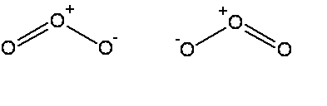


The common thread: if electrons can be moved to make the same molecule => `resonance’
Resonance structure
All bonds are equivalent
in resonance
structures
Resonance structure

Slide 17
`RESONANCE’ circulates the electrons evenly between participating atoms so that the bond lengths between those atoms are identical and an average of the possible single/ double bond distributions.
O-O length = 15 pm
O=O length = 12 pm
Observed O-O bonds all = 13.5 pm
Average = 13.5 pm
C-C lengths= 16 pm
C=C lengths = 13 pm
Average = 14.5 pm
Observed C-C bonds all= 14.5 pm

Slide 18
U-Do-it: Oxyanion examples of resonance
NO₃⁻ NO₂⁻ CO₃⁻²
What is the static octet prediction for each ?
b) What is the actual, expected bond order to O for each example ?
4/3=1.333
3/2=1.5
4/3= 1.333

Slide 19

The `big picture’ for the Lewis model, so far:
The Lewis Model of Bonding Tells Chemists:
Bond order and electron ownership
Formal charge distributions
Excited state configurations (COCl₂ example)
Whether resonance exists (or not)

Slide 20

The Lewis model also provides:
Insight into chemical reactivity.
Predictions of Molecular structure (VSEPR theory pp. 193-217)

Slide 21
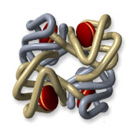
Lewis and chemical reactivity: some simple examples
1) CO and blood
Fe³⁺
vs.
-
CO has 200-400X stronger electrostatic attraction to Fe³⁺ from formal charge vs. O₂. Explains why CO so easily asphyxiates humans even at `low’ concentrations (400 ppm)…it never lets go of the Fe³⁺

Slide 22
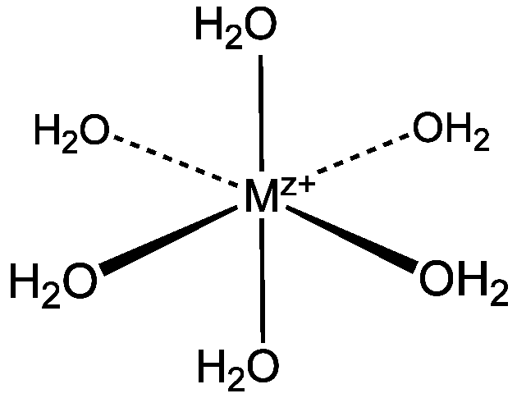
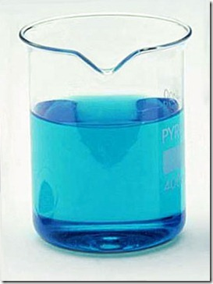
Lewis and chemical reactivity: some simple examples (cont.)
2) complexation of metals
Aquo complexes of metals’
color related to lone pair bonding to M^{z+}
Cu(OH₂)₆²⁺

Slide 23
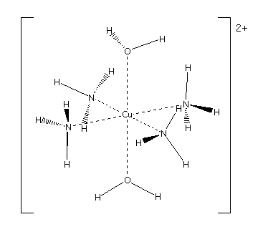


Change the source of the lone pair….. changes the color

Slide 24
Lewis and chemical reactivity: some simple examples (cont.)
In biology we need bacteria and light to fix N₂ (convert to C-N single bonds). Chemically it is very hard to `fix’ N₂ .Why ??
3 bonds are tough to rupture
When H₂O and CO₂ mix to make carbonic acid (essence of Sprite), what goes where to make the acid ??
+2δ
- 2δ
- δ
+ δ

Slide 25
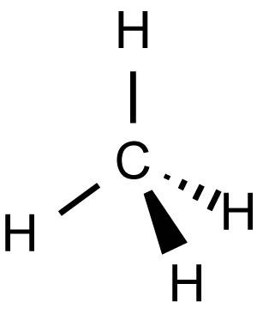
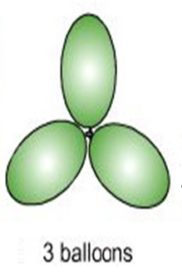
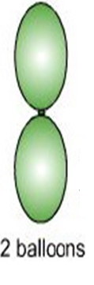
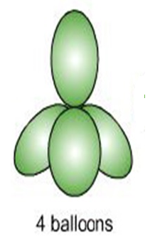
Lewis Model and Molecular Structure (p)
(VSEPR theory : electron clouds are balloons)
:N≡N:
TRIGONAL PLANAR
LINEAR
TETRAHEDRON

Slide 26
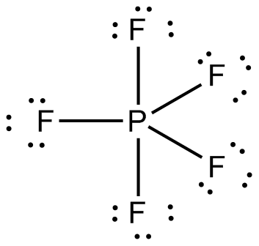
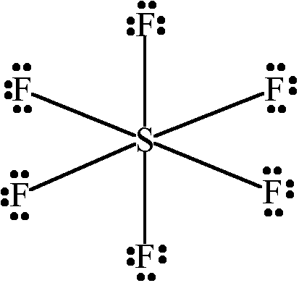
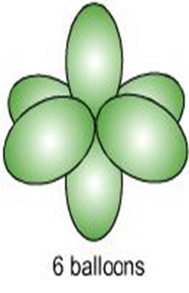
TRIGONAL BIPYRAMID
OCTAHEDRON

Slide 27
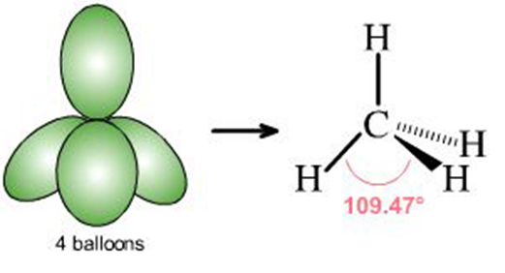
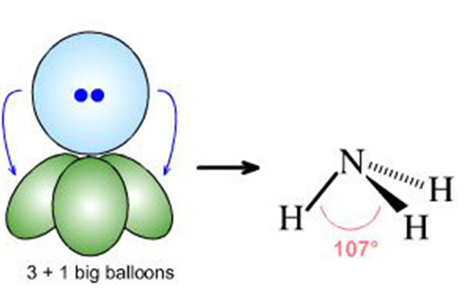
What if lone pairs take up some of the balloon space ?
No lone pairs: 4 bonds to atoms
Pyramid or tetrahedron
1 lone pair + 3 bonds to atoms
Trigonal pyramid

Slide 28
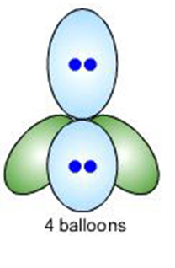
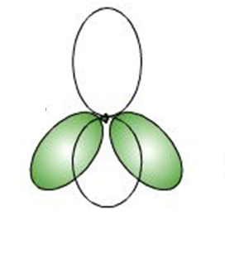
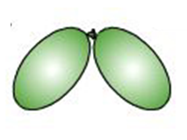
2 lone pairs + 2 bonds to atoms
Chemical example
Bent structure

Slide 29
Lewis structure
Relevant shape?
shape name?
Trigonal plane
formaldehyde
LINEAR
carbon dioxide

Slide 30
Lewis structure
Relevant shape?
shape name?
Bent structure
Nitrite anion
TETRAHEDRON
Sulfuric acid

Slide 31
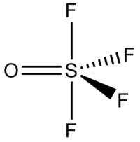
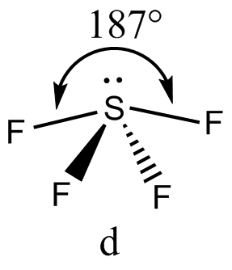
Lewis structure
Relevant shape?
shape name?
Trigonal
bipyramid
Sulfur tetrafluoride
Square pyramid
1 lone pair + 4 bonds

