Slide 1


Where we’ve been….
Rutherford & Bohr 1910
1) Atomic structure & dimensions
2) p+nº , e⁻ bookkeeping
3) Crazy quantum models

Slide 2

Where we’ve been ……
Mendeleev 1865 AD
1)Organizing element behavior to predict chemistry
2)Periodicity and the Periodic Table

Slide 3


In the land of the spectroscopists:
Where we’ve been….
1s² 2s² 2p⁶ 3s² 3p⁴ ……
Describing atoms by electronic configurations implied by observation and predicted by Periodic table
spectroscopy
`fugetabout theory….let the line spectra rule or I breaka your face !

Slide 4
Reading: Chapter 8
pp. 352-365 ionic model
pp. 376-380 Lewis rules & covalent
compounds
pp. 380-384 exceptions
pp. 384-389 formal charge, resonance
pp. 389-402 VSEPR theory

Slide 5

HOW DO YOU KNOW A COMPOUND IS IONIC???
CONDUCTIVITY DEMO….
NaCl
∴If it lights up the light bulb, it’s ionic

Slide 6
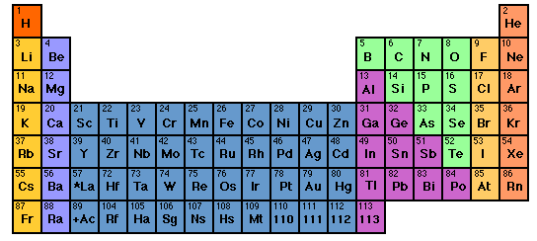
Trends in binary ionic and near-ionic formulas
LiCl
Li₂O
Li₃P
Trends down a column
M_{a} X_{b} …all M’s combine the same for a given X
NaCl
Na₂O
Na₃P
KCl
K₂O
K₃P

Slide 7
Trends in ionic and not ionic compound formulas
Al₂O₃
AlP
HCl
NaCl
Na₂O
Na₃P
MgCl₂
MgO
Mg₃P₂
CH₄
NH₃
H₂O
Trend across columns
Is there a simple pattern here ??

Slide 8
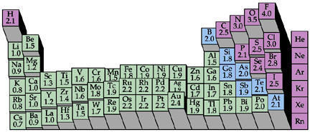
HINT #1: The Periodic Trend of Pauling’ Electronegativity (=electron suckativity) scale reveals a cliff….
1 2
3 4 5 6 7
???

Slide 9
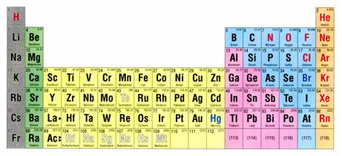
HINT #2: the curious case of column 8
1 2 3 4 5 6 7 8

Slide 10
What’s so curious ??
8
The “Noble” Elements are utterly stable …
…And what’s with this number 8 ??
Noble gas chemistry
0
None
Nada
Noble…because like all aristocrats they have nothing to do with any of the lower class elements.

Slide 11
The crazy stability of the noble gas electronic configuration is the key to a model for predicting ionic and near-ionic compound formulas.
Example:
CaO
Ca= [Ar]4s²
O=[He]2s²2p⁴
Lose 2 e-
gain 2 e-
O²⁻ =[He]2s²2p⁶=[Ne]
Ca²⁺=[Ar]

Slide 12
Lewis dot pix for atoms
+2
-2
Ca
Ca
O
O
Ar
Ne
[CORE]
VALENCE
Ca= [Ar]4s²
O= [He]2s²2p⁴
= [Ar]
= [He]2s²2p⁶=[Ne]

Slide 13

A quick visual way to know element charges
Cations: count left to col 8 for + charge
Anions: count right to col 8 for - charge
+2
-3
…but don’t do this with transition metals

Slide 14
Knowing cation and anion charges lets us predict binary compound formulas (you’ve already seen this)
EXAMPLE:
Predict compound made of Na and S
+1
-2
1)FIND PREFERRED CHARGES
Na
S
2
1
2)“CROSS” CHARGE MAGNITUDES

Slide 15
In-Class practice:
Deducing formulas for ionic compounds
Ca + Cl
CaCl₂
Al + O
Al₂O₃
B + N
BN
K + S
K₂S
Mg+ As
Mg₃As₂

Slide 16
Another dumb Doc question:
“If the atoms in a compound don’t light up the bulb (not ionic) then how are the electrons distributed if not like ionic case ??”

Slide 17

* We know how to use the fancy math…but our `style ‘ is visual and practical
The Americans land…
G. N. Lewis 1925 AD: Teaches us how to use the Periodic table to rationalize ionic and covalent compound formulas without breaking a sweat…The Big Kahuna of an American-style Chemistry that looks at the big picture and uses simple, intuitive models .
(sans calculations …)*

Slide 18
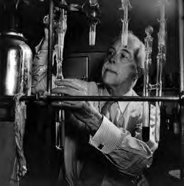
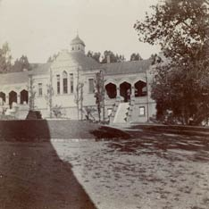
Legacies of the American chemist:
Gilbert Newton Lewis
Gilbert Newton Lewis American Chemist UC Berkeley “at work” ~1930
Before Lewis: UC Berkeley Chemistry Building ~1915

Slide 19
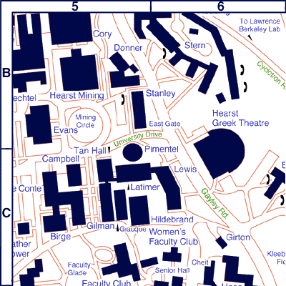
Chemistry `Quad’
UC Berkeley 2013
+ more `on the hill’ at L-L Labs

Slide 20

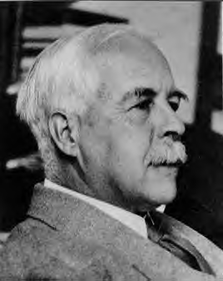
As young chemistry
nerd …Young Doc
Fong sits in here
staring every day
at a 4’x 6’ photo of…
The House that Lewis Built: Lewis Hall of Chemistry
UC Berkeley

Slide 21
Lewis `octet’ model (see also pp. 378)
The Entire Lewis model In a nutshell:
All bonds contain two electrons.
All elements except H and He¹ seek an outer (valence) shell of 8 electrons.
If you can –minimize formal charge.
For elements from P onwards, you can break the octet rule and use rule 3.
¹H and He are satisfied with 2 electrons= `duet’ rule

Slide 22
IN-CLASS BOARD OCTET RULE PRACTICE WITH::
Diatomics O₂ √ N₂ √ CO √
tri,tetra-atomics CO₂ H₂O OF₂ COCl₂

Slide 23
IN-CLASS BOARD OCTET RULE PRACTICE (continued)::
Multi-atom, neutral compounds¹
Tri, tetratomics CO₂ H₂O OF₂ COCl₂
¹How do we know what bonds to what ?
Some rules of thumb:
Atoms closer to center of Periodic Table are in center of molecule
Molecules tend to be symmetric.

Slide 24
Which structure below satisfies the Lewis octet rule for SOBr₂ ?
all single bond
S=O double
S=Br double
None of the above

Slide 25
IN-CLASS BOARD OCTET RULE PRACTICE WITH::
Diatomics O₂ √ N₂ √ CO √
tri,tetra-atomics CO₂ √ H₂O √ OF₂√ COCl₂ √
oxyanions NO₃⁻ CO₃⁻ SO₄²⁻

Slide 26
Which is the best structure for SO₃²⁻ that satisfies the Lewis octet rule
All single S-O
1 S=O,2 S-O
2 =O, 1 S-O
All S=O

Slide 27
IN-CLASS BOARD OCTET RULE PRACTICE WITH::
Diatomics O₂ √ N₂ √ CO √
tri,tetra-atomics CO₂ √ H₂O √ OF₂√ COCl₂ √
oxyanions NO₃⁻ √ CO₃²⁻ √ SO₄²⁻
Non-Lewis octet H₂SO₄ SO₂ SO₃ SO₄²⁻

Slide 28
BEYOND THE OCTET RULE: FORMAL CHARGE
UGLY CHEMICAL FACT OF LIFE #1:
For elements starting with Si in the 3rd row, the octet rule is often broken.
EXAMPLE #1: BATTERY ACID (H₂SO₄)
From Experiment
(Kuczkowski et. al. 1983)
Lewis octet prediction for H₂SO₄ structure

Slide 29
We-work-it Examples where formal charge is minimized even if we break the octet rule.
a) SO₂ SO₃ SO₄²⁻
What is the octet rule prediction for SO₂ ?
0
☹
☺
VS.
0
0
+ and – formal charges
Lewis rule 3 says not good
No formal charges anywhere.
Lewis rule 3 says good !

Slide 30
Which is the best structure for PO₄²⁻ that satisfies the minimize formal charge rule
All single P-O
1P=O, 3P-O
2P=O, 2P-O
None of the above

Slide 31
IN-CLASS BOARD OCTET RULE PRACTICE WITH::
Diatomics O₂ √ N₂ √ CO √
tri,tetra-atomics CO₂ √ H₂O √ OF₂√ COCl₂ √
oxyanions NO₃⁻ √ CO₃²⁻ √ SO₄²⁻
Non-Lewis octet H₂SO₄ √ SO₂ √ SO₃ √SO₄²⁻
√
Non-Lewis octet and radicals PF₅ SF₆ NO₂

Slide 32
Examples where we minimize formal charge or simply break octet rule because of the atom count on central atom.
CRAZY STABLE !!! (Demo)
PF₅ SF₆

Slide 33
UGLY CHEMICAL FACT OF LIFE #2
For many compounds the Lewis octet prediction of bond lengths don’t match experiment even for elements < Si
Example 1: Ozone O₃
Lewis model prediction
Expect O-O length = 15 pm
Expect O=O length = 12 pm
Observe : Both bond lengths
are identical=13.5 pm

Slide 34
Example 2: Benzene C₆H₆
Lewis Model prediction
Expect C-C lengths= 16 pm
Expect C=C lengths = 13 pm
Observe: all C-C lengths are identical = 14.5 pm

Slide 35
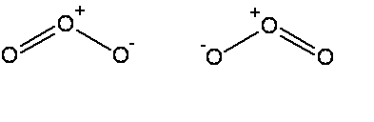


The common thread: if electrons can be moved to make the same molecule => `resonance’
Resonance structure
All bonds are equivalent
in resonance
structures
Resonance structure

Slide 36
`RESONANCE’ circulates the electrons evenly between participating atoms so that the bond lengths between those atoms are identical and an average of the possible single/ double bond distributions.
O-O length = 15 pm
O=O length = 12 pm
Observed O-O bonds all = 13.5 pm
Average = 13.5 pm
C-C lengths= 16 pm
C=C lengths = 13 pm
Average = 14.5 pm
Observed C-C bonds all
= 14.5 pm

Slide 37
U-Do-it: Oxyanion examples of resonance
NO₃⁻ NO₂⁻ CO₃⁻²
What is the static octet prediction for each ?
b) What is the actual, expected bond order to O for each example ?
4/3=1.333
3/2=1.5
4/3= 1.333

Slide 38
BEYOND THE OCTET RULE: FORMAL CHARGE
UGLY CHEMICAL FACT OF LIFE #1:
For elements starting with Si in the 3rd row, the octet rule is often broken.
EXAMPLE #1: BATTERY ACID (H₂SO₄)
Lone pairs
not shown
From Experiment
(Kuczkowski et. al. 1983)
Lewis octet prediction for H₂SO₄ structure

Slide 39
U-Do-it Examples where we minimize formal charge or simply break octet rule-
a) SO₂ SO₃ SO₄²⁻
What is the octet rule prediction for SO₂ ?
What will be the S-O bond order in SO₄²⁻ ?
1.5

Slide 40
U-Do-it Examples where we minimize formal charge or simply break octet rule (continued)
b) H₃PO₄ PO₄³⁻
What will be the P-O bond order in PO₄³⁻ ?
5/4 =1.25

Slide 41
U-Do-it Examples where we minimize formal charge or simply break octet rule (continued)
c) HClO₄ ClO₄¹⁻
What will be the Cl-O bond order in ClO₄⁻?
7/4 =1.75

Slide 42
IN-CLASS BOARD PRACTICE WITH::
Diatomics O₂ N₂ CO
tri, tetra-atomics CO₂ H₂O SOCl₂
oxyanions NO₃⁻ CO₃⁻ SO₄²⁻
Non-Lewis octet SO₄²⁻ SO₃ PF₅ SF₆
MORE…??

