Slide 1
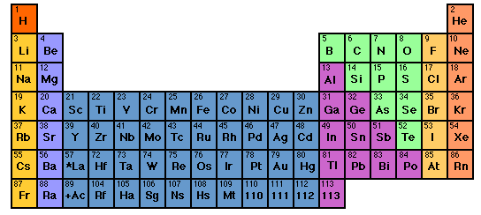
s d p
He is s not p
3d
4d
5d
6d
IN-CLASS EXERCISE :
COMPLETE ELECTRONIC CONFIGURATIONS

Slide 2
Write complete electronic configurations for:
Cl
K
c) Mn
d) Se
1s² 2s² 2p⁶ 3s² 3p⁵
1s² 2s² 2p⁶ 3s² 3p⁶ 4s¹
1s² 2s² 2p⁶ 3s² 3p⁶ 4s² 3d⁵
1s² 2s² 2p⁶ 3s² 3p⁶ 4s² 3d¹⁰4p⁴

Slide 3
2.2 Write the abbreviated electron configurations for
the elements below, assuming they are in the
gas phase.
a) Ca
b) Al
c) As
[Ar] 4s²
[Ne] 3s² 3p¹
[Ar] 4s² 3d¹⁰ 4p³

Slide 4
d electron variations
1) s d electron configuration switching
Example: behavior of Mn
From spectra of atomized elements
As it behaves chemically in solution
Mn
[Ar] 4s² 3d⁵
[Ar] 3d⁵ 4s²
Mn ²⁺
[Ar] 3d⁵
Evidenced by fact that all transition metals have a stable 2+ state… => outer 4s² are removed first

Slide 5
2.3. Write the correct, abbreviated d-switched
configurations for the transition metals below
a) Cu
b) Fe ²⁺
c) Zn ²⁺
[Ar] 3d⁹ 4s² (3d and 4s switch order)
[Ar] 3d⁶ (outer 4s electrons lost first)
[Ar] 3d¹⁰ (outer 4s electrons lost first)

Slide 6
2) s and d undergo filled/half-filled/empty rearrangements
d-electron variations (continued)
Cr⁺¹
[Ar] 4s² 3d³
[Ar] 3d⁴ 4s¹
[Ar] 3d⁵ 4s⁰
Periodic Table predicts
RIGHT based on chemistry and spectroscopy
Corrected for chemistry by d-switching
STILL WRONG ☹

Slide 7
Pigeonhole¹ representation of electrons
¹Called orbital diagrams in text
As implied by Table
+ chemical reversal
After fill, half-filled, empty correction
Cr⁺ =
[Ar] 3d⁴ 4s¹
[Ar]3d⁵ 4s⁰
*This final moving around applies only for transition metals
3d
4s
Pigeonhole representation
[Ar]
D switch rule: s and d electrons in valence shell move around to produce filled, half-filled and/or empty orbitals in order to attain a more stable atom.
Corrected for filled,half-filled, empty rule
[Ar]

Slide 8
d switch rule: s and d electrons in valence shell move around to produce filled, half-filled and/or empty orbitals in order to attain a more stable atom.
If element only has s and p….it means no switching….

Slide 9

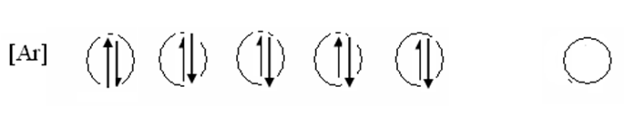

Write the correct, pigeonhole diagrams for the transition metal species below
Write the correct, pigeonhole diagrams for the transition
metal species below
a) Cr
Ni
Ag⁺
remember…rule is applied ONLY with the s & d electron combos
(e.g. transition elements only)

Slide 10
What is the correct, abbreviated, d-switched configuration for Cu⁺¹ ?
[Ar] 4s⁰ 3d¹⁰
[Ar] 3d⁹ 4s¹
[Ar] 4s¹3d¹⁰
[Ar] 3d¹⁰ 4s⁰

Slide 11


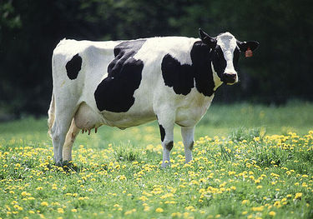
Why (really) the spdf song is sung…..
electrons utterly rule how elements react to make compounds.
What kind of electronic orbitals they possess decides how they behave chemically.
Dogs drool, cats rule
s is for silly cow
p is for pretty kitty
d is for dumb dog

Slide 12
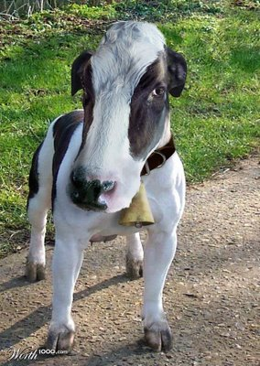
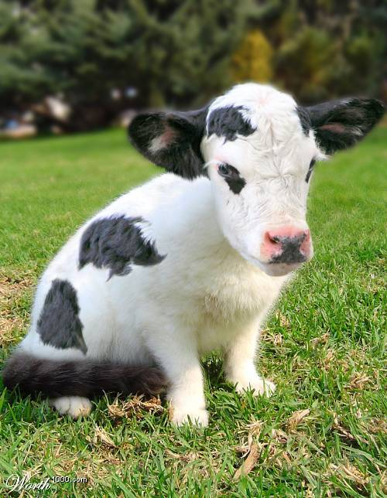
The specific combo of orbits creates the unique chemistry of an element
Be= [He]2s²
Cl=[Ne]3s² 3p⁴
Ti = [Ar] 3d²4s²
100% cow
33% cow+66% kitty
50% cow +50% dog

Slide 13
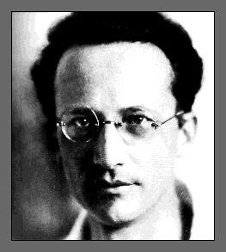

Erwin Schrodinger (whiz kid) finally solves H atom to everyone’s satisfaction (in mid 1930s) with equation below* but only after the spectroscopists gave him the benchmarks to measure his predictions against….
A little addendum…
*
“-h(∇²ϕ)/2m +μϕ/r =Eϕ obviously…(duh)”
Schrodinger’s eigenvalue equation for single electron in 1/r electrostatic potential field (H atom)
“….spectroscopists rule, you drool.”
No closed math form for general atoms yet

Slide 14




Where we’ve been so far on the chemistry bus trip…

Slide 15


Where we’ve been….
Rutherford & Bohr 1910
1) Atomic structure & dimensions
2) p+nº , e⁻ bookkeeping
3) Crazy quantum models

Slide 16

Where we’ve been ……
Mendeleev 1865 AD
1)Organizing element behavior to predict chemistry
2)Periodicity and the Periodic Table

Slide 17

In the land of the spectroscopists:
Where we’ve been….
1s² 2s² 2p⁶ 3s² 3p⁴ ……
Describing atoms by electronic configurations implied by observation and predicted by Periodic table
spectroscopy
`fugetabout theory….let the line spectra rule or I breaka your face !

Slide 18
Where we’ve been…
Dalton 1805AD
1)Law of constant proportions
2)Law of multiple proportions
Moles till we drop…..

Slide 19


Slide 20

Doc asks a few more of his dumb questions.
“OK…so we know that water is H₂O,
salt is NaCl…
Why don’t we ever see HO₂ and Na₂Cl…
…and what holds H₂O and NaCl together in the first place ?”

Slide 21

To answer Doc’s dumb questions we take a forced hike through several chemical bonding theories

Slide 22
Reading: Chapter 8
pp. 352-365 ionic model
pp. 376-380 Lewis rules & covalent
compounds
pp. 380-384 exceptions
pp. 384-389 formal charge, resonance
pp. 389-402 VSEPR theory

Slide 23
HOW DO YOU KNOW A COMPOUND IS IONIC???
CONDUCTIVITY DEMO….
NaCl
∴If it lights up the light bulb, it’s ionic

Slide 24
Trends in binary ionic and near-ionic formulas
LiCl
Li₂O
Li₃P
Trends down a column
M_{a} X_{b} …all M’s combine the same for a given X
NaCl
Na₂O
Na₃P
KCl
K₂O
K₃P

Slide 25
Trends in ionic and not ionic compound formulas
Al₂O₃
AlP
HCl
NaCl
Na₂O
Na₃P
MgCl₂
MgO
Mg₃P₂
CH₄
NH₃
H₂O
Trend across columns
Is there a simple pattern here ??

Slide 26
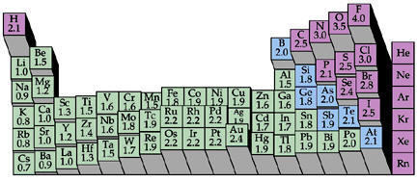
HINT #1: The Periodic Trend of Pauling’ Electronegativity (=electron suckativity) scale reveals a cliff….
1 2
3 4 5 6 7
???

Slide 27
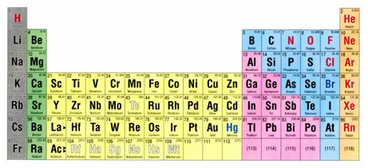
HINT #2: the curious case of column 8
1 2 3 4 5 6 7 8

Slide 28
What’s so curious ??
8
The “Noble” Elements are utterly stable …
…And what’s with this number 8 ??
Noble gas chemistry
0
None
Nada
Noble…because like all aristocrats they have nothing to do with any of the lower class elements.

Slide 29
The crazy stability of the noble gas electronic configuration is the key to a model for predicting ionic and near-ionic compound formulas.
Example:
CaO
Ca= [Ar]4s²
O=[He]2s²2p⁴
Lose 2 e-
gain 2 e-
Ca²⁺=[Ar]
O²⁻ =[He]2s²2p⁶=[Ne]

Slide 30
Lewis dot pix for atoms
+2
-2
Ca
Ca
O
O
Complete octets
(ns² np⁶)
Ar
Ne
[CORE]
VALENCE
Ca= [Ar]4s²
O= [He]2s²2p⁴

Slide 31

A quick visual way to know element charges
Cations: count left to col 8 for + charge
Anions: count right to col 8 for - charge
+2
-3
…but don’t do this with transition metals

Slide 32
Knowing cation and anion charges lets us predict binary compound formulas.
EXAMPLE:
Predict compound made of Na and S
1)FIND PREFERRED CHARGES
+1
-2
Na
S
2
1
2)“CROSS” CHARGE MAGNITUDES

Slide 33
In-Class practice:
Deducing formulas for ionic compounds
Ca + Cl
CaCl₂
Al + O
Al₂O₃
B + N
BN
K + S
K₂S
Mg+ As
Mg₃As₂

Slide 34
Another dumb Doc question:
“If the atoms in a compound don’t light up the bulb (not ionic) then how are the electrons distributed if not like ionic case ??”

Slide 35

* We know how to use the fancy math…but our `style ‘ is visual and practical
The Americans land…
G. N. Lewis 1925 AD: Teaches us how to use the Periodic table to rationalize ionic and covalent compound formulas without breaking a sweat…The Big Kahuna of an American-style Chemistry that looks at the big picture and uses simple, intuitive models .
(sans calculations …)*

Slide 36
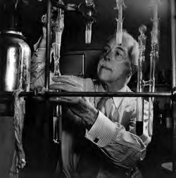
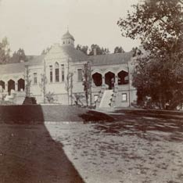
Legacies of the American chemist:
Gilbert Newton Lewis
Gilbert Newton Lewis American Chemist UC Berkeley “at work” ~1930
Before Lewis: UC Berkeley Chemistry Building ~1915

Slide 37
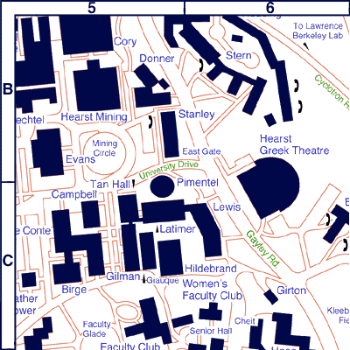
Chemistry `Quad’
UC Berkeley 2013
+ more `on the hill’ at L-L Labs

Slide 38

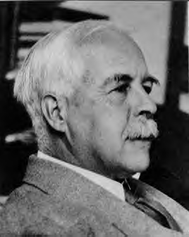
As young chemistry
nerd …Young Doc
Fong sits in here
staring every day
at a 4’x 6’ photo of…
The House that Lewis Built: Lewis Hall of Chemistry
UC Berkeley

Slide 39
Lewis `octet’ model (see also pp. 378)
The Entire Lewis model In a nutshell:
All bonds contain two electrons.
All elements except H and He¹ seek an outer (valence) shell of 8 electrons.
If you can –minimize formal charge.
For elements from P onwards, you can break the octet rule and use rule 3.
¹H and He are satisfied with 2 electrons= `duet’ rule

Slide 40
IN-CLASS BOARD OCTET RULE PRACTICE WITH::
Diatomics O₂ √ N₂ √ CO √
tri,tetra-atomics CO₂ H₂O OF₂ COCl₂

Slide 41
IN-CLASS BOARD OCTET RULE PRACTICE (continued)::
Multi-atom, neutral compounds¹
Tri, tetratomics CO₂ H₂O OF₂ COCl₂
¹How do we know what bonds to what ?
Some rules of thumb:
Atoms closer to center of Periodic Table are in center of molecule
Molecules tend to be symmetric.

Slide 42
Which structure below satisfies the Lewis octet rule for SOBr₂ ?
all single bond
S=O double
S=Br double
None of the above

Slide 43
IN-CLASS BOARD OCTET RULE PRACTICE WITH::
Diatomics O₂ √ N₂ √ CO √
tri,tetra-atomics CO₂ √ H₂O √ OF₂√ COCl₂ √
oxyanions NO₃⁻ CO₃⁻ SO₄²⁻

Slide 44
Which is the best structure for SO₃²⁻ that satisfies the Lewis octet rule
All single S-O
1 S=O,2 S-O
2 =O, 1 S-O
All S=O

Slide 45
IN-CLASS BOARD OCTET RULE PRACTICE WITH::
Diatomics O₂ √ N₂ √ CO √
tri,tetra-atomics CO₂ √ H₂O √ OF₂√ COCl₂ √
oxyanions NO₃⁻ √ CO₃²⁻ √ SO₄²⁻
Non-Lewis octet H₂SO₄ SO₂ SO₃ SO₄²⁻

Slide 46
BEYOND THE OCTET RULE: FORMAL CHARGE
UGLY CHEMICAL FACT OF LIFE #1:
For elements starting with Si in the 3rd row, the octet rule is often broken.
EXAMPLE #1: BATTERY ACID (H₂SO₄)
From Experiment
(Kuczkowski et. al. 1983)
Lewis octet prediction for H₂SO₄ structure

Slide 47
We-work-it Examples where formal charge is minimized even if we break the octet rule.
a) SO₂ SO₃ SO₄²⁻
What is the octet rule prediction for SO₂ ?
0
☹
☺
VS.
0
0
+ and – formal charges
Lewis rule 3 says not good
No formal charges anywhere.
Lewis rule 3 says good !

Slide 48
Which is the best structure for PO₄²⁻ that satisfies the minimize formal charge rule
All single P-O
1P=O, 3P-O
2P=O, 2P-O
None of the above

Slide 49
IN-CLASS BOARD OCTET RULE PRACTICE WITH::
Diatomics O₂ √ N₂ √ CO √
tri,tetra-atomics CO₂ √ H₂O √ OF₂√ COCl₂ √
oxyanions NO₃⁻ √ CO₃²⁻ √ SO₄²⁻
Non-Lewis octet H₂SO₄ √ SO₂ √ SO₃ √SO₄²⁻
√
Non-Lewis octet and radicals PF₅ SF₆ NO₂

Slide 50
Examples where we minimize formal charge or simply break octet rule because of the atom count on central atom.
CRAZY STABLE !!! (Demo)
PF₅ SF₆

Slide 51
UGLY CHEMICAL FACT OF LIFE #2
For many compounds the Lewis octet prediction of bond lengths don’t match experiment even for elements < Si
Example 1: Ozone O₃
Lewis model prediction
Expect O-O length = 15 pm
Expect O=O length = 12 pm
Observe : Both bond lengths
are identical=13.5 pm

Slide 52
Example 2: Benzene C₆H₆
Lewis Model prediction
Expect C-C lengths= 16 pm
Expect C=C lengths = 13 pm
Observe: all C-C lengths are identical = 14.5 pm

Slide 53
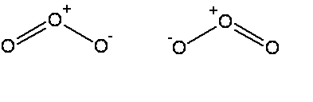


The common thread: if electrons can be moved to make the same molecule => `resonance’
Resonance structure
All bonds are equivalent
in resonance
structures
Resonance structure

Slide 54
`RESONANCE’ circulates the electrons evenly between participating atoms so that the bond lengths between those atoms are identical and an average of the possible single/ double bond distributions.
O-O length = 15 pm
O=O length = 12 pm
Observed O-O bonds all = 13.5 pm
Average = 13.5 pm
C-C lengths= 16 pm
C=C lengths = 13 pm
Average = 14.5 pm
Observed C-C bonds all
= 14.5 pm

Slide 55
U-Do-it: Oxyanion examples of resonance
NO₃⁻ NO₂⁻ CO₃⁻²
What is the static octet prediction for each ?
b) What is the actual, expected bond order to O for each example ?
4/3=1.333
3/2=1.5
4/3= 1.333

Slide 56
BEYOND THE OCTET RULE: FORMAL CHARGE
UGLY CHEMICAL FACT OF LIFE #1:
For elements starting with Si in the 3rd row, the octet rule is often broken.
EXAMPLE #1: BATTERY ACID (H₂SO₄)
Lone pairs
not shown
From Experiment
(Kuczkowski et. al. 1983)
Lewis octet prediction for H₂SO₄ structure

Slide 57
U-Do-it Examples where we minimize formal charge or simply break octet rule-
a) SO₂ SO₃ SO₄²⁻
What is the octet rule prediction for SO₂ ?
What will be the S-O bond order in SO₄²⁻ ?
1.5

Slide 58
U-Do-it Examples where we minimize formal charge or simply break octet rule (continued)
b) H₃PO₄ PO₄³⁻
What will be the P-O bond order in PO₄³⁻ ?
5/4 =1.25

Slide 59
U-Do-it Examples where we minimize formal charge or simply break octet rule (continued)
c) HClO₄ ClO₄¹⁻
What will be the Cl-O bond order in ClO₄⁻?
7/4 =1.75

Slide 60
IN-CLASS BOARD PRACTICE WITH::
Diatomics O₂ N₂ CO
tri, tetra-atomics CO₂ H₂O SOCl₂
oxyanions NO₃⁻ CO₃⁻ SO₄²⁻
Non-Lewis octet SO₄²⁻ SO₃ PF₅ SF₆
MORE…??

