Slide 1
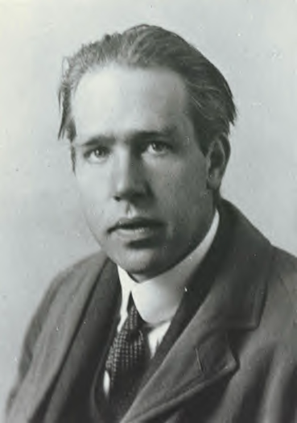
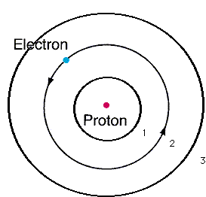
From pure theory Bohr derives the Energy, E_{H}, of the electron around Hydrogen and proposes the Bohr model of the atom:
n=3
n=2
Eq. 2.1 of text
n=1
E_{H}(J)= -2.178*10⁻¹⁸
n²
n=1,2,3…are integers defining circular orbits around positive nucleus

Slide 2
Bohr Model Predictions vs. Experiment
Calc λ_{theory}
obs λ
435
486
656
n_{i} n_{f}
435
486
656
5 2
4 2
3 2
n=5
4
2
1
3
Observed H line (sun) spectrum (Balmer series)
0% error between observed and calculated !!!
5→2
4→2
3→ 2
Bohr’s `explanation of H spectrum’: quantum transitions between levels
λ = 435 486 656 nm

Slide 3
Bohr Model Predictions vs. Experiment (continued)
Theoretical Computed radius of first H orbit:
5.20 nm
Experimentally measured ground state radius of H:
0% error between observed and calculated (again) !!!
5.20 nm

Slide 4
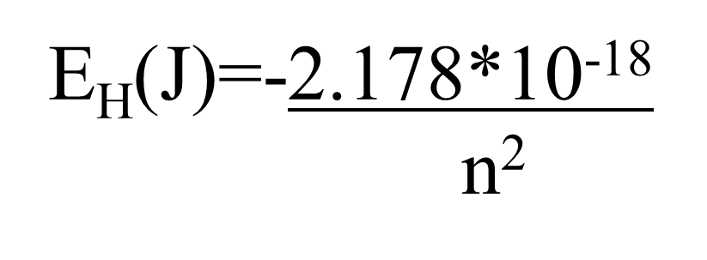
Let’s confirm that n=5→n=2 electron jump predicts λ=434.9 nm for H using Bohr model:
h=6.63*10⁻³⁴ J s
c=3*10⁸ m/s
h*c= 1.989*10⁻²⁵ J*m
E₅ –E₂ =ΔE= hc
λ

Slide 5

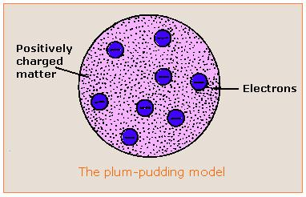

Evolution of the atomic model so far….
Thomson Model
1897
Bohr Model
1913
Philosophical Magazine 44, 295 (1897)
Philosophical
Magazine Series 6,
21, 669-688 (1911)
Philosophical Magazine Series 6
26. 1-25 (1913)

Slide 6



the quantum cat dilemma-one consequence of Bohr’s quantum concept
Kitty state =ψ = f₁ ϕ₁ f₂ϕ₂
(According to quantum physics)
f₁ ~ 1, but not quite f₂ ~ 0 but not quite

Slide 7

Another animated,
Abused quantum cat-in-a-box
story….

Slide 8


What happened to chemistry ?????
Walter White talking chemistry in “Breaking Bad”

Slide 9

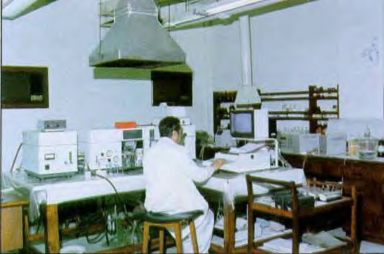

The Bohr Model dies…1930
1930
Bohr theory
The experimental chemists and spectroscopists say “fugetabout” it.
“typical” experimental spectroscopist/chemist
Experimentalist’s attitude towards theoreticians:
“If I want your opinion, I’ll give it to you…”

Slide 10


Bohr’s little Problem…
Observed
Na-`D’ line
Is yellow
1930
Bohr theory
Even worse..
Spectroscopists observe….
Bohr’s prediction: 1 green line
11 lines !!
1≠11
1)Bohr can’t predict anything right except H. The other elements have too many lines, e.g. Na
BOHR
1 line predicted
EXPERIMENT
11 LINES OBSERVED

Slide 11
Bohr model’s failures (continued)
2)…even Bohr’s predictions for H have problems
Can’t predict magnetic `fine’ structure of H, e.g
…magnetize H and even n=1 splits into 2 lines
1 ≠ 2
Turn on magnet near H
☹ Not even the smartest theoretical physicists of the day (Sommerfeld, Planck, Dirac) can make 1=2 or 1=11…. with Bohr’s model

Slide 12
Link to atomic line spectra of elements…none of which Bohr can explain except H
http://chemistry.bd.psu.edu/jircitano/periodic4.html

Slide 13

Evolution of the atomic model so far….
Thomson Model
1897
Bohr Model
1913
Philosophical Magazine 44, 295 (1897)
Philosophical
Magazine Series 6,
21, 669-688 (1911)
Philosophical Magazine Series 6
26. 1-25 (1913)

Slide 14

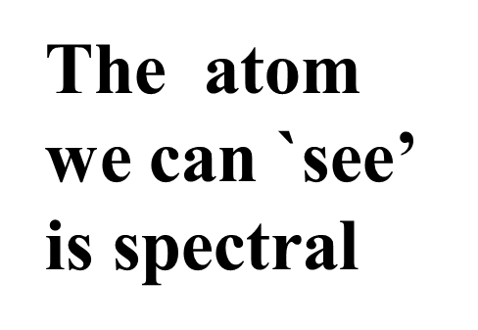
“Model 4: The spectroscopist’s atom
My way or the highway…
…or why we sing the spdf song
The spectroscopists description of what they deduce from observing lines is the `atom’

Slide 15
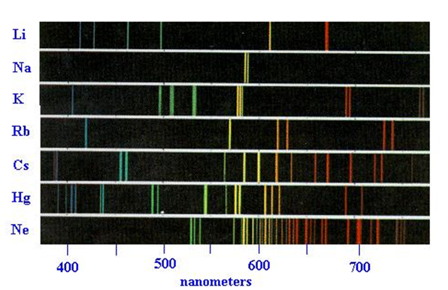
The observed spectra define the energy levels in the elements

Slide 16
Four main `line’ types are observed in atomic spectra:
abbreviations
Sharp lines (=> very narrow)
s
p
d
f
2. Principal lines (=> most intense)
3. Diffuse lines (=> weak, broad )
4. Fundamental lines (=> family of lines terminating spectra at high energy)

Slide 17
5
4
4
4
3
d
3
3
The qualitative, general distribution of multi-electron atomic energy levels grouped by line type
2
2
p
n=1
s

Slide 18
4
d
5
s
4
s
OBSERVED ATOMIC ENERGY LEVEL ORDERING SIMPLIFIED
3
d
3
p
2
p
s
n=1
s

Slide 19
4
d
5
s
4
s
3
d
3
p
Describing Carbon’s energy levels
C=1s²
2s²
2p²
2
p
s
C has 6 electrons
n=1
s

Slide 20
4
d
5
s
4
s
3
d
3
p
Describing Fluorine’s energy levels
F=1s²
2s²
2p⁵
2
p
s
F has 9 electrons
n=1
s

Slide 21
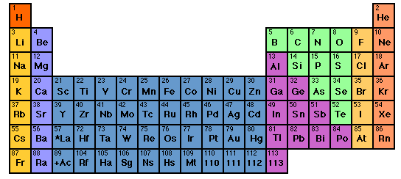

How to sing the spdf song without memorizing the energy levels: electron neighborhoods: s, p, d and f
s
d
p
1
2
3
4
5
6
7
3d
4d
5d
6d
f
4f
5f

Slide 22
Singing the song…what is the complete electronic configuration of….
Will stay in first 5 rows so f orbitals can be dropped
s
p
1
2
3
4
5
6
7
1s² 2s¹
d
3d
4d
5d
6d
f
H =
1s¹
He =
1s²
Li=
1s²
+
2s¹
Be=
1s²
+
2s²

Slide 23
spdf song –continued: YOU complete electronic configuration of:
s d p
H
He
Li
Be
B
C
N
1
2
3
4
5
1s¹
1s²
1s² 2s¹
1s² 2s²
1s² 2s² 2p¹
O
F
Ne
1s² 2s² 2p⁴
1s² 2s² 2p²
1s² 2s² 2p⁵
1s² 2s² 2p³
1s² 2s² 2p⁶

Slide 24
s d p
He is s not p
3d
4d
5d
6d
IN-CLASS EXERCISE :
COMPLETE ELECTRONIC CONFIGURATIONS

Slide 25
Write complete electronic configurations for:
Cl
K
c) Mn
d) Se
1s² 2s² 2p⁶ 3s² 3p⁵
1s² 2s² 2p⁶ 3s² 3p⁶ 4s¹
1s² 2s² 2p⁶ 3s² 3p⁶ 4s² 3d⁵
1s² 2s² 2p⁶ 3s² 3p⁶ 4s² 3d¹⁰4p⁴

Slide 26
2.2 Write the abbreviated electron configurations for
the elements below, assuming they are in the
gas phase.
a) Ca
b) Al
c) As
[Ar] 4s²
[Ne] 3s² 3p¹
[Ar] 4s² 3d¹⁰ 4p³

Slide 27
d electron variations
1) s d electron configuration switching
Example: behavior of Mn
From spectra of atomized elements
As it behaves chemically in solution
Mn
[Ar] 4s² 3d⁵
[Ar] 3d⁵ 4s²
Mn ²⁺
[Ar] 3d⁵
Evidenced by fact that all transition metals have a stable 2+ state… => outer 4s² are removed first

Slide 28
2.3. Write the correct, abbreviated d-switched
configurations for the transition metals below
a) Cu
b) Fe ²⁺
c) Zn ²⁺
[Ar] 3d⁹ 4s² (3d and 4s switch order)
[Ar] 3d⁶ (outer 4s electrons lost first)
[Ar] 3d¹⁰ (outer 4s electrons lost first)

