Slide 1

WHAT THE PHOTOELECTRIC EFFECT MEANS: (SEE PAGE 299-304)
1) THE ENERGY, E, OF LIGHT IS NOT
CONNECTED TO AMPLITUDE

Slide 2

WHAT THE PHOTOELECTRIC EFFECT MEANS (continued):
Planck’s constant h in J*s
2) E(J) = h*f = 6.63*10⁻³⁴ *f(Hz)
1 hz = 1 cycle/second
The Planck equation

Slide 3

WHAT THE PHOTOELECTRIC EFFECT MEANS (continued)
3) LIGHT IS NOT A WAVE !!!!

Slide 4
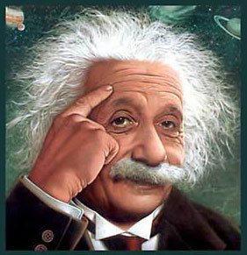
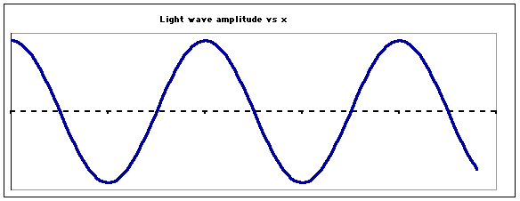
…so what is light if not a wave ??????
Einstein’s metaphor….
LIGHT IS A “PHOTON”
=A MASSLESS BULLET OF ENERGY
OLD
wave
See also Figure 7.5 page 302
NEW
Stream of photons

Slide 5
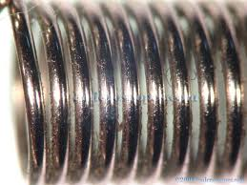
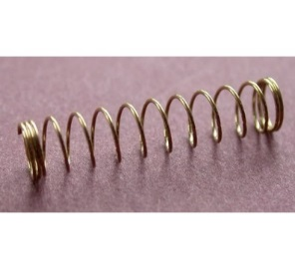
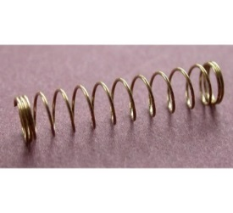


Planck’s equation: hf=E_{photon}
hf
hf
hf
hf
Stream of photons
Doc’s analogy: 1 Photon is like a unit of coiled spring
High frequency(high f)…high energy
tight
low frequency (low f)…low energy
loose

Slide 6
What the `photon’ idea gives us…first on board
Joules=J
h=6.63*10⁻³⁴ Joule *s
E(J)=hf(Hz)
Planck’s Law
Combined with…
c=f*λ
=> f= c λ
Substitute into…
wave equation
∴ E= hc
λ
c=3*10⁸ m/s
λ in meters(m)
Energy of light is now connected to the color (wavelength) of light

Slide 7
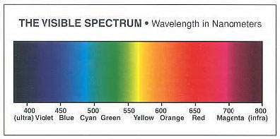
Which is the high energy end of the visible spectrum ?
short wavelengths
long wavelengths
High f
High E
low f
low E
λ Units in 10⁻⁹ m

Slide 8

In-class practice on board:
Planck’s law exercises …
E(J)= hf=hc/λ
=6.63*10⁻³⁴ J*s *f(Hz)=1.989*10⁻²⁵/λ(m)
Mole buck opportunities

Slide 9
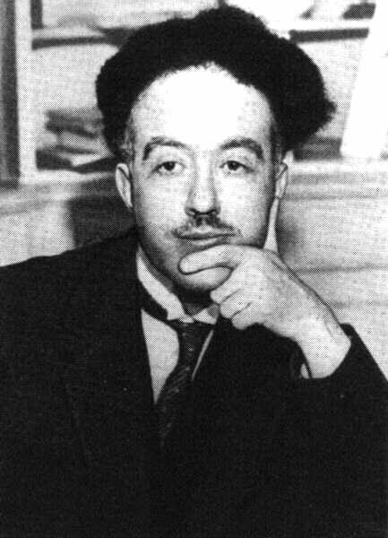
De Broglie’s* hypothesis (pp.63-64)
If light acts `particle-like’ ….
then matter can act `wave-like.’
*Louis-Victor-Pierre-Raymond, 7th duc de Broglie

Slide 10
DeBroglie’s basic thinking connecting matter to waves:
Rest energy of matter*
1) Steal from Einstein: E=mc²
energy of light `wave’
2) Steal from Planck: E = hf=hc/λ
3) Combine them and simplify:
E=mc²=hc/λ
mc =h/λ
* Energy you can convert mass m to when it is not moving (at rest), e.g., v=0…source of atomic bombs.

Slide 11
De Broglie’s Hypothesis (continued)
His big idea….assume a similar relationship exists when the mass is moving at a non-zero velocity v.
=> Replace c with v:
mc =h/λ
mv =h/λ
Rearrange…to define the wavelength of a mass m moving at velocity v
=>DeBroglie’s equation:
λ = h/mv

Slide 12
Planck’s Law explains
Photoelectric effect
E= hf
λ = h/mv
DeBroglie’s equation
connects matter to a hypothetical λ
How do these fix the problems with Rutherford’s atom ?????

Slide 13
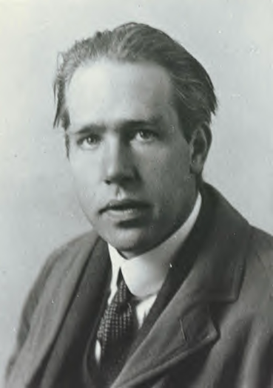
Ask him !
(see also pp. 68-72)
Niels “the kid” Bohr at 27 soon after he makes
his big theoretical breakthrough.

Slide 14
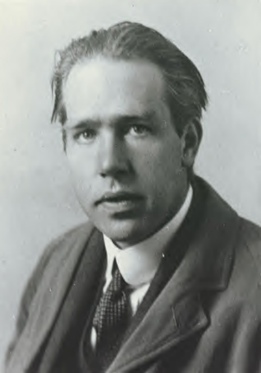
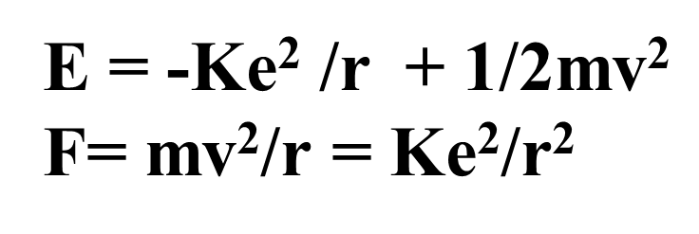
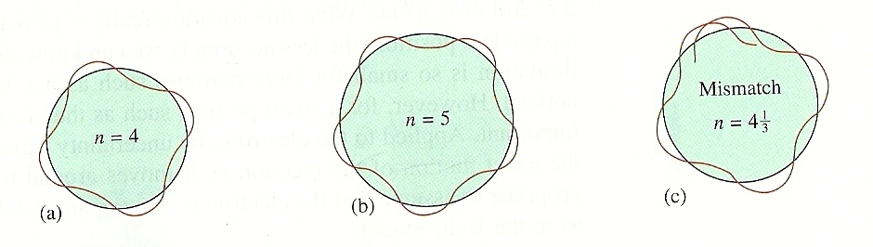
What the `kid’ does:
Takes a dollop of Old School physics
Mixes in New School Planck and DeBroglie equations:
E= hf
λ = h/mv
Forces the wavelength to fit a circular orbit around the nucleus:
see Figure 2.11 pg. 73

Slide 15
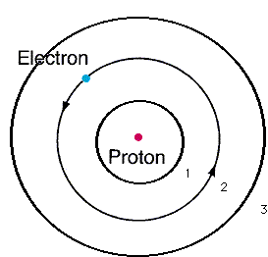
From pure theory Bohr derives the Energy, E_{H}, of the electron around Hydrogen and proposes the Bohr model of the atom:
n=3
n=2
Eq. 2.1 of text
n=1
E_{H}(J)= -2.178*10⁻¹⁸
n²
n=1,2,3…are integers defining circular orbits around positive nucleus

Slide 16
Bohr Model Predictions vs. Experiment
Calc λ_{theory}
obs λ
435
486
656
n_{i} n_{f}
435
486
656
5 2
4 2
3 2
n=5
4
2
1
3
Observed H line (sun) spectrum (Balmer series)
0% error between observed and calculated !!!
5→2
4→2
3→ 2
Bohr’s `explanation of H spectrum’: quantum transitions between levels
λ = 435 486 656 nm

Slide 17
Bohr Model Predictions vs. Experiment (continued)
Theoretical Computed radius of first H orbit:
5.20 nm
Experimentally measured ground state radius of H:
0% error between observed and calculated (again) !!!
5.20 nm

Slide 18
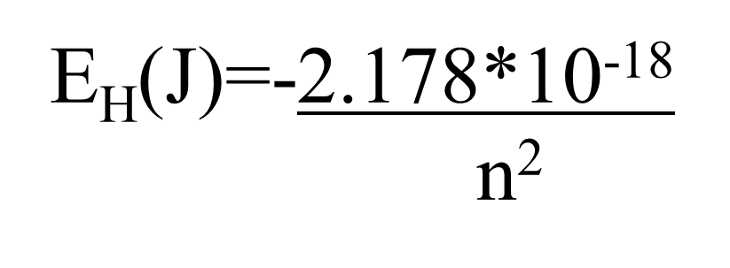
Let’s confirm that n=5→n=2 electron jump predicts λ=434.9 nm for H using Bohr model:
h=6.63*10⁻³⁴ J s
c=3*10⁸ m/s
h*c= 1.989*10⁻²⁵ J*m
E₅ –E₂ =ΔE= hc
λ

Slide 19

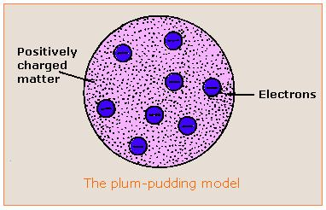

Evolution of the atomic model so far….
Thomson Model
1897
Bohr Model
1913
Philosophical Magazine 44, 295 (1897)
Philosophical
Magazine Series 6,
21, 669-688 (1911)
Philosophical Magazine Series 6
26. 1-25 (1913)

Slide 20



the quantum cat dilemma-one consequence of Bohr’s quantum concept
Kitty state =ψ = f₁ ϕ₁ f₂ϕ₂
(According to quantum physics)
f₁ ~ 1, but not quite f₂ ~ 0 but not quite

Slide 21

Another animated,
Abused quantum cat-in-a-box
story….

Slide 22
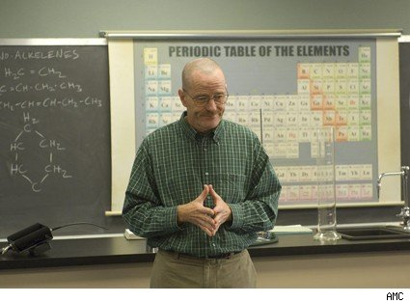

What happened to chemistry ?????
Walter White talking chemistry in “Breaking Bad”

Slide 23

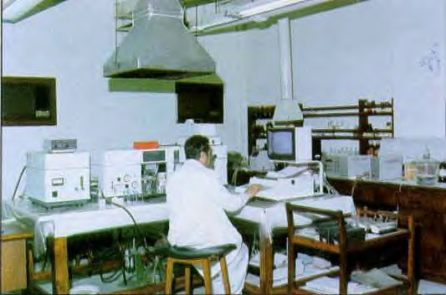

The Bohr Model dies…1930
1930
Bohr theory
The experimental chemists and spectroscopists say “fugetabout” it.
“typical” experimental spectroscopist/chemist
Experimentalist’s attitude towards theoreticians:
“If I want your opinion, I’ll give it to you…”

Slide 24


Bohr’s little Problem…
Observed
Na-`D’ line
Is yellow
1930
Bohr theory
Even worse..
Spectroscopists observe….
Bohr’s prediction: 1 green line
11 lines !!
1≠11
1)Bohr can’t predict anything right except H. The other elements have too many lines, e.g. Na
BOHR
1 line predicted
EXPERIMENT
11 LINES OBSERVED

Slide 25
Bohr model’s failures (continued)
2)…even Bohr’s predictions for H have problems
Can’t predict magnetic `fine’ structure of H, e.g
…magnetize H and even n=1 splits into 2 lines
1 ≠ 2
Turn on magnet near H
☹ Not even the smartest theoretical physicists of the day (Sommerfeld, Planck, Dirac) can make 1=2 or 1=11…. with Bohr’s model

Slide 26
Link to atomic line spectra of elements…none of which Bohr can explain except H
http://chemistry.bd.psu.edu/jircitano/periodic4.html

Slide 27

Evolution of the atomic model so far….
Thomson Model
1897
Bohr Model
1913
Philosophical Magazine 44, 295 (1897)
Philosophical
Magazine Series 6,
21, 669-688 (1911)
Philosophical Magazine Series 6
26. 1-25 (1913)

Slide 28

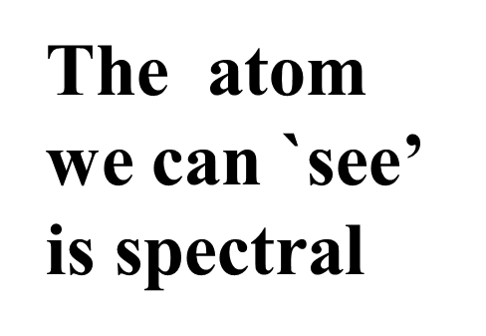
“Model 4: The spectroscopist’s atom
My way or the highway…
…or why we sing the spdf song
The spectroscopists description of what they deduce from observing lines is the `atom’

Slide 29
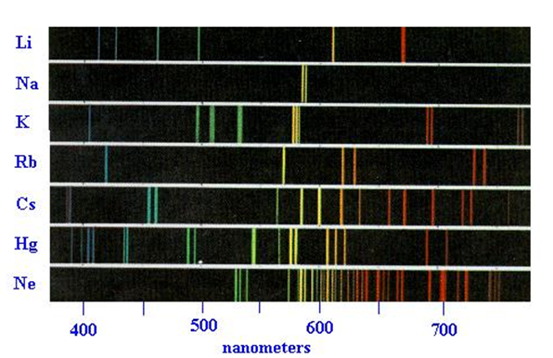
The observed spectra define the energy levels in the elements

Slide 30
Four main `line’ types are observed in atomic spectra:
abbreviations
Sharp lines (=> very narrow)
s
p
d
f
2. Principal lines (=> most intense)
3. Diffuse lines (=> weak, broad )
4. Fundamental lines (=> family of lines terminating spectra at high energy)

Slide 31
5
4
4
4
3
d
3
3
The qualitative, general distribution of multi-electron atomic energy levels grouped by line type
2
2
p
n=1
s

Slide 32
4
d
5
s
4
s
OBSERVED ATOMIC ENERGY LEVEL ORDERING SIMPLIFIED
3
d
3
p
2
p
s
n=1
s

Slide 33
4
d
5
s
4
s
3
d
3
p
Describing Carbon’s energy levels
C=1s²
2s²
2p²
2
p
s
C has 6 electrons
n=1
s

Slide 34
4
d
5
s
4
s
3
d
3
p
Describing Fluorine’s energy levels
F=1s²
2s²
2p⁵
2
p
s
F has 9 electrons
n=1
s

Slide 35
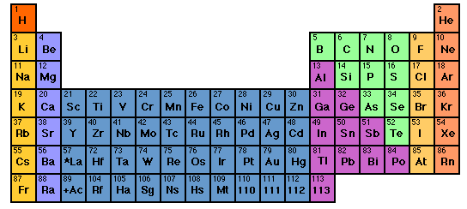

How to sing the spdf song without memorizing the energy levels: electron neighborhoods: s, p, d and f
s
d
p
1
2
3
4
5
6
7
3d
4d
5d
6d
f
4f
5f

Slide 36
Singing the song…what is the complete electronic configuration of….
Will stay in first 5 rows so f orbitals can be dropped
s
p
1
2
3
4
5
6
7
1s² 2s¹
d
3d
4d
5d
6d
f
H =
1s¹
He =
1s²
Li=
1s²
+
2s¹
Be=
1s²
+
2s²

Slide 37
spdf song –continued: YOU complete electronic configuration of:
s d p
H
He
Li
Be
B
C
N
1
2
3
4
5
1s¹
1s²
1s² 2s¹
1s² 2s²
1s² 2s² 2p¹
O
F
Ne
1s² 2s² 2p⁴
1s² 2s² 2p²
1s² 2s² 2p⁵
1s² 2s² 2p³
1s² 2s² 2p⁶

Slide 38
s d p
He is s not p
3d
4d
5d
6d
IN-CLASS EXERCISE :
COMPLETE ELECTRONIC CONFIGURATIONS

Slide 39
Write complete electronic configurations for:
Cl
K
c) Mn
d) Se
1s² 2s² 2p⁶ 3s² 3p⁵
1s² 2s² 2p⁶ 3s² 3p⁶ 4s¹
1s² 2s² 2p⁶ 3s² 3p⁶ 4s² 3d⁵
1s² 2s² 2p⁶ 3s² 3p⁶ 4s² 3d¹⁰4p⁴

Slide 40
2.2 Write the abbreviated electron configurations for
the elements below, assuming they are in the
gas phase.
a) Ca
b) Al
c) As
[Ar] 4s²
[Ne] 3s² 3p¹
[Ar] 4s² 3d¹⁰ 4p³

Slide 41
d electron variations
1) s d electron configuration switching
Example: behavior of Mn
From spectra of atomized elements
As it behaves chemically in solution
Mn
[Ar] 4s² 3d⁵
[Ar] 3d⁵ 4s²
Mn ²⁺
[Ar] 3d⁵
Evidenced by fact that all transition metals have a stable 2+ state… => outer 4s² are removed first

Slide 42
2.3. Write the correct, abbreviated d-switched
configurations for the transition metals below
a) Cu
b) Fe ²⁺
c) Zn ²⁺
[Ar] 3d⁹ 4s² (3d and 4s switch order)
[Ar] 3d⁶ (outer 4s electrons lost first)
[Ar] 3d¹⁰ (outer 4s electrons lost first)

