Slide 1

The surprising dimensions of the atom
R(electron) ~ 100,000 R(nucleus)
m(proton) ~ 2000
m(electron)

Slide 2

More examples of modeling atomic dimensions…
Basket ball =radius of the nucleus=5 inches
= nuclear radius
Electron radius
=7.89 miles

Slide 3

The metaphor…
= nuclear radius
Electron radius ~ distance from Alfred to Hornell

Slide 4
More examples of modeling atomic dimensions…(cont.)
Electronic density vs. nuclear density (g/ m³)
Atom part
r(m)
M(g)
V(m³) =4πr³/3
d=M/V
Nucleus
Electron cloud
10⁻¹⁵
10⁻¹⁰
1.67*10 ⁻³⁰
9.11*10 ⁻³⁴
4.2*10 ⁻⁴⁵
4.2*10 ⁻³⁰
~4*10 ⁺¹⁴
~2*10 ⁻⁴

Slide 5
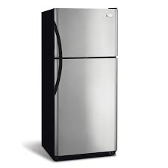
Modeling electron and nuclear density….
d(nucleus)~4*10⁺¹⁴ g/m3
d(electrons)~2*10⁻⁴ g/m3
If electron’s fill the space=>
what weight stuff in it = ??
Recall: M=d*V
3m³ 2*10⁻⁴ g/m³=6*10⁻⁴ g
A refrigerator occupies V= 3 m³

Slide 6
Modeling electron and nuclear density….
d(nucleus)~4*10⁺¹⁴ g/m3
d(electrons)~2*10⁻⁴ g/m3
If nuclei fills the space=>
what weight stuff in it = ??
Recall: M=d*V
3m³ 4*10¹⁴ g/m³=1.2*10¹⁵ g
A refrigerator occupies V= 3 m³

Slide 7
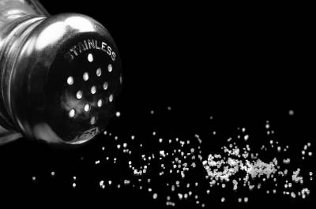
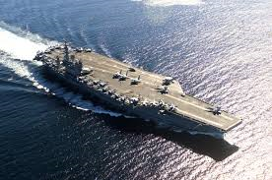
Electron density=> mass in refrigerator
=6*10⁻⁴ g in frig
The metaphor:
1 grain of salt in frig…
Nuclear density mass in refrigerator=>
=1.2*10¹⁵ g in frig
= 1.3*10⁹ tons
The metaphor:
How many of these in frig ..?
One Nimitz class carrier = 7*10⁵ tons
1.3*10⁹/7*10⁵~1857 carriers

Slide 8
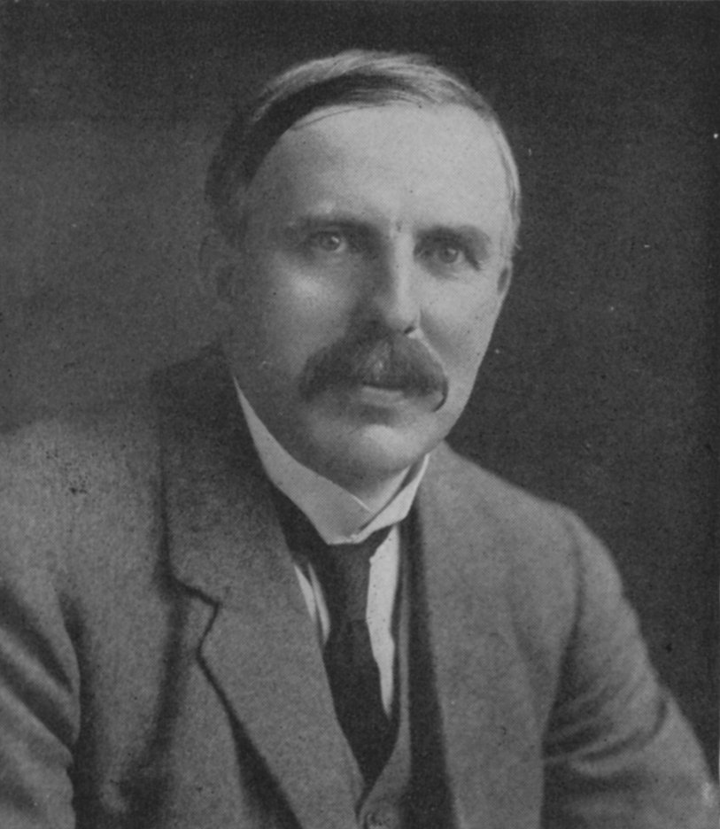
1912: Rutherford ‘s atomic model rules
Electrons (-) out here
+
Protons (+) and neutrons squeezed in here

Slide 9
1912 : Ernst Rutherford is the `Man’…and presides over the `Golden Age of Experimental Physics’…THE ATOM APPEARS CONQUERED
vintage Rutherford:
“All science is either Physics or stamp collecting.”

Slide 10
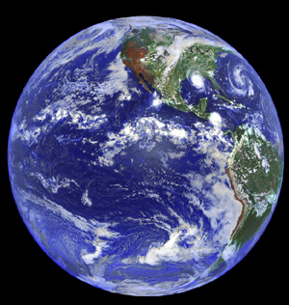

But there are 2 BIG Problems
with Rutherford’s model
1)Why don’t the p⁺ and e⁻ attract and come together ??? (or…why isn’t Earth the size of a golf ball?)
???

Slide 11

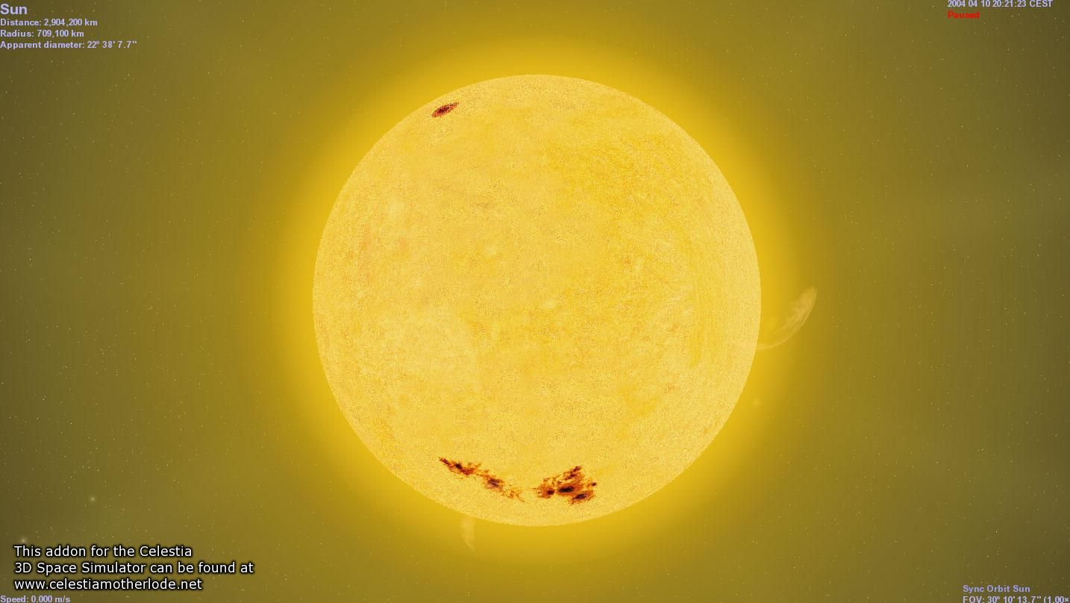
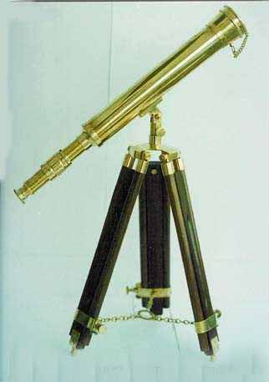
Rutherford atom’s problems (continued)
2)Why doesn’t the sun show all colors (e.g. show white light) when telescopes record spectrum?
Diffraction grating divides up light colors
???
Why only few really strong lines

Slide 12
AN EVEN BIGGER third PROBLEM FOR RUTHERFORD’S LAB
3) The photoelectric effect problem
and the trouble with the theory of light
Help!!!!

Slide 13
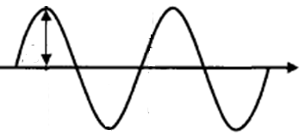
λ
Language of classical light theory (see also: p 58-60)
A
C
A= amplitude
λ= wavelength (meters)
c= speed of light = 3*10⁸ meters/second
“nu”
ν=f = frequency = # full waves passing a point in a second (cycles/second)

Slide 14
λ
Equations of classical light theory (see also:
p 58-60)
A
C
f*λ=c
Wave Energy ~ A²
ν=f = frequency
= # full waves passing a point in a second

Slide 15
Units for wave equation
frequency * wavelength = speed of light
f * λ =c
1
seconds(s)
*
meters(m)
= 3.0*10⁸ m
s
Hertz (Hz)
Cycles/second (cps)

Slide 16
In-class, on-board exercises with wave equation:
f * λ =c

Slide 17
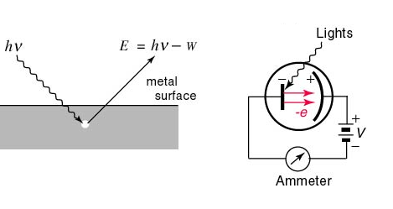
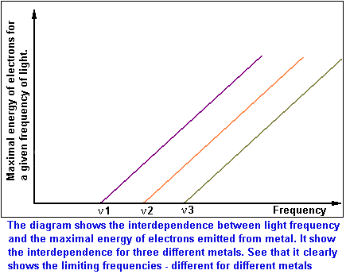
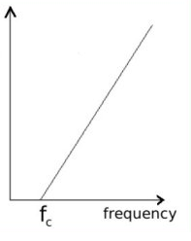
Photoelectric effect: the textbook version
E=Energy of ejected electron from metal
See also p. 300-302 of text
Threshold frequency for emission varies with metals (f₁=ν₁ for metal 1, f₂=ν₂ for metal 2 etc.)

Slide 18

According to `common’ sense, which wave capsizes Mickey and the gang ?
High amplitude (A)
Low frequency (f)
Low amplitude (A)
high frequency (f)
Let Mickey and friends be electrons in a metal

Slide 19
What actually happens in the photoelectric effect experiment
High amplitude (A)
Low frequency (f)
Low amplitude (A)
high frequency (f)
Let Mickey and friends be electrons in metal

Slide 20
WHAT THE PHOTOELECTRIC EFFECT MEANS: (SEE PAGE 299-304)
1) THE ENERGY, E, OF LIGHT IS NOT
CONNECTED TO AMPLITUDE

Slide 21
WHAT THE PHOTOELECTRIC EFFECT MEANS (continued):
Planck’s constant h in J*s
2) E(J) = h*f = 6.63*10⁻³⁴ *f(Hz)
1 hz = 1 cycle/second
The Planck equation

Slide 22
WHAT THE PHOTOELECTRIC EFFECT MEANS (continued)
3) LIGHT IS NOT A WAVE !!!!

Slide 23
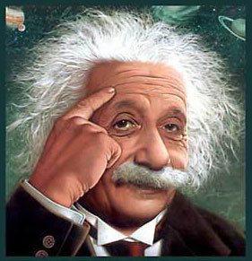
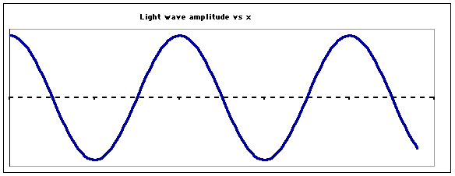
…so what is light if not a wave ??????
Einstein’s image….
LIGHT IS A “PHOTON”
=A MASSLESS BULLET OF ENERGY
OLD
wave
See also Figure 7.5 page 302
NEW
Stream of photons

Slide 24
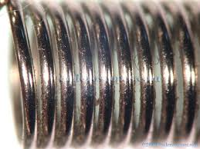
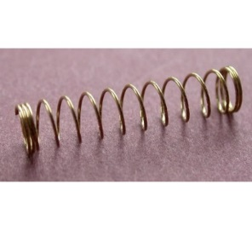
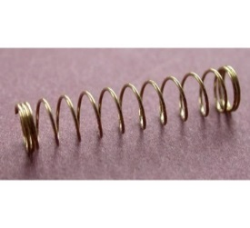
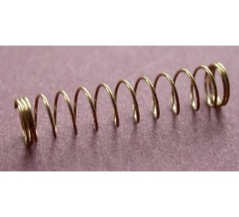
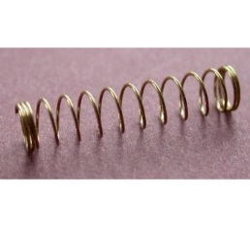
Planck’s equation: hf=E_{photon}
hf
hf
hf
hf
Stream of photons
Doc’s analogy: 1 Photon is like a unit of coiled spring
High frequency(high f)…high energy
tight
low frequency (low f)…low energy
loose

Slide 25
What the `photon’ idea gives us…first on board
Joules=J
h=6.63*10⁻³⁴ Joule *s
E(J)=hf(Hz)
Planck’s Law
Combined with…
c=f*λ
=> f= c λ
Substitute into…
wave equation
∴ E= hc
λ
c=3*10⁸ m/s
λ in meters(m)
Energy of light is now connected to the color (wavelength) of light

Slide 26
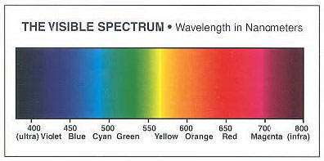
Which is the high energy end of the visible spectrum ?
short wavelengths
long wavelengths
High f
High E
low f
low E
λ Units in 10⁻⁹ m

Slide 27

In-class practice on board:
Planck’s law exercises …
E(J)= hf
=6.63*10⁻³⁴ J*s *f(Hz)
Mole buck opportunities

Slide 28
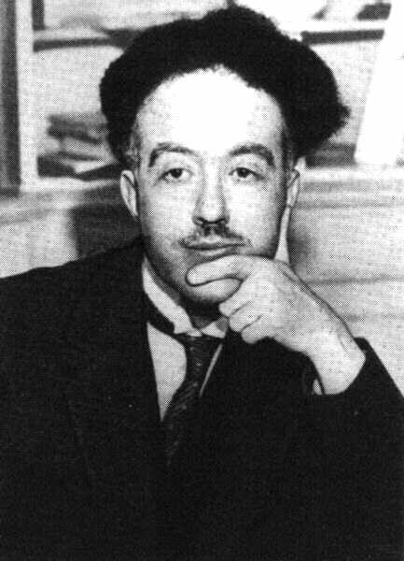
De Broglie’s* hypothesis (pp.63-64)
If light acts `particle-like’ ….
then matter can act `wave-like.’
*Louis-Victor-Pierre-Raymond, 7th duc de Broglie

Slide 29
DeBroglie’s basic thinking connecting matter to waves:
Rest energy of matter*
1) Steal from Einstein: E=mc²
energy of light `wave’
2) Steal from Planck: E = hf=hc/λ
3) Combine them and simplify:
E=mc²=hc/λ
mc =h/λ
* Energy you can convert mass m to when it is not moving (at rest), e.g., v=0…source of atomic bombs.

Slide 30
De Broglie’s Hypothesis (continued)
His big idea….assume a similar relationship exists when the mass is moving at a non-zero velocity v.
=> Replace c with v:
mc =h/λ
mv =h/λ
Rearrange…to define the wavelength of a mass m moving at velocity v
=>DeBroglie’s equation:
λ = h/mv

Slide 31
Planck’s Law explains
Photoelectric effect
E= hf
λ = h/mv
DeBroglie’s equation
connects matter to a hypothetical λ
How do these fix the problems with Rutherford’s atom ?????

Slide 32
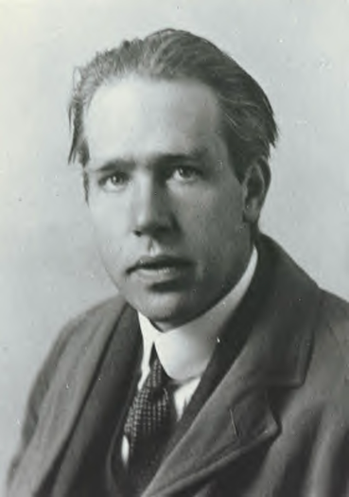
Ask him !
(see also pp. 68-72)
Niels “the kid” Bohr at 27 soon after he makes
his big theoretical breakthrough.

Slide 33
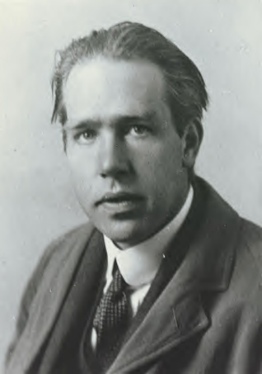
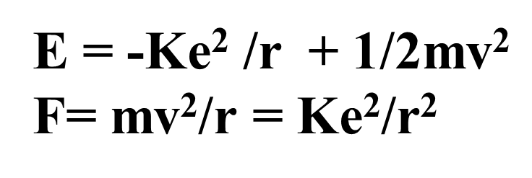
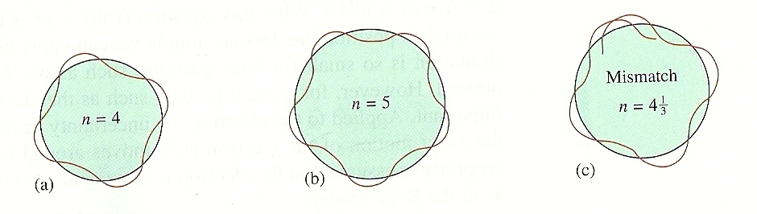
What the `kid’ does:
Takes a dollop of Old School physics
Mixes in New School Planck and DeBroglie equations:
E= hf
λ = h/mv
Forces the wavelength to fit a circular orbit around the nucleus:
see Figure 2.11 pg. 73

Slide 34
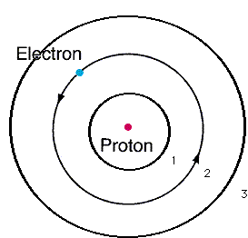
From pure theory Bohr derives the Energy, E_{H}, of the electron around Hydrogen and proposes the Bohr model of the atom:
n=3
n=2
Eq. 2.1 of text
n=1
E_{H}(J)= -2.178*10⁻¹⁸
n²
n=1,2,3…are integers defining circular orbits around positive nucleus

Slide 35
Bohr Model Predictions vs. Experiment
Calc λ_{theory}
obs λ
434
486
656
n_{i} n_{f}
434
486
656
5 2
4 2
3 2
n=5
4
2
1
3
0% error between observed and calculated !!!
Observed H line (sun) spectrum (Balmer series)
5→2
4→2
3→ 2
Bohr’s `explanation of H spectrum’: quantum transitions between levels
λ = 434 486 656 nm

Slide 36
Bohr Model Predictions vs. Experiment (continued)
Theoretical Computed radius of first H orbit:
5.20 nm
Experimentally measured ground state radius of H:
0% error between observed and calculated (again) !!!
5.20 nm

Slide 37
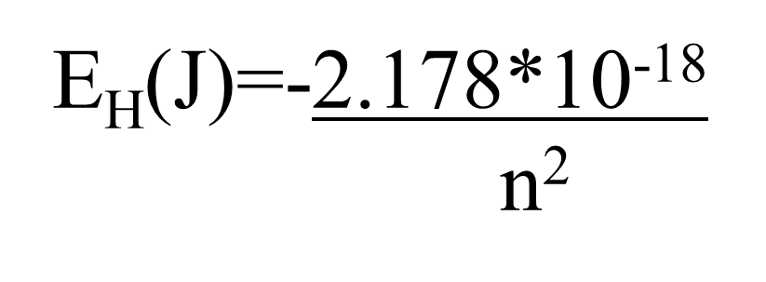
Let’s confirm that n=5→n=2 electron jump predicts λ=434 nm for H using Bohr model:
h=6.63*10⁻³⁴ J s
c=3*10⁸ m/s
h*c= 1.989*10⁻²⁶ J*m

Slide 38
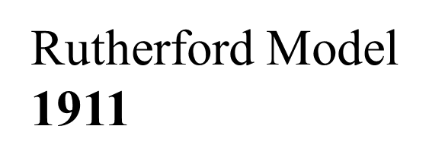
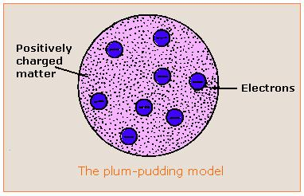

Evolution of the atomic model so far….
Thomson Model
1897
Bohr Model
1913
Philosophical Magazine 44, 295 (1897)
Philosophical
Magazine Series 6,
21, 669-688 (1911)
Philosophical Magazine Series 6
26. 1-25 (1913)

