Slide 1


Road trip so far:
Classic chemistry:
Chapters 1-5
Mole reasoning
Reactions
Gas=> stoichiometries
Ahead of us (and your reading):
What’s inside the atomic cookie (pp. 50-53 + Ch.7)
Molecular models (Ch. 8)

Slide 2

Today’s Student Learning Objective (SLO):
SLO#2 Students should be able to provide a basic description of the atomic and
electronic structures of atoms .
Translation:
What’s inside the atomic cookie….
and how do we know this ???

Slide 3
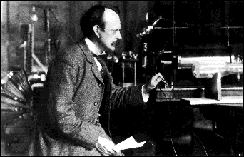
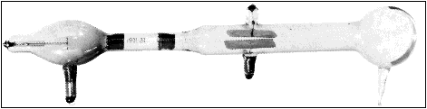
The first try at mapping the atomic cookie:
J. J. Thomson’s `Plum Pudding Model’ : 1897 (see text p.50 )
J.J. Thomson Cavendish Labs, Cambridge UK
J.J’s `Cathode Ray Tube’ (CRT)*
*factoid: Thomson was said to be astonishingly bad in the lab and fumble-fingered; the CRT was made by a gifted glassblower, E. Everett

Slide 4
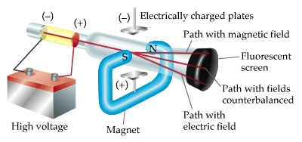
Atomic structure: try 1 –Thomson’s atom (continued)
Schematic of Thomson’s critical experiments
1)Battery voltage tears something (e-) away from metal cathode
2) e⁻ beam from cathode (- plate)
accelerated towards (+) plate
3) Fields applied and results observed on `TV’ screen
Notes:
Explain results on board….emphasize field directions vs. charge (lorentz rh rule for magnet; like repels like for electrical

Slide 5
Atomic structure: try 1-Thomson’s atom (continued)
Basic result of Thomson’s CRT experiments:
All the materials subjected to high voltage in the tube vomited the same kind of `negative’ particles-dubbed the electron.
Thomson’s Conjecture from his CRT experiments
If all matter has negative electrons, there must be a counterbalancing positive glue that sticks to and neutralizes the electrons’ negative charge (since matter is normally neutral).

Slide 6
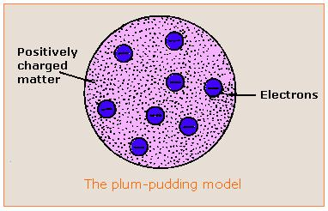
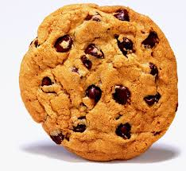
Atomic structure: try 1 –Thomson’s atom (continued)
Thompson’s conjecture morphed into the first experimentally derived atomic model:
“The Plum Pudding Model”¹
Cookie metaphor -if you’ve never had plum pudding
¹ J.J. Thomson Cathode Rays,
Philosophical Magazine 44, 295 (1897)

Slide 7
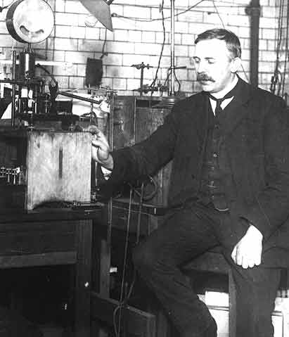
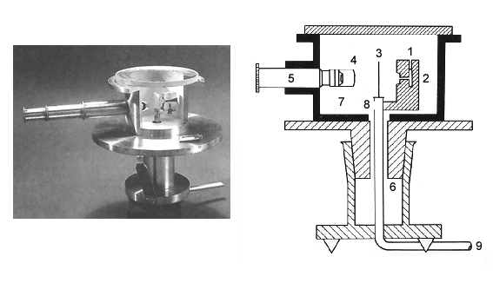
Testing the plum pudding atom: Rutherford’s gold foil experiment (1910) (see also: page 52 of text)
Ernst Rutherford
Physical Laboratory
Manchester University, UK
Rutherford’s Gold foil apparatus*
*Factoid: it’s really his students-Geiger and Marsden- who machine the device and do the measurements.

Slide 8
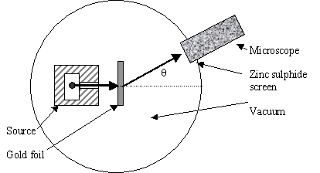
Atomic structure: testing Thomson’s Plum Pudding atomic model (continued)
Schematic of Rutherford’s `gold foil’ apparatus
Microscope
Rotated to detect scintillations
Alpha (α) particles=He⁺
ZnS screen is a scintillating surface
Gold Foil Experiment lore
Marie Curie supplied the radon =α source.
It required ~ 1 hour sitting in absolute dark to condition eyes.
You could only observe scintillations for 1-2 minutes before
desensitizing.

Slide 9
Atomic structure: testing Thomson’s Plum Pudding Atomic Model(continued)
Other Facts about the Gold Leaf Experiment rarely mentioned:
α particles move crazy fast:
velocity ~ 0.1c ~7*10⁷ mph
(can get to NYC from here in ~0.01 sec)
α particles are crazy overweight compared to the electrons (e-) in a gold atom:
~800X heavier than all 79 e- in gold atom
The gold foil is crazy thin:
~ 8.6*10⁻⁶ cm thick
(~1/3000 the thickness of cheap toilet paper )

Slide 10
Atomic structure: testing Thomson’s Plum Pudding Model (continued):
Reminder of the Plum Pudding Model being tested

Slide 11
Given the preceding facts, predict how the α particles will behave after striking the gold foil if the structure of gold is as described in Thomson’s Plum Pudding model .
Bounce straight backwards off the foil like a baseball hitting a wall.
Punch through the foil like it wasn’t there.
Scatter off the foil randomly in all directions.

Slide 12
Plum Pudding model predicts the massive α particles will pass ~un-deflected through gold foil made of diffuse matter
α particles
Rutherford’s observations mostly agree with above.
But sometimes a few curve off significantly…
And once and in a great while, one bounces back. !
Gold foil

Slide 13
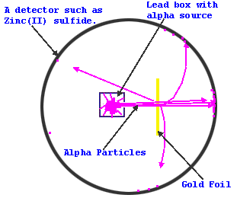
Atomic structure: testing Thomson’s Plum Pudding Atomic Model(continued)
Pictorial summary of results of gold foil experiment
Seminal publication on results:
Geiger H. & Marsden E., On the Diffuse Reflectance of α-Particles Proceedings of the Royal Society, Series A 82: 495–500 (1909)

Slide 14
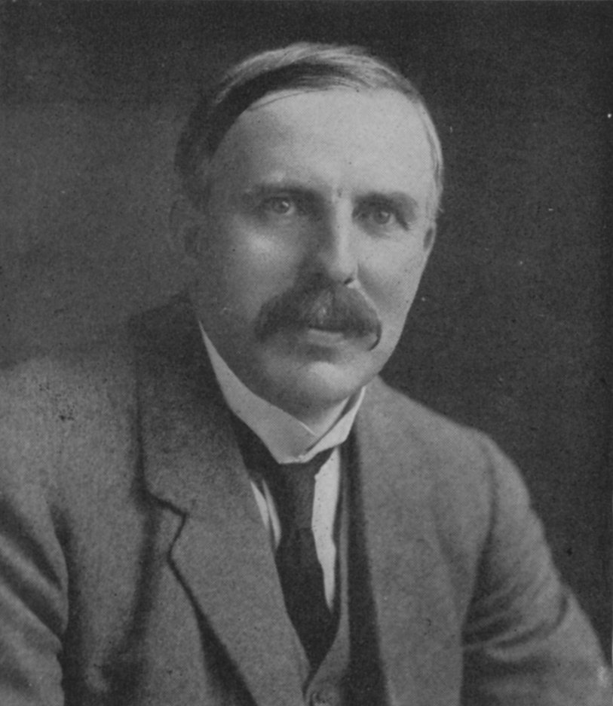
Atomic structure: testing Thomson’s Plum Pudding Atomic Model(continued)
Rutherford’s famous `take’ on Marsden and Geiger’s results:
“Like firing a howitzer at tissue paper and having the shell bounce back !!”

Slide 15
Which model below best explains the gold foil scattering data?
Thin, dense electron ring around large, dense ball of positives.
diffuse, continuous ball of electrons around tiny, dense ball of positives.
Inner thin, dense positive ring surrounded by outer thin,dense electron ring.

Slide 16
Atomic structure: Rutherford’s Atomic Model
Rutherford’s Atom:1911
The Second Experimentally-Based Model of the Atom
Electrons in diffuse cloud around tiny (but massive) positive charged nucleus.
E. Rutherford, F.R.S. The Scattering of α and β Particles by Matter and the Structure of the Atom
Philosophical Magazine Series 6, vol. 21, p. 669-688 (1911)

Slide 17
Dimensions of Rutherford atomic model*
*derived from statistics of gold leaf scattering experiment
Nuclear radius ~10⁻¹⁵ meters
Electronic cloud radius ~ 10⁻¹⁰ meters
Electronic radius/Nuclear radius ~ 10⁺⁵
Masses of subatomic pieces**
Subatomic piece | Mass (g) | Relative mass
proton
1.67*10⁻³⁰
1
neutron
1.67*10⁻³⁰
1
electron
9.11*10⁻³⁴
0.0005
** from J. Aston development of mass spectroscopy at Cavendish Labs (w/Rutherford as its’ new Director)

Slide 18
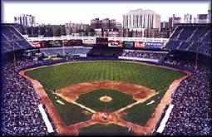


Atom dimensions in familiar terms.
Metaphor 1
Electrons start here (~2.4 miles past cheap seats)
3”
Baseball as nucleus
PS: Yanks rule Boston drools
Old Yankee Stadium, the Bronx
Notes:
Show how calculation was done on board

Slide 19

Nucleus(+)
~ dimension of Rutherford’s electronic cloud (-) (2.4 mile radius from baseball nucleus)
Notes:
Stadium at 1. E. 161st st., Bronx NY 14051

Slide 20

Atom dimensions in familiar terms Example 2 U-Do-It
Super Target store in Omaha, Neb., is the nucleus
Assume the radius of the store is 75 m (0.75 km)
Assume electronic cloud is 100,000X larger in diameter

Slide 21
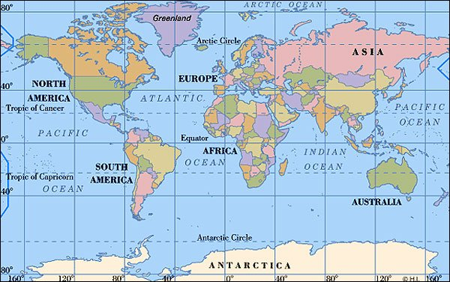
Atom dimensions in familiar terms…
U-Do-it Example 2: where is electron cloud?
Chicago NYC Paris Beijing
Nucleus= Super Target
store in Omaha

Slide 22
Which city best defines the boundary of Rutherford’s electron cloud if a Super Target store in Omaha is the nucleus ?
Chicago:7*10² km away
NYC: 2*10³ km away
Paris: 7*10³ km away
Beijing 1.6*10⁴ km away
Store radius = 75 m
Electron radius =100,000
Nuclear radius
Notes:
Can re-vote after hint on board…if initial responses are poor.

Slide 23
Paris
Nucleus=Super Target
store in Omaha

Slide 24
OTHER METAPHORS TO `GRASP’ ATOMIC DIMENSIONS
Pencil dot + string
Penny analogy
paper + scissors (board work)
Pea=nucleus→volume of electrons (board work)

Slide 25
If a pencil dot, which has a radius of~ 0.02 cm, is the nucleus, how many cm away are the electrons ?
200,000 cm
20,000 cm
2000 cm
200 cm
I have no clue

Slide 26
If an electron is a penny , how much money do you need to equal the mass of 1 proton ? (mass of proton/mass of electron ~1836)
$18.36
$ 1836
$1.83(6)
0.0005 $
No clue

Slide 27

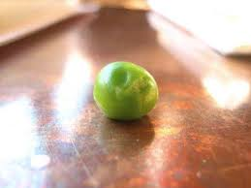
Volume comparison
The electron cloud volume is 10¹⁵ times bigger than the nuclear volume
Electron cloud volume ~ volume of water in Honeoye Lake, NY (10¹⁵ times pea volume)
Nuclear volume=
1 pea (~0.065 cm³)

Slide 28

According to `common’ sense, which wave capsizes Mickey and the gang ?
High amplitude (A)
Low frequency (f)
Low amplitude (A)
high frequency (f)
Let Mickey and friends be electrons in a metal

Slide 29
What actually happens in the photoelectric effect experiment
High amplitude (A)
Low frequency (f)
Low amplitude (A)
high frequency (f)
Let Mickey and friends be electrons in metal

Slide 30
WHAT THE PHOTOELECTRIC EFFECT MEANS: (SEE PAGE 299-304)
1) THE ENERGY, E, OF LIGHT IS NOT
CONNECTED TO AMPLITUDE

Slide 31
WHAT THE PHOTOELECTRIC EFFECT MEANS (continued):
Planck’s constant h in J*s
2) E(J) = h*f = 6.63*10⁻³⁴ *f(Hz)
1 hz = 1 cycle/second
The Planck equation

Slide 32
WHAT THE PHOTOELECTRIC EFFECT MEANS (continued)
3) LIGHT IS NOT A WAVE !!!!

Slide 33
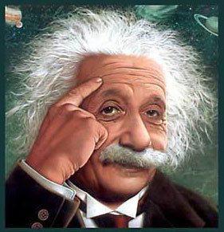
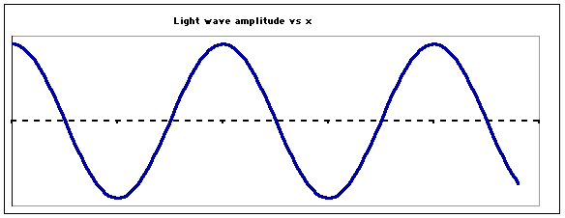
…so what is light if not a wave ??????
Einstein’s image….
LIGHT IS A “PHOTON”
=A MASSLESS BULLET OF ENERGY
OLD
wave
See also Figure 7.5 page 302
NEW
Stream of photons

Slide 34
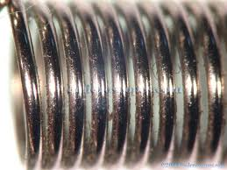
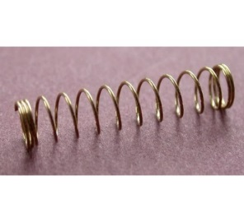
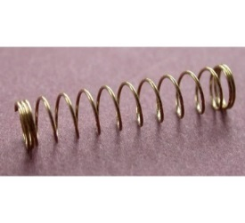
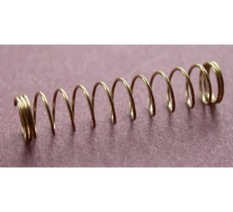
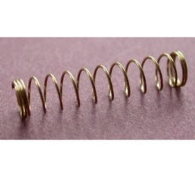
Planck’s equation: hf=E_{photon}
hf
hf
hf
hf
Stream of photons
Doc’s analogy: 1 Photon is like a unit of coiled spring
High frequency(high f)…high energy
tight
low frequency (low f)…low energy
loose

Slide 35
What the `photon’ idea gives us…first on board
Joules=J
h=6.63*10⁻³⁴ Joule *s
E(J)=hf(Hz)
Planck’s Law
Combined with…
c=f*λ
=> f= c λ
Substitute into…
wave equation
∴ E= hc
λ
c=3*10⁸ m/s
λ in meters(m)
Energy of light is now connected to the color (wavelength) of light

Slide 36
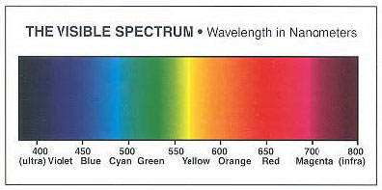
Which is the high energy end of the visible spectrum ?
short wavelengths
long wavelengths
High f
High E
low f
low E
λ Units in 10⁻⁹ m

Slide 37

In-class practice on board:
Planck’s law exercises …
E(J)= hf
=6.63*10⁻³⁴ J*s *f(Hz)
Mole buck opportunities

Slide 38
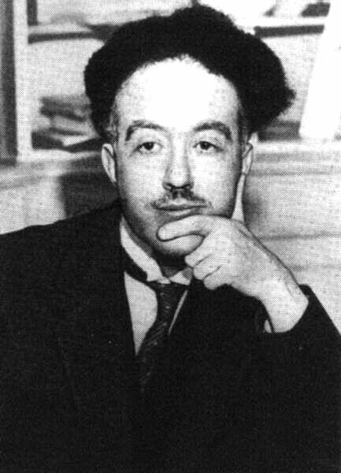
De Broglie’s* hypothesis (pp.63-64)
If light acts `particle-like’ ….
then matter can act `wave-like.’
*Louis-Victor-Pierre-Raymond, 7th duc de Broglie

Slide 39
DeBroglie’s basic thinking connecting matter to waves:
Rest energy of matter*
1) Steal from Einstein: E=mc²
energy of light `wave’
2) Steal from Planck: E = hf=hc/λ
3) Combine them and simplify:
E=mc²=hc/λ
mc =h/λ
* Energy you can convert mass m to when it is not moving (at rest), e.g., v=0…source of atomic bombs.

Slide 40
De Broglie’s Hypothesis (continued)
His big idea….assume a similar relationship exists when the mass is moving at a non-zero velocity v.
=> Replace c with v:
mc =h/λ
mv =h/λ
Rearrange…to define the wavelength of a mass m moving at velocity v
=>DeBroglie’s equation:
λ = h/mv

Slide 41
Planck’s Law explains
Photoelectric effect
E= hf
λ = h/mv
DeBroglie’s equation
connects matter to a hypothetical λ
How do these fix the problems with Rutherford’s atom ?????

Slide 42
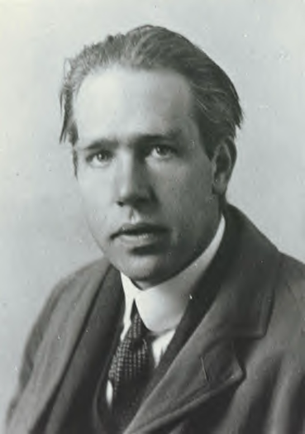
Ask him !
(see also pp. 68-72)
Niels “the kid” Bohr at 27 soon after he makes
his big theoretical breakthrough.

Slide 43
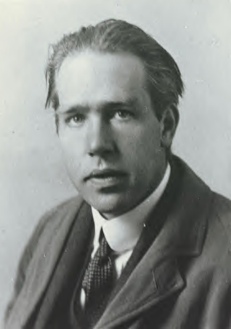
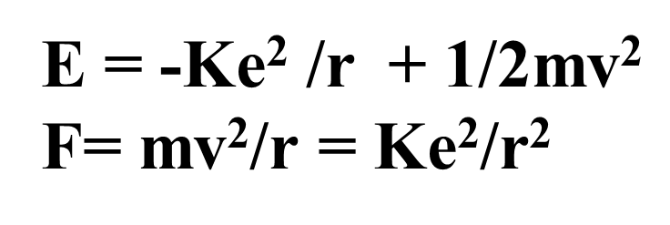
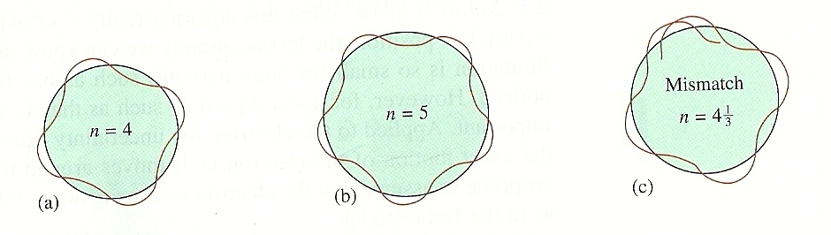
What the `kid’ does:
Takes a dollop of Old School physics
Mixes in New School Planck and DeBroglie equations:
E= hf
λ = h/mv
Forces the wavelength to fit a circular orbit around the nucleus:
see Figure 2.11 pg. 73

Slide 44
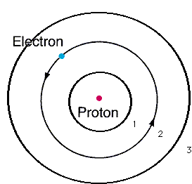
From pure theory Bohr derives the Energy, E_{H}, of the electron around Hydrogen and proposes the Bohr model of the atom:
n=3
n=2
Eq. 2.1 of text
n=1
E_{H}(J)= -2.178*10⁻¹⁸
n²
n=1,2,3…are integers defining circular orbits around positive nucleus

Slide 45
Bohr Model Predictions vs. Experiment
Calc λ_{theory}
obs λ
434
486
656
n_{i} n_{f}
434
486
656
5 2
4 2
3 2
n=5
4
2
1
3
0% error between observed and calculated !!!
Observed H line (sun) spectrum (Balmer series)
5→2
4→2
3→ 2
Bohr’s `explanation of H spectrum’: quantum transitions between levels
λ = 434 486 656 nm

Slide 46
Bohr Model Predictions vs. Experiment (continued)
Theoretical Computed radius of first H orbit:
5.20 nm
Experimentally measured ground state radius of H:
0% error between observed and calculated (again) !!!
5.20 nm

Slide 47
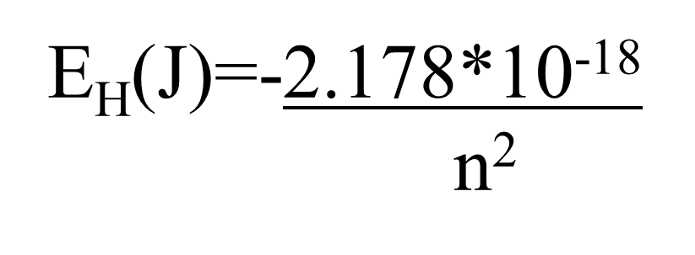
Let’s confirm that n=5→n=2 electron jump predicts λ=434 nm for H using Bohr model:
h=6.63*10⁻³⁴ J s
c=3*10⁸ m/s
h*c= 1.989*10⁻²⁶ J*m

Slide 48
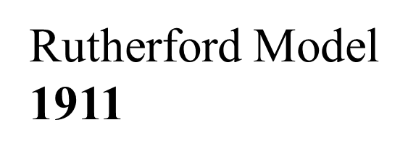

Evolution of the atomic model so far….
Thomson Model
1897
Bohr Model
1913
Philosophical Magazine 44, 295 (1897)
Philosophical
Magazine Series 6,
21, 669-688 (1911)
Philosophical Magazine Series 6
26. 1-25 (1913)

