Slide 1
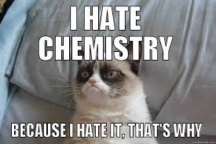
Exam 3
Wednesday 3 December
See Mini-quizzes 24-34
+ octet rule structures
+ formal charge

Slide 2
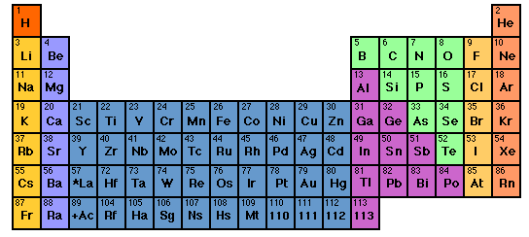
For Mini-quiz 34

Slide 3
Lewis `octet’ model (see also pp. 378)
The Entire Lewis model In a nutshell:
All bonds contain two electrons.
All elements except H and He¹ seek an outer (valence) shell of 8 electrons.
If you can –minimize formal charge.
For elements from P onwards, you can break the octet rule and use rule 3.
¹H and He are satisfied with 2 electrons= `duet’ rule

Slide 4
IN-CLASS BOARD OCTET RULE PRACTICE (continued)::
Multi-atom, neutral compounds¹
Tri, tetratomics CO₂ H₂O OF₂ COCl₂
¹How do we know what bonds to what ?
Some rules of thumb:
Atoms closer to center of Periodic Table are in center of molecule
Molecules tend to be symmetric.

Slide 5
Which structure below satisfies the Lewis octet rule for SOBr₂ ?
all single bond
S=O double
S=Br double
None of the above

Slide 6
IN-CLASS BOARD OCTET RULE PRACTICE WITH::
Diatomics O₂ √ N₂ √ CO √
tri,tetra-atomics CO₂ √ H₂O √ OF₂√ COCl₂ √
oxyanions NO₃⁻ CO₃⁻ SO₄²⁻

Slide 7
Which is the best structure for SO₃²⁻ that satisfies the Lewis octet rule
All single S-O
1 S=O,2 S-O
2 =O, 1 S-O
All S=O

Slide 8
IN-CLASS BOARD OCTET RULE PRACTICE WITH::
Diatomics O₂ √ N₂ √ CO √
tri,tetra-atomics CO₂ √ H₂O √ OF₂√ COCl₂ √
oxyanions NO₃⁻ √ CO₃²⁻ √ SO₄²⁻
Non-Lewis octet H₂SO₄ SO₂ SO₃ SO₄²⁻

Slide 9
BEYOND THE OCTET RULE: FORMAL CHARGE
UGLY CHEMICAL FACT OF LIFE #1:
For elements starting with Si in the 3rd row, the octet rule is often broken.
EXAMPLE #1: BATTERY ACID (H₂SO₄)
Lewis octet prediction for H₂SO₄ structure
From Experiment
(Kuczkowski et. al. 1983)

Slide 10
We-work-it Examples where formal charge is minimized even if we break the octet rule.
a) SO₂ SO₃ SO₄²⁻
What is the octet rule prediction for SO₂ ?
0
☹
☺
VS.
0
0
+ and – formal charges
Lewis rule 3 says not good
No formal charges anywhere.
Lewis rule 3 says good !

Slide 11
Which is the best structure for PO₄²⁻ that satisfies the minimize formal charge rule
All single P-O
1P=O, 3P-O
2P=O, 2P-O
None of the above

Slide 12
IN-CLASS BOARD OCTET RULE PRACTICE WITH::
Diatomics O₂ √ N₂ √ CO √
tri,tetra-atomics CO₂ √ H₂O √ OF₂√ COCl₂ √
oxyanions NO₃⁻ √ CO₃²⁻ √ SO₄²⁻
Non-Lewis octet H₂SO₄ √ SO₂ √ SO₃ √SO₄²⁻
√
Non-Lewis octet and radicals PF₅ SF₆ NO₂

Slide 13
Examples where we minimize formal charge or simply break octet rule because of the atom count on central atom.
CRAZY STABLE !!! (Demo)
PF₅ SF₆

Slide 14
UGLY CHEMICAL FACT OF LIFE #2
For many compounds the Lewis octet prediction of bond lengths don’t match experiment even for elements < Si
Example 1: Ozone O₃
Lewis model prediction
Expect O-O length = 15 pm
Expect O=O length = 12 pm
Observe : Both bond lengths
are identical=13.5 pm

Slide 15
Example 2: Benzene C₆H₆
Lewis Model prediction
Expect C-C lengths= 16 pm
Expect C=C lengths = 13 pm
Observe: all C-C lengths are identical = 14.5 pm

Slide 16
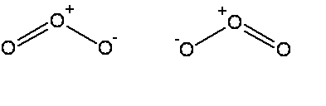


The common thread: if electrons can be moved to make the same molecule => `resonance’
Resonance structure
All bonds are equivalent
in resonance
structures
Resonance structure

Slide 17
`RESONANCE’ circulates the electrons evenly between participating atoms so that the bond lengths between those atoms are identical and an average of the possible single/ double bond distributions.
O-O length = 15 pm
O=O length = 12 pm
Observed O-O bonds all = 13.5 pm
Average = 13.5 pm
C-C lengths= 16 pm
C=C lengths = 13 pm
Average = 14.5 pm
Observed C-C bonds all
= 14.5 pm

Slide 18
U-Do-it: Oxyanion examples of resonance
NO₃⁻ NO₂⁻ CO₃⁻²
What is the static octet prediction for each ?
b) What is the actual, expected bond order to O for each example ?
4/3=1.333
3/2=1.5
4/3= 1.333

Slide 19
BEYOND THE OCTET RULE: FORMAL CHARGE
UGLY CHEMICAL FACT OF LIFE #1:
For elements starting with Si in the 3rd row, the octet rule is often broken.
EXAMPLE #1: BATTERY ACID (H₂SO₄)
Lone pairs
not shown
Lewis octet prediction for H₂SO₄ structure
From Experiment
(Kuczkowski et. al. 1983)

Slide 20
U-Do-it Examples where we minimize formal charge or simply break octet rule-
a) SO₂ SO₃ SO₄²⁻
What is the octet rule prediction for SO₂ ?
What will be the S-O bond order in SO₄²⁻ ?
1.5

Slide 21
U-Do-it Examples where we minimize formal charge or simply break octet rule (continued)
b) H₃PO₄ PO₄³⁻
What will be the P-O bond order in PO₄³⁻ ?
5/4 =1.25

Slide 22
U-Do-it Examples where we minimize formal charge or simply break octet rule (continued)
c) HClO₄ ClO₄¹⁻
What will be the Cl-O bond order in ClO₄⁻?
7/4 =1.75

Slide 23
IN-CLASS BOARD PRACTICE WITH::
Diatomics O₂ N₂ CO
tri, tetra-atomics CO₂ H₂O SOCl₂
oxyanions NO₃⁻ CO₃⁻ SO₄²⁻
Non-Lewis octet SO₄²⁻ SO₃ PF₅ SF₆
MORE…??

