Slide 1
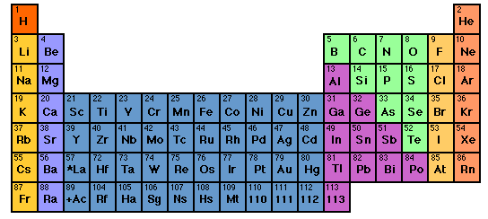
For Mini-quiz 33

Slide 2
Trends in ionic and not ionic compound formulas
HCl
NaCl
Na₂O
Na₃P
CH₄
NH₃
H₂O
MgCl₂
MgO
Mg₃P₂
Al₂O₃
AlP
Is there a simple pattern here ??
Trend across columns

Slide 3
What’s so curious ??
8
The “Noble” Elements are utterly stable …
…And what’s with this number 8 ??
Noble gas chemistry
0
None
Nada
Noble…because like all aristocrats they have nothing to do with any of the lower class elements.

Slide 4

HCl
H₂O
H₃P
1 + 7 = 8
The rule of 8: an early rationale for ionic compound formulas
2*1 + 6 =8
3*1 + 5 = 8
1
5
6
7

Slide 5
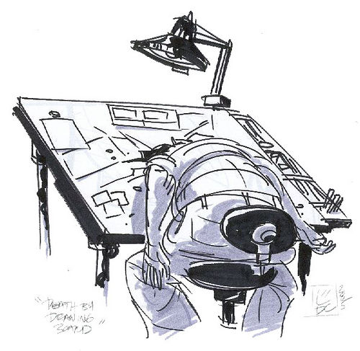
BUT…what about…
Mg + N ???
2 5
Rule of 16 ??? 3*2 +2*5=16 =2x8
(ICKY…too much math for us Americans) ☹
Actual formula Mg₃N₂

Slide 6
The crazy stability of the noble gas electronic configuration is the key to a model for predicting ionic and near-ionic compound formulas.
Example:
CaO
Ca= [Ar]4s²
O=[He]2s²2p⁴
Lose 2 e-
gain 2 e-
Ca²⁺=[Ar]
O²⁻ =[He]2s²2p⁶=[Ne]

Slide 7
Lewis dot pix for atoms
+2
-2
Ca
Ca
O
O
Complete octets
(ns² np⁶)
Ar
Ne
[CORE]
VALENCE
Ca= [Ar]4s²
O= [He]2s²2p⁴

Slide 8
The naturally occurring stable charges of elements in ionic compounds reflects the elements desire to have just a core (inert gas) set of electrons around it.

Slide 9
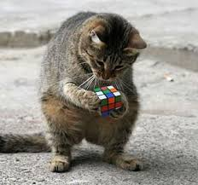
If you know the charges of elements…
you can figure out the correct formula for the compounds formed from them since the charges must add to zero in a neutral compound

Slide 10
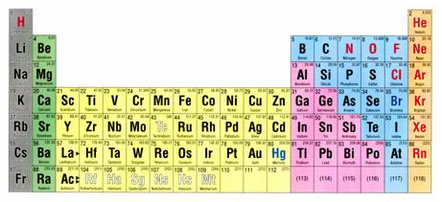

A quick visual way to know element charges
Cations: count left to col 8 for + charge
Anions: count right to col 8 for - charge
+2
-3
…but don’t do this with transition metals

Slide 11
Knowing cation and anion charges lets us predict binary compound formulas.
EXAMPLE:
Predict compound made of Na and S
1)FIND PREFERRED CHARGES
+1
-2
Na
S
2
1
2)“CROSS” CHARGE MAGNITUDES

Slide 12
In-Class practice:
Deducing formulas for ionic compounds
Ca + Cl
CaCl₂
Al + O
Al₂O₃
B + N
BN
K + S
K₂S
Mg+ As
Mg₃As₂

Slide 13
What is the correct formula for Ba + Sb ?
BaSb
Ba₂Sb
Ba₂Sb₃
Ba₃Sb₂

Slide 14

Another dumb Doc question:
“If the atoms in a compound don’t light up the bulb (not ionic) then how are the electrons distributed if not like ionic case ??”

Slide 15

* We know how to use the fancy math…but our `style ‘ is visual and practical
The Americans land…
G. N. Lewis 1925 AD: Teaches us how to use the Periodic table to rationalize ionic and covalent compound formulas without breaking a sweat…The Big Kahuna of an American-style Chemistry that looks at the big picture and uses simple, intuitive models .
(sans calculations …)*

Slide 16
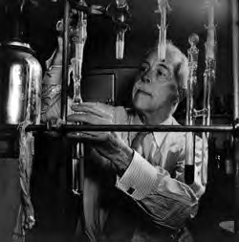
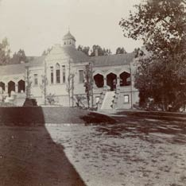
Legacies of the American chemist:
Gilbert Newton Lewis
Gilbert Newton Lewis American Chemist UC Berkeley “at work” ~1930
Before Lewis: UC Berkeley Chemistry Building ~1915

Slide 17
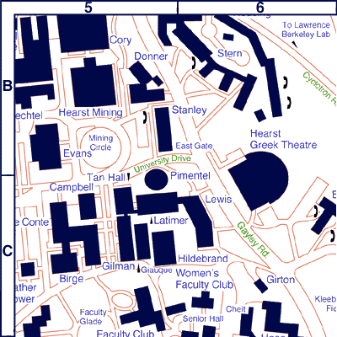
Chemistry `Quad’
UC Berkeley 2013
+ more `on the hill’ at L-L Labs

Slide 18

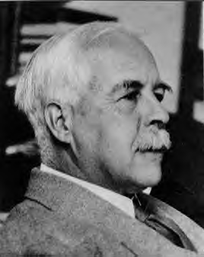
As young chemistry
nerd …Young Doc
Fong sits in here
staring every day
at a 4’x 6’ photo of…
The House that Lewis Built: Lewis Hall of Chemistry
UC Berkeley

Slide 19
Lewis `octet’ model (see also pp. 378)
The Entire Lewis model In a nutshell:
All bonds contain two electrons.
All elements except H and He¹ seek an outer (valence) shell of 8 electrons.
If you can –minimize formal charge.
For elements from P onwards, you can break the octet rule and use rule 3.
¹H and He are satisfied with 2 electrons= `duet’ rule

Slide 20
IN-CLASS BOARD OCTET RULE PRACTICE WITH::
Diatomics O₂ N₂ CO

