Slide 1
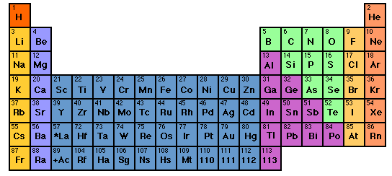
For Mini-quiz 32

Slide 2
Pigeonhole¹ representation of electrons
¹Called orbital diagrams in text
As implied by Table
+ chemical reversal
After fill, half-filled, empty correction
Cr⁺ =
[Ar] 3d⁴ 4s¹
[Ar]3d⁵ 4s⁰
*This final moving around applies only for transition metals
3d
4s
Pigeonhole representation
[Ar]
D switch rule: s and d electrons in valence shell move around to produce filled, half-filled and/or empty orbitals in order to attain a more stable atom.
Corrected for filled,half-filled, empty rule
[Ar]

Slide 3
d switch rule: s and d electrons in valence shell move around to produce filled, half-filled and/or empty orbitals in order to attain a more stable atom.
If element only has s and p….it means no switching….

Slide 4

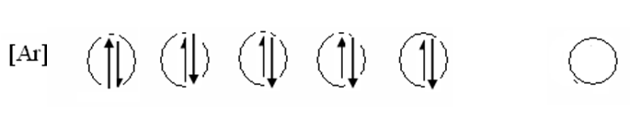

Write the correct, pigeonhole diagrams for the transition metal species below
Write the correct, pigeonhole diagrams for the transition
metal species below
a) Cr
Ni
Ag⁺
remember…rule is applied ONLY with the s & d electron combos
(e.g. transition elements only)

Slide 5
What is the correct, abbreviated, d-switched configuration for Cu⁺¹ ?
[Ar] 4s⁰ 3d¹⁰
[Ar] 3d⁹ 4s¹
[Ar] 4s¹3d¹⁰
[Ar] 3d¹⁰ 4s⁰

Slide 6


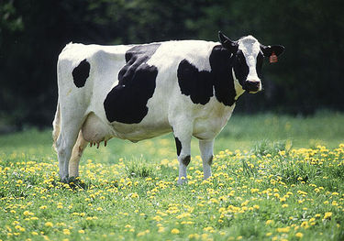
Why (really) the spdf song is sung…..
electrons utterly rule how elements react to make compounds.
What kind of electronic orbitals they possess decides how they behave chemically.
Dogs drool, cats rule
s is for silly cow
p is for pretty kitty
d is for dumb dog

Slide 7
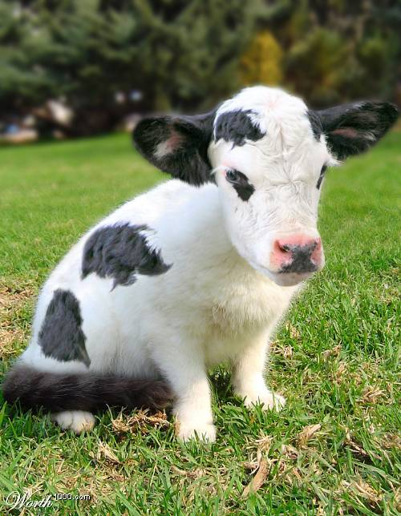

The specific combo of orbits creates the unique chemistry of an element
Be= [He]2s²
Cl=[Ne]3s² 3p⁴
Ti = [Ar] 3d²4s²
100% cow
33% cow+66% kitty
50% cow +50% dog

Slide 8
What’s Periodic about the Periodic Table ?

Slide 9

Periodic Commonalities: halogens
So what’s common ???
MP and BP very different
p mass
X
MP (^{O}C) BP ( ^{O} C)
Halogen chemistry !!!
2Na + X₂ → 2NaX (high melting white salts)
X₂(colored) + ethene→ colorless dihalides
Breathing X₂ kills you
Chemistry=
[inert gas] ns²np⁵
3 7
11 23
19 40
37 85
55 133
-220
-101
-7
114
302
-188
-35
59
184
337

Slide 10

Another example of periodic commonality inert (noble) gases
So what’s common ???
p mass
MP(º C) BP (⁰ C )
4
20
40
84
131
86 222
-272 - 269
-249 -246
-189 -186
-157 -152
-112 -107
-71 -62
[Noble gas] chemistry=
Core chemistry=
NONE

Slide 11

A final example of `periodic commonality’:
reactivities of alkali metals
Alkali metals
[inert gas] ns¹
It’s all about ….
chemistry
SIZE (n) MATTERS !

Slide 12
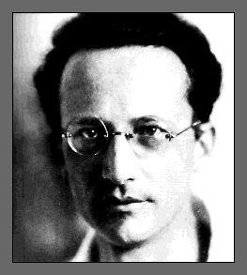

Erwin Schrodinger (whiz kid) finally solves H atom to everyone’s satisfaction (in mid 1930s) with equation below* but only after the spectroscopists gave him the benchmarks to measure his predictions against….
A little addendum…
“-h(∇²ϕ)/2m +μϕ/r =Eϕ obviously…(duh)”
*
Schrodinger’s eigenvalue equation for one electron in 1/r electrostatic potential field= (H atom)
“….spectroscopists rule, you drool.”
No closed math form for general atoms yet

Slide 13

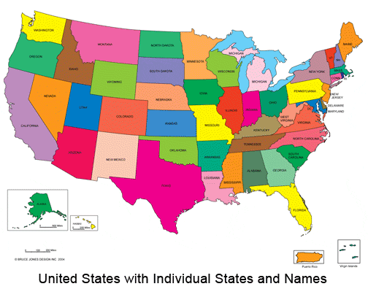


Where we’ve been so far on the chemistry bus trip…

Slide 14


Where we’ve been….
Rutherford & Bohr 1910
1) Atomic structure & dimensions
2) p+nº , e⁻ bookkeeping
3) Crazy quantum models

Slide 15

Where we’ve been ……
Mendeleev 1865 AD
1)Organizing element behavior to predict chemistry
2)Periodicity and the Periodic Table

Slide 16

In the land of the spectroscopists:
Where we’ve been….
1s² 2s² 2p⁶ 3s² 3p⁴ ……
Describing atoms by electronic configurations implied by observation and predicted by Periodic table
spectroscopy
`fugetabout theory….let the line spectra rule or I breaka your face !

Slide 17
Where we’ve been…
Dalton 1805AD
1)Law of constant proportions
2)Law of multiple proportions
Moles till we drop…..

Slide 18


Slide 19

Doc asks a few more of his dumb questions.
“OK…so we know that water is H₂O,
salt is NaCl…
Why don’t we ever see HO₂ and Na₂Cl…
…and what holds H₂O and NaCl together in the first place ?”

Slide 20

To answer Doc’s dumb questions we take a forced hike through several chemical bonding theories

Slide 21
Reading:
Chapter 8
pp. 352-365 ionic model
pp. 376-380 Lewis rules & covalent
compounds
pp. 380-384 exceptions
pp. 384-389 formal charge, resonance
pp. 389-402 VSEPR theory

Slide 22
HOW DO YOU KNOW A COMPOUND IS IONIC???
CONDUCTIVITY DEMO….
NaCl
∴If it lights up the light bulb, it’s ionic

Slide 23
Trends in binary ionic and near-ionic formulas
LiCl
Li₂O
Li₃P
Trends down a column
M_{a} X_{b} …all M’s combine the same for a given X
NaCl
Na₂O
Na₃P
KCl
K₂O
K₃P

Slide 24
Trends in ionic and not ionic compound formulas
HCl
NaCl
Na₂O
Na₃P
CH₄
NH₃
H₂O
MgCl₂
MgO
Mg₃P₂
Al₂O₃
AlP
Is there a simple pattern here ??
Trend across columns

Slide 25
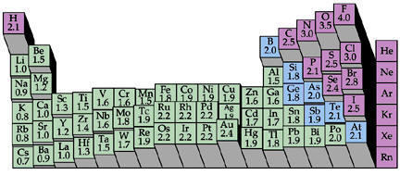
HINT #1: The Periodic Trend of Pauling’ Electronegativity (=electron suckativity) scale reveals a cliff….
1 2
3 4 5 6 7
???

Slide 26
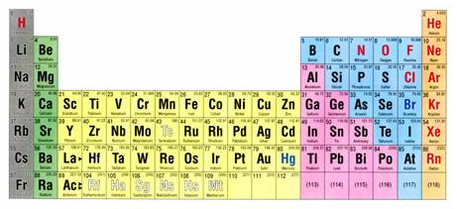
HINT #2: the curious case of column 8
1 2 3 4 5 6 7 8

Slide 27
What’s so curious ??
8
The “Noble” Elements are utterly stable …
…And what’s with this number 8 ??
Noble gas chemistry
0
None
Nada
Noble…because like all aristocrats they have nothing to do with any of the lower class elements.

