Slide 1
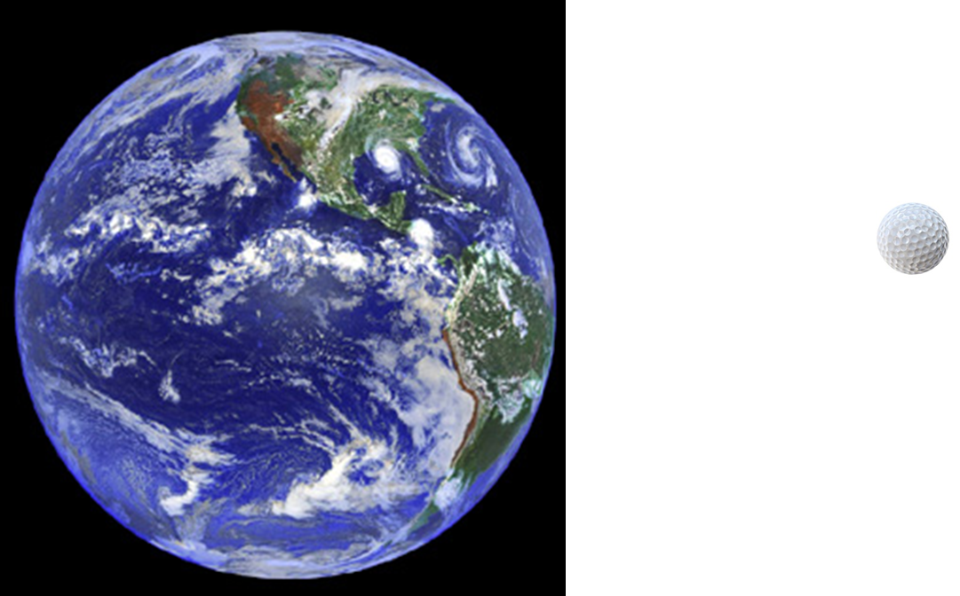
Problems with Rutherford’s atom and the old theory of light
re-summarized
- Electrons don’t suck down into + nucleus…why not ???
#1

Slide 2

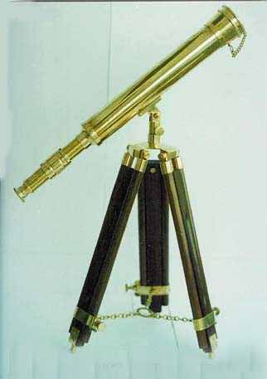
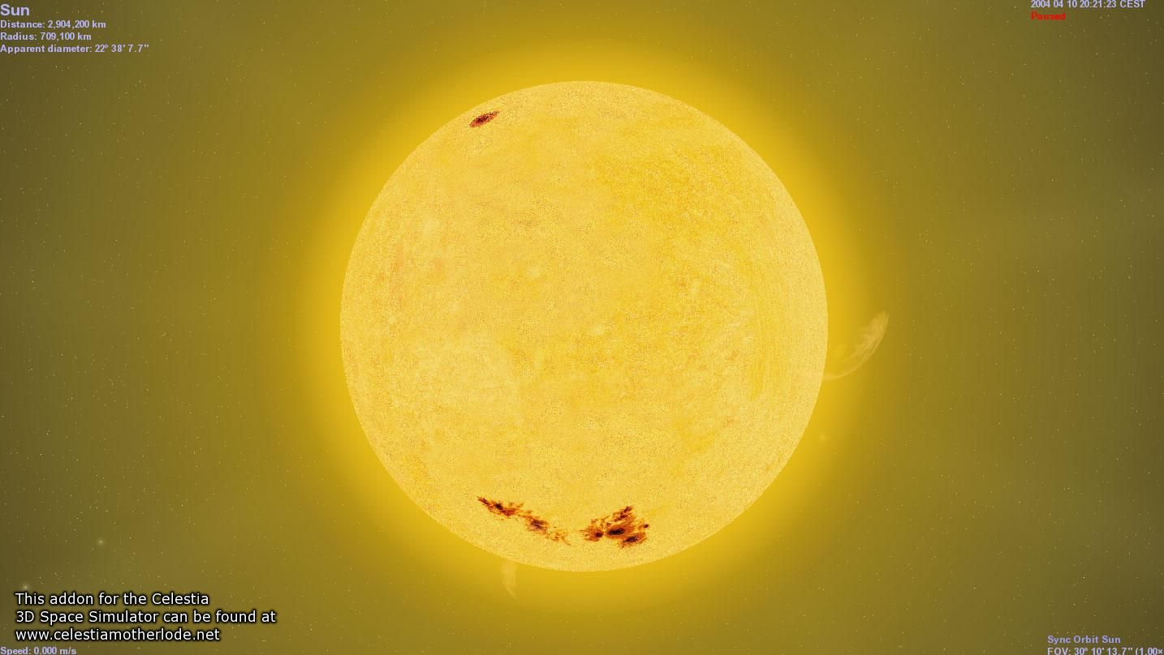
Problems with Rutherford’s atom and the old theory of light
re-summarized
#2
Why does Sun only have a few wavelengths of light coming out ???

Slide 3

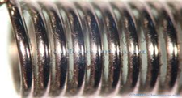
Problems with Rutherford’s atom and the old theory of light
re-summarized
Let Mickey and friends be electrons in a metal
#3
Photoelectric effect=> light is not a wave
E(photon)=hf=hc/λ=

Slide 4

A few more In-class practice on board: Planck’s law exercises …
E(J)= hf
=6.63*10⁻³⁴ J*s *f(Hz)=1.989*10⁻²⁵/λ
Mole buck opportunities

Slide 5
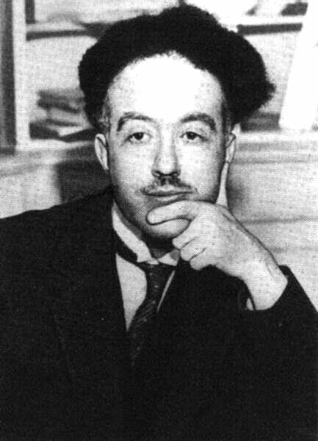
De Broglie’s* hypothesis (pp. 302)
If light acts `particle-like’ ….
then matter can act `wave-like.’
*Louis-Victor-Pierre-Raymond, 7th duc de Broglie

Slide 6
DeBroglie’s basic thinking connecting matter to waves:
Rest energy of matter*
1) Steal from Einstein: E=mc²
energy of light `wave’
2) Steal from Planck: E = hf=hc/λ
3) Combine them and simplify:
E=mc²=hc/λ
mc =h/λ
* Energy you can convert mass m to when it is not moving (at rest), e.g., v=0…source of atomic bombs.

Slide 7
De Broglie’s Hypothesis (continued)
His big idea….assume a similar relationship exists when the mass is moving at a non-zero velocity v.
=> Replace c with v:
mc =h/λ
mv =h/λ
Rearrange…to define the wavelength of a mass m moving at velocity v
=>DeBroglie’s equation:
λ = h/mv

Slide 8
E= hf
Planck’s Law explains
Photoelectric effect
DeBroglie’s equation
connects matter to a hypothetical λ
λ = h/mv
How do these fix the problems with Rutherford’s atom ?????

Slide 9
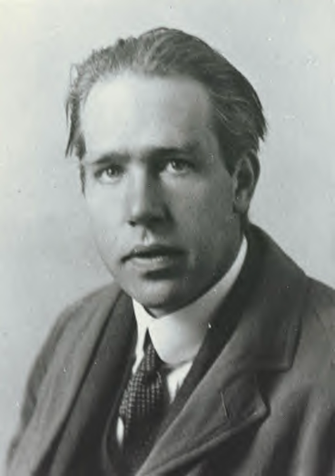
Ask him !
(see also pp. 306-310)
Niels “the kid” Bohr at 27 soon after he makes
his big theoretical breakthrough.

Slide 10
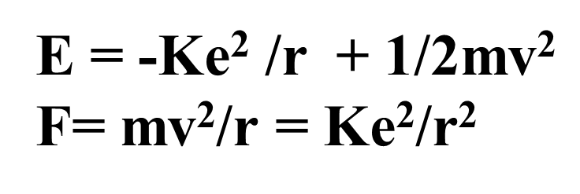
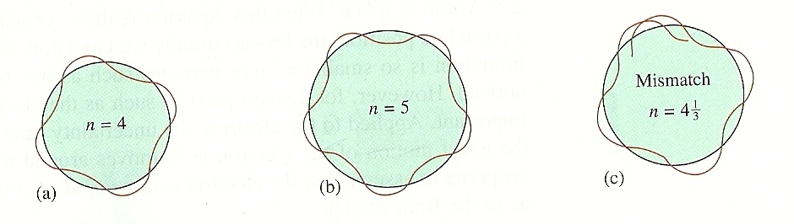
What the `kid’ does:
Takes a dollop of Old School physics
Mixes in New School Planck and DeBroglie equations:
E= hf
λ = h/mv
Forces the wavelength to fit a circular orbit around the nucleus:
see Figure 7.11 pg. 311

Slide 11
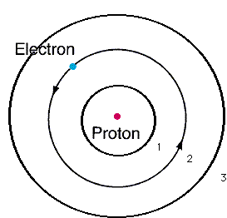
From pure theory Bohr derives the Energy, E_{H}, of the electron around Hydrogen and proposes the Bohr model of the atom:
n=3
n=2
Eq. 7.1 of text
n=1
E_{H}(J)=-2.178*10⁻¹⁸
n²
n=1,2,3…are integers defining circular orbits around positive nucleus

Slide 12
Bohr Model Predictions vs. Experiment
obs λ
434
486
656
Calc λ_{theory}
n_{i} n_{f}
434
486
656
5 2
4 2
3 2
n=5
1
4
2
3
0% error between observed and calculated !!!
Observed H line (sun) spectrum (Balmer series)
5→2
4→2
3→ 2
Bohr’s `explanation of H spectrum’: quantum transitions between levels
λ = 434 486 656 nm

Slide 13
Bohr Model Predictions vs. Experiment (continued)
Theoretical Computed radius of first H orbit:
5.20 nm
Experimentally measured ground state radius of H:
0% error between observed and calculated (again) !!!
5.20 nm

Slide 14
Bohr’s Quantum jump pix
Mr. electron sez FU…hell no
I won’t go
Light with different energy than E₁₂ (even if a tiny, tiny bit smaller)
n=2
n=1
Light with exactly energy E₁₂
Magic happens
E₁₂

Slide 15
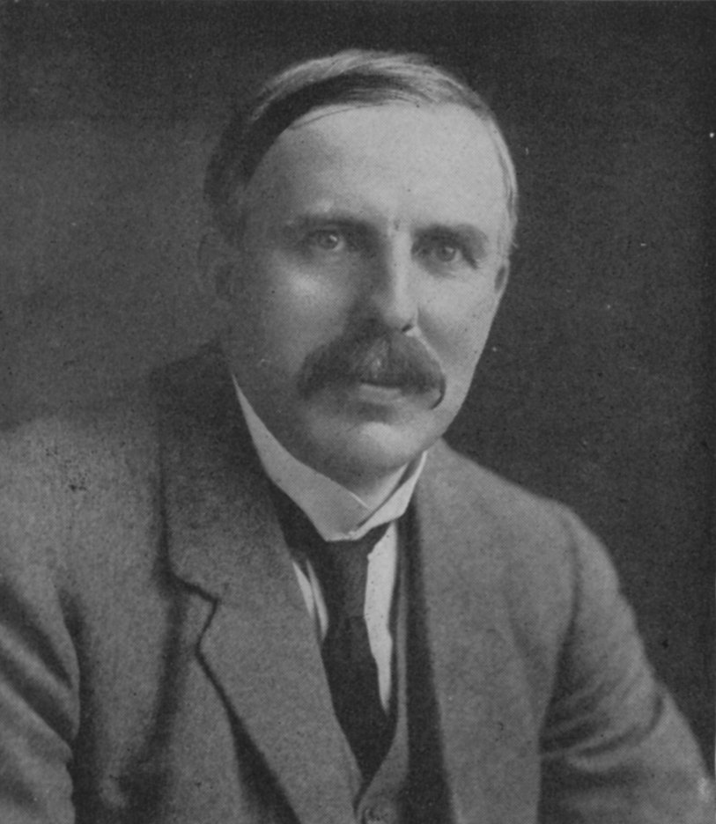
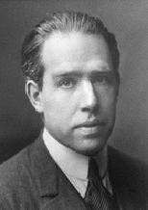

How Bohr’s new way of thinking about matter bails out Rutherford
1)Why don’t the p⁺ and e⁻ attract and come together ??? (or…why isn’t Earth the size of a golf ball?)
help
???
Electrons exist exclusively in defined circular paths at fixed distances from the nucleus

Slide 16

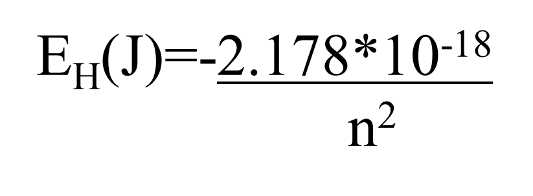
2)Why doesn’t the sun show all colors (e.g. show white light) when telescopes record spectrum?
???
help
???

Slide 17
Let’s confirm that n=5→n=2 electron jump predicts λ=434 nm for H using Bohr model:
h=6.63*10⁻³⁴ J s
c=3*10⁸ m/s
h*c= 1.989*10⁻²⁵ J*m

Slide 18
3) Light’s not a wave…photoelectric effect
see Figure 7.11 pg. 311
…Bohr turns this on its head (like DeBroglie)…matter is a little wavelike…and it works !!!

Slide 19
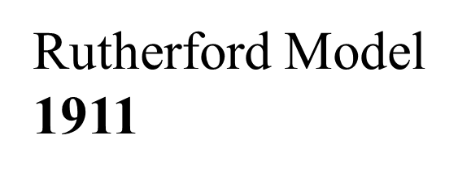
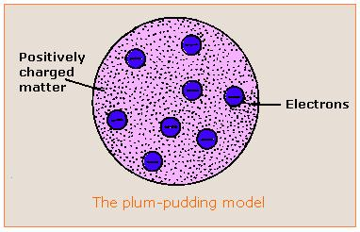

Evolution of the atomic model so far….
Thomson Model
1897
Bohr Model
1913
Philosophical Magazine 44, 295 (1897)
Philosophical
Magazine Series 6,
21, 669-688 (1911)
Philosophical Magazine Series 6
26. 1-25 (1913)

Slide 20



the quantum cat dilemma-one consequence of Bohr’s quantum concept
Kitty state =ψ = f₁ ϕ₁ + f₂ϕ₂
(According to quantum physics)
f₁ ~ 1, but not quite f₂ ~ 0 but not quite

Slide 21

Another animated,
Abused quantum cat-in-a-box
story….

Slide 22

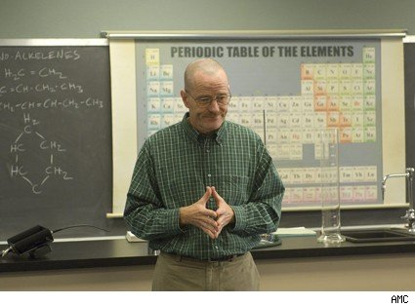
What happened to chemistry ?????
Walter White talking chemistry in “Breaking Bad”

Slide 23

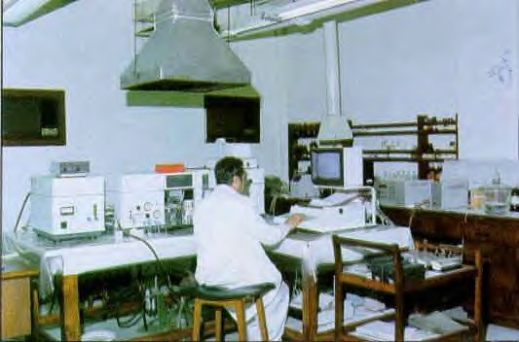

The Bohr Model dies…1930
1930
Bohr theory
The experimental chemists and spectroscopists say “fugetabout” it.
“typical” experimental spectroscopist/chemist
Experimentalist’s attitude towards theoreticians:
“If I want your opinion, I’ll give it to you…”

Slide 24


Bohr’s little Problem…
1930
Bohr theory
Observed
Na-`D’ line
Is yellow
Even worse..
Spectroscopists observe….
Bohr’s prediction: 1 green line
11 lines !!
1≠11
1)Bohr can’t predict anything right except H…the other elements have too many lines, e.g. Na
BOHR
1 line predicted
EXPERIMENT
11 LINES OBSERVED

Slide 25
Bohr model’s failures (continued)
2)…even Bohr’s predictions for H have problems
Can’t predict magnetic `fine’ structure of H, e.g
…magnetize H and even n=1 splits into 2 lines
1 ≠ 2
Turn on magnet near H
☹ Not even the smartest theoretical physicists of the day (Sommerfeld, Planck, Dirac) can make 1=2 or 1=11…. with Bohr’s model

Slide 26
Link to atomic line spectra of elements…none of which Bohr can explain except H
http://chemistry.bd.psu.edu/jircitano/periodic4.html

Slide 27

Evolution of the atomic model so far….
Thomson Model
1897
Bohr Model
1913
Philosophical Magazine 44, 295 (1897)
Philosophical
Magazine Series 6,
21, 669-688 (1911)
Philosophical Magazine Series 6
26. 1-25 (1913)

Slide 28

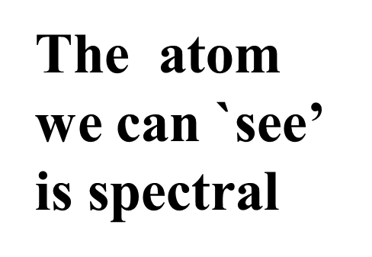
“Model 4: The spectroscopist’s atom
My way or the highway…
…or why we sing the spdf song
The spectroscopists description of what they deduce from observingt lines is the `atom’

