Slide 1
More examples of modeling atomic dimensions…
1) Electronic density vs. nuclear density (g/ m³)
Atom part
r(m)
M(g)
V(m³) =4πr³/3
d=M/V
Nucleus
Electron cloud
10⁻¹⁵
10⁻¹⁰
1.67*10 ⁻³⁰
9.11*10 ⁻³⁴
4.2*10 ⁻⁴⁵
4.2*10 ⁻³⁰
~4*10 ⁺¹⁴
~2*10 ⁻⁴
d(nucleus) = 2*10 ¹⁸
d(electron cloud)

Slide 2
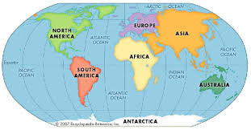

The metaphor….
Total surface area of Earth ~5*10 ¹⁴ m²
d(Electron cloud) ~ 1 person alone on Earth/5*10¹⁴

Slide 3
d(nucleus) = 2*10¹⁸ = >
d(electron cloud)
d(nucleus)=2*10¹⁸*d(electron cloud)
The metaphor:
d(nucleus)=2*10¹⁸*( 1/5*10¹⁴ )= 4000
~ equivalent to having every square meter of earth
stacked 4000 people

Slide 4
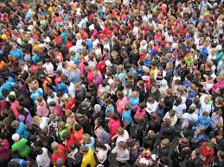
The metaphor….extended to the nucleus
d(electron cloud) …
d(nucleus)
4000 layers of people cover the planet

Slide 5
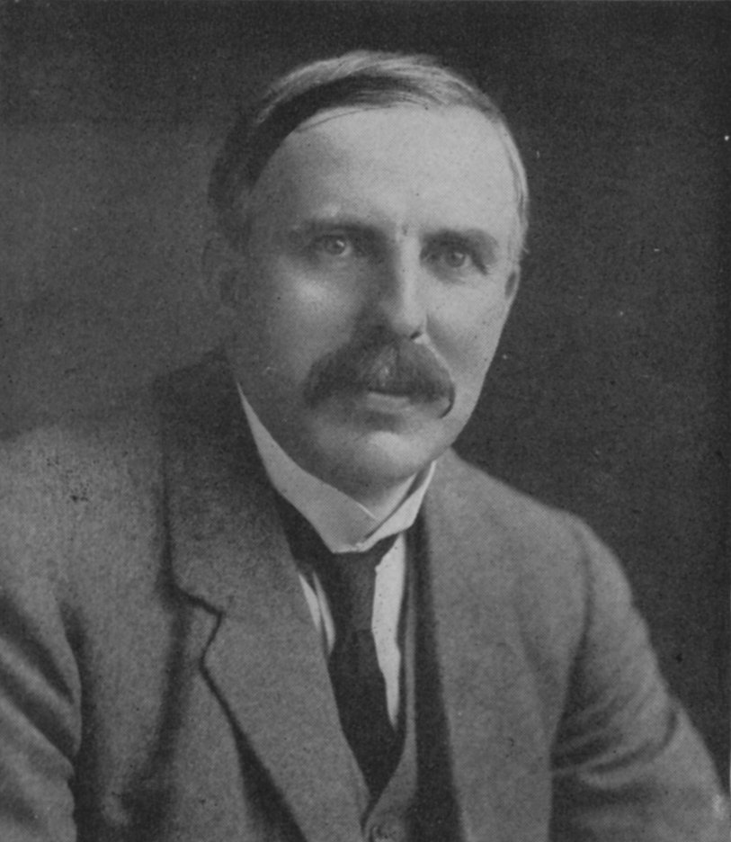
1912 : Ernst Rutherford is the `Man’…and presides over the `Golden Age of Experimental Physics’…THE ATOM APPEARS CONQUERED
vintage Rutherford:
“All science is either Physics or stamp collecting.”
His students find neutrons, build first mass spectrometers, establish source of isotopes, measure atomic charge, mass & dimensions

Slide 6
1912: Rutherford ‘s atomic model rules
Electrons (-) out here
+
Protons (+) and neutrons squeezed in here

Slide 7
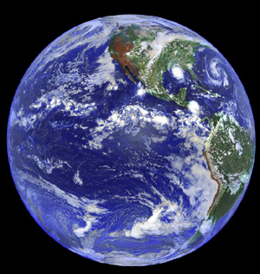
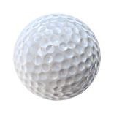
But there are 2 BIG Problems
with Rutherford’s model
1)Why don’t the p⁺ and e⁻ attract and come together ??? (or…why isn’t Earth the size of a golf ball?)
???

Slide 8

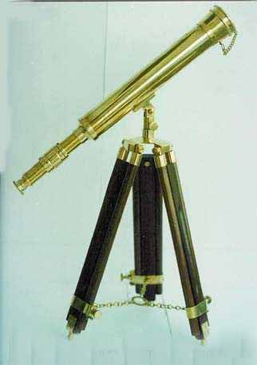
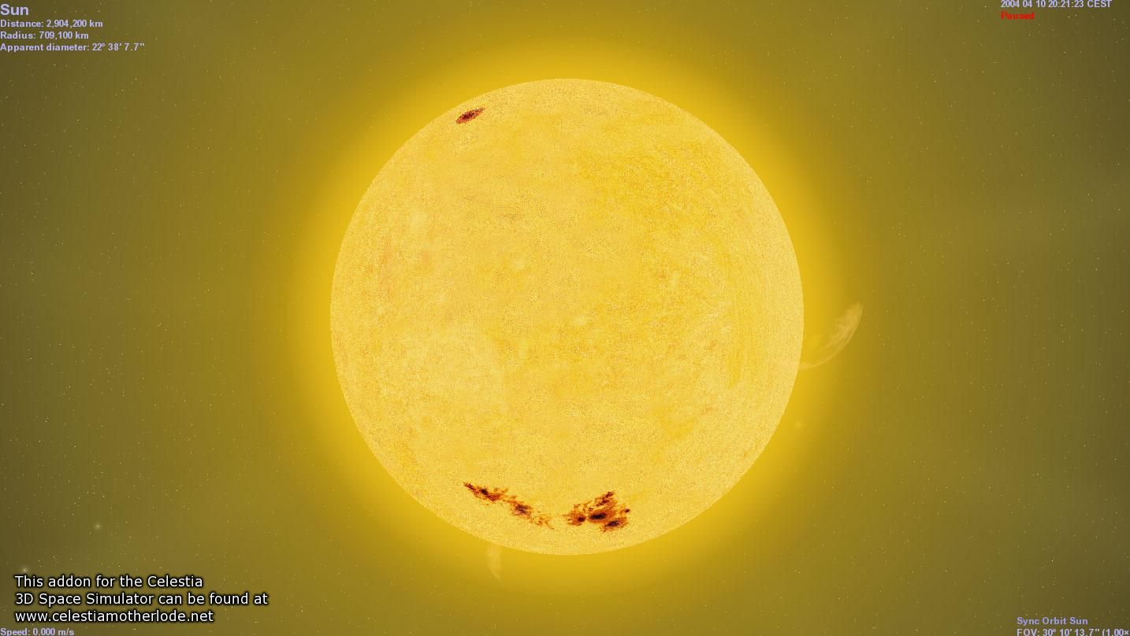
Rutherford atom’s problems (continued)
2)Why doesn’t the sun show all colors (e.g. show white light) when telescopes record spectrum?
Diffraction grating divides up light colors
???
Why only few really strong lines

Slide 9
AN EVEN BIGGER third PROBLEM FOR RUTHERFORD’S LAB
3) The photoelectric effect problem
and the trouble with the theory of light
Help!!!!

Slide 10
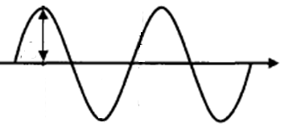
λ
Language of classical light theory (see also: p 58-60)
A
C
A= amplitude
λ= wavelength (meters)
c= speed of light = 3*10⁸ meters/second
“nu”
ν=f = frequency = # full waves passing a point in a second (cycles/second)

Slide 11
λ
Equations of classical light theory (see also:
p 58-60)
A
C
f*λ=c
Wave Energy ~ A²
ν=f = frequency
= # full waves passing a point in a second

Slide 12
Units for wave equation
frequency * wavelength = speed of light
f * λ =c
1
seconds(s)
*
meters(m)
= 3.0*10⁸ m
s
Hertz (Hz)
Cycles/second (cps)

Slide 13
In-class, on-board exercises with wave equation:
f * λ =c

Slide 14
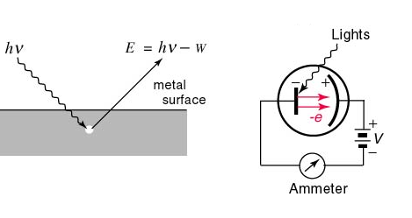
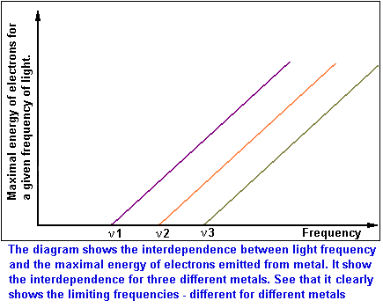
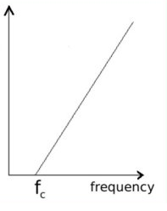
Photoelectric effect: the textbook version
E=Energy of ejected electron from metal
See also p. 300-302 of text
Threshold frequency for emission varies with metals (f₁=ν₁ for metal 1, f₂=ν₂ for metal 2 etc.)

Slide 15


The usual textbook explanations of the photoelectric effect mask the really bizarre, underlying meaning of the experiment.
The Mickey Mouse alternative:

Slide 16

According to `common’ sense, which wave capsizes Mickey and the gang ?
High amplitude (A)
Low frequency (f)
Low amplitude (A)
high frequency (f)
Let Mickey and friends be electrons in a metal

Slide 17
What actually happens in the photoelectric effect experiment
High amplitude (A)
Low frequency (f)
Low amplitude (A)
high frequency (f)
Let Mickey and friends be electrons in metal

Slide 18
WHAT THE PHOTOELECTRIC EFFECT MEANS: (SEE PAGE 299-304)
1) THE ENERGY, E, OF LIGHT IS NOT
CONNECTED TO AMPLITUDE

Slide 19
WHAT THE PHOTOELECTRIC EFFECT MEANS (continued):
Planck’s constant h in J*s
2) E(J) = h*f = 6.63*10⁻³⁴ *f(Hz)
1 hz = 1 cycle/second
The Planck equation

Slide 20
WHAT THE PHOTOELECTRIC EFFECT MEANS (continued)
3) LIGHT IS NOT A WAVE !!!!

Slide 21
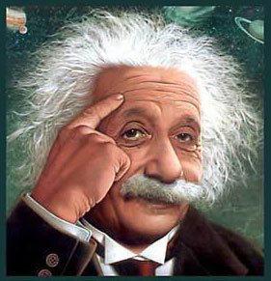
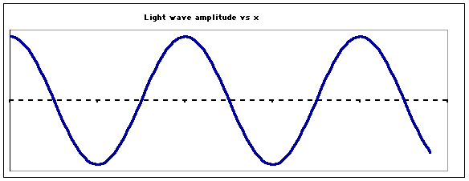
…so what is light if not a wave ??????
Einstein’s image….
LIGHT IS A “PHOTON”
=A MASSLESS BULLET OF ENERGY
OLD
wave
See also Figure 7.5 page 302
NEW
Stream of photons

Slide 22
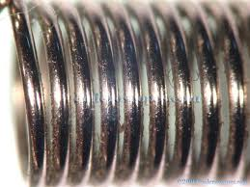
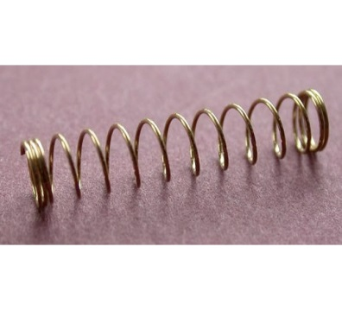
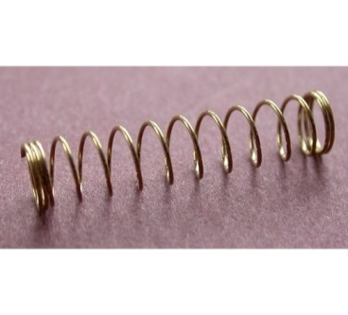

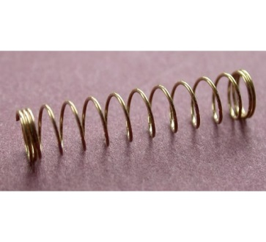
Planck’s equation: hf=E_{photon}
hf
hf
hf
hf
Stream of photons
Doc’s analogy: 1 Photon is like a unit of coiled spring
High frequency(high f)…high energy
tight
low frequency (low f)…low energy
loose

Slide 23
What the `photon’ idea gives us…
Joules=J
h=6.63*10⁻³⁴ Joule *s
E(J)=hf(Hz)
Planck’s Law
Combined with…
c=f*λ
=> f= c λ
Substitute into…
wave equation
∴ E= hc
λ
Energy of light is now connected to the color (wavelength) of light
c=3*10⁸ m/s
λ in meters(m)

Slide 24
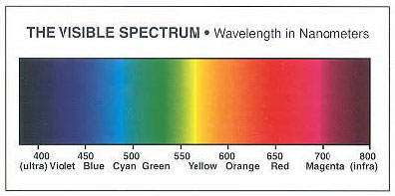
Which is the high energy end of the visible spectrum ?
short wavelengths
long wavelengths
High f
High E
low f
low E
λ Units in 10⁻⁹ m

