Slide 1
Exam 3: coverage
Homework 14-22
PV=nRT problems
Qualitative features of kinetic theory of gasses
Atomic dimensions and theories
spdf song (including d switch, and the filled/half-filled empty rule)
Ionic compound prediction
Basic Lewis octet structures and formal charges
Beyond Lewis:
minimize formal charge structures
excited states
resonance
bond order
VSEPR predictions

Slide 2
Final exam:
10:15 AM Monday 14 December
PHS 107

Slide 3
U-Do-it: Oxyanion examples of resonance
NO₃⁻ NO₂⁻ CO₃⁻²
What is the static octet prediction for each ?
b) What is the actual, expected bond order to O for each example ?
4/3=1.333
3/2=1.5
4/3= 1.333

Slide 4

The `big picture’ for the Lewis model, so far:
The Lewis Model of Bonding Tells Chemists:
Bond order and electron ownership
Formal charge distributions
Excited state configurations (COCl₂ example)
Whether resonance exists (or not)

Slide 5

The Lewis model also provides:
Insight into chemical reactivity.
Predictions of Molecular structure (VSEPR theory pp. 193-217)

Slide 6
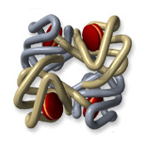
Lewis and chemical reactivity: some simple examples
1) CO and blood
Fe³⁺
vs.
-
CO has 200-400X stronger electrostatic attraction to Fe³⁺ from formal charge vs. O₂. Explains why CO so easily asphyxiates humans even at `low’ concentrations (400 ppm)…it never lets go of the Fe³⁺

Slide 7
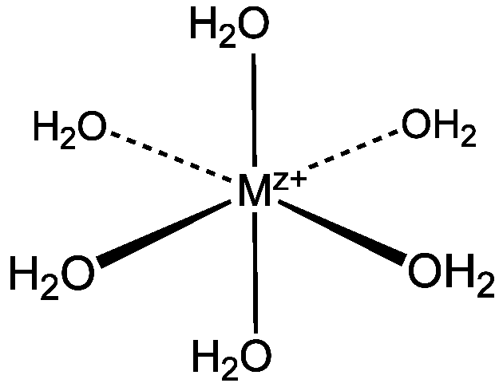
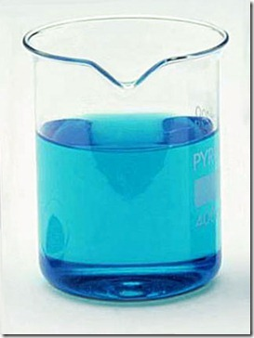
Lewis and chemical reactivity: some simple examples (cont.)
2) complexation of metals
Aquo complexes of metals’
color related to lone pair bonding to M^{z+}
Cu(OH₂)₆²⁺

Slide 8
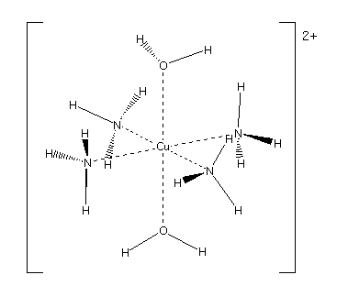


Change the source of the lone pair….. changes the color

Slide 9
Lewis and chemical reactivity: some simple examples (cont.)
In biology we need bacteria and light to fix N₂ (convert to C-N single bonds). Chemically it is very hard to `fix’ N₂ .Why ??
3 bonds are tough to rupture
When H₂O and CO₂ mix to make carbonic acid (H₂CO₃) (essence of Sprite), how does it happen??

Slide 10
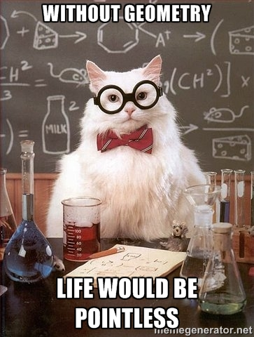
And Finally…..Lewis Model provides accurate molecular structure predictions

Slide 11
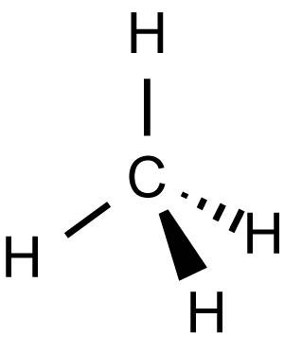
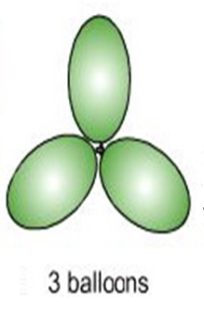
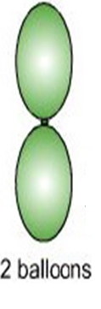
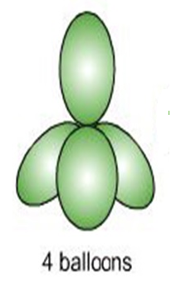
Lewis Model and Molecular Structure predictions
(VSEPR theory : electron clouds are balloons)
:N≡N:
TRIGONAL PLANAR
LINEAR
TETRAHEDRON

Slide 12
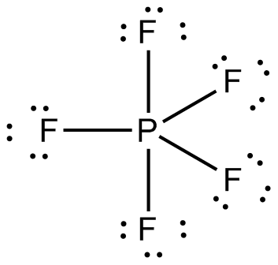
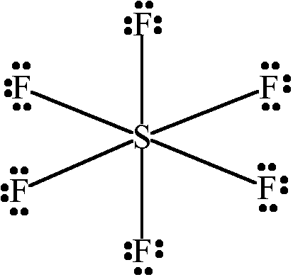
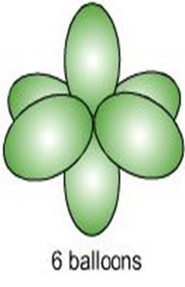
TRIGONAL BIPYRAMID
OCTAHEDRON

Slide 13
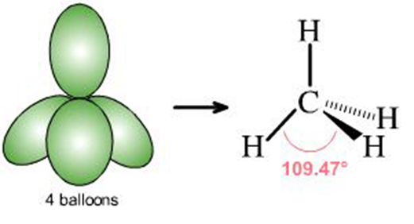
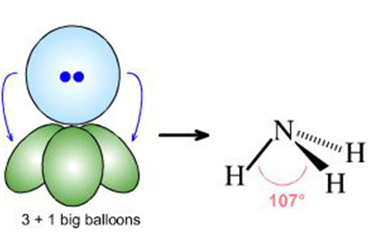
What if lone pairs take up some of the balloon space ?
No lone pairs: 4 bonds to atoms
Pyramid or tetrahedron
1 lone pair + 3 bonds to atoms
Trigonal pyramid

Slide 14
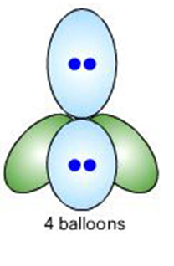


2 lone pairs + 2 bonds to atoms
Chemical example
Bent structure

Slide 15
Lewis structure
Relevant shape?
shape name?
Trigonal plane
formaldehyde
LINEAR
carbon dioxide

Slide 16
Lewis structure
Relevant shape?
shape name?
Bent structure
Nitrite anion
TETRAHEDRON
Sulfuric acid

Slide 17
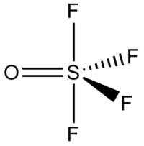
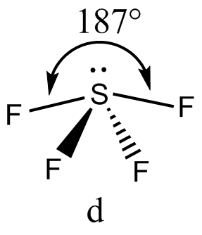
Lewis structure
Relevant shape?
shape name?
Trigonal
bipyramid
Sulfur tetrafluoride
Square pyramid
1 lone pair + 4 bonds

Slide 18
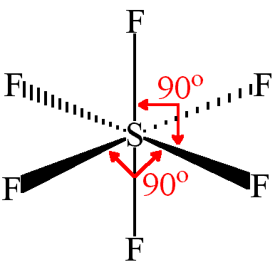
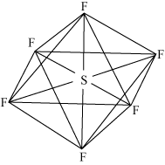

And finally…SF₆, a `six-balloon structrure
Shape it makes is `octahedral’

Slide 19
U-Do-It VSEPR predictions
NO₂⁻
PH₃
SO₂
SO₃
ClO₄⁻
Hint: First do Lewis structure
Then select a shape
1)Linear 4) trigonal pyramid
2)Trigonal plane 5) pyramid
3)Bent 6) square pyramid
7) octahedron

