Slide 2
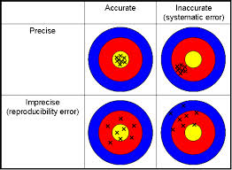
PRECISION AND ACCURACY : what are they ?
Your thoughts…..

Slide 3
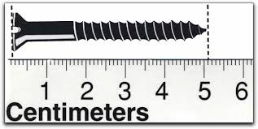
Why do we care about Sig Figs in Chemistry?
The Sig Fig count tells us the precision of measurement
How long is the screw ?
1 sig fig
5 cm
How long is the screw now?
5.1 cm
2 sig fig

Slide 4
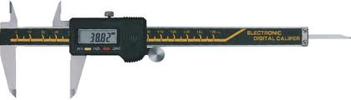
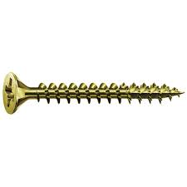
Metric micrometer does even better
51.03^{mm}
How long is the screw now in cm ?
5.103 cm
How many sig figs now ?
4 sig fig

Slide 5
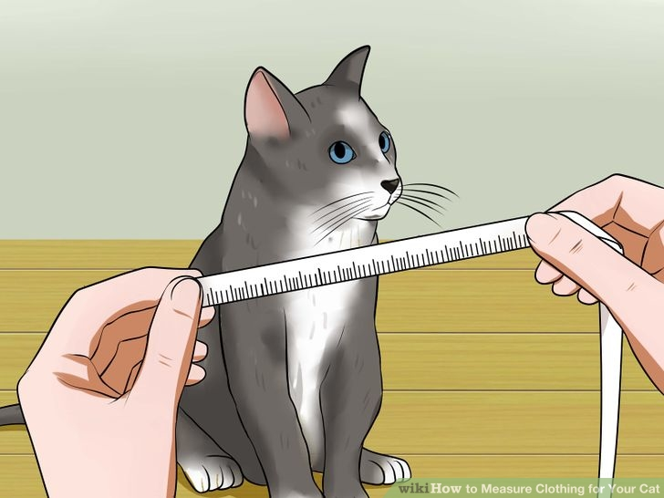
Technological aside:
Higher verifiable precision
(more sig figs) correlates
with higher technical development
1492: Columbus is within + 10,000 miles of estimate for Earth’s diameter
2016: we can pin point the position of anyone via GPS to within ~ + 0.0001 miles (within 12 inches)
In ~ 500 years human measurement precision has increased by > 10 million

Slide 6
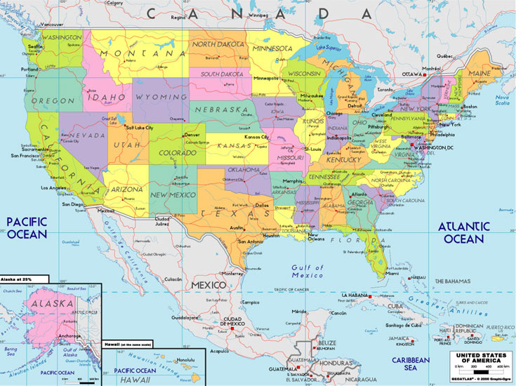
Counting sig figs: Atlantic & Pacific method
Absent Decimal…
move from right (Atlantic side) and start counting when first non-zero digit encountered
10020
300
450070
4
1
5
# sig fig ?

Slide 7
Counting sig figs: Atlantic & Pacific method
Possesses decimal
…move from left (Pacific side) and start counting when first non-zero digit encountered
1.002
0.030
0.00400
4
2
# sig fig ?
3

Slide 8

What is the sig fig count given a scientific notation version of a number ???
3 sig figs
exponent
Example: 6.02*10²³
Pre-exponent
The count of digits in the pre-exponent is the sig fig count.

Slide 9
# sig figs ?
value | 0.0051 | 510 | 5.10 | 5.0010 | 5.0*10⁶⁰
# sig figs =
2
2
3
5
2

Slide 10
Calculations done to correct sig fig
Adding/subtracting
The decimal count of the least precise value sets the determines the calculation’s decimal count….
3.1
3.001 + 0.1 + 0.01 =_____
16
14.5- 0.100 + 2 = _____

Slide 11
Calculations done to correct sig fig
Multiplying/dividing
The value with the lowest sig fig count dictates the calculation’s sig fig count
1.0
9
(10.1/2.000) =______
5.0*0.99876
11*0.9 =_____ 5.1000*0.211

Slide 12
Calculations done to correct sig fig
Multiplying/dividing
Combo
Do +/- first to correct count; then x and / to lowest sig fig count
3.1
3.001 + 0.1 + 0.01 = _______ 1.5000*2.00
= 1.0
3.0

