Slide 1
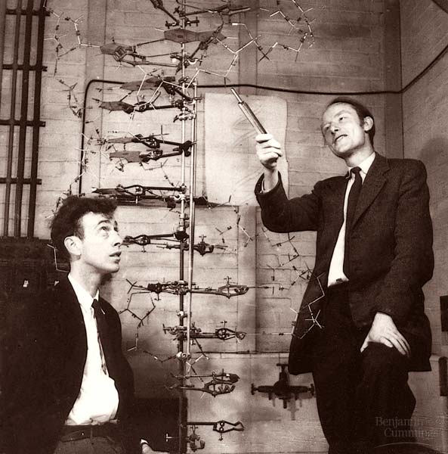
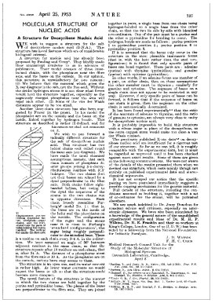
Biologist
CHEMIST
Physicist
Nature 171, 737-738 (1953)
The paper that changed everything.
WATSON
CRICK

Slide 2
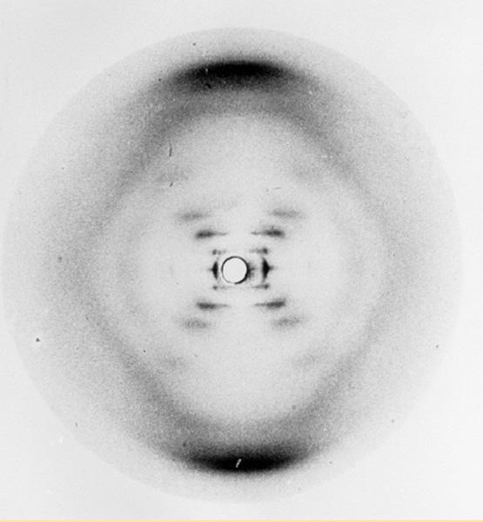
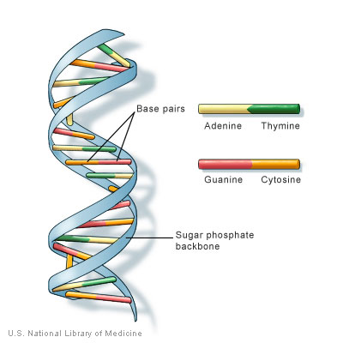
CHEMISTS:
EVERYWHERE IN THE DETAILS

Slide 3

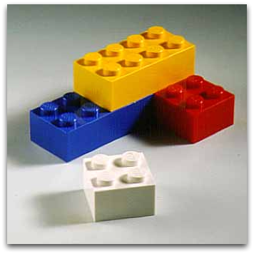
The start of everything….Lego metaphor
Chemical Elements: basic building blocks of everything
Elements(atoms)
Molecules

Slide 4
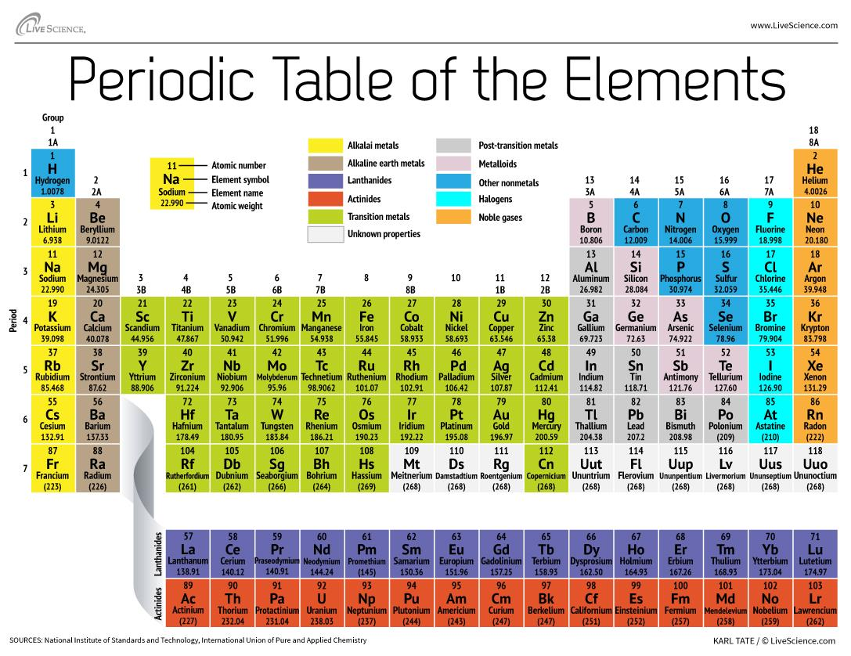
Periodic Table of the Elements:
how we organize the building blocks of everything
Know names and symbols of 1st three rows by Friday
K

Slide 5


OK…everything is built of (indivisible) elements=atoms….so…. ????
What does an atom look like ?
(FYI…it doesn’t look like a Lego…)

Slide 6
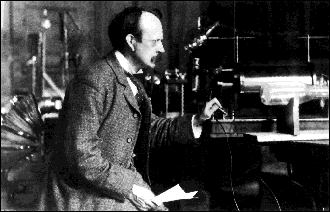
The first real try at probing the atom’s insides:
J. J. Thomson’s `CRT’: 1897 (see chapter section 2.4)
J.J. Thomson Cavendish Labs, Cambridge UK
J.J’s `Cathode Ray Tube’ (CRT)*
Proves that atoms are composed equal amounts of + and – (=electrons)

Slide 7
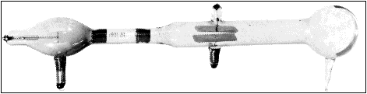
Thompson’s¹ `CRT’ …opposites attract, likes repel
(+)
(-)
What must be charge of outgoing beam ?
(-)
(+)
Negative (-)
Only sees (-) beam,
never a (+) beam

Slide 8
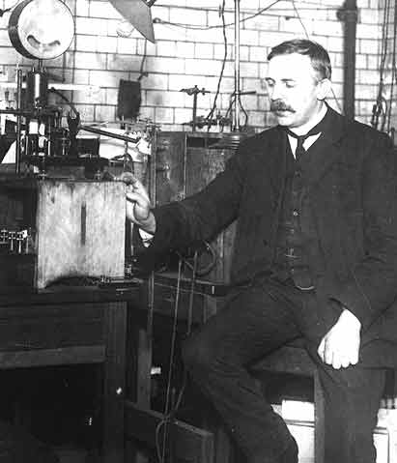
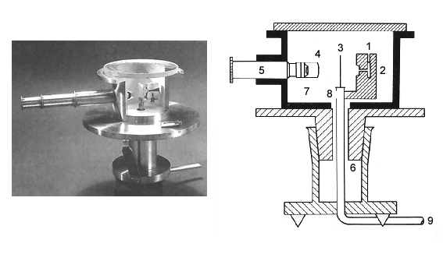
Testing Thomson’s model: Rutherford’s gold foil experiment (1910) see also: figure 2.11 pg. 52
Ernst Rutherford
Physical Laboratory
Manchester University, UK
Rutherford’s Gold foil apparatus*

Slide 9
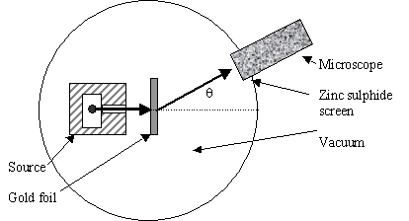
Atomic structure testing (continued)
Schematic of Rutherford’s `gold foil’ apparatus
Microscope
Rotated to detect scintillations
Alpha (α) particles=He⁺
ZnS screen is a scintillating surface
Gold Foil Experiment lore
Marie Curie supplied the radon =α source.
It required ~ 1 hour sitting in absolute dark to condition eyes.
You could only observe scintillations for 1-2 minutes before
desensitizing.

Slide 10
Atomic structure: testing Thomson’s Plum Pudding Atomic Model(continued)
Other Facts about the Gold Leaf Experiment rarely mentioned:
α particles move crazy fast:
velocity ~ 0.1c ~7*10⁷ mph
(can get to NYC from here in ~0.01 sec)
α particles are crazy overweight compared to the electrons (e-) in a gold atom:
~800X heavier than all 79 e- in gold atom
The gold foil is crazy thin:
~ 8.6*10⁻⁶ cm thick
(~1/3000 the thickness of cheap toilet paper )

Slide 11
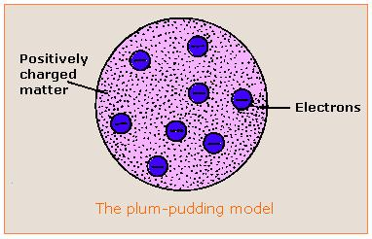
Atomic structure: testing Thomson’s Plum Pudding Model (continued):
Reminder of the Plum Pudding Model being tested

Slide 12
Given the preceding facts, predict how the α particles will behave after striking the gold foil if the structure of gold is as described in Thomson’s Plum Pudding model .
Bounce straight backwards off the foil like a baseball hitting a wall.
Punch through the foil like it wasn’t there.
Scatter off the foil randomly in all directions.

Slide 13
Plum Pudding model predicts the massive α particles will pass ~un-deflected through gold foil made of diffuse matter
α particles
Rutherford’s observations mostly agree with above.
But sometimes a few curve off significantly…
And once and in a great while, one bounces back. !
Gold foil

Slide 14
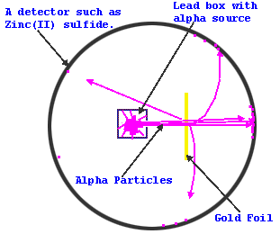
Atomic structure: testing Thomson’s Plum Pudding Atomic Model(continued)
Pictorial summary of results of gold foil experiment
Seminal publication on results:
Geiger H. & Marsden E., On the Diffuse Reflectance of α-Particles Proceedings of the Royal Society, Series A 82: 495–500 (1909)

Slide 15
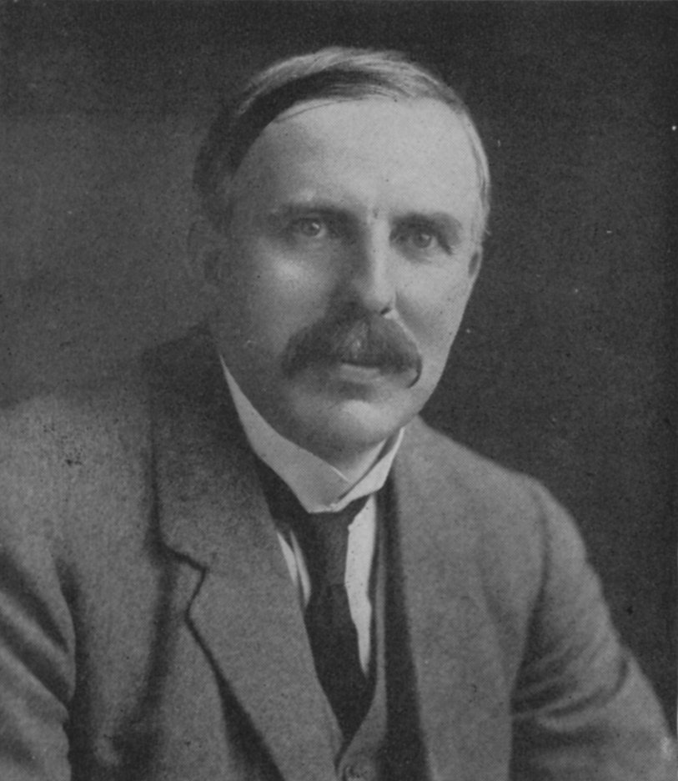
Atomic structure: testing Thomson’s Plum Pudding Atomic Model(continued)
Rutherford’s famous `take’ on Marsden and Geiger’s results:
“Like firing a howitzer at tissue paper and having the shell bounce back !!”

Slide 16
Which model below best explains the gold foil scattering data?
Thin, dense electron ring around large, dense ball of positives.
diffuse, continuous ball of electrons around tiny, dense ball of positives.
Inner thin, dense positive ring surrounded by outer thin,dense electron ring.

Slide 17
Atomic structure: Rutherford’s Atomic Model
Rutherford’s Atom:1911
The Second Experimentally-Based Metaphor of the Atom
Electrons in diffuse cloud around tiny (but massive) positive charged nucleus.
E. Rutherford, F.R.S. The Scattering of α and β Particles by Matter and the Structure of the Atom
Philosophical Magazine Series 6, vol. 21, p. 669-688 (1911)

Slide 18
Some Details of Rutherford’s Atom
Diffuse electron
Cloud out here
~ 10⁻¹⁰ m
~10⁻¹⁵ m
Nucleus is + charged
Electrons are - charged
Nucleus at center (magnified here ~10,000X)

Slide 19
Rutherford’s Atom by the numbers
Diameter of electron cloud = 100,000
Diameter of nucleus 1
Atomic part Relative mass % mass of atom
Nucleus 1 99.5
Electrons 0.005 0.5
Atomic part Relative volume
Nucleus 0.00000000000001
Electrons 1
electron cloud is 99.99999999% of atomic volume but only 0.5% of the mass

Slide 20
Chemical metaphor 1 for Rutherford atom
Atom as …..
String and pencil dot

Slide 21

N=# cuts
1
2
3
4
20 cm (~8 inches)
Atomic metaphor 2:
Touchy, feely sense of atom dimensions:
paper and scissors example
N=31
N to electron radius ??
N to nuclear radius ??
N=50

Slide 22
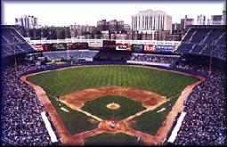


Atom dimensions in familiar terms: Metaphor 3
where is the edge of the electron cloud ?
3”
Baseball as nucleus
Old Yankee Stadium, the Bronx

Slide 23

Nucleus(+)
~ dimension of electronic cloud (-) (2.4 mile radius from baseball nucleus)
Notes:
Stadium at 1. E. 161st st., Bronx NY 14051

Slide 24
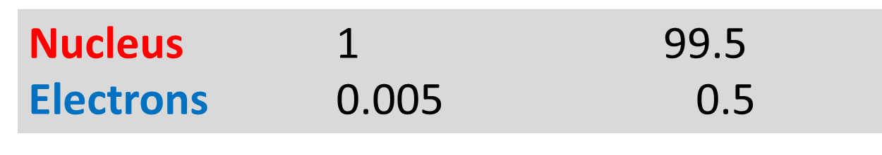
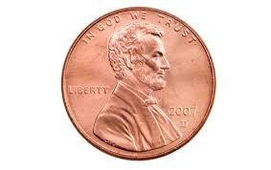
Chemical metaphor 4:
nuclear vs. electron mass
Atomic part Relative mass % mass of atom
Nucleus mass/electron mass
=1/0.005 =2000
if electron mass (≈ 3 g=0.0066 lb)
=>Nuclear mass≈ ?
2000*0.0066 lb=13.2 lb

