Slide 1
I am taking Chem 1013 because:
My curriculum forces me to.
My heart’s desire is to be a chemist.
I’m a sick masochist who loves pain.
Nothing else better to do with my time.

Slide 2
SO…WHY TAKE CHEMISTRY ?
Your thoughts ?

Slide 3
My first gut reaction to Chemistry is:
Fear that I won’t ‘get’ it
One more thing I have to do
Utter enthusiasm and excitement
Utter indifference

Slide 4
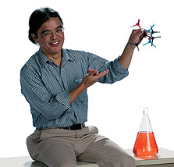
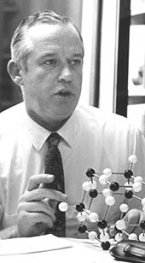
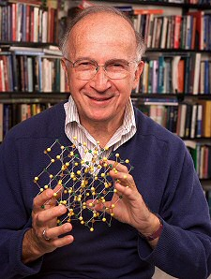
Can you locate the chemist’s universal obsession…..?
Structure Chemist
Nut case Chemist
Organic Chemist

Slide 5
Molecules
You can’t see molecules directly.
You can’t measure molecules directly.
You can’t watch how molecules react.
They’re just too damned small.

Slide 6
Chemistry involves imaginative, BUT deeply abstract metaphors for molecules, things we can’t know directly.

Slide 7
WHY CHEMISTRY ? My Take…
CHEMISTRY…is a 250 year old discipline that can take apart, put back together, manipulate and transform objects (molecules) which are objects we have no chance to directly see nor directly measure.
Thinking Like a Chemist (TLC)
is powerful (but hard to acquire)

Slide 8
THE “PROBLEM” WITH CHEMISTS …..
Chemists are obsessed with molecules- which is like being infatuated with car parts- but not in driving the car….
You can name famous race car drivers…but what are their chief mechanics named ?

Slide 9
The strength and weakness of chemists is that we sweat the details and revel in them.
EXAMPLE #1
Hoffmann’s 1981 Nobel Prize in Chemistry awarded for explaining ……..
+
Concerted 1,3 cycloaddition
(Diels-Alder Reaction)

Slide 10
Enol→keto tautomeric shift
EXAMPLE #2
keto
enol
Resonance shift
The `real’ shape
of Thymine (T)
Perfect fit for
`H’ bonding A→T
Jerry Donahue
structure chemist
Adenosine (A)

Slide 11
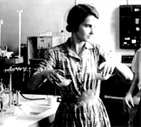
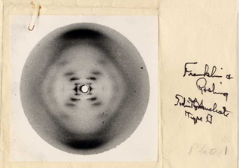
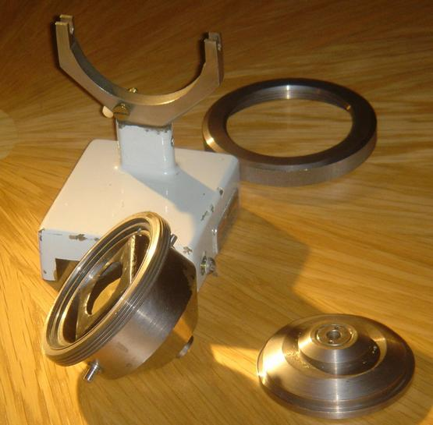
First recorded diffraction
picture of A form DNA
EXAMPLE #3
Rosalind Franklin, physical chemist
Phillips micro x-ray camera mount modified by Franklin for mounting DNA in controlled humidity at King’s College, UK.

Slide 12
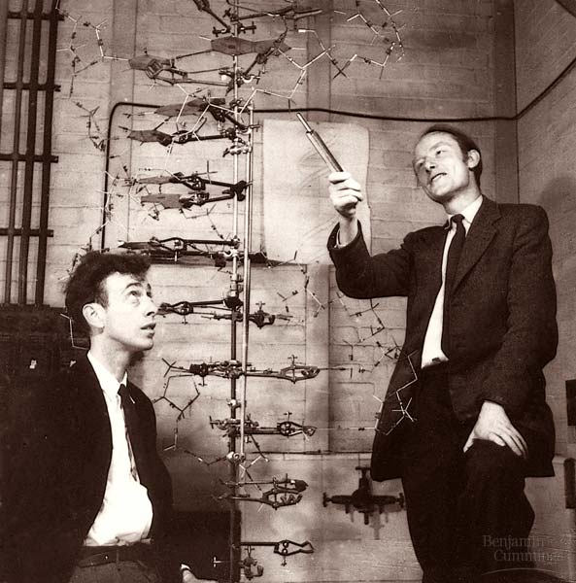
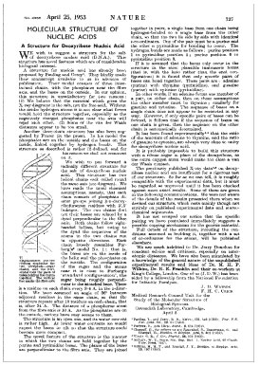
Biologist
CHEMIST
Physicist
Nature 171, 737-738 (1953)
The paper that changed everything.
WATSON
CRICK

