Slide 1
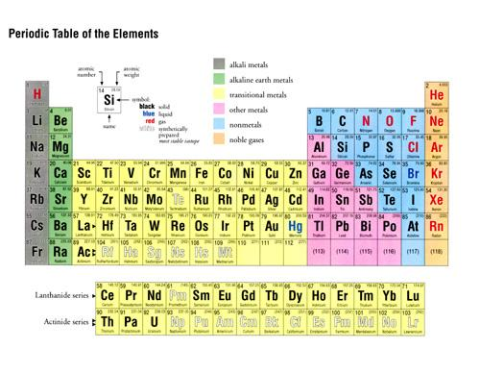
Modern version of Mendeleev’s Periodic table of the elements

Slide 2

Why the Periodic Table Rocks….
Thinking Like a Chemist Russian style
property
Atomic mass
Melting point (º C)
Density (g/cm³)
common oxide
Density of oxide(g/cm³)
common chloride
chloride boiling point (C)
??
Silicon (Si)
predicted¹
Found²
Tin (Sn)
Ge
28
1410
2.33
SiO₂
2.66
SiCl₄
57.6
72
821
5.5
XO₂
4.7
XCl₄
100
72.6
947
5.4
GeO₂
4.23
GeCl₄
84
118
232
7.28
SnO₂
6.95
SnCl₄
114
¹Average of Si and Sn data
²1886 Germanium (Ge) discovered

Slide 3
Another example…
property
Atomic mass
Melting point º C
Boiling point ºC
Density (g/cm³)
common oxide
Predicted for
`eka-Aluminum
Gallium ¹
68 amu
Low
HIGH
5.9
X₂0₃
69.7
30.1 ^{O} C
1983 ºC
5.91
Ga₂O₃
¹ discovered in 1874 by Paul-Emile Lecoq de Boisbaudran

Slide 4
Given the data below, predict the mp and density (d) for X(also called Rubidium) which lies between K and Cs
mp=637 d=2.72
mp=1.36 d=319
mp=319 d=1.36
mp=35 d=1
element | mp(melting point) | d=Density (g/mL)
K | 336 | 0.86
X | ? | ?
Cs | 301 | 1.86

Slide 5
More Thinking Like a Russian Chemist…
symbol | Atomic # | Mass # | #n/#p | Melting pt ºC | Boiling point ºC | Density g/cm³ | name
Fi | 150 | 315 | 1.10 | 1400 | 2400 | 7.0 | Fee
 |  | Done on board
Fo | 170 | 357 | 1.10 | 1800 | 3000 | 9.0 | Foe
 |  | Done on board
Fy
160
160
1.10
1600
2700
8.0
Fye
Fu
180
1.10
2000
3300
10.0
Fum
Finding Mass # for Fy:
#n/#p= 1.10 =#n/160
=> 1.10*160=#n= 176
∴mass #=#n+#p= 176+160=336

Slide 6
Another example…
property
Atomic mass
Melting point º C
Boiling point ºC
Density (g/cm³)
common oxide
Predicted for
`eka-Aluminum
Gallium ¹
68 amu
Low
HIGH
5.9
X₂0₃
69.7
30.1 ^{O} C
1983 ºC
5.91
Ga₂O₃
¹ discovered in 1874 by Paul-Emile Lecoq de Boisbaudran

Slide 7

Example of `periodicity’: halogens
X
p mass
MP (^{O}C) BP ( ^{O} C)
3 7
11 23
19 40
37 85
55 133
-220
-101
-7
114
302
-188
-35
59
184
337
MP and BP very different
Halogen chemistry
2Na + X₂ → 2NaX (high melting white salts)
X₂(colored) + ethene→ colorless dihalides
Breathing X₂ kills you

Slide 8
Why call this the Periodic Table ?
…chemistry of elements repeats periodically (in columns) as we walk across the Table

Slide 9
Another example of periodicity inert (noble) gases
p mass
MP(º C) BP (⁰ C )
4
20
40
84
131
86 222
-272 - 269
-249 -246
-189 -186
-157 -152
-112 -107
-71 -62
MP ~ BP
Noble gas chemistry
NONE

Slide 10
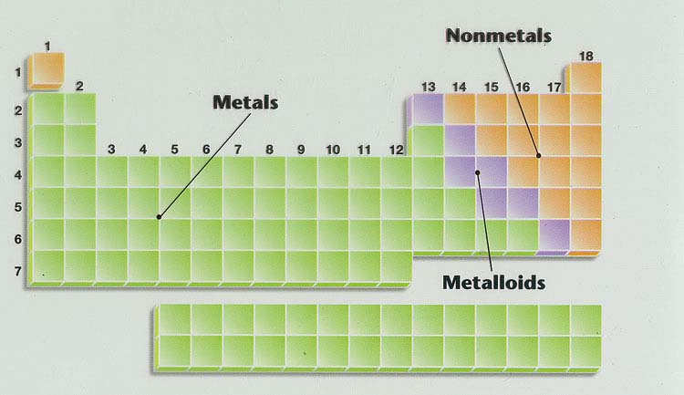
Geography of Periodic Table see also figure 2.19 page 59 & pp. 58-60
Main group elements
Noble metals
Ag, Au, Pt (Cu)
Alkaline earth metals
Noble gases
Transition metals
halogens
Alkali metals
lanthanides
actinides
Know names of regions in yellow boxes too
Know where metals, metalloids and non metals are

Slide 11
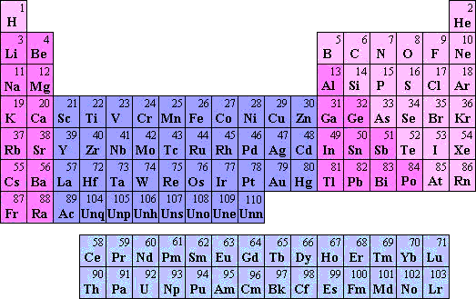
Naming Inorganic compounds
metals
Text: pp 60-69
Handouts at course website
Non-metals
Transition metals
Lanthanides
Actinide

Slide 12
Binary compound naming
Non-Metal + Non-Metal = NM+NM
Metal + Non-Metal = M + NM
Transition Metal + Non-Metal = TM + NM
Why three different naming patterns ….because want name pattern to reflect different chemistry for each kind of compound above

Slide 13
Non-Metals Where ?
Transition Metals Where ?
Metals where ?

Slide 14
Building Ionic Binaries: Know-Thy Charges
0
+1
-4,+4
+2
-5,+3
-3
-1
-2
+1,2,3,4,…(depends)

