Slide 1

Quick review of atomic language
# P + # N = MASS NUMBER FOR A
SPECIFIC ISOTOPE
# P= ATOMIC NUMBER
27
Al
13
Average atomic mass
or 27-Al
Element as listed on Periodic Table
How specific isotopes of an element are are written

Slide 2
How average atomic mass arises for isotope abundance
27
Al
13
26
Al
13
+
98.2 % of all Al atoms
1.8 % of all Al atoms
Average atomic mass of Al= (98.2*27 + 1.8*26)
100
=26.982

Slide 3
Given the data below, what is the average atomic mass of Cl ?
(35+37)/2
(35*25 +37*75)/100
(35*75+37*25)
(35*75+37*25)/100
Isotope | Mass # | %
35-Cl | 35 | 75
37-Cl | 37 | 25

Slide 4
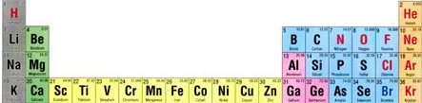
ATOMIC BOOKKEEPING
Atomic # mass# symbol #p⁺ #nº #e⁻ atom charge
. |  |  | 12 | 12 |  | 0
 | 31 |  | 15 |  |  | 0
 | 17 | O |  | 9 | 10
12
24
Mg
12
15
P
16
15
8
8
-2
Pertinent section of Periodic table

Slide 5
Let’s go down a column left to right….
Atomic # mass# symbol #p⁺ #nº #e⁻ atom charge
 | 20 |  |  |  | 10 | 0
7 | 14 |  |  |  |  | -1
 |  | Fe |  | 30 |  | 0
17 |  |  |  | 18 | 19
10
Ne
10
10
N
7
7
8
26
56
26
26
35
Cl
17
-2

Slide 6

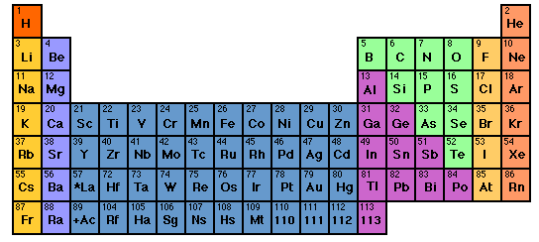
?? Whose your Daddy ???

Slide 7
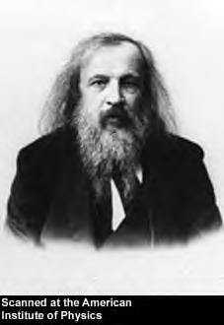
THINKING LIKE A CHEMIST: Russian style
Dimitri Mendeleev ~1865
At …St Petersburg U Chemistry …the dedicated chemistry teacher

Slide 8
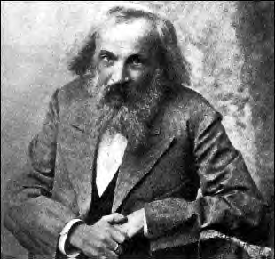
Out of school…
Cardplayer
known party animal
political troublemaker
confirmed `tippler’

Slide 9
The mess he deals with…
~ 60 elements by 1865
# element some properties
1 H completely reactive; not found except as H₂ gas at room temperature. Found in numerous organic and inorganic compounds
He completely unreactive. Gas at room temperature. No known compounds of He.
3 Li very reactive. Solid metal at room temperature.
Found many inorganic compounds
No apparent rhyme or reason as element count goes up….

Slide 10
`How Do We Organize the Elements Problem’: Some Analogies
1) Is there a coherent `pattern’ to these 26 symbols ?
ABCDEFGHIJKLMNOPQRSTUVWXYZ
THE QUICK BROWN FOX JUMPS OVER THE LAZY DOG
Essentially a word pattern and so a 1D problem. Imagine 92 letters ….

Slide 11
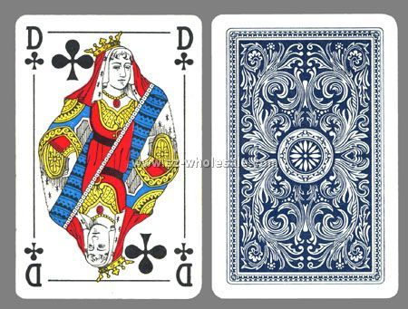

2) Card player insights…2 (and higher) ….Dimensional puzzling
Analogies (continued)
⁶C
12.01
GRAPHITE
MP 1710 ^{O}C
d=2.11 g/cm³
BLACK
CO, CO₂
2 other crystal forms
Playing card
Element card

Slide 12
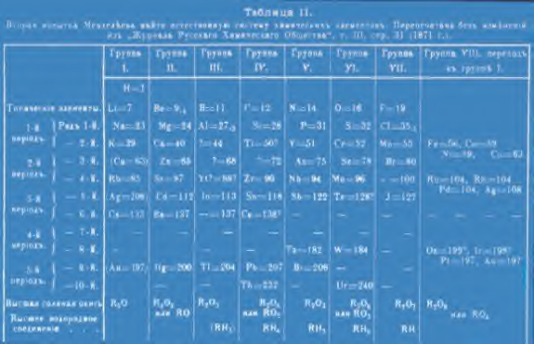

Slide 13
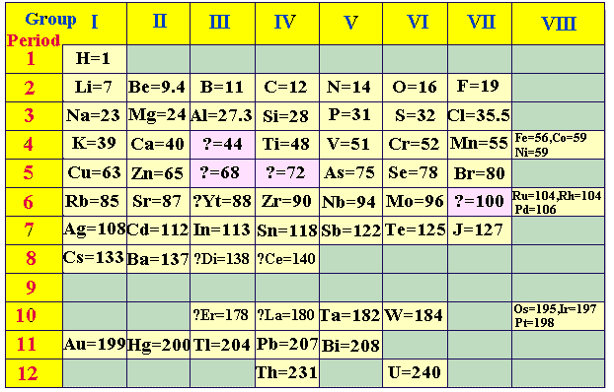
THINKING LIKE A CHEMIST: Mendeleev (cont.)
Organizing the mess that are the ~60 known elements circa 1870:
Negative of Mendeleev’s
Perioyodik tablo
“Colorized” version with English translation

Slide 14
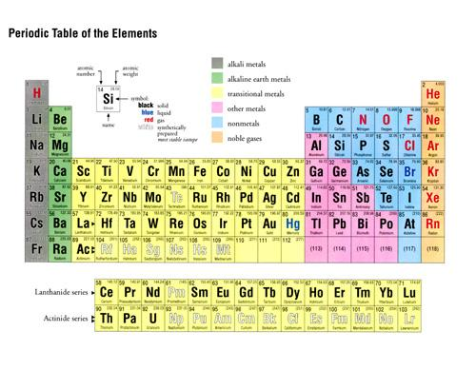
Modern version of Mendeleev’s Periodic table of the elements

Slide 15

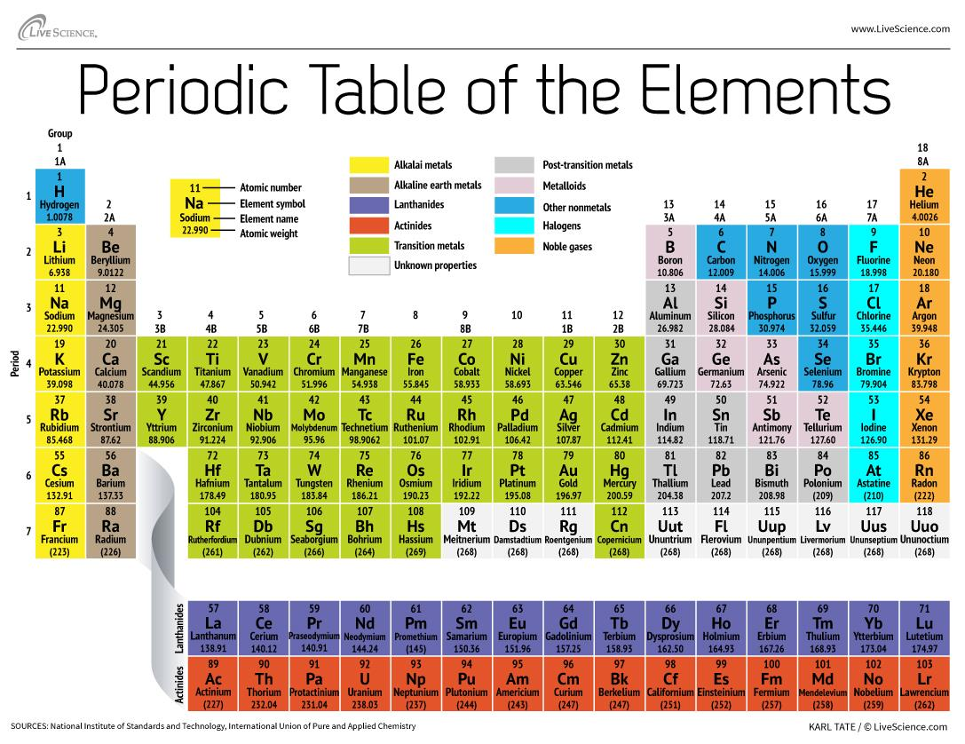
Know more of thy elements,Maggots !
By Friday 6 November
Expand to Symbols and names for…first 4 rows +…SPECIALS
Ag, Au, Hg, Pb, Pt, Ba, Sr, Sn, I, U

Slide 16
K=potassium
Ca=calcium
Sc=scandium
Ti-titanium
V=Vanadium
Cr=chromium
Mn=manganese
Fe=iron
Co=cobalt
Cu=copper
Zn=zinc
Ga=gallium
Ge=germanium
As=arsenic
Se=selenium
Br=bromine
Kr=krypton
Ag=silver
Au=gold
Hg=mercury
Pb= lead
Pt = platinum
Ba= barium
Sr=strontium
Sn =tin
I = iodine
U=uranium
Row 4
specials

Slide 17

Why the Periodic Table Rocks….
Thinking Like a Chemist Russian style
property
Atomic mass
Melting point (º C)
Density (g/cm³)
common oxide
Density of oxide(g/cm³)
common chloride
chloride boiling point (C)
??
Silicon (Si)
predicted¹
Found²
Tin (Sn)
Ge
28
1410
2.33
SiO₂
2.66
SiCl₄
57.6
72
821
5.5
XO₂
4.7
XCl₄
100
72.6
947
5.4
GeO₂
4.23
GeCl₄
84
118
232
7.28
SnO₂
6.95
SnCl₄
114
¹Average of Si and Sn data
²1886 Germanium (Ge) discovered

