Slide 1
The Rutherford atom is best described as:
Thin circle of negative electrons around a tiny positive nucleus
The ‘chocolate chip cookie’ model (negative electrons as chips; positive charge as dough)
Diffuse cloud of negative electrons around a tiny positive nucleus

Slide 2
Some Details of Rutherford’s Atom
Diffuse electron
Cloud out here
~ 10⁻¹⁰ m
~10⁻¹⁵ m
Nucleus is + charged
Electrons are - charged
Nucleus at center (magnified here ~10,000X)

Slide 3
Rutherford’s Atom by the numbers
Diameter of electron cloud = 100,000
Diameter of nucleus 1
Atomic part Relative mass % mass of atom
Nucleus 1 99.5
Electrons 0.005 0.5
Atomic part Relative volume
Nucleus 0.00000000000001
Electrons 1
electron cloud is 99.99999999% of atomic volume but only 0.5% of the mass

Slide 4
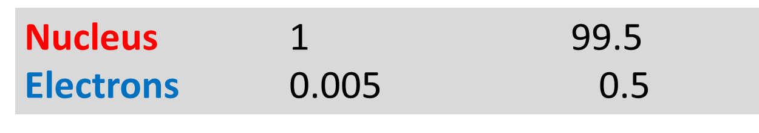
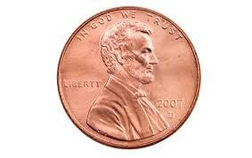
Chemical metaphor 4:
nuclear vs. electron mass
Atomic part Relative mass % mass of atom
Nucleus mass/electron mass
=1/0.005 =2000
if electron mass (≈ 3 g=0.0066 lb)
=>Nuclear mass≈ ?
2000*0.0066 lb=13.2 lb

Slide 5
Some more details and language about atoms
1) In a neutral atom:
positive charge sum = proton count=#p⁺
= negative charge sum =electron count=#e⁻
#p⁺ = #e⁻
Implies the electron `cloud’ is more like a rapidly moving ball of negative charged gnats flying around in an equal number of tiny positive charged lead balls

Slide 6
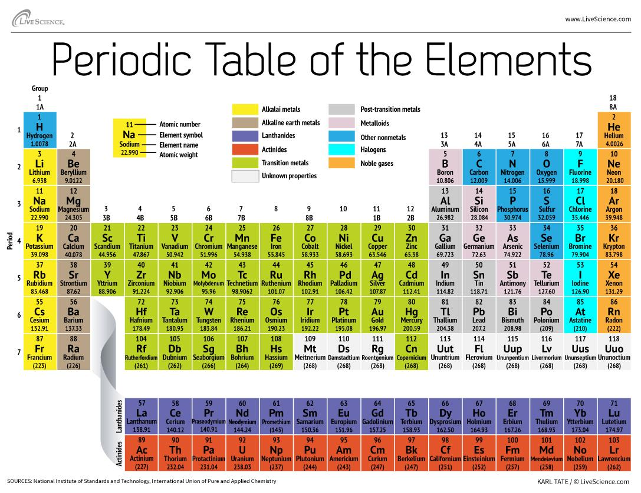

2) The proton count is the same as the Periodic Table’s Atomic # => proton count defines the element
Atomic # =#p⁺

Slide 7

How many protons in an Aluminum atom ?
26
26.982
27-13=14
varies

Slide 8
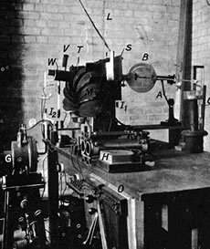
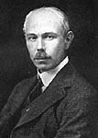
3) Elements come in several `flavors’= isotopes
=# p⁺
Aston’s
Mass Spectrometer
??????
Francis William Aston
Cambridge University UK
Nobel Prize in Chemistry 1922
What Aston sees in his mass spectrometer when he puts in pure Ne
Mass/p
20.0
22.0

Slide 9
Mass/p
20.0
22.0
Something else besides protons is in nucleus, but it has no charge. Dubbed a neutron =nº .
The neutron weighs the same as a proton (Mass/p=whole #)
You can have different numbers of nº in a given element.
(A specific # of nº = a specific isotope)
=# p⁺
What Aston ‘s result teach….

Slide 10
How many electrons (e), protons (p) and neutrons (n) in the Ne isotope circled below?
10 e 20 p 20 n
10 e 12 p 10 n
10 e 10 p 22 n
10 e 10 p 12 n
Mass/p
20.0
22.0
22.0

Slide 11
Symbolic for isotopes (see p. 54)
Mass Number=Z
22
Ne
10
neutron count= n
=Z-p
Atomic Number=p
Can also be written: 22-Ne

Slide 12
Aston experiments explains the mysterious 20.18
Mass/p
20.0
22.0
Atomic #=#p⁺
% of total signal 91 9
Average Neon mass=
91*20.0 + 9*22.0
100
=20.18
???
AVERAGE ATOMIC MASS

Slide 13
Given the data below, what is the average atomic mass of Cl ?
(35+37)/2
(35*25 +37*75)/100
(35*75+37*25)
(35*75+37*25)/100
Isotope | Mass # | %
35-Cl | 35 | 75
37-Cl | 37 | 25

Slide 14

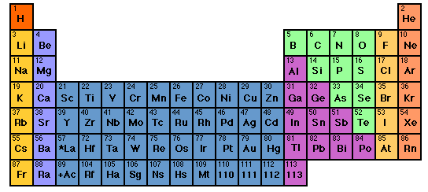
?? Whose your Daddy ???

Slide 15
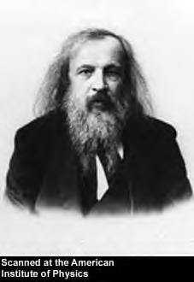
THINKING LIKE A CHEMIST: Russian style
Dimitri Mendeleev ~1865
At …St Petersburg U Chemistry …the dedicated chemistry teacher

Slide 16
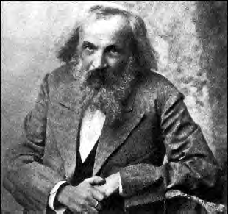
Out of school…
Cardplayer
known party animal
political troublemaker
confirmed `tippler’

Slide 17
The mess he deals with…
~ 60 elements by 1865
# element some properties
1 H completely reactive; not found except as H₂ gas at room temperature. Found in numerous organic and inorganic compounds
He completely unreactive. Gas at room temperature. No known compounds of He.
3 Li very reactive. Solid metal at room temperature.
Found many inorganic compounds
No apparent rhyme or reason as element count goes up….

