Slide 1

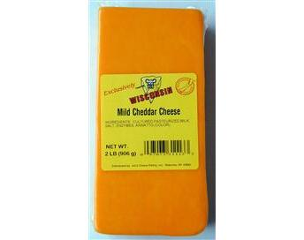
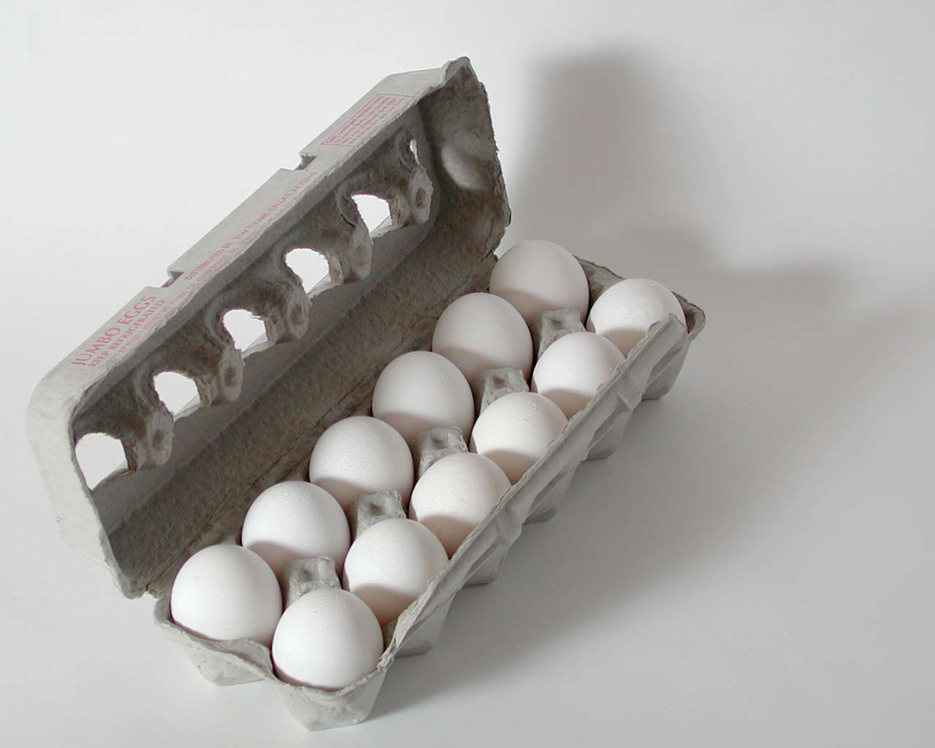
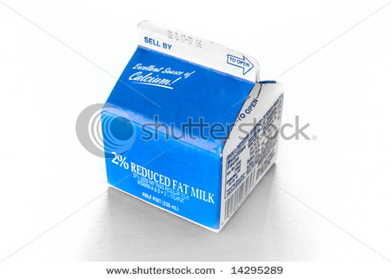
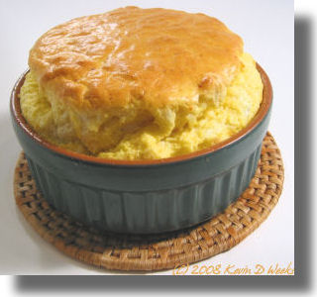
Cooking and stoichiometry (continued)
THE RECIPE
1
+
2
+
3
300 g/block
500 g/dozen
200 g/box
1900 g/souffle
*How many eggs needed to combine with 1200 g cream?
48
*900 grams cheese makes what weight of souffles?
5700 g
*1200 eggs combines with how many grams cheese?
1500 g
*How many boxes of cream combine with 600 g cheese
6

Slide 2

BLACKBOARD EXERCISES
Given the balanced chemical reaction
C₃H₈ + 5O₂--------> 3CO₂ + 4H₂O
44 32 44 18 g/mol
Calculate the moles of O₂ necessary to produce 6 moles of CO₂
= 10 mol O₂
Calculate the grams of CO₂ created by burning 0.0757 moles of C₃H₈
= 10 grams CO₂

Slide 3
BLACKBOARD EXERCISES (continued)
Given the balanced chemical reaction
C₃H₈ + 5O₂--------> 3CO₂ + 4H₂O
44 32 44 18 g/mol
Calculate the moles of H₂O formed by burning 400 grams of O₂
= 10 mol H₂O
Calculate the grams of O₂ to form 1.506*10²² H₂O molecules
=10 grams O₂

Slide 4
BLACKBOARD EXERCISES (continued)
Given the balanced chemical reaction
C₃H₈ + 5O₂--------> 3CO₂ + 4H₂O
44 32 44 18 g/mol
How many molecules of CO₂ form if 0.400 g H₂O results ?
=1*10²² molecules CO₂
How many grams of O₂ are needed to form 1.50*10²² molecules of H₂O ?
=1.0 g O₂

Slide 5
BLACKBOARD EXERCISES (continued)
Given the balanced chemical reaction
6HCl + 2Al -----→ 2AlCl₃ + 3H₂
36 27 123 2 g/mol
moles to moles
How many moles of Al must be added to
produce 30 moles of H₂ ?
20 mol Al
moles to weight
How many grams of H₂ are created by reacting
20 moles of HCl ?
20 g H₂

Slide 6
BLACKBOARD EXERCISES (continued)
Given the balanced chemical reaction
6HCl + 2Al -----→ 2AlCl₃ + 3H₂
36 27 123 2 g/mol
weight to moles
How many moles of HCl can combine with 270 g of Al ?
30 mol HCl
weight to weight
How many grams of Al must react to form 11.111 g H₂ ?
100 g Al

Slide 7
BLACKBOARD EXERCISES (continued)
Given the balanced chemical reaction
6HCl + 2Al -----→ 2AlCl₃ + 3H₂
36 27 123 2 g/mol
weight to count
How many molecules of HCl are needed to make
34.165 g AlCl₃?
5*10²³ HCl molecules
count to weight
how many grams of Al produce 6.6666 *10²² molecules of H₂ ?
2 g Al

