Slide 1

Reaction Stoichiometry Problems part 1:
Class Practice Balancing Reactions
1
2
1
2
___CH₄ + ___O₂ __CO₂ + __H₂O
2
3
2
4
___CH₄ + ___O₂ __CO + __H₂O
3
1
1
3
__AgNO₃ + ___Na₃PO₄ __Ag₃PO₄ +___NaNO₃
2
6
2
3
____Al + ___HCl __AlCl₃ + ___H₂
Gasoline combustion reaction
2
25
16
18
__C₈H₁₈ + __O₂ __CO₂ + __ H₂O

Slide 2

“So…why give an excremental ejection about stoichiometric coefficients and equation balancing ???”

Slide 3
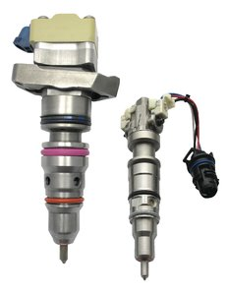
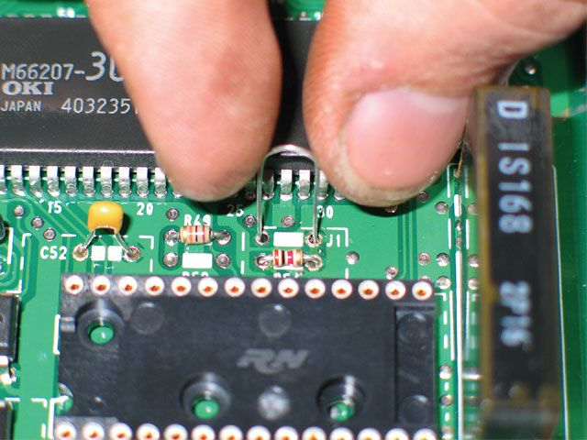
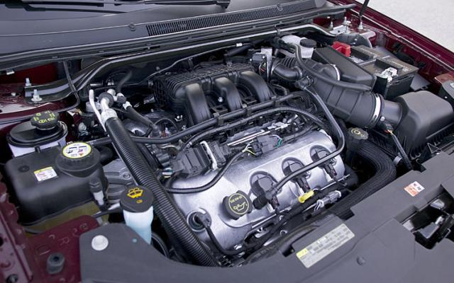
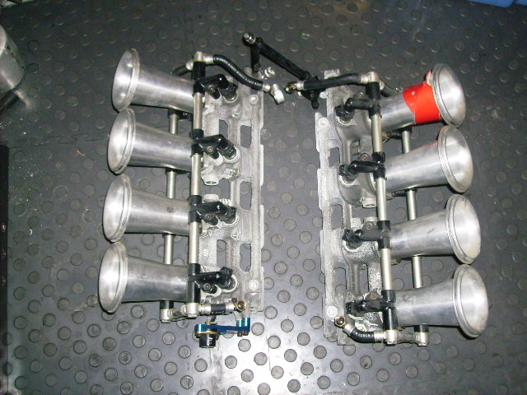
Individual fuel injectors
Stoichiometric control in the real world
Gas/O₂ ratio and flow rate to each fuel injector controlled by engine block microchip
Microchip controlling engine operation
V-8 fuel injection module
Goes under here*

Slide 4
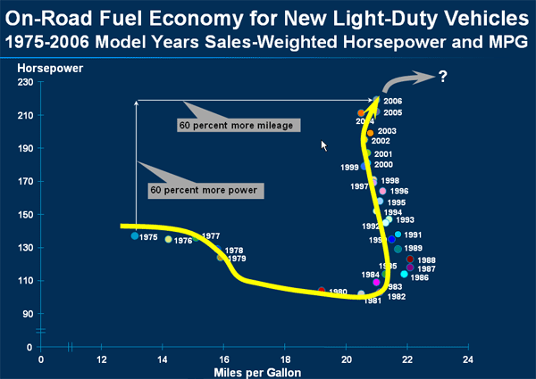
Variation of mpg and hp vs time for light-duty trucks
1975 US Congressional mandate for 23.5 mpg fleet average enacted
8 bit PROM chips become reasonably cheap

Slide 5

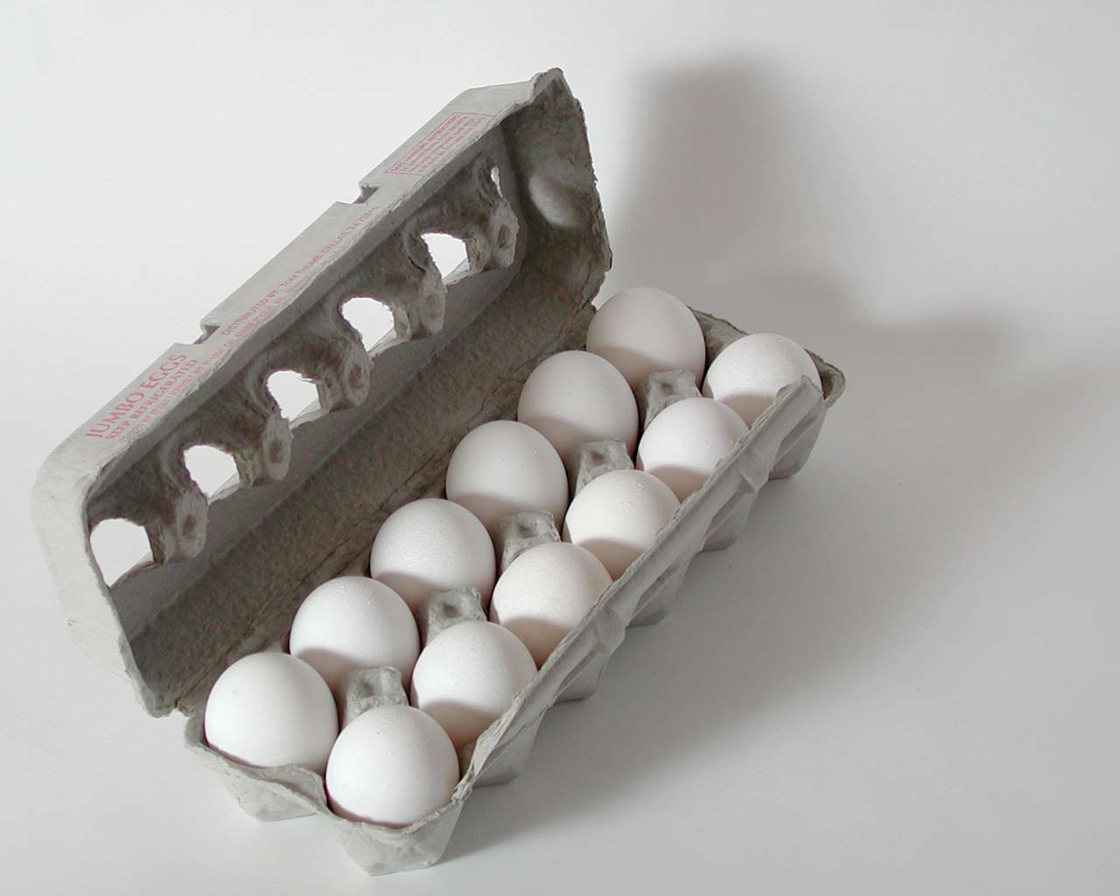
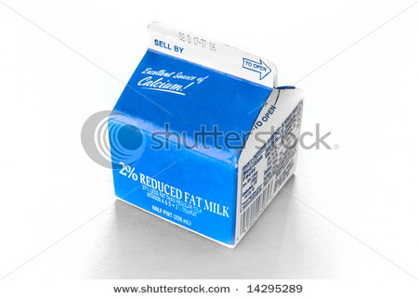
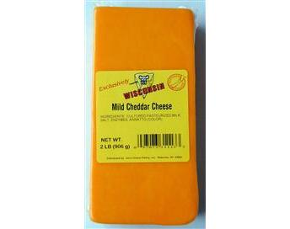
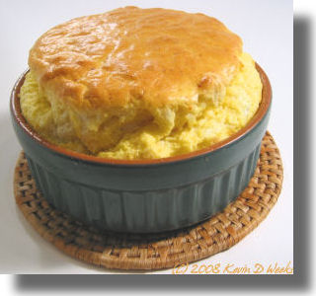
Stoichiometry is cooking: Recipe for egg and cheese souffle
IN
1
+
2
+
3
200 g/box
300 g/block
500 g/dozen
OUT
Mass of 1 output souffle ?
1 *300 g
+
2* 500 g
+
3*200
cheese
eggs
condensed milk
=1900 g/souffle

Slide 6
Cooking and stoichiometry
THE RECIPE
1
+
2
+
3
300 g/block
500 g/dozen
200 g/box
1900 g/souffle
How many….to make whole # of souffles ?
How many boxes of cream to make 4 souffles ?
12
600 grams cheese makes how many souffles ?
2
How many grams of eggs combine with 9 boxes of cream ?
3000 g
48 eggs combine with how many blocks of cheese ?
2

